Slide 1
Caffeine Disk Results
Spring 2014

Slide 2
Procedure
Grow clone from glycerol stock
Amp or amp + chlor
4 mM caffeine
Measure A590 and standardize to 0.1 or 0.01
Spread 50 ul on Tet only plate with beads
Prepare disks
Commercial disks
35 ul solution per disk
Up to 100 mM caffeine
Place disks
Use sterile insulin needle and sterile tip
Incubate
37 C overnight, then room temp for several days

Slide 3
Amp Plasmid
J119346
High promoter
High C-dog
RFP

Slide 4
Amp Plasmid
J119347
Low promoter
Low C-dog
GFP

Slide 5
20 Clones
Amp Plasmid
Promoter – C dog
High-High versus Low-Low
Origin
pSB1A2 High copy number
J119310 Low copy number
Chlor plasmid, pSB4C5
Chaperones
pG-Tf2
pTf16
pG-KJE8
pGro7
pKJE7

Slide 6
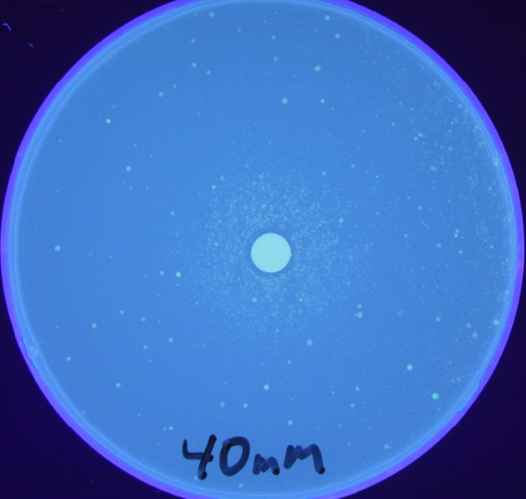
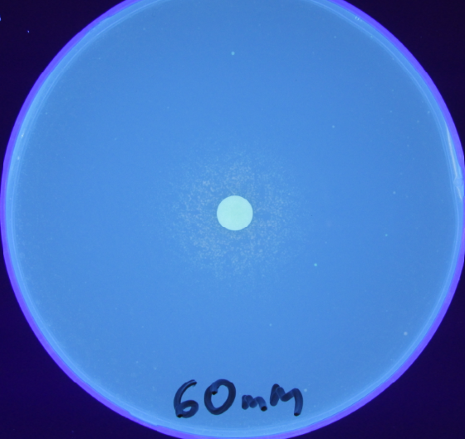
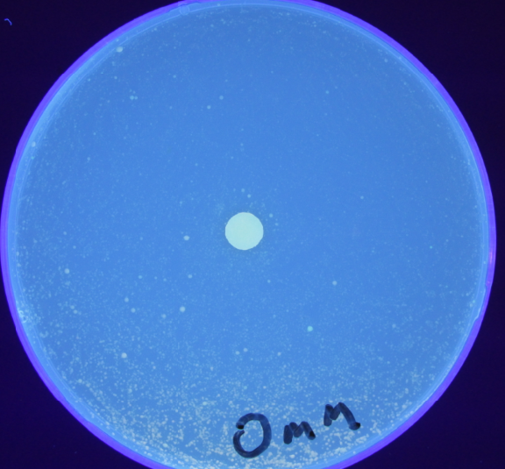
Too many bacteria, A590 = 1.0

Slide 7
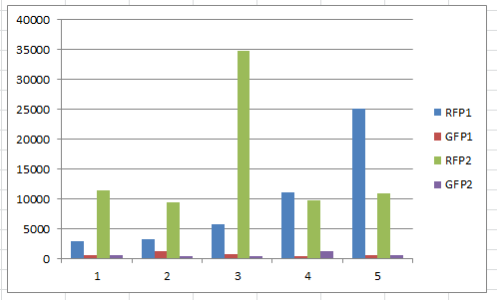
RFP on All 20

Slide 8
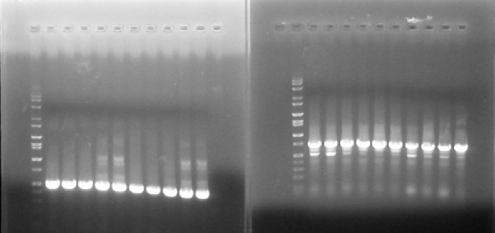
Origin PCR
All are pSB1A2 All are J119310
with 500 bp with 750 bp

Slide 9
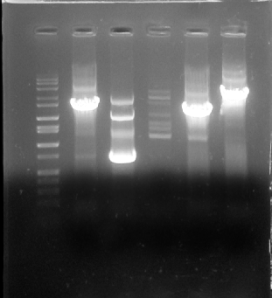
Chaperone PCR
Marker
pG-Tf2
pTf16
pG-KJE8
pGro7
pKJE7

Slide 10
Procedure
Do Caffeine disk experiments with 0, 20, 40, 60, 100 mM
Take Pictures
Use loop to take colonies from near the disks and streak onto plates for colony isolation
Pick individual colonies and measure
RFP on Cytation
Chaperone PCR
Origin PCR

Slide 11
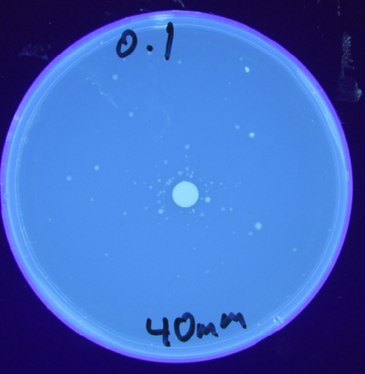
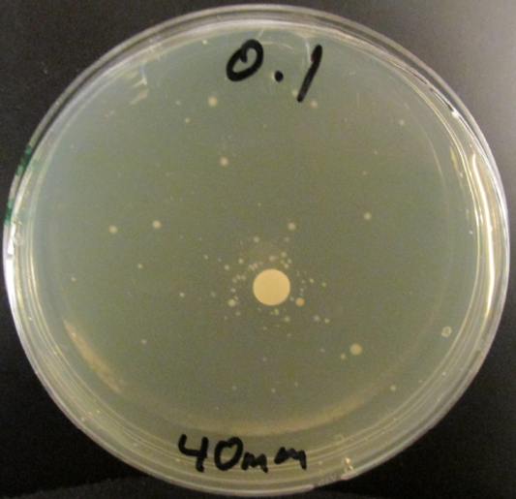
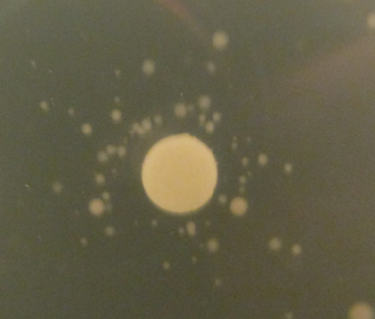
All 20 Clones

Slide 12
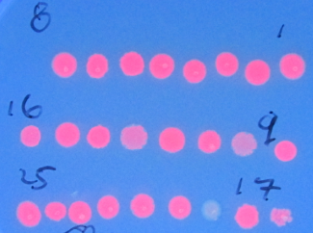
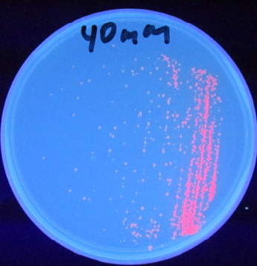
High-High vs. Low-Low

Slide 13
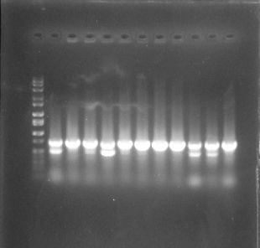
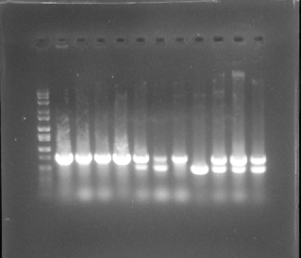
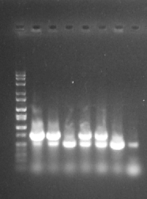
Origin PCR

Slide 14
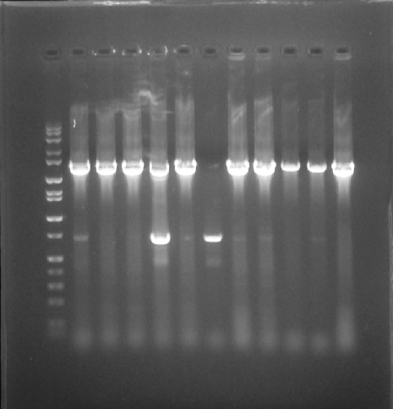
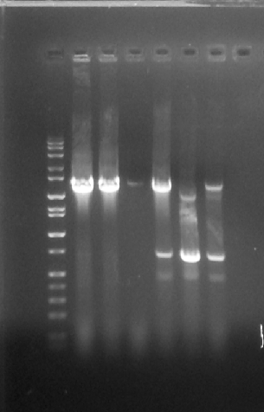
Chaperone PCR

Slide 15
Genotypes
Clone | High-High | Low-Low | 1A2 | J310 | pG-Tf2 | pTf16 | pG-KJE8 | pGro7 | PKJE7
1 | X |  |  | x |  |  |  | x
2 | X |  |  | x |  |  |  | x
3 | X |  |  | x |  |  |  | x
4 | X |  |  | x |  | x
5 | X |  |  | x |  |  |  | x
6 | X |  |  | x |  | x
7 | X |  |  | x |  |  |  | x
8 | X |  |  | x |  |  |  | x
9 | X |  |  | x |  |  |  | x
10 | X |  |  | x |  |  |  | x
11 | X |  |  | x |  |  |  | x
12 | X |  |  | x |  |  |  | x
13 | X |  |  | x |  |  |  | x
14 | X |  |  | x |  |  |  | x
15 | X |  |  | x |  |  |  | x
16 | X |  |  | x |  |  |  | x
17 | X |  |  | x |  |  |  | x
18 | X |  |  | x |  |  |  | x
19 |  | x | x |  |  | x
20 | X |  |  | x |  |  |  | x
21 | X |  |  | x |  |  |  | x
22 | X |  |  | x |  |  |  | x
23 | X |  |  | x |  |  |  | x
24 | x |  |  | x |  |  |  | x
25 | x |  | x |  |  |  |  | x

Slide 16
Sorted Genotypes
Clone | High-High | Low-Low | 1A2 | J310 | pG-Tf2 | pTf16 | pG-KJE8 | pGro7 | PKJE7
9 | x |  |  | x |  |  |  | x |  | #14
11 | x |  |  | x |  |  |  | x
14 | x |  |  | x |  |  |  | x
15 | x |  |  | x |  |  |  | x
16 | x |  |  | x |  |  |  | x
17 | x |  |  | x |  |  |  | x
18 | x |  |  | x |  |  |  | x
20 | x |  |  | x |  |  |  | x
22 | x |  |  | x |  |  |  | x
23 | x |  |  | x |  |  |  | x
24 | x |  |  | x |  |  |  | x
1 | x |  |  | x |  |  |  | x
2 | x |  |  | x |  |  |  | x
3 | x |  |  | x |  |  |  | x
5 | x |  |  | x |  |  |  | x
7 | x |  |  | x |  |  |  | x
8 | x |  |  | x |  |  |  | x
10 | x |  |  | x |  |  |  | x
12 | x |  |  | x |  |  |  | x
13 | x |  |  | x |  |  |  | x
21 | x |  |  | x |  |  |  | x
6 | x |  |  | x |  | x |  |  |  | #12
4 | x |  |  | x |  | x |  | x |  | #12 + #14
19 |  | x | x |  |  | x |  |  |  | #7
25 | x |  | x |  |  |  |  | x |  | #4

Slide 17
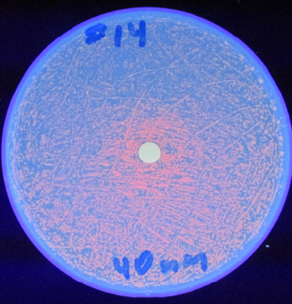
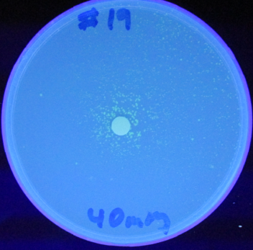
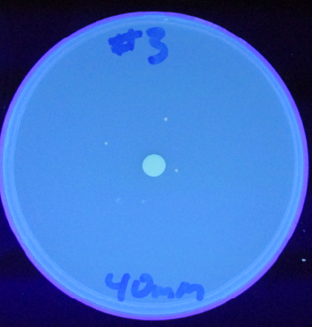
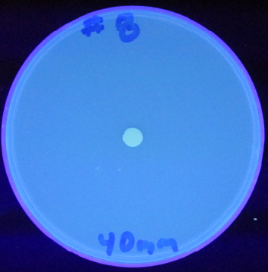
Grown only overnight at 37 C

Slide 18
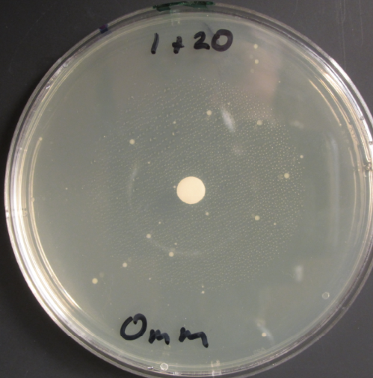
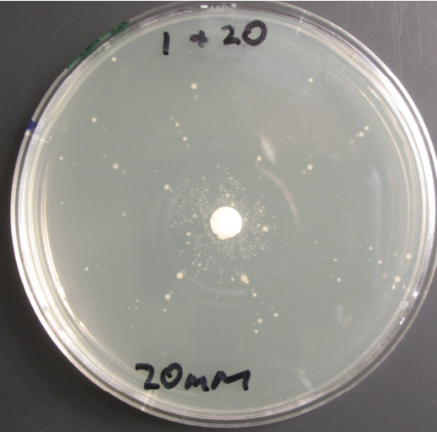
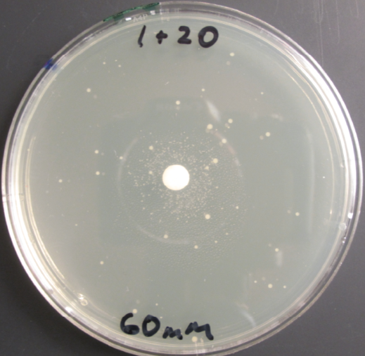
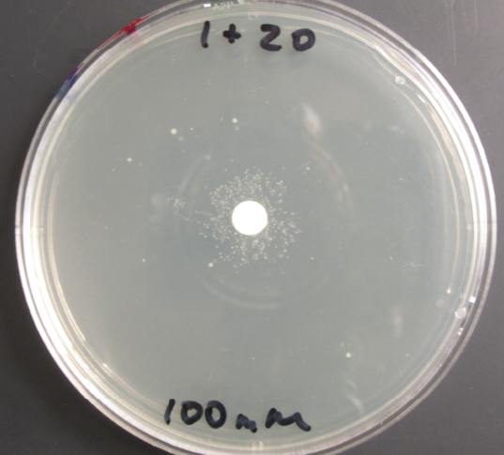
1 + 20 with Caffeine Disks

Slide 19
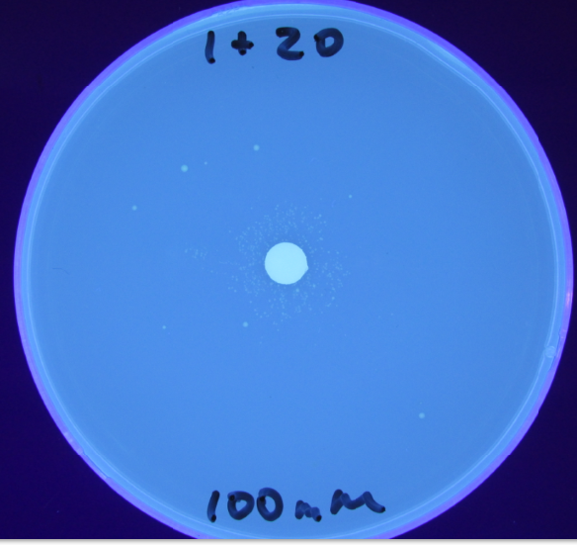

Slide 20
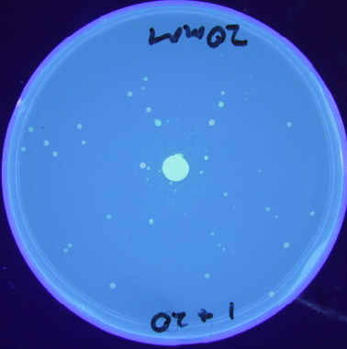
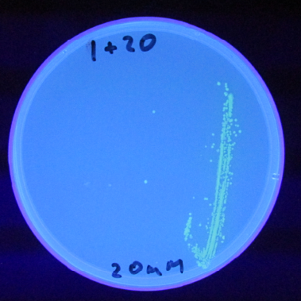
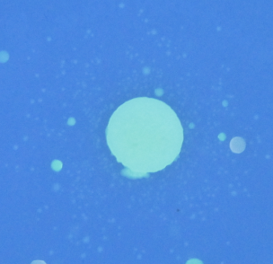

Slide 21
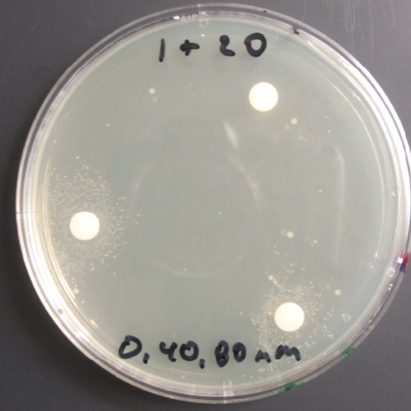
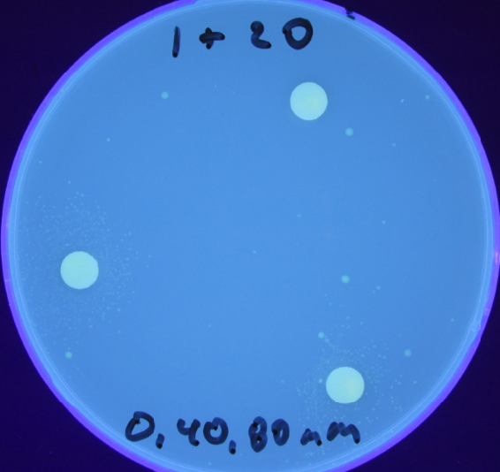
Fitness Clocks

Slide 22
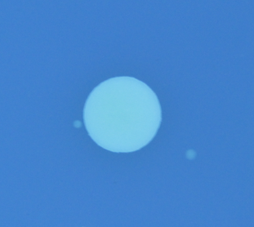
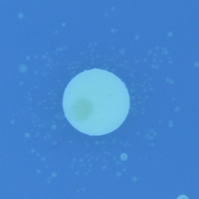
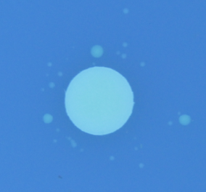
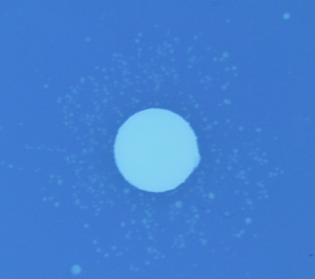
1 + 20 with Caffeine Disks
0 mM
20 nM
40 mM
60 mM
80 mM
100 mM

Slide 23
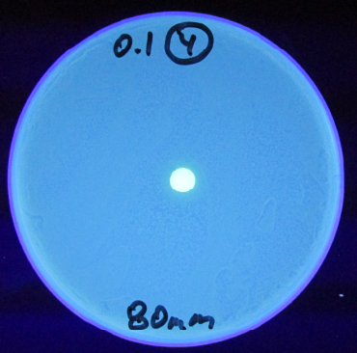
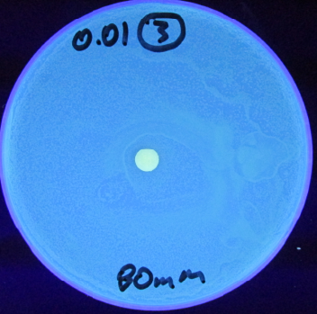
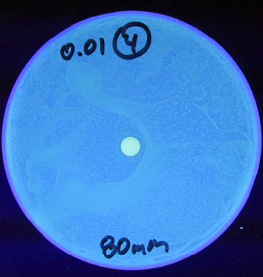
Biosensor Expts

Slide 24
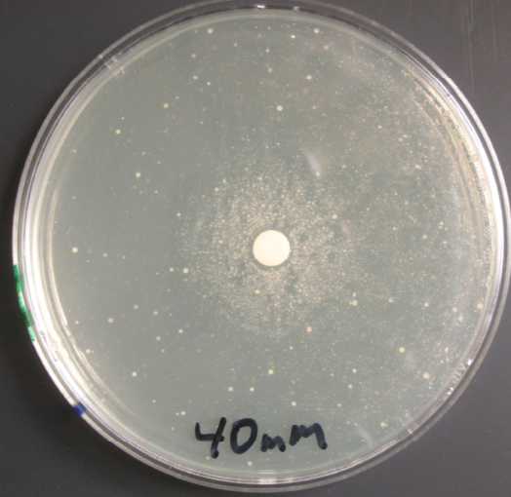
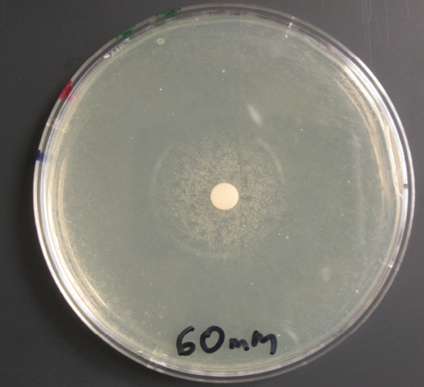
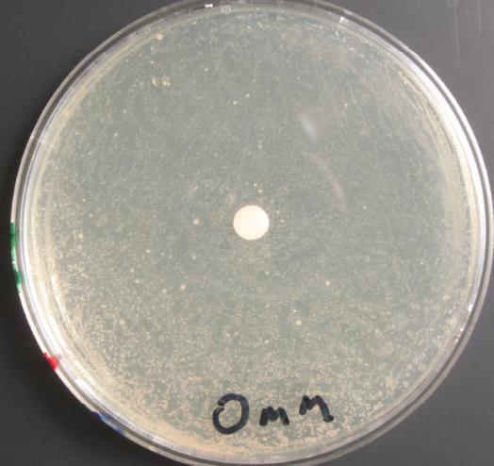
Too many bacteria, A590 = 1.0

Slide 25
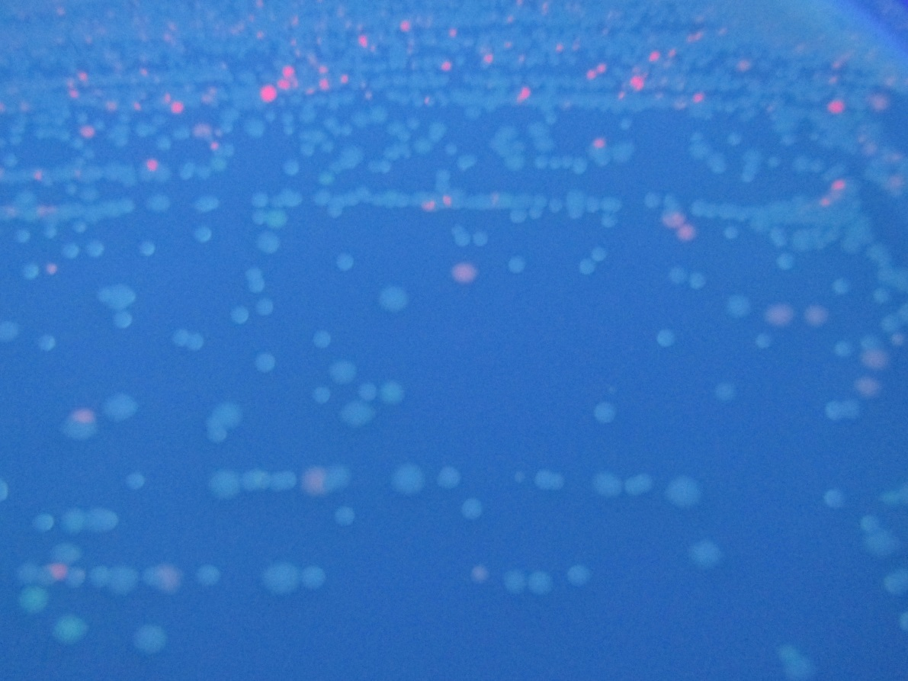
RFP and GFP on All 20

Slide 26
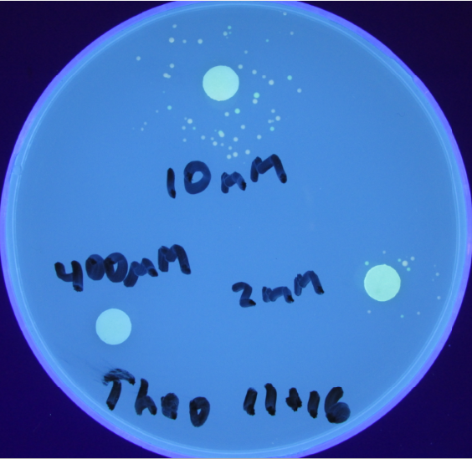
1 + 20 with Theo Disks

