Slide 1
Lab Meeting
Catherine Doyle
09/13/13

Slide 2
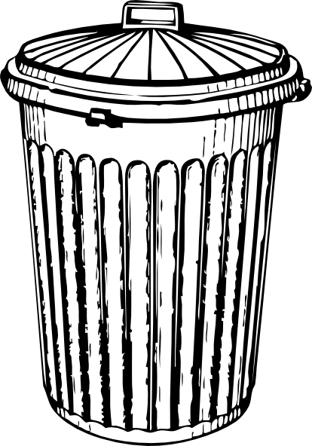
RBS
Aptamer
Mutate for 6,7,or 8 base paring with RNA polymerase
Add Riboswitch w/o apatamer
Complete Riboswitch
Mutated RBS
Randomize 8 bp between RBS and aptamer
Add two 8 bp spacers and ATG to RBS
65,536 Riboswitches
Riboswitch w/o Aptamer
Predict free energy of aptamer
M-fold
Riboswtiches with Calculated Free Energy
Filter out riboswitches too large of free energy
Riboswitches with greater free energy than aptamer
Putative Riboswitches

Slide 3
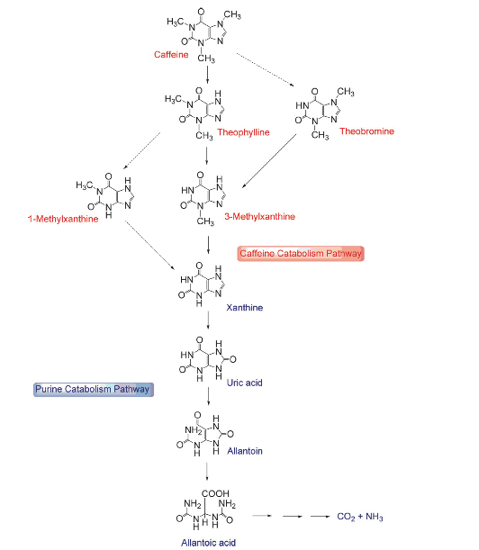
Caffeine Metabolism

Slide 4
c.Dog RBS
eCDM8
psB4C5
GFP
Low Copy
psB1A8
High Copy

Slide 5
c.Dog RBS
eCDM8
psB1A8
GFP
High Copy
psB4C5
Low Copy

Slide 6
c.Dog RBS
eCDM8
GFP
psB1A8
High Copy

Slide 7
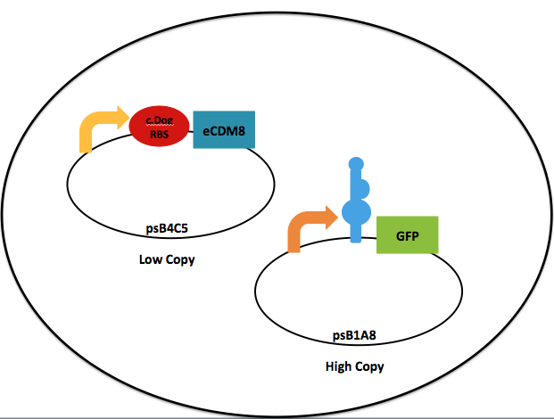
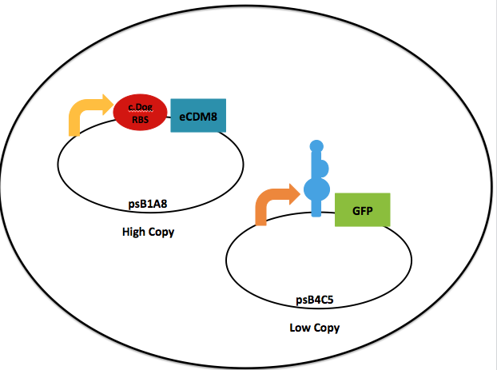
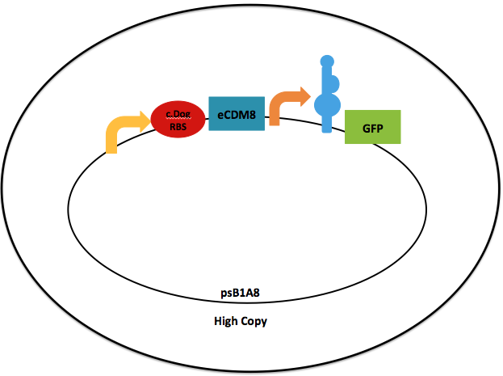
Inoculate in media with different metabolites
- caffeine
+ caffeine
+ caffeine
+ 3-methyl
- caffeine
+ 3-methyl
+ caffeine
+ xanthine
- caffeine
+ xanthine
Grow o/n @ 37C and measure GFP expression
Notes:
Questions:0, 0.5, 1, 1.5, 2, 2.5
How much enzyme do we add? Whose notebook is it in
How many replicates? 3X for stastical power

Slide 9
Future Work
Implement UnaFold and generate putative riboswitches

