Slide 1
Aptamers and Riboswitches
Lab Meeting
08/30/2013

Slide 2
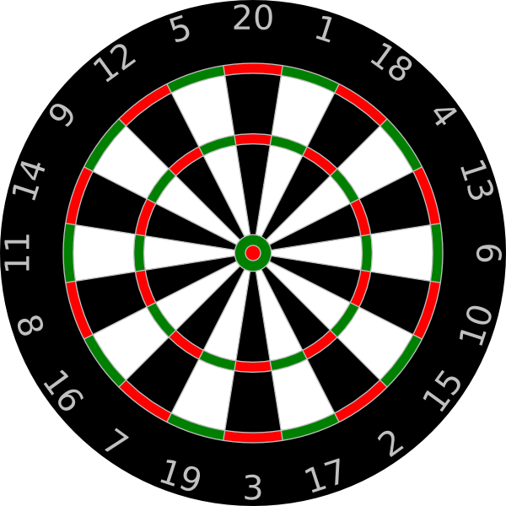
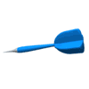
Aptamer
Short nucleic acid sequence that binds to a specific small molecule or ligand
Aptamer
Molecular Targets
Notes:
Hit a specific point a specific target 2 million targets
Customized nucelic acid dart dart to hit a single moluecle among millions

Slide 3
Riboswitches
In 5’ untranslated region of mRNA
Contains aptamer sequence
Translational control
Untranslated Region
GOI: Translated Region
RBS
ATG
TGA
Taken from Becca Summer 2012
Notes:
One class of mRNA element, the riboswitches, directly bind small molecules, changing their fold to modify levels of transcription or translation. In these cases, the mRNA regulates itself.

Slide 4
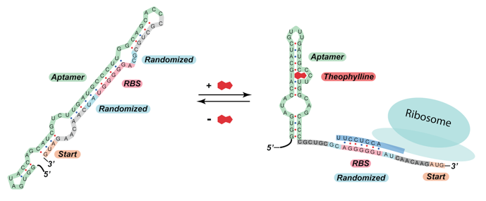
Riboswitches

Slide 5
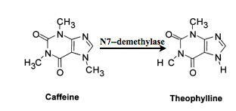
Theophylline Biosynthesis

Slide 6
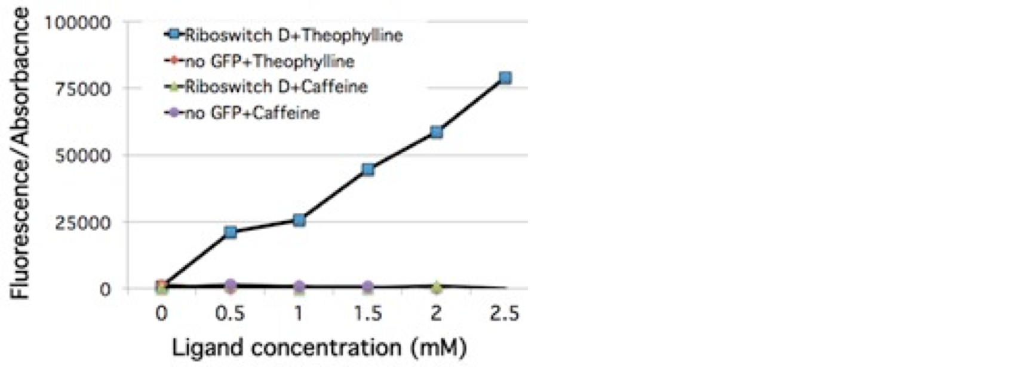
Theophylline Riboswitch

Slide 7
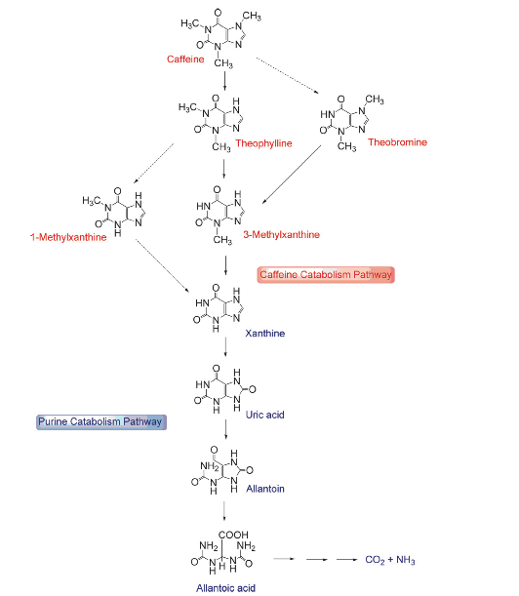
Caffeine Metabolism

Slide 8
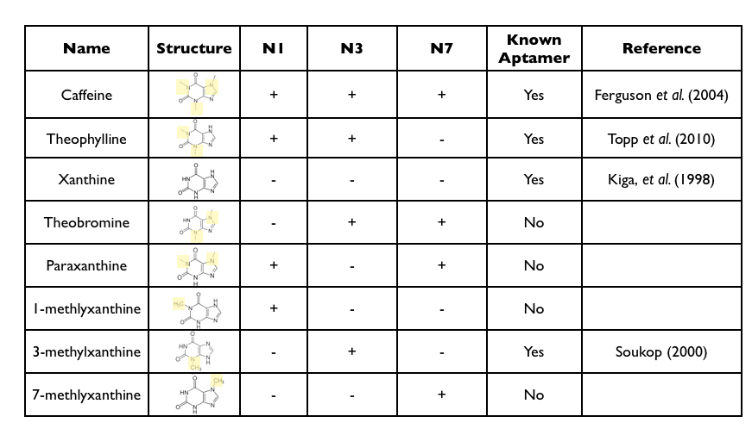
Caffeine Derivatives

Slide 9
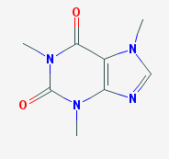
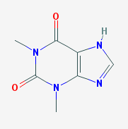
Caffeine and its Derivatives
Caffeine
Theophylline
3-Methlyxanthine
Xanthine

Slide 10
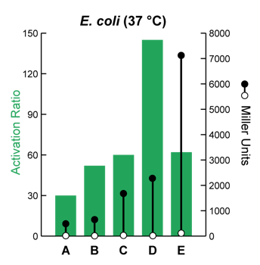
Different Riboswitches in E. coli

