Slide 1
Lab Meeting
10/04/2013

Slide 2
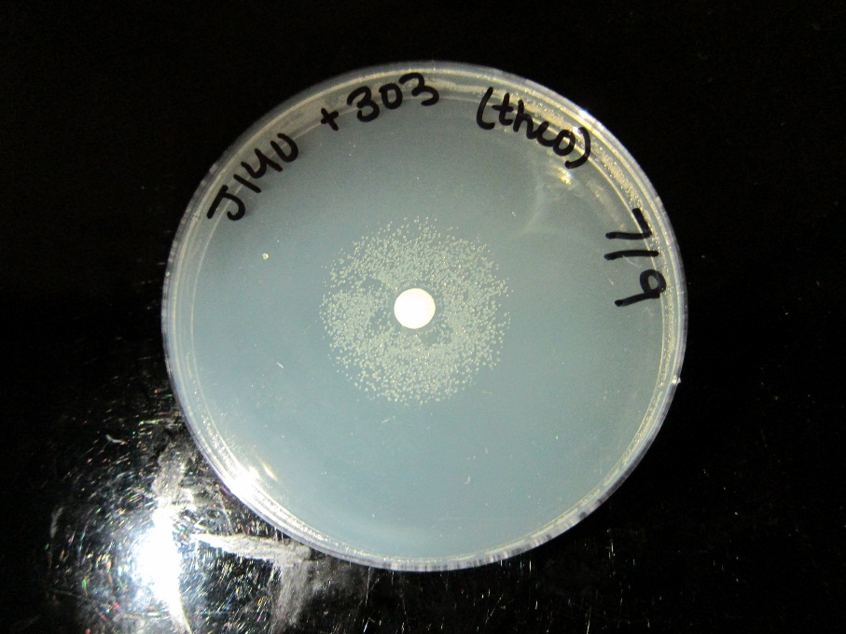
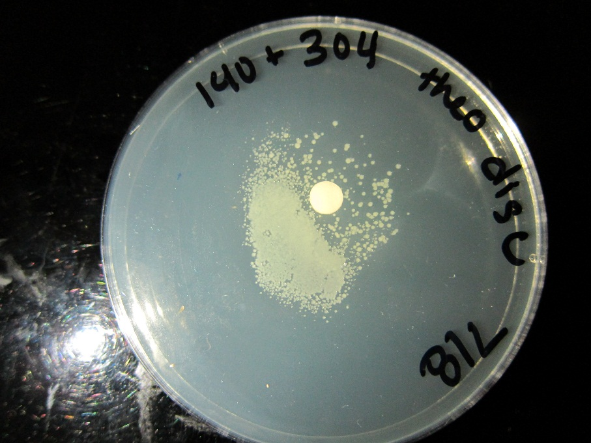
Results – Theophylline Disc
Ecdm8 + Riboswitch + tetA
Ecdm8 + Riboswitch + tetA
Ecdm8 + Riboswitch + tetA
Constructs on same Plasmid
High Promoter
Low Promoter

Slide 3
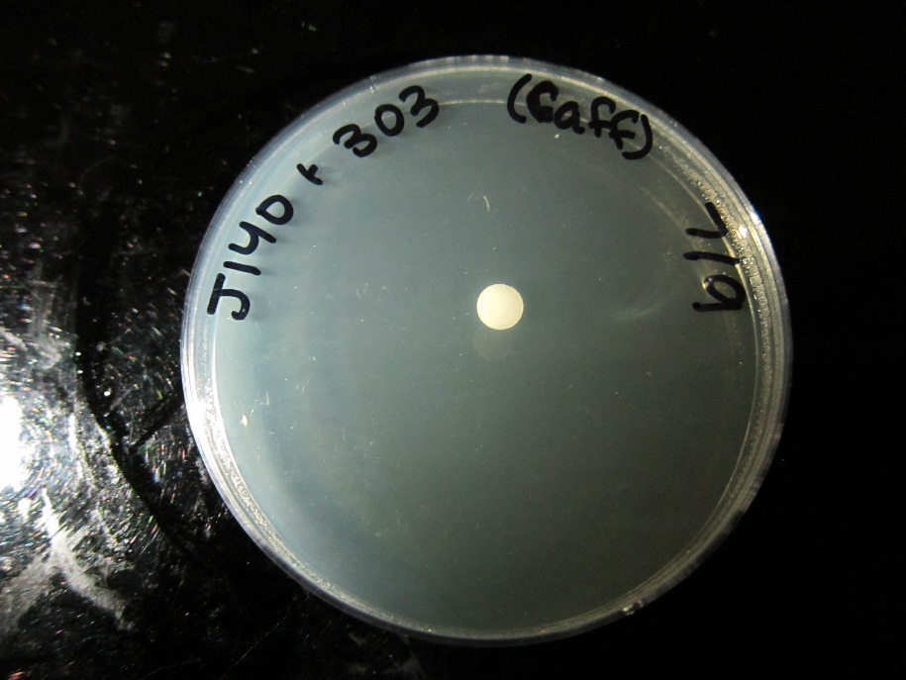
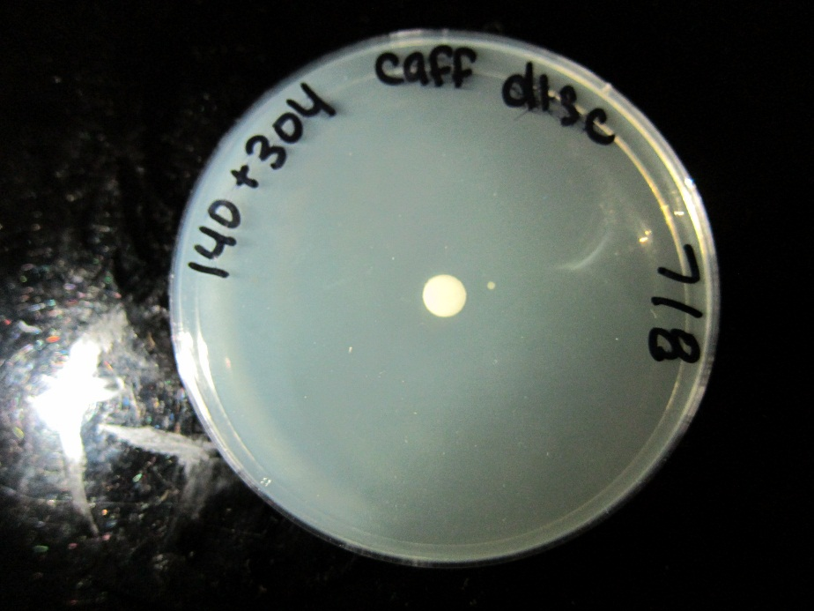
Results – Caffeine Disc
Ecdm8 + Riboswitch + tetA
Ecdm8 + Riboswitch + tetA
Ecdm8 + Riboswitch + tetA
Constructs on same Plasmid
High Promoter
Low Promoter

Slide 4
Results 15 hour absorbance minus initial absorbance with 1 mM Theophylline

Slide 5
Results 15 hour absorbance minus initial absorbance with 5 mM Caffeine

Slide 6
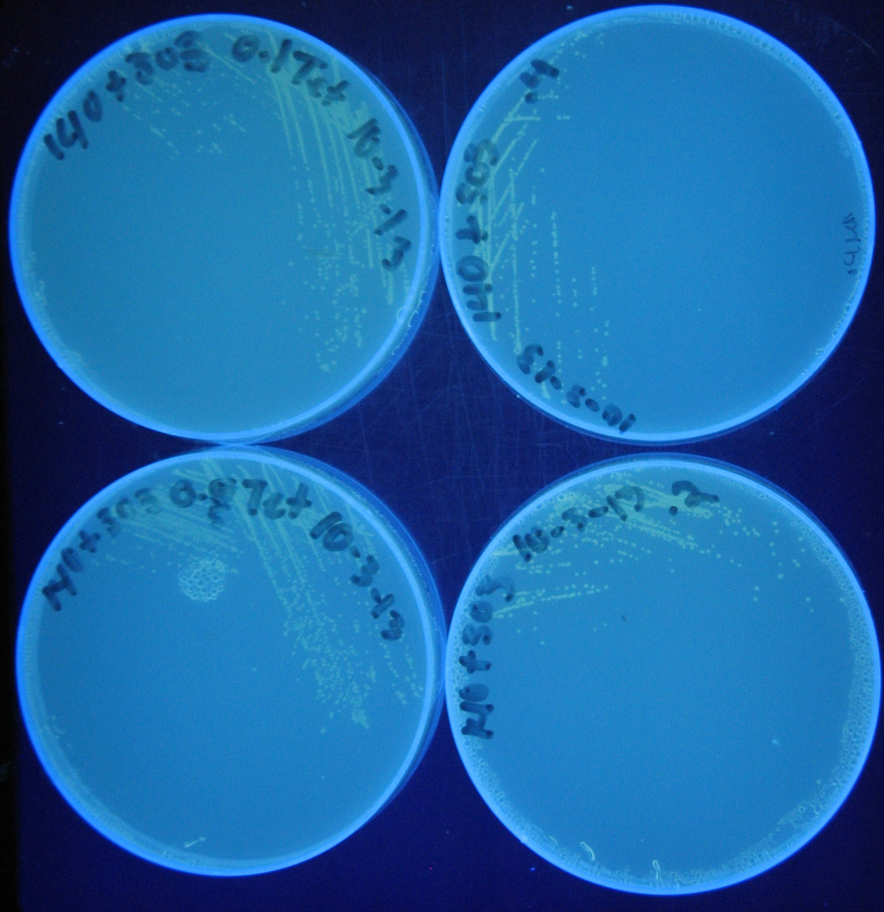
Ecdm8(low copy) + TetA Module(high copy)
0.1mM
0.05mM
0.4mM
0.2mM
0mM of Theophylline

Slide 7
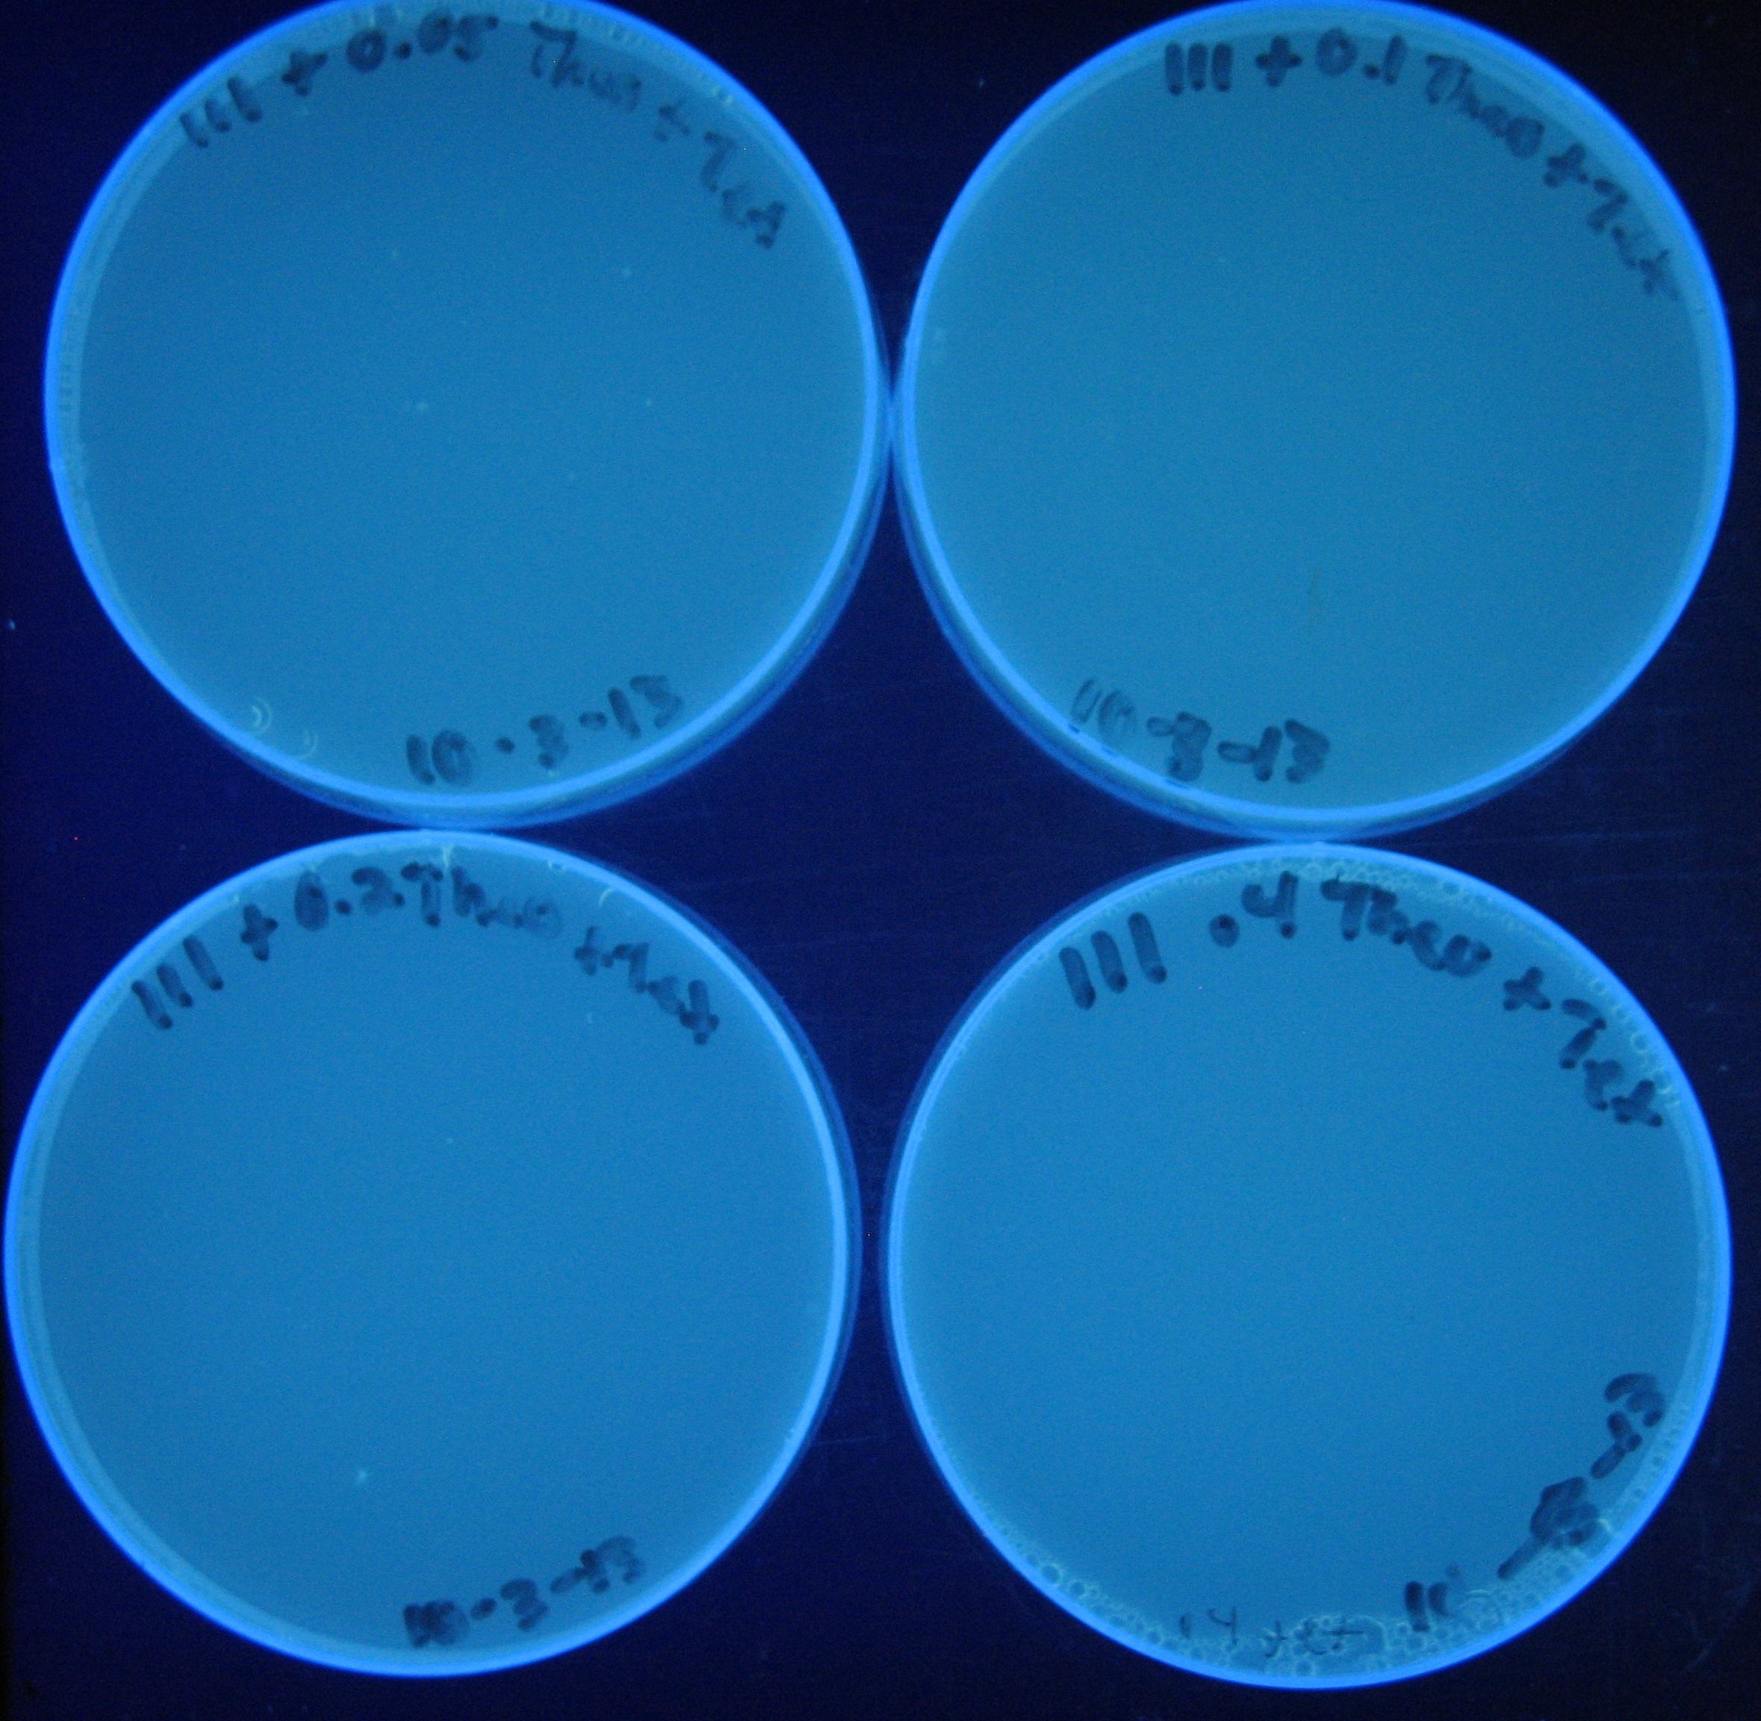
Ecdm8+ TetA Module
0.1mM
0.05mM
0.4mM
0.2mM
0mM of Theophylline

Slide 8
Future work
Test tetA fitness module and ecdm8 with caffeine, 3-methylxanthine, and xanthine
Thesis Preview Tuesday common hour Dana 146

