Slide 1
Sodium Biofortification
A. Malcolm Campbell, Davidson College Biology, 2014
What does Na⁺ do in a plant?
How does Na⁺ get into a cell?
How does Na⁺ get out of a cell?
Where is Na⁺ stored in plants?
How do plants tolerate Na⁺ (salt stress)?
What ions influence Na⁺ in plants?
QTL results!

Slide 2
What does Na⁺ do in a plant?
not required for the growth of most land plants
strong inhibitory effect on many enzymes
High Na⁺ at root surface disrupts potassium nutrition
K⁺ influences cell turgor, membrane potential, & enzyme activity (Lazof and Bernstein, 1999)
K⁺ uptake via KUP1 inhibited by Na⁺ (Kim et al., 1998; Fu and Luan, 1998; Fu and Luan, 1998)
23-230 ppm sodium in soil is acceptable (www.dpi.nsw.gov.au/agriculture/resources/soils/testing/interpret)

Slide 3
How does Na⁺ get into a cell?
Na⁺ enters root cells through cation channels
Na+ in Arabidopsis root is SAS1
voltage-independent cation channels (major entry route)
voltage-dependent cation channels
plasma membrane potential (MP) root cells ~ -130 mV
Function of AtHKT1 in plants is unclear

Slide 4
How does Na⁺ get out of a cell?
Na⁺/H⁺ exchanger in vacuole membrane and plasma membrane
Na⁺ in vacuole removes from cytoplasm (good)
Balance low extracellular osmotic potential created by salt stress.

Slide 5
Where is Na⁺ stored in plants?
NOK2 sequester Na⁺ in vacuole with transport K⁺
NHX1 up regulated by NaCl

Slide 6
Salt tolerance / Salt stress
Increased salt tolerance if overexpressing ROS scavenging enzymes:
Catalase

Slide 7
What ions influence Na⁺ in plants?
Increased calcium protects plants under sodium stress
AtACA4 vacuolar Ca²⁺-ATPase increased the salt tolerance | (Geisler et al., 2001)
Ca²⁺/H⁺ antiporter AtCAX1 increased sensitivity to ionic stress
Extra glutamate receptor AtGluR2 → Ca²⁺-deficient & salt sensitive (Kim et al., 2001)

Slide 8
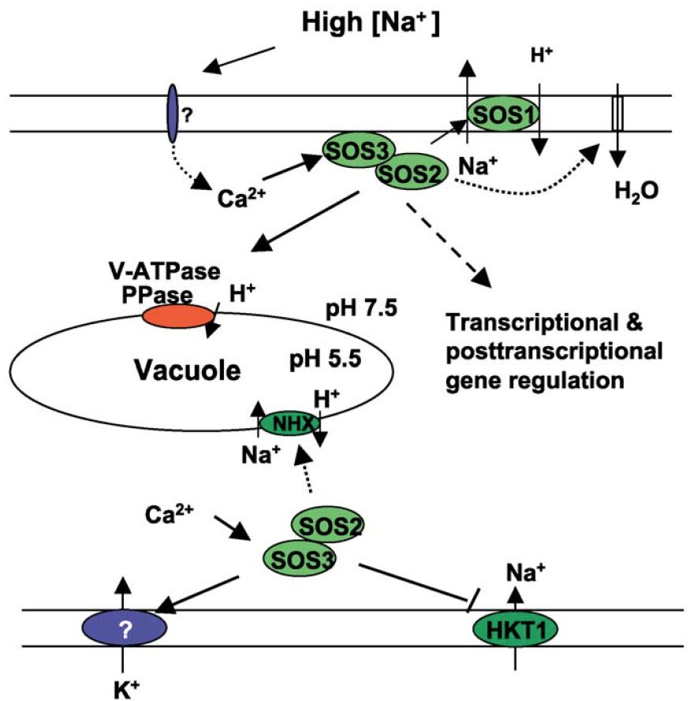
vacuolar H⁺-pyrophosphatase (AVP1)
AtNHX1
Ca²⁺-binding protein SOS3 is similar to the beta subunit of calcineurin (Liu and Zhu, 1998)
SOS3 does not function through a phosphatase (Halfter et al., 2000)
Notes:
High extracellular concentrations of salt elicit a rise in cytosolic Ca2+ concentrations. The Ca2+ sensor SOS3 upon the perception of this Ca2+ signal interacts with and activates the protein kinase SOS2. Activated SOS2 then regulates the activities of ion transporters or transcriptional activators to regulate ion homeostasis or gene expression. The SOS2 targets include the SOS1 Na+/H+ antiporter, the vacuolar Na+/H+ exchangers NHX, and the Na+ transporter HKT1.

Slide 9
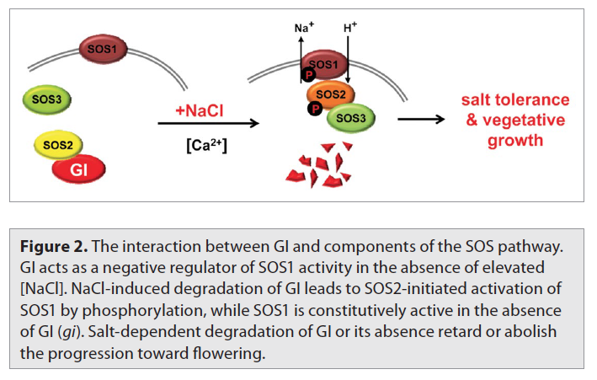
Notes:
High extracellular concentrations of salt elicit a rise in cytosolic Ca2+ concentrations. The Ca2+ sensor SOS3 upon the perception of this Ca2+ signal interacts with and activates the protein kinase SOS2. Activated SOS2 then regulates the activities of ion transporters or transcriptional activators to regulate ion homeostasis or gene expression. The SOS2 targets include the SOS1 Na+/H+ antiporter, the vacuolar Na+/H+ exchangers NHX, and the Na+ transporter HKT1.

Slide 10
BLAST
Chrom 2
IGB
1,541,105
Na/H exchanger
QTL 49,684,079
ABI2
-27,402
phosphatase 2C
SOS3
-468,152
-635,082
E1/E2 ATPase

Slide 11
ABI2: Chrom 2, 6, 9
Biological Process
Involved in hyperosmotic salinity response
Cellular Component
Molecular Function
serine/threonine phosphatase 2C
Growth and Development
petal differentiation and expansion stage
Plant Structure
collective leaf structure, guard cell, inflorescence meristem, seed, sepal, stamen, stem
exhibit compromised water relations, increased leaf transpiration rate which leads to symptoms of wilting and withering especially under low relative humidity and water stress,

Slide 12
SOS3: Chrom 2
Biological Process
hyperosmotic salinity response, calcium ion detection
Cellular Component
Molecular Function
calcium binding protein, Ca-dependent S/T phosphatase
Growth and Development
petal differentiation and expansion stage
Plant Structure
collective leaf structure, guard cell, hypocotyl, petal, root, sepal, stem
encodes a calcium sensor that is essential for K+ nutrition, K+/Na+ selectivity, and salt tolerance. The protein is similar to calcineurin B. Lines carrying recessive mutations are hypersensitive to Na+ and Li+ stresses and is unable to grow in low K+. The growth defect is rescued by extracellular calcium.

Slide 13
ATPase: Chrom 2, 6 (AT4G37640.1)
Biological Process
Ca²⁺-ATPase 2 of the ER (my thesis protein!)
Cellular Component
ER and plasma membrane
Molecular Function
calcium pump
Growth and Development
petal differentiation and expansion stage
Plant Structure
flower, inflorescence meristem, petal, pollen,

Slide 14
Na/H exchanger: Chrom 2 (AT5G27150)
Biological Process
response to salt stress, sodium ion transmembrane transport, sodium ion transport
Cellular Component
plant-type vacuole, plasma membrane, vacuolar membrane, vacuole
Molecular Function
sodium ion transmembrane transporter activity, sodium:hydrogen antiporter activity
Growth and Development
petal differentiation and expansion stage
Plant Structure
Flower, inflorescence meristem, pollen
Encodes a vacuolar sodium/proton antiporter involved in salt tolerance, ion homeostasis, and leaf development.

Slide 15
BLAST
Chrom 6
IGB
GluR
1,412,231
ABI1/2
440,209
phosphatase 2C
405,873
ATPase
QTL 3,981,788
-17,114
Mg transporter
-359,396
vacuolar sorting
KUP1
-968,209
-1,757,704
dehydration response

Slide 16
ABI1: Chrom 6, 9
Biological Process
response to water deprivation
Cellular Component
nucleus, protein serine/threonine phosphatase complex
Molecular Function
calcium ion binding, protein kinase binding, protein serine/threonine phosphatase activity
Growth and Development
petal differentiation and expansion stage
Plant Structure
carpel, cauline leaf, collective leaf structure, cotyledon, flower, guard cell, hypocotyl, inflorescence meristem, leaf apex, leaf lamina base, pedicel, petal, petiole, plant embryo, pollen, pollen tube cell, root, root tip, seed, sepal, shoot apex, shoot system, stamen, stem, vascular leaf
Involved in abscisic acid (ABA) signal transduction. Negative regulator of ABA promotion of stomatal closure.

Slide 17
KUP1: Chrom 6
Biological Process
K+ ion transport
Cellular Component
plasma membrane
Molecular Function
potassium ion transmembrane transporter activity
Growth and Development
petal differentiation and expansion stage
Plant Structure
carpel, cauline leaf, collective leaf structure, cotyledon, flower, guard cell, hypocotyl, inflorescence meristem, leaf apex, leaf lamina base, pedicel, petal, petiole, plant embryo, plant sperm cell, pollen, root, seed, sepal, shoot apex, shoot system, stamen, stem, vascular leaf
Encodes a high affinity potassium transporter.

Slide 18
GLUR: Chrom 6
Biological Process
cellular cation homeostasis
Cellular Component
extracellular region, membrane
Molecular Function
extracellular-glutamate-gated ion channel activity, intracellular ligand-gated ion channel activity, ionotropic glutamate receptor activity, transporter activity
Growth and Development
petal differentiation and expansion stage
Plant Structure
collective leaf structure, flower, guard cell, hypocotyl, inflorescence meristem, leaf apex, pedicel, plant embryo, root, seed, sepal, shoot apex, shoot system, stem
Encodes a glutamate receptor. Involved in calcium-programmed stomatal closure.

Slide 19
dehydration responder: Chrom 6 (AT1G69450)
Biological Process
Early-responsive to dehydration stress protein (ERD4)
Cellular Component
membrane, plasma membrane
Molecular Function
unknown
Growth and Development
petal differentiation and expansion stage
Plant Structure
carpel, cauline leaf, collective leaf structure, cotyledon, flower, guard cell, hypocotyl, inflorescence meristem, leaf apex, leaf lamina base, pedicel, petal, petiole, plant embryo, plant sperm cell, pollen, root, seed, sepal, shoot apex, shoot system, stamen, stem, vascular leaf

Slide 20
vacuolar sorting protein: Chrom 6 (AT1G71270)
Biological Process
pollen tube growth, sexual reproduction
Cellular Component
Golgi apparatus, Golgi membrane, endomembrane system
Molecular Function
unknown
Growth and Development
not documented
Plant Structure
flower, guard cell, pollen, root, vascular leaf
Encodes a homolog of the yeast Vps52p/SAC2. Involved in pollen tube germination and growth. Located in multiple endomembrane organelles including the golgi. The yeast protein has been shown to be located at the late Golgi and to function in a complex involved in retrograde trafficking of vesicles between the early endosomal compartment and the trans-Golgi network.

Slide 21
Mg²⁺ transporting: Chrom 6 (AT1G71900)
Biological Process
unknown
Cellular Component
unknown
Molecular Function
unknown
Growth and Development
petal differentiation and expansion stage
Plant Structure
carpel, cauline leaf, collective leaf structure, cotyledon, flower, guard cell, hypocotyl, inflorescence meristem, leaf apex, leaf lamina base, pedicel, petal, petiole, plant embryo, plant sperm cell, root, seed, sepal, shoot apex, shoot system, stamen, stem, vascular leaf
annotation does not match with name provided by IGB

Slide 22
BLAST
Chrom 8
IGB
1,160,501
catalase
MEKK1
790,383
495,803
located in vacuole
425,665
phosphatase 2C
QTL 24,127,988

Slide 23
MEKK1 Chrom 8, 9
Biological Process
response to osmotic stress, response to salt stress
Cellular Component
nucleus
Molecular Function
DNA binding, kinase binding, protein binding
Growth and Development
petal differentiation and expansion stage
Plant Structure
carpel, cauline leaf, collective leaf structure, cotyledon, cultured plant cell, flower, guard cell, hypocotyl, inflorescence meristem, leaf apex, leaf lamina base, pedicel, petal, petiole, plant embryo, pollen, pollen tube cell, root, seed, sepal, shoot apex, shoot system, stamen, stem, vascular leaf
Mediates cold, salt, cadmium and wounding stress signaling. Phosphorylates MEK1.

Slide 24
located in vacuole Chrom 8 (AT1G22060)
Biological Process
regulation of meristem growth
Cellular Component
cytoplasm, vacuole
Molecular Function
unknown
Growth and Development
petal differentiation and expansion stage
Plant Structure
carpel, cauline leaf, collective leaf structure, cotyledon, cultured plant cell, flower, guard cell, hypocotyl, inflorescence meristem, leaf apex, leaf lamina base, pedicel, petal, petiole, plant embryo, pollen, root, seed, sepal, shoot apex, shoot system, stamen, stem, vascular leaf
no clear function

Slide 25
catalase Chrom 8
Biological Process
cellular response to a lot of things but salt or dehydration not listed
Cellular Component
apoplast, cell wall, chloroplast, chloroplast envelope, chloroplast stroma, cytosolic ribosome, membrane, mitochondrion, nucleus, peroxisome, plasma membrane, plasmodesma, vacuole
Molecular Function
catalase activity, heme binding, cobalt ion binding
Growth and Development
petal differentiation and expansion stage, seedling development stage, sporophyte senescent stage
Plant Structure
flower, guard cell, inflorescence, inflorescence meristem
Catalase, catalyzes the breakdown of hydrogen peroxide (H2O2) into water and oxygen.

Slide 26
BLAST
Chrom 9
IGB
shared QTL with
Boron and Zn
SOS2
1,169,561
STO/STZ
1,121,285
SOS2
633,547
590,474
cation exchanger
MEKK1
410,571
QTL 41,992,687
ABI1/2
-81,304
phosphatase 2C
-103,033
S/T phosphatase
-628,436
K+ efflux antiporter

Slide 27
STO/STZ Chrom 9
Biological Process
response to salt stress, response to temperature stimulus, water transport
Cellular Component
intracellular, nucleus
Molecular Function
protein binding, DNA binding transcription factor activity, zinc ion binding
Growth and Development
petal differentiation and expansion stage
Plant Structure
carpel, cauline leaf, collective leaf structure, cotyledon, flower, guard cell, hypocotyl, inflorescence meristem, leaf apex, leaf lamina base, pedicel, petal, petiole, plant embryo, plant sperm cell, pollen, root, seed, sepal, shoot apex, shoot system, stamen, stem, vascular leaf
Encodes salt tolerance protein (STO) which confers salt tolerance to yeast cells. Fully complements calcineurin deficient yeast but does not encode a phosphoprotein phosphatase. Sequence has similarities to CONSTANS. STO co-localizes with COP1 and plays a role in light signaling.

Slide 28
SOS2 Chrom 9
Biological Process
response to salt stress
Cellular Component
plant-type vacuole membrane, plasma membrane
Molecular Function
identical protein binding, kinase activity, protein binding, protein kinase activity
Growth and Development
petal differentiation and expansion stage
Plant Structure
carpel, cauline leaf, collective leaf structure, cotyledon, flower, guard cell, hypocotyl, inflorescence meristem, leaf apex, petal, plant embryo, plant sperm cell, pollen, pollen tube cell, root, seed, sepal, shoot apex, shoot system, stamen, stem, vascular leaf
encodes a member of the CBL-interacting protein kinase family, is a regulatory component controlling plant potassium nutrition

Slide 29
K+ efflux antiporter Chrom 9 (AT5G51710)
Biological Process
sodium ion transport
Cellular Component
integral to membrane
Molecular Function
potassium:hydrogen antiporter
Growth and Development
petal differentiation and expansion stage
Plant Structure
carpel, cauline leaf, collective leaf structure, cotyledon, flower, guard cell, hypocotyl, inflorescence meristem, leaf apex, leaf lamina base, pedicel, petal, petiole, plant embryo, plant sperm cell, pollen, pollen tube cell, root, seed, sepal, shoot apex, shoot system, stamen, stem, vascular leaf
Putative potassium proton antiporter family

Slide 30
S/T phosphatase Chrom 9 (AT5G59160)
Biological Process
hydrogen peroxide biosynthetic process, protein dephosphorylation, protein desumoylation, vegetative to reproductive phase transition of meristem
Cellular Component
protein phosphatase type 1 complex
Molecular Function
protein serine/threonine phosphatase activity
Growth and Development
petal differentiation and expansion stage
Plant Structure
carpel, cauline leaf, collective leaf structure, cotyledon, flower, guard cell, hypocotyl, inflorescence meristem, leaf apex, leaf lamina base, pedicel, petal, petiole, plant embryo, pollen, pollen tube cell, root, seed, sepal, shoot apex, shoot system, stamen, stem, vascular leaf
Encodes the catalytic subunit of a Type 1 phosphoprotein Ser/Thr phosphatase, expressed in roots, shoots and flowers.

Slide 31
cation exchanger Chrom 9 (AT5G37060)
Biological Process
sodium ion transmembrane transport, sodium ion transport,
Cellular Component
integral to membrane
Molecular Function
sodium:hydrogen antiporter activity
Growth and Development
petal differentiation and expansion stage
Plant Structure
collective leaf structure, flower, petal, pollen
member of Putative Na+/H+ antiporter family

Slide 32
Show how to use IGB to get amino acid sequence

Slide 33
References
Liming Xiong and Jian-Kang Zhu. 2012. Salt Tolerance. The Arabidopsis Book, Number 1 2002. The American Society of Plant Biologists. DOI: http://dx.doi.org/10.1199/tab.0048
Increased tolerance to salt stress in the phosphate-accumulating Arabidopsis mutants siz1 and pho2. Miura K, Sato A, Ohta M, Furukawa J.
Overexpression of HARDY, an AP2/ERF gene from Arabidopsis, improves drought and salt tolerance by reducing transpiration and sodium uptake in transgenic Trifolium alexandrinum L. Abogadallah GM, Nada RM, Malinowski R, Quick P. Planta. 2011 Jun;233(6):1265-76. doi: 10.1007/s00425-011-1382-3. Epub 2011 Feb 22.

Slide 35
My QTLs
C09 Bn-C9-p41992687
C06 Bn-C6-p03981788
C02 Bn-C2-p49684079
C08 Bn-C8-p24127988
A10 7-8 MBP
A02 22-24 MBP
A07 22-25 MBP
A08 ?

Slide 36
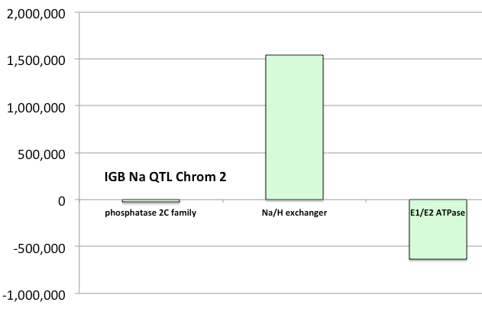

Slide 37
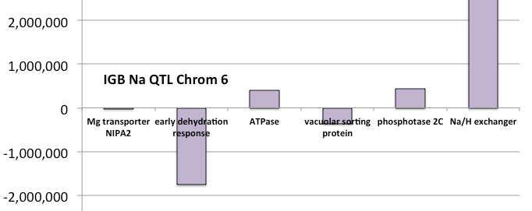

Slide 38
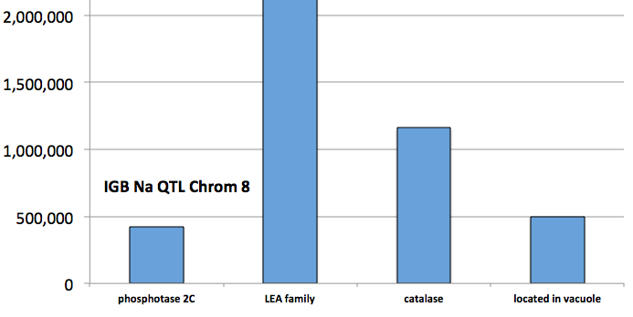

Slide 39
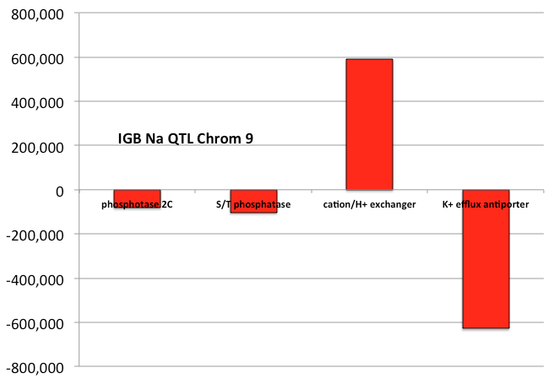

Slide 40
QTL on Chromosome 2 49,684,079
Bo2g159080
Protein phosphatase 2C family protein
plus
49,711,481
49,713,429
Bo2g160820
E1-E2 ATPase family protein
plus
50,319,161
50,326,165
Bo2g155070
Sodium/hydrogen exchanger
plus
48,142,791
48,142,974

Slide 41
QTL on Chromosome 6 3,981,788
Bo6g012450
Magnesium transporter NIPA2
minus
3,998,902
Bo6g010650
Protein phosphatase 2c%2C putative
minus
3,541,579
Bo6g017960
Early-responsive to dehydration stress-related protein
plus
5,739,492
Bo6g002820
Sodium/hydrogen exchanger
plus
390,767
390,828
Bo6g010720
ATPase
minus
3,575,915
Bo6g013980
Vacuolar protein sorting protein%2C putative
minus
4,341,184

Slide 42
QTL on Chromosome 8 24,127,988
Bo8g071390
Protein phosphatase 2c%2C putative
plus
23,701,126
23,702,323
Bo8g071280
LOCATED IN: vacuole
minus
23,632,185
23,629,688
Bo8g067350
Late embryogenesis abundant (LEA) hydroxyproline-rich glycoprotein family
plus
21,796,311
21,797,091
Bo8g070290
Catalase
plus
22,966,710
22,967,487

Slide 43
QTL on Chromosome 9 41,992,687
Bo9g136980
Protein phosphatase 2C
plus
42,073,991
42,075,849
Bo9g137020
Serine/threonine-protein phosphatase
minus
42,097,168
42,095,720
Bo9g135110
cation/H+ exchanger
minus
41,402,213
41,399,987
Bo9g140680
K+ efflux antiporter
plus
42,618,629
42,621,123

Slide 44
ABI1 AT4G26080 Chr 9: 80 kb; Chr 6, 440 kb;
Biological Process
hyperosmotic salinity response
Cellular Component
protein serine/threonine phosphatase complex
Molecular Function
calcium ion binding
Growth and Development
Petal differentiation
Plant Structure
flower
IGB find: Bo9g137020.1 is serine/threonine protein phosphatase
increased leaf transpiration rate which leads to symptoms of wilting and withering especially under low relative humidity and water stress

Slide 45
BLAST
IGB

Slide 46
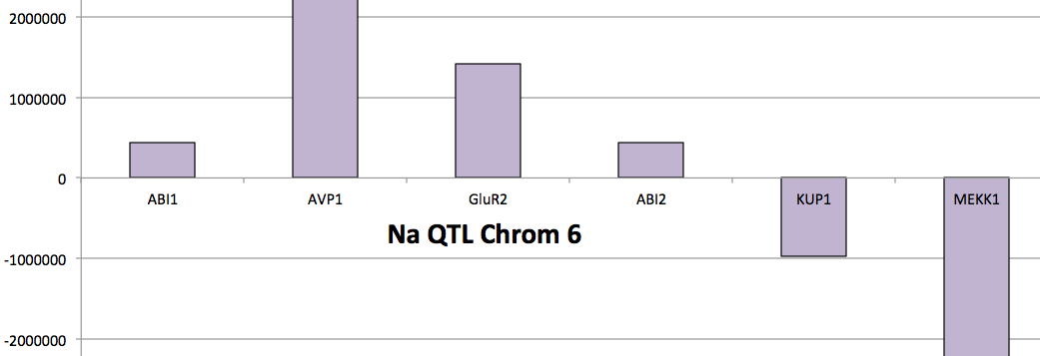
BLAST
IGB

Slide 47
BLAST
IGB

Slide 48
BLAST
IGB

Slide 49
Chr2 QTL 49,484,079 ←> 49,884,079
Bo2g159080
Protein phosphatase 2C family protein
Bo2g159080.1
Bo2g159080.1
C2
49,712,895
49,713,429
534
SOS3 was annotated in IGB

Slide 50
Chr6 QTL 3,781,788 ←> 4,181,788
Nothing found by scrolling 200 kb each way
IGB found one gene at this location for ABI1 or ABI2

Slide 51
Chr8 QTL 23,927,988 ←> 24,327,988
Nothing found by scrolling 200 kb each way
IGB found “Protein kinase-like protein” instead of MEKKK

Slide 52
Chr9 QTL 41,792,687 ←> 42,192,687
IGB find: Bo9g137020.1 is serine/threonine protein phosphatase
IGB find: found as Bo9g136980.1 = phosphatase 2c

Slide 53
MEKK1 AT4G08500 Chr 9: 400 kb; Chr 8: 790 kb
Biological Process
response to osmotic stress
Cellular Component
Nucleus
Molecular Function
DNA binding
Growth and Development
Petal differentiation and expansion
Plant Structure
flower
Mediates cold, salt, cadmium and wounding stress signaling

Slide 54
SOS2 AT5G35410 Chr 9: 633 kb
Biological Process
Response to salt stress
Cellular Component
Vaculolar membrane
Molecular Function
Kinase
Growth and Development
Petal differentiation and expansion
Plant Structure
flower
encodes a member of the CBL-interacting protein kinase family, is a regulatory component controlling plant potassium nutrition

Slide 55
SOS3 AT5G24270 Chr 2: 468 kb
Biological Process
calcium-mediated signaling, cellular potassium ion homeostasis, detection of calcium ion, hypotonic salinity response, stomatal movement
Cellular Component
calcineurin complex, cytoplasm, plasma membrane
Molecular Function
calcium ion binding
Growth and Development
Petal differentiation and expansion
Plant Structure
Petal, guard cell, collective leaf structure
encodes a calcium sensor that is essential for K+ nutrition, K+/Na+ selectivity, and salt tolerance. The protein is similar to calcineurin B. Lines carrying recessive mutations are hypersensitive to Na+ and Li+ stresses and is unable to grow in low K+. The growth defect is rescued by extracellular calcium.

