Slide 1
EST Search for Genes in the Cold Tolerance Pathway of Vaccinium corymbosum
Shamita Punjabi
Notes:
A chronological view of how I proceeded to find ESTs and new scaffolds for genes in the cold tolerance pathway

Slide 2
Cold Tolerance Pathway
Notes:
-diacylglycerol kinase—prevalent in phospholipid signaling and may have an effect on the composition of the cell membrane, particularly during times of cold acclimation

Slide 3
Scaffold used for Each Gene
ICE1 00051
ATDGK1 00019
SIZ1 00171
CBF1c 00009

Slide 4
EST Search Process
*Scaffold for Gene (obtained via tBLASTn of an ortholog)
Vaccinium.org
3’ end method
Primer design method
Towson
3’ end method
Primer design method
Query: Amino Acid of scaffold from alignment (tBLASTn)
Query: *Nucleotide fragment from scaffold (BLASTn)
Query: Amino Acid of scaffold from alignment (tBLASTn)
Query: *Nucleotide fragment from scaffold (BLASTn)
Portion of Scaffold with Gene
Database used
to find EST
Search Method
Nature of Query
Subject: EST (nucleotide)
Subject: EST (nucleotide)
Nature of Hit
If ESTs validated in in NCBI (BLASTn), then…
Validation of Hit
End Goal
*Use EST sequences to find new scaffolds for gene
*Note: All scaffolds and scaffold sequences were found on Vaccinium.org
Notes:
-starting with the scaffold associated with each gene, I used two databases and two possible methods of searching for each database:
-databases: Vaccinium.org and Towson
-search methods: 3’ end and primer design
-the 3’ end method queries a protein section of the scaffold that had been obtained from an alignment with the Arabidopsis ortholog
-primer design method uses the results of the SSR search to find a segment of DNA on the entire nucleotide sequence of the scaffold (downloaded from Vaccinium.org) in the vicinity of primers near the end of a gene (end of gene guesstimated by using Arabidopsis ortholog as a reference)

Slide 5
3’ end vs Primer design methods
3’ end method
Query: translated scaffold
Translated scaffold sequence obtained from alignment between ortholog and scaffold
tBLASTn is used to query EST database
Primer design method
Query: nucleotide sequence of scaffold
Sequence obtained from a txt file downloaded from Vaccinium.org
Fragment query obtained by using SSR primers in vicinity of gene ends
BLASTn used to query ESTs

Slide 6
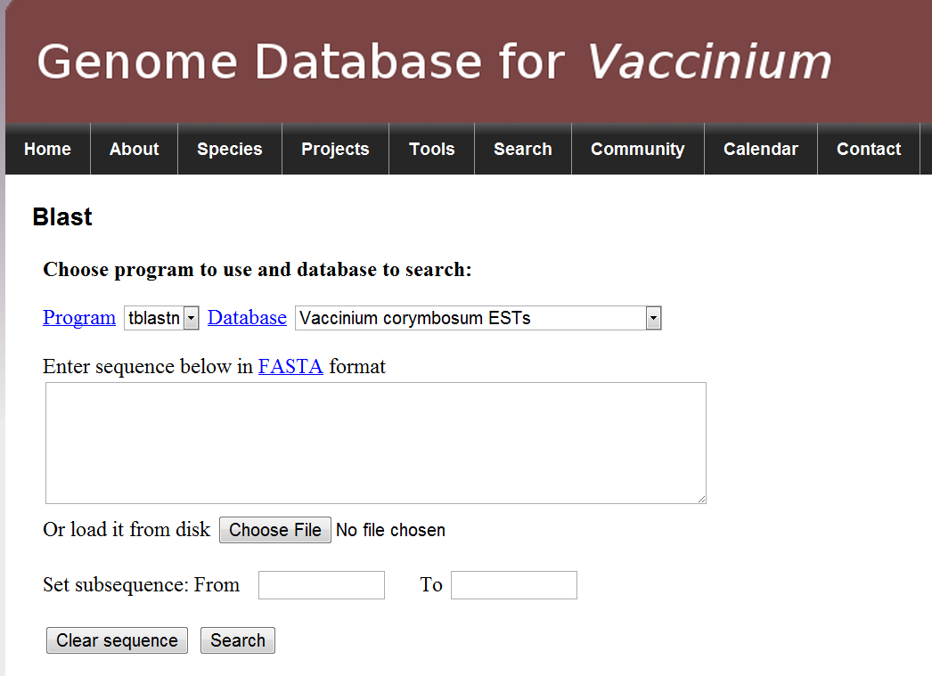
Using Vaccinium.org EST Database

Slide 7
ESTs for ICE1 3’ end approach
Queried a short segment of the scaffold (tBLASTn) near the supposed 3’ end of the gene to query the EST database (~57,000bp)
Found CV09182 as a good match (E=10⁻⁴)
Notes:
Explain where I get the sequence for the query – draw on the board..
Arabidopsis sequence match with Scaffold (tBLASTx)
Scaffold taken and queried in the EST database (subject is the EST in question)

Slide 8
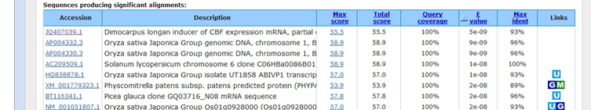
Ortholog of ICE1 EST found on NCBI GenBank
Nucleotide search in GenBank (BLASTn) using CV09182 as query
Found that the EST is very similar to an ortholog that is an inducer of CBF
Notes:
Dimocarpus longan (tropical tree in South Asia—Eudicot)

Slide 9
ESTs for ICE1 Primer Design Approach
Does searching between PCR primers give a better result?
Queried a ~2000 bp segment of scaffold(BLASTn) (~56,500bp)
Query sequence was validated in NCBI (matched ICE1 in other species)
No good hits (E>1)—might be picking up alternative genes outside of the ICE1 region on the scaffold
Search of these ESTs in NCBI GenBank found that they were close matches to grape contigs, but no mention of ICE1 in description
Notes:
I was curious as to whether searching between PCR primers would give a better result, so I used a segment between NN bases in scaffold

Slide 10
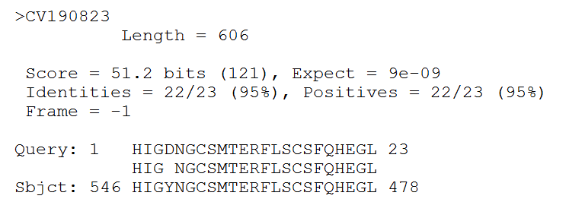
EST for ATDGK1 3’ end approach
Queried 3’ (tBLASTn) end of gene from three different alignments to scaffold in the EST database (~361,800 bp)
All found CV190823 as good match (E=10⁻⁹)
Notes:
I used only the 3’ approach because I had several alignments with the scaffold that were towards the end of the gene—when all of these gave me the same EST, I decided that the Primer approach wasn’t necessary

Slide 11
Ortholog of ATDGK1 EST found on NCBI GenBank
CV190823 was queried in NCBI (BLASTn)
DAG kinase-like gene found in grape (E=10⁻³⁰)

Slide 12
EST for SIZ1 3’ end approach
Submitted the 3’ ends on the scaffold (tBLASTn) of 4 different alignments (~85,000 bp)
All resulting alignments had poor E scores (E>1)
Query of 60 bp returned 2 poor hits
Notes:
My suspicion is that that I’m either not picking up the SIZ1 gene or it just doesn’t exist in the ESTs

Slide 13
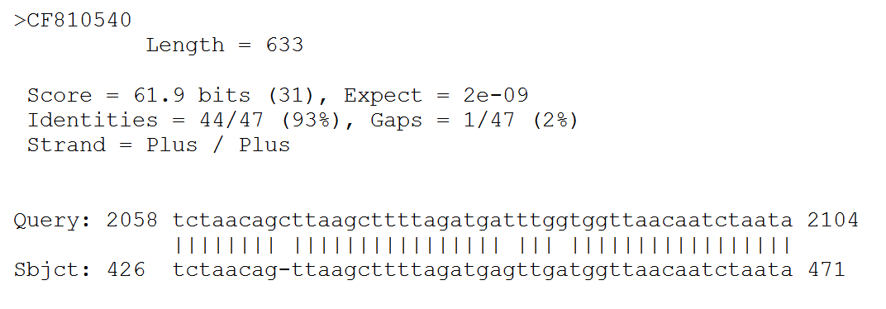
EST for SIZ1 Primer design approach
Used a ~2000 bp fragment at 173,500 bp (Query was validated in NCBI, found match to SIZ1 in grape) located near primers towards the end of the gene (BLASTn)
Found CF810540 as best hit (E=10⁻⁹)
Notes:
Submitted the fragment directly from the scaffold and found that it matched to SIZ1 in grape
Queried the scaffold in EST and found a good hit

Slide 14
No Orthologs of SIZ1 EST found on NCBI GenBank
Nucleotide search in GenBank using CF810540 as query (BLASTn)
No orthologs of SIZ1 were returned in the results
Notes:
Queried the EST in the genbank database, no orthologous hits

Slide 15
EST for CBF1c 3’ end approach
Queried 3’ end of gene from the scaffold (tBLASTn) in the EST database (~488,000 bp)
Found DW043014 and DW043054 as good matches (E=10⁻¹⁶)
Notes:
I had three scaffold fragments that were supposedly near the ends of genes.

Slide 16
Exact match for CBF1c ESTs found on NCBI GenBank (!!)
Vaccinium.org describes DW043014 as having transcription factor activity
Search of gene sequences in GenBank using DW043054 as query (BLASTn)
Perfect match of query to CBF gene in blueberry was returned (E=0)

Slide 17
New Scaffolds (Vaccinium.org ESTs) ICE1 and CBF1c
ICE1 (EST: CV091282)
scaffold00197 E score = 0.0 scaffold01278 E score = 2e-17 scaffold01345 E score = 2e-14
CBF1c (EST: DW043014)
scaffold00009 E score = 0.0 scaffold01137 E score = 2e-10 scaffold00814 E score = 4e-05
*New Scaffolds indicated in Red, while parent Scaffold is Black
Notes:
Only found Scaffolds for these two genes before I heard about this next method from Dr. Rowland.

Slide 18
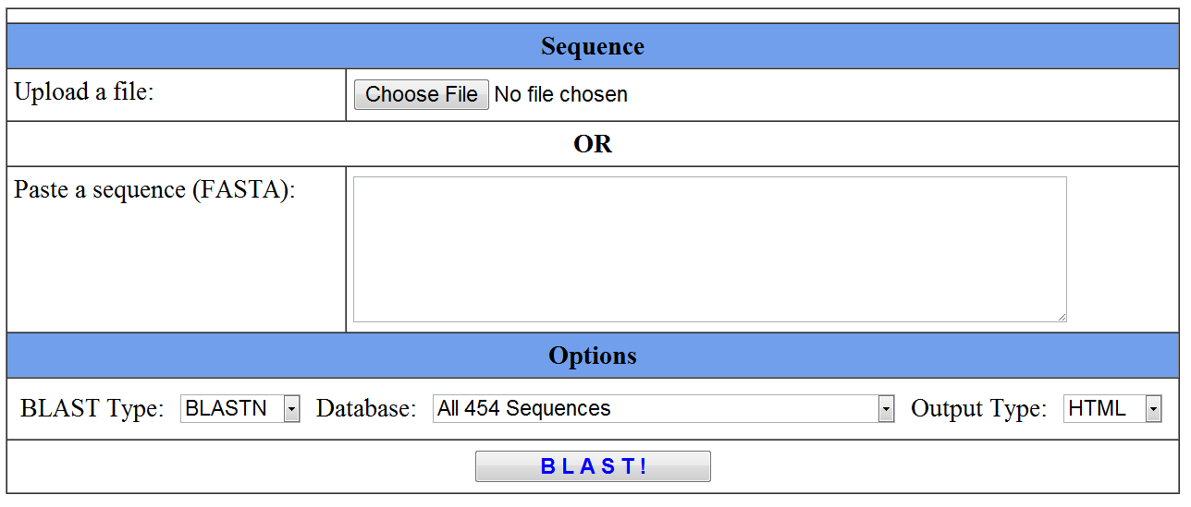
Using Towson Database
Notes:
-more complete access to all ESTs in blueberry
-Began with SIZ1 since my results from the Vaccinium.org search were unsatisfactory Towson has a more complete library of ESTs taken from 9 different tissues, and the cold tolerance is taken from bud tissues at 4 different stages in the acclimation process. So the data is much more thorough. I’d like to find out how this is different from the library in Vaccinium.

Slide 19
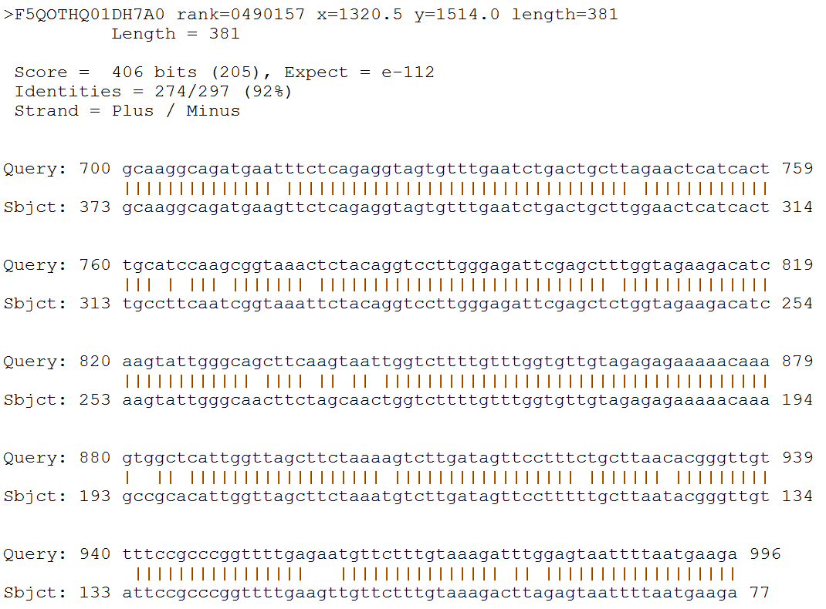
EST for SIZ 1 Primer design approach
Submitted a fragment of ~1800 bp near primers on scaffold
nBLAST against all 454 sequences gave F5QOTHQ01DH7A0 as a good match (E= 10⁻¹¹²)

Slide 20
Ortholog to SIZ1 ESTs found on NCBI GenBank
Input the F5QOTHQ01DH7A0 sequence into NCBI
GenBank found a very close match to EST in Populus drought stressed leaves, mild to severe (E=10⁻⁸)
Notes:
-explain how freezing is considered a form of dehydration, because all the water in the extracellular environment freezes, causing the water inside the cell to leave

Slide 21
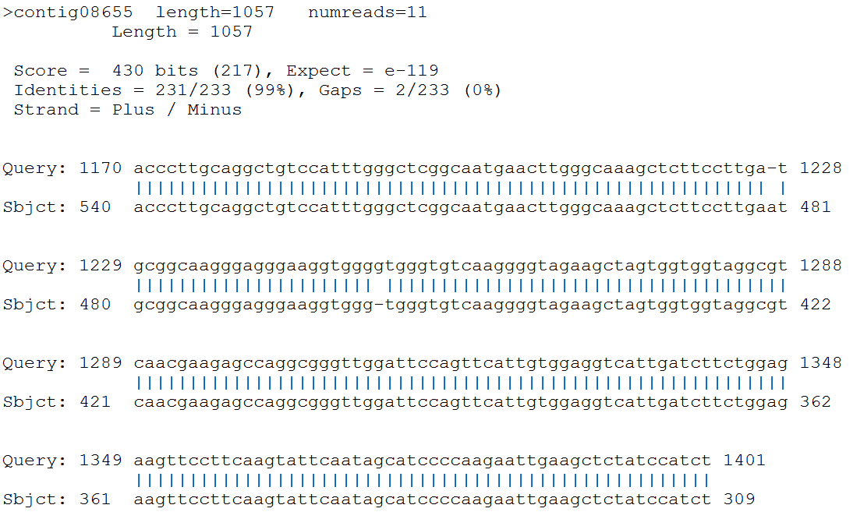
EST for ICE1 Primer design approach
Using same method as for SIZ1, queried the portion of the scaffold that gave bad ESTs in Vaccinium.org (~56,500bp)
Best match was contig08655 (E=10⁻¹¹⁹)
Description of the contig on Towson noted that it had transcription regulation activity
Notes:
-because ICE1 data could have been better from the Vaccinium search, I decided to repeat it

Slide 22
Ortholog to ICE1 EST found on NCBI GenBank
Queried a portion of contig08655 from the alignment in NCBI GenBank
Best match was ICE-like protein (E=10⁻¹¹)
Notes:
Corylus heterophylla: Eastern Asian eudicot

Slide 23
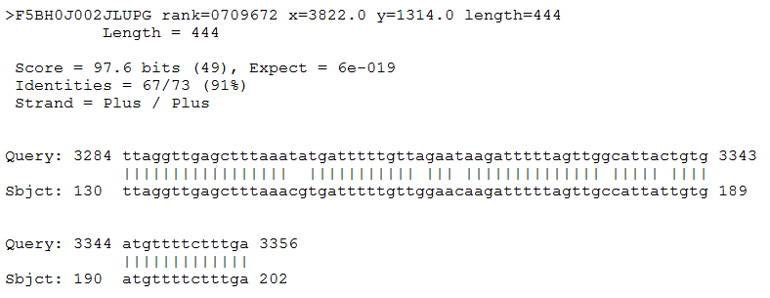
EST for ICE1 Primer design approach
Queried same portion of scaffold (~56,500bp)
Another good hit found EST: F5BH0J002JLUPG (E=10⁻¹⁹)

Slide 24
Ortholog to ICE1 EST found on NCBI GenBank
Input the F5BH0J002JLUPG sequence into NCBI
GenBank found four very close matches to an EST in Populus drought stressed leaves, mild (E=10⁻¹¹)

Slide 25
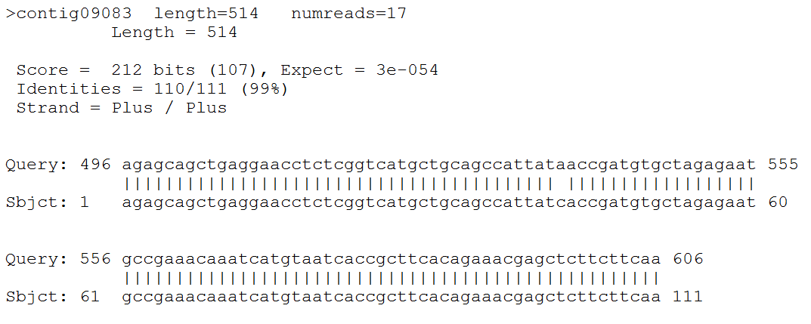
ESTs for ATDGK1 (Dr. Campbell)
Used EST Shamita had obtained from NCBI to query the Towson EST database
Best hit EST: contig09083 (E=10⁻⁵⁴)

Slide 26
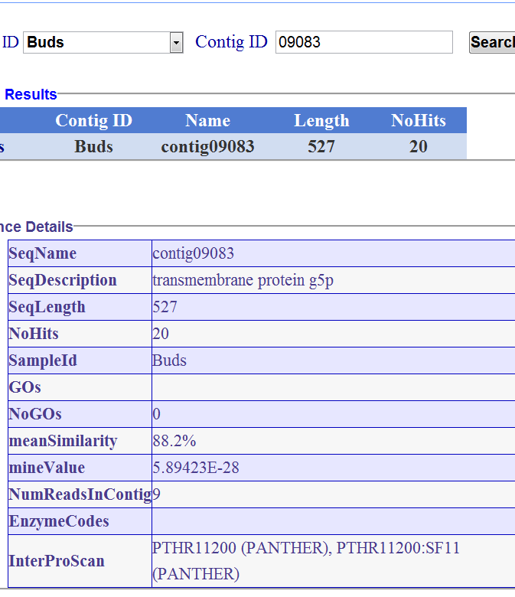
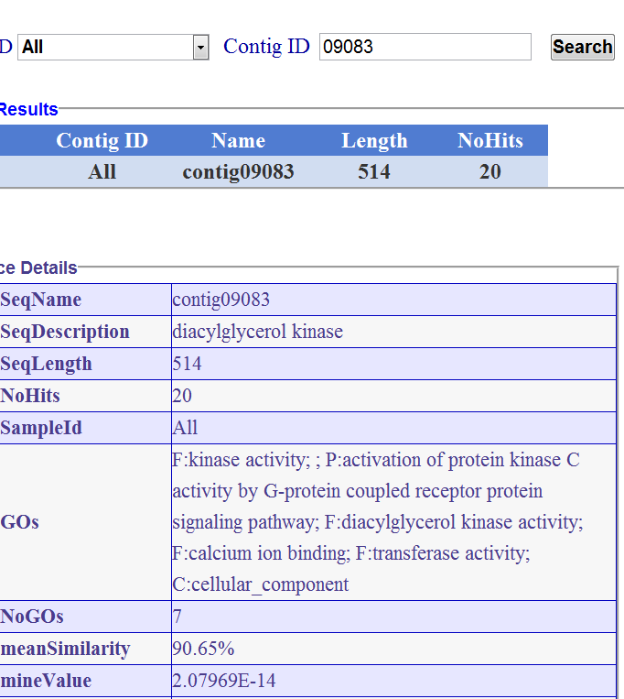
Some ambivalence in contig Function/Sequence on Towson
Query 09083 in Buds
Query 09083 in All
*The alignment from this sequence was submitted to NCBI to obtain an EST. Same EST as before was found: CV190823.
*This sequence had several matches in the Vitis vinifera phosphatidylinositide phosphatase SAC1-like family on NCBI
Notes:
Depending on what library is specified, it gives 2 different results

Slide 27
New Scaffolds (Towson ESTs) SIZ1, ICE1, and ATDGK1
SIZ1 (EST: F5QOTHQ01DH7A0 )
scaffold02191 length=47427 E Score = e-146
scaffold00717 length=144267 E Score = e-112
scaffold00530 length=187309 E Score = 1e-66
ICE1 (EST: F5BH0J002JLUPG )
scaffold00508 length=174034 E Score = 0.0
scaffold00628 length=181951 E Score = 3e-55
scaffold00440 length=239660 E Score = 3e-55
ATDGK1 (EST: CV190823)
scaffold00019 length=528048 E Score = 0.0
scaffold00393 length=244216 1 E Score = e-21
*New Scaffolds indicated in Red, while parent Scaffold is Black

Slide 28
Summary & Conclusions
CBF1c
00009
DW043054
DW043014
00009
01137
ATDGK1
00019
CV190823
00019
00393
Gene
Original Scaffold
ESTs
New Scaffold
Vaccinium.org
Towson
ICE1
00051
CV09182
01278
01345
00197
contig08655
F5BH0J002JLUPG
00508
00628
00440
SIZ1
00171
CF810540
F5QOTHQ01DH7A0
02191
00717
*Parent scaffolds via ESTs are underlined
Notes:
Orange= Towson Database
Blue=Vaccinium Database

Slide 29
Conclusions
Using ESTs found on both Vaccinium.org and the Towson Database, new scaffolds were uncovered for all genes
All of the genes appeared to be captured in an EST (though debatable whether this is known for any gene except CBF1c)
Towson Database
Excellent source for obtaining comprehensive collection of ESTs
In order to be a useful tool, need some clarification on categorization and searching
Next?
Use the new scaffolds to confirm whether paralogs of the genes exist.
Use ESTs and new scaffolds to fill missing genes in cold tolerance pathway

