Slide 1
RFP Inputs | J119055 (a’ or b) and (a or c’) | J119056 (b’ or c’) and (a or b) | J119057 (b or c) and (a’ or b’) | J119058 (a’ or c) and (b or c) | J119059 (a or b') and (a or c) | J119060 (a' or c') and (b' or c)
a,b’,c J93 | - | + | + | + | + | -
a’,b,c J94 | - | - | + | + | - | +
a,b,c’ J95 | + | + | - | - | + | -
a’,b,c’ J96 | + | + | + | + | - | -
a’,b’,c J97 | - | - | + | + | + | +
a’,b’,c’ J98 | + | - | - | - | - | +
a,b’,c’ J99 | - | + | - | - | + | +
a,b,c J100 | + | - | - | + | + | -
These are all the expected +’s and –’s
Red means we got the opposite result from expected
There were 16 False +’s, 11 False –’s = 27 Total

Slide 2
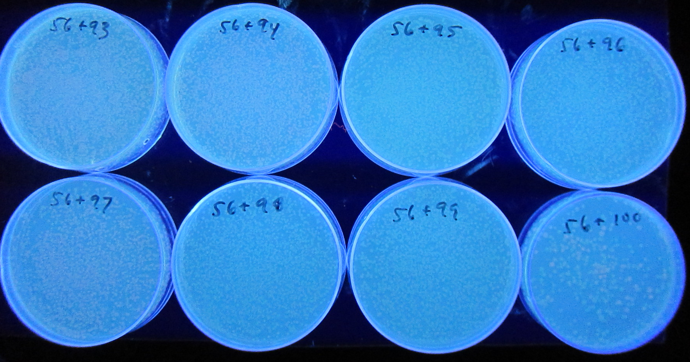
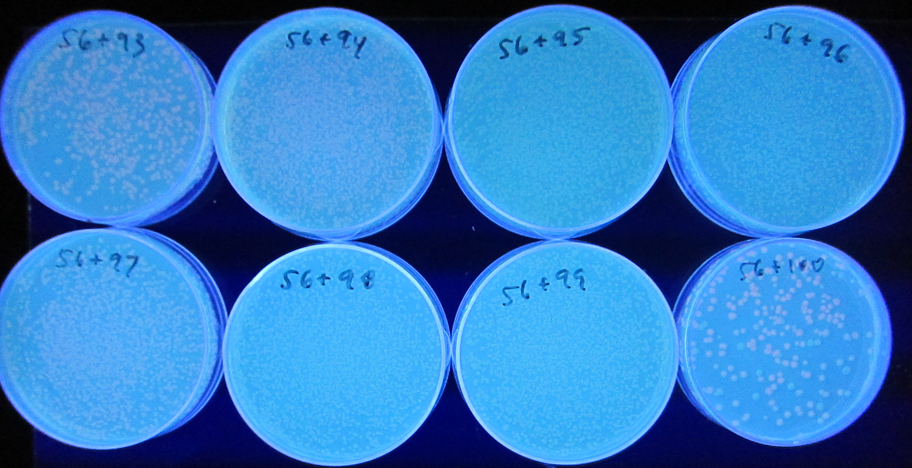
RFP Inputs | J119056 (b’ or c’) and (a or b)
a,b’,c J93 | +
a’,b,c J94 | -
a,b,c’ J95 | +
a’,b,c’ J96 | +
a’,b’,c J97 | -
a’,b’,c’ J98 | -
a,b’,c’ J99 | +
a,b,c J100 | -

Slide 3
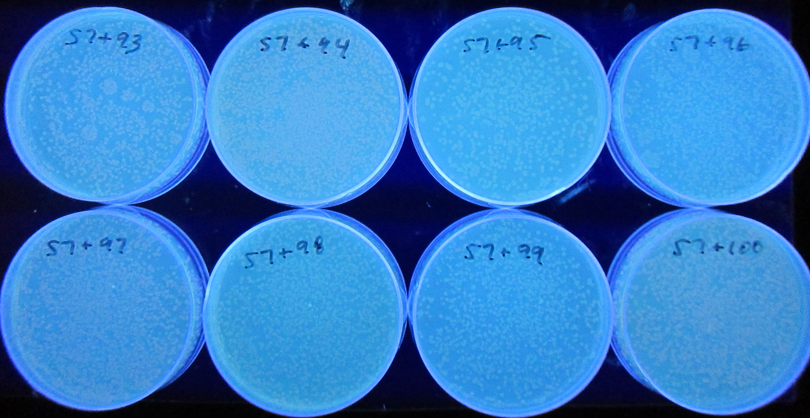
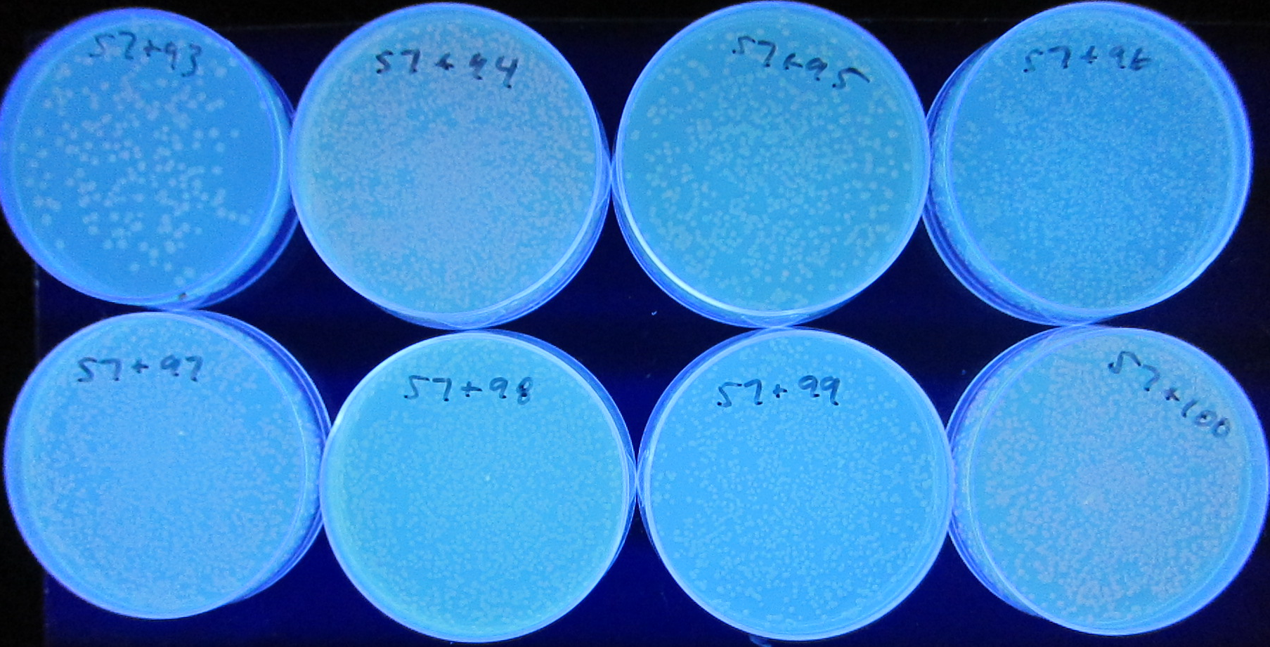
RFP Inputs | J119057 (b or c) and (a’ or b’)
a,b’,c J93 | +
a’,b,c J94 | +
a,b,c’ J95 | -
a’,b,c’ J96 | +
a’,b’,c J97 | +
a’,b’,c’ J98 | -
a,b’,c’ J99 | -
a,b,c J100 | -

Slide 4
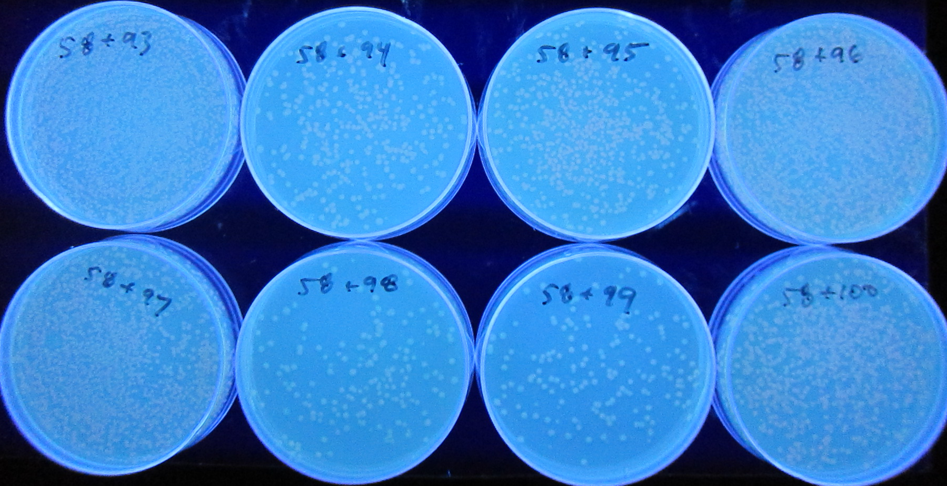
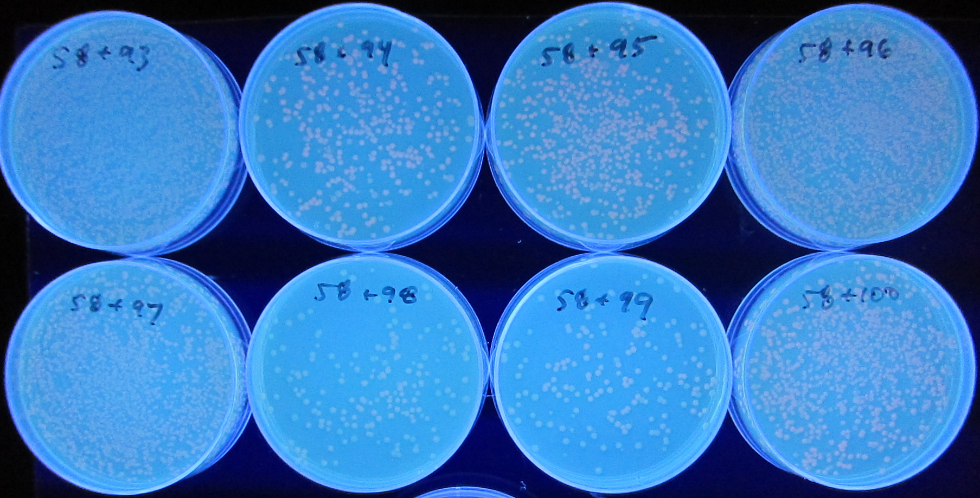
RFP Inputs | J119058 (a’ or c) and (b or c)
a,b’,c J93 | +
a’,b,c J94 | +
a,b,c’ J95 | -
a’,b,c’ J96 | +
a’,b’,c J97 | +
a’,b’,c’ J98 | -
a,b’,c’ J99 | -
a,b,c J100 | +

Slide 5
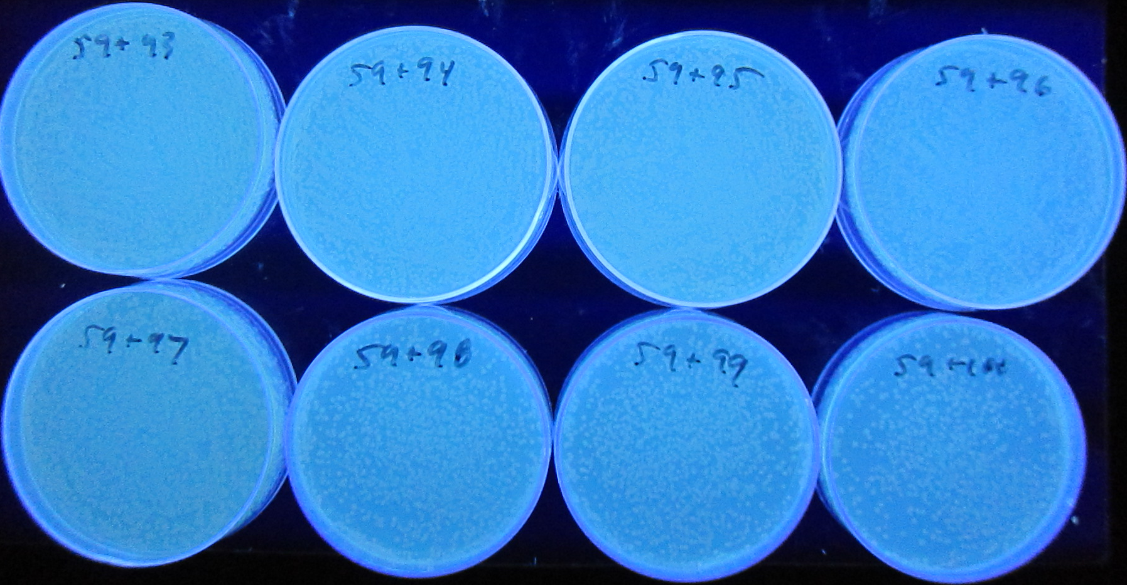
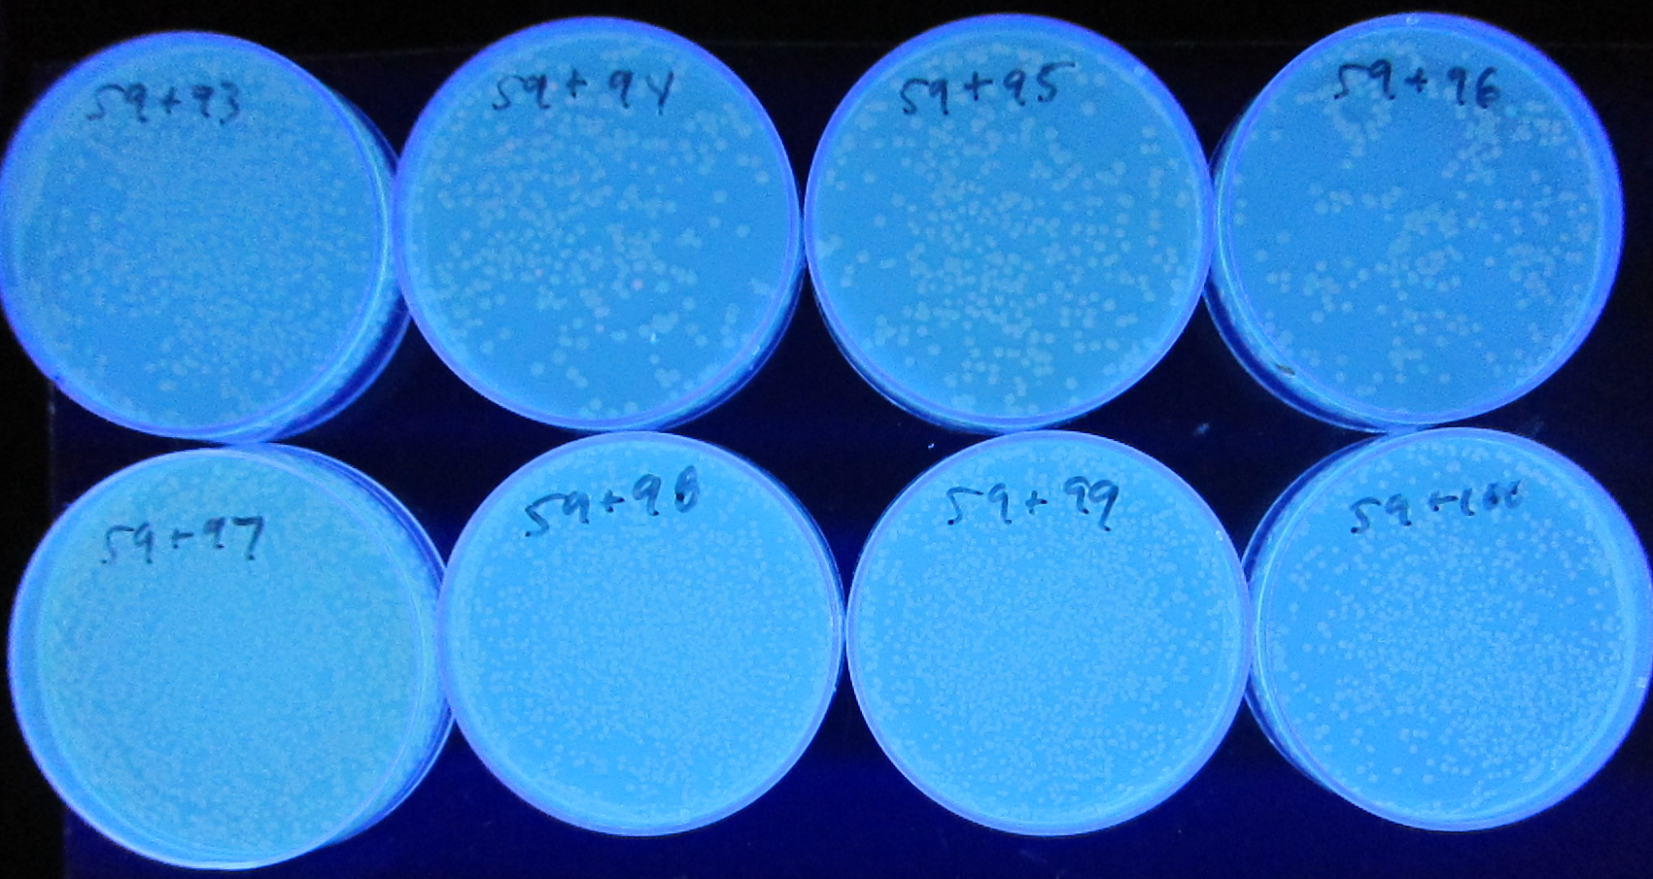
RFP Inputs | J119059 (a or b') and (a or c)
a,b’,c J93 | +
a’,b,c J94 | -
a,b,c’ J95 | +
a’,b,c’ J96 | -
a’,b’,c J97 | +
a’,b’,c’ J98 | -
a,b’,c’ J99 | +
a,b,c J100 | +

