Slide 1
CDM picture results Claire Shinneman Summer 2013

Slide 2
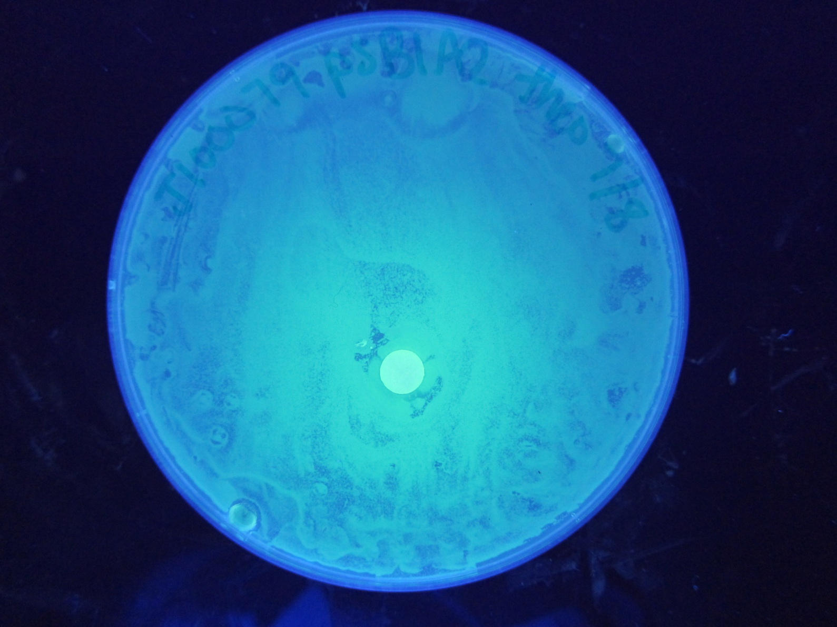
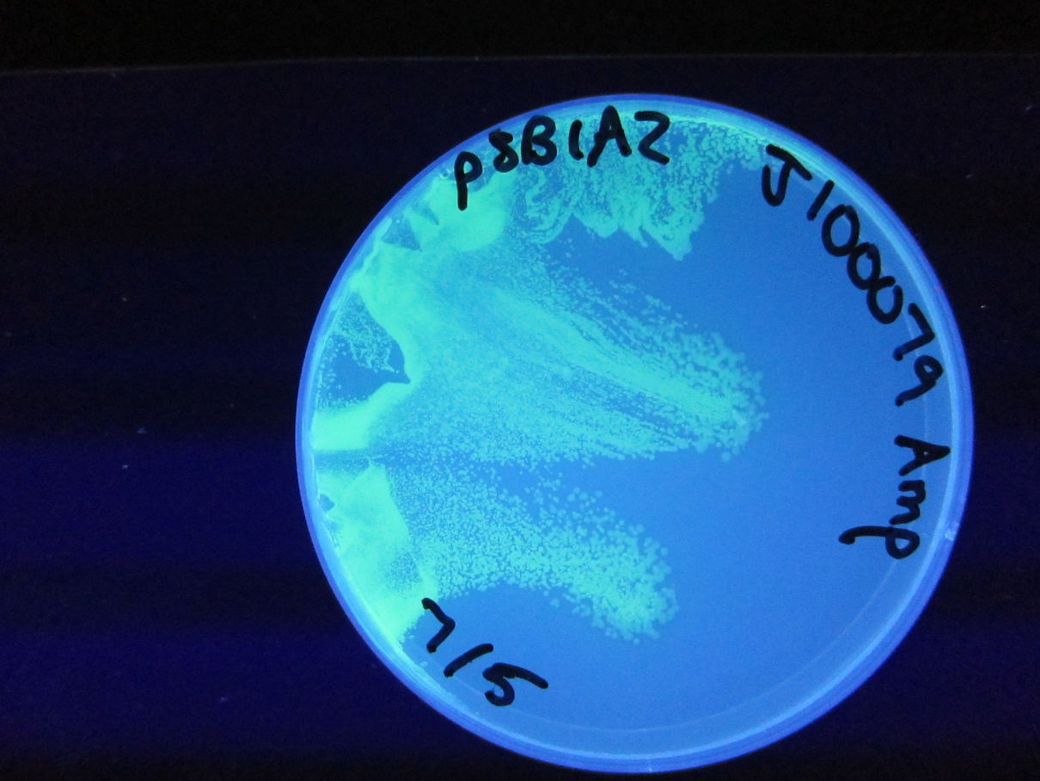
J100079 in pSB1A2 + Theo

Slide 3
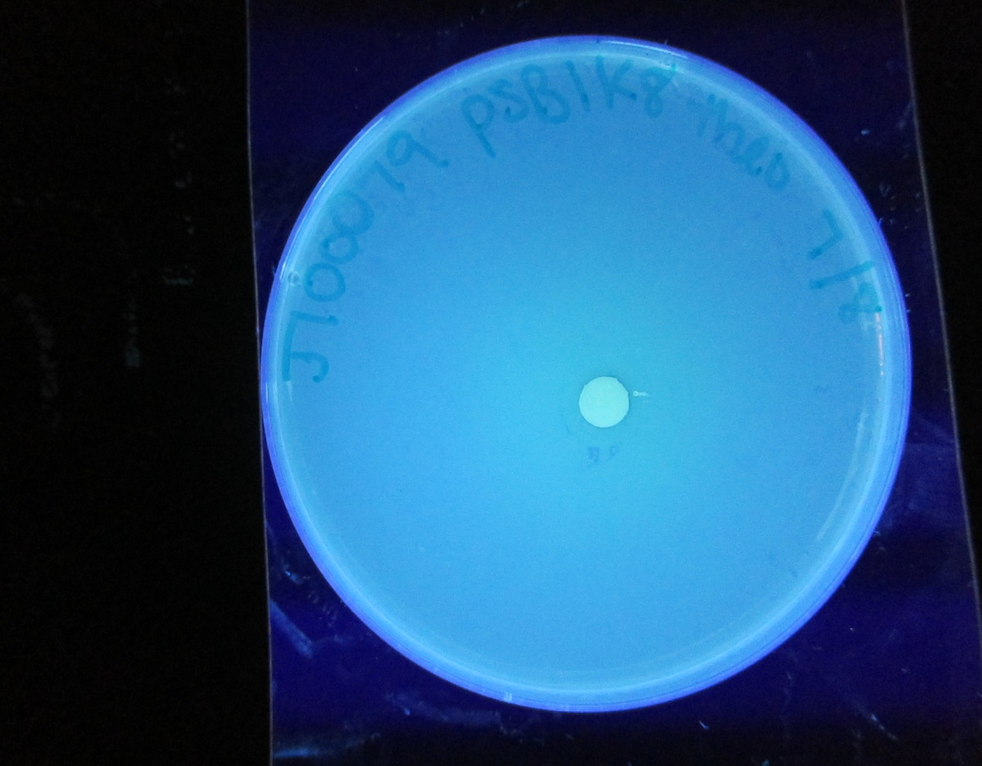
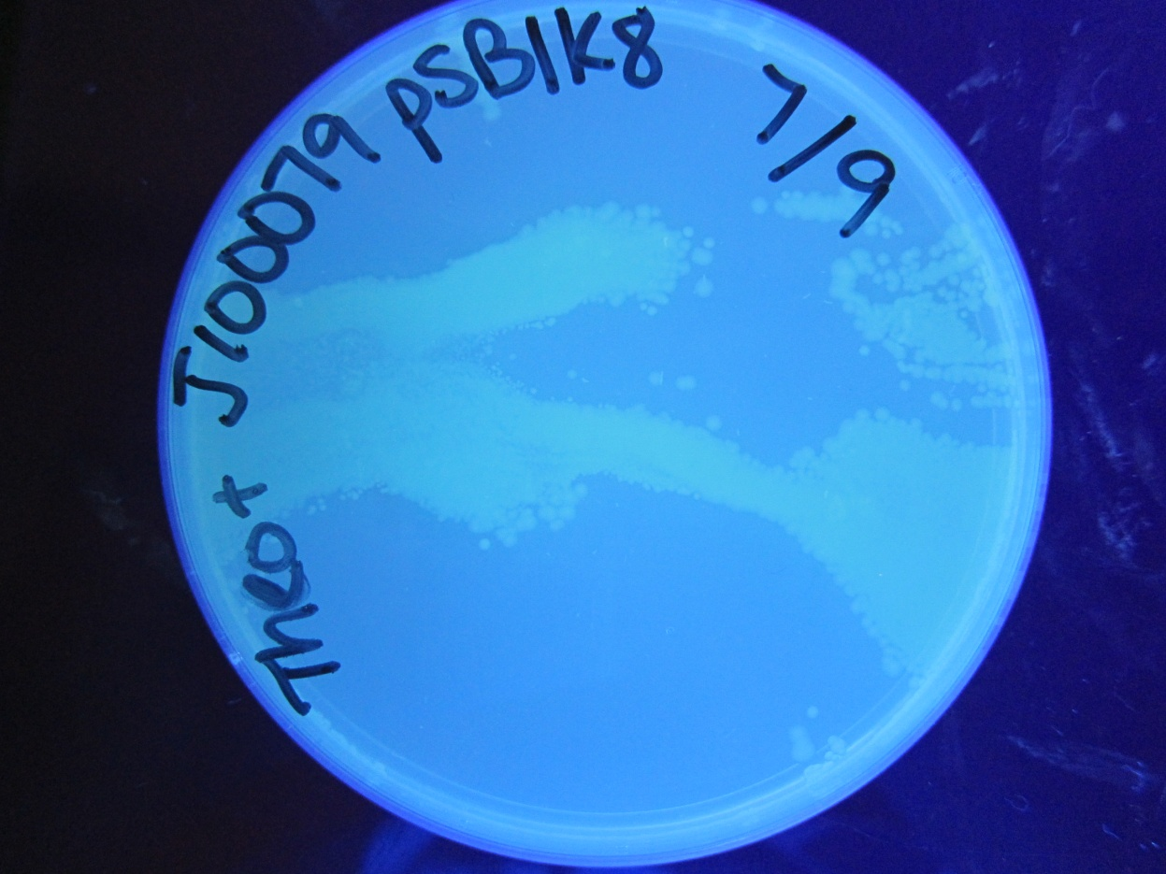
J100079 in pSB1K8 + Theo

Slide 4
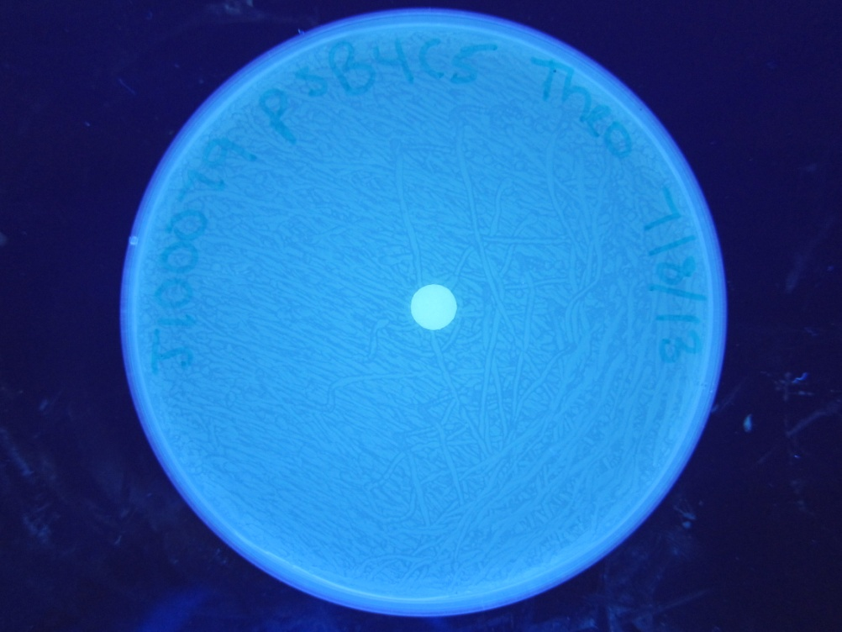
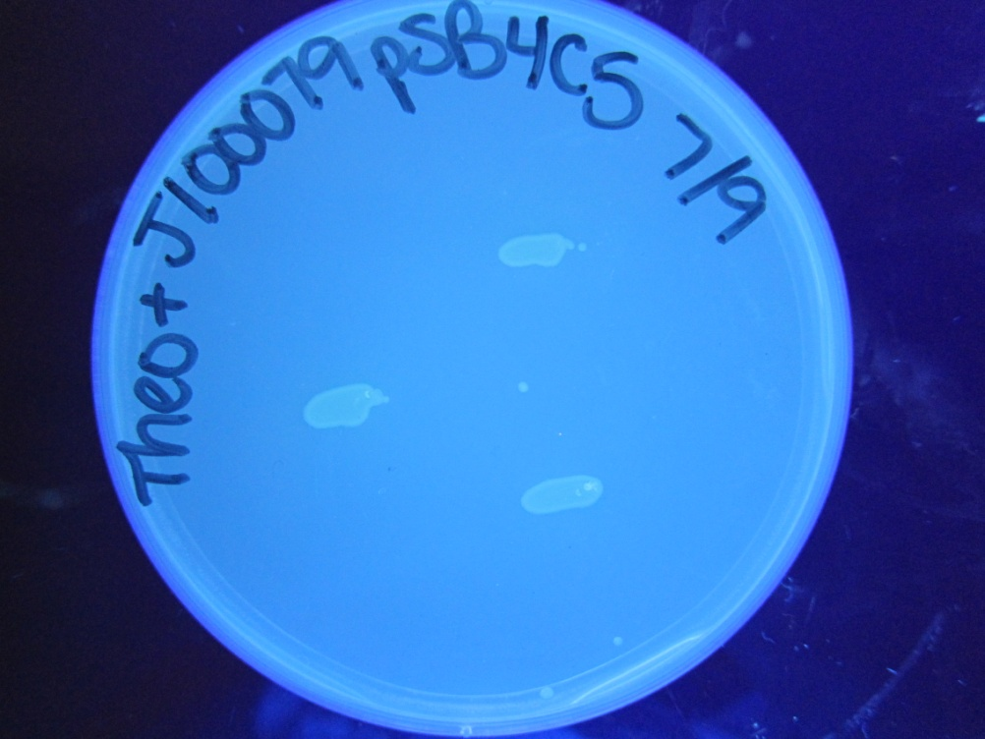
J100079 in pSB4C5 + Theo

Slide 5
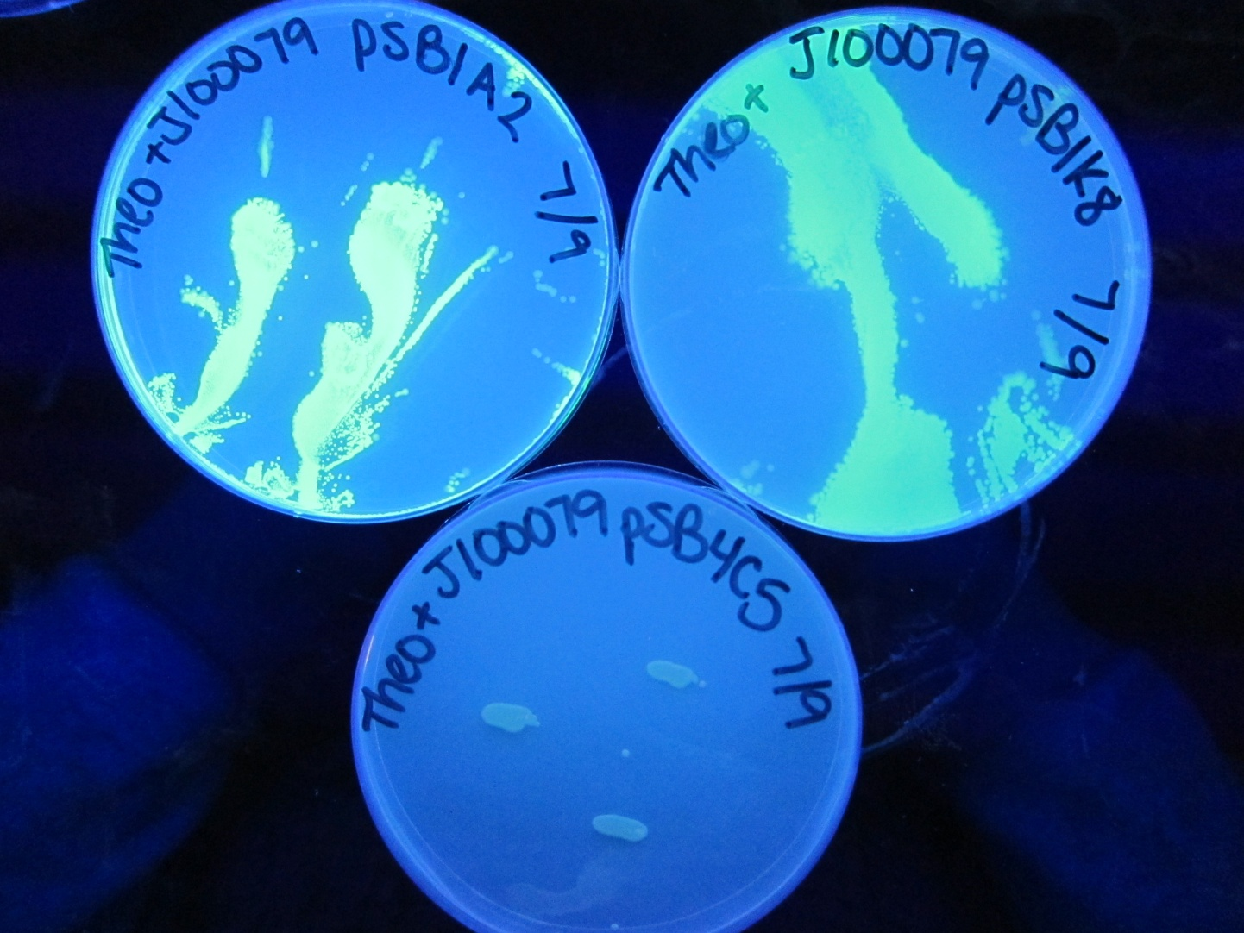
Side-by-side Comparison 7/12/13

Slide 6
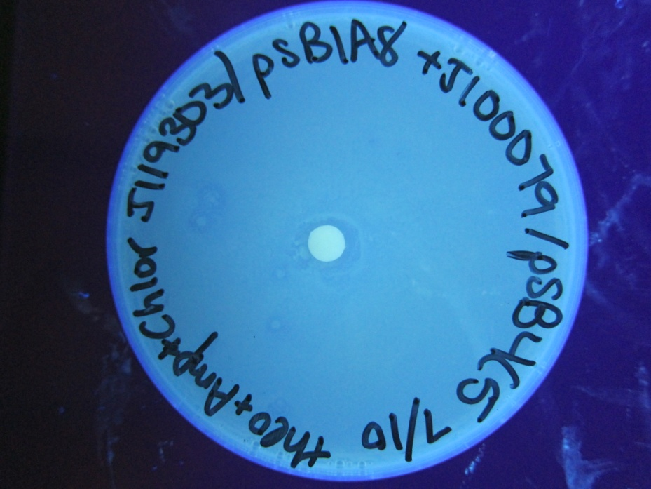
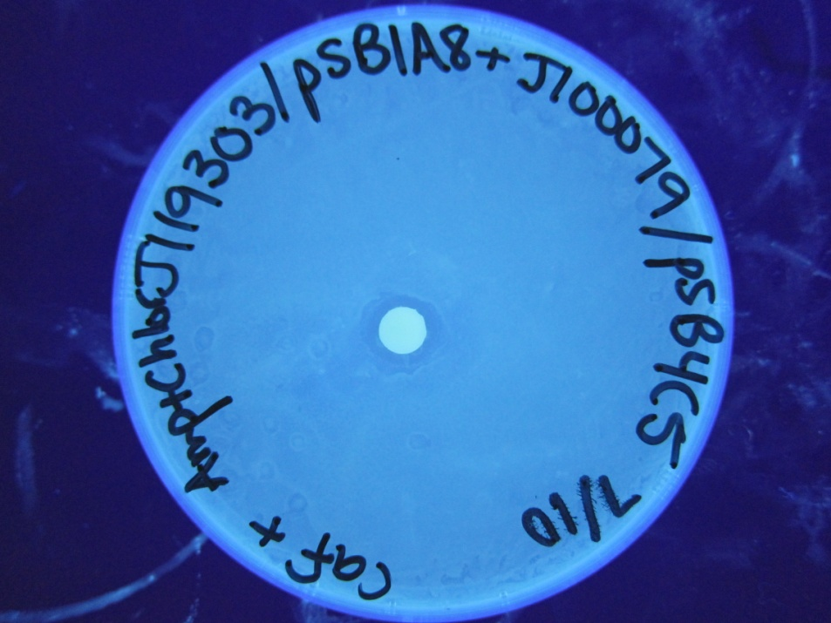
Old transformations→ J119303/pSB1A8+J100079/pSB4C5

Slide 7
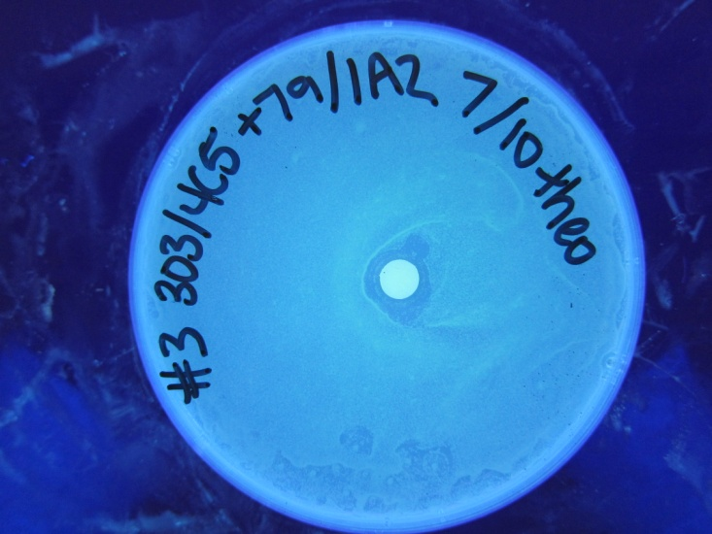
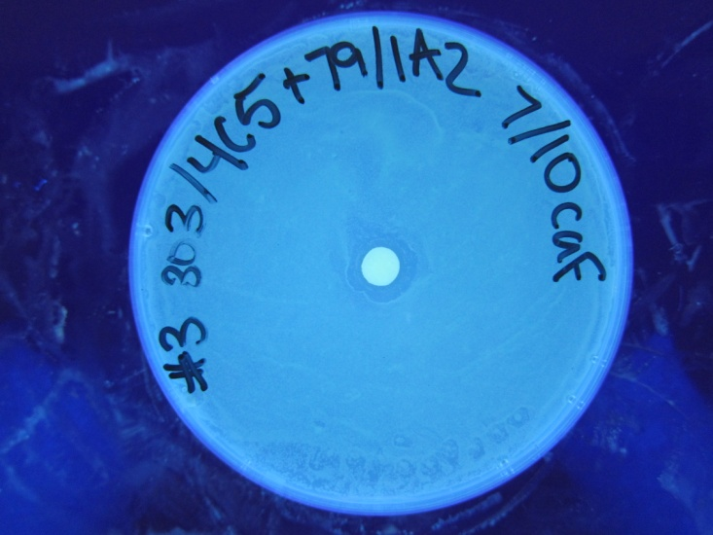
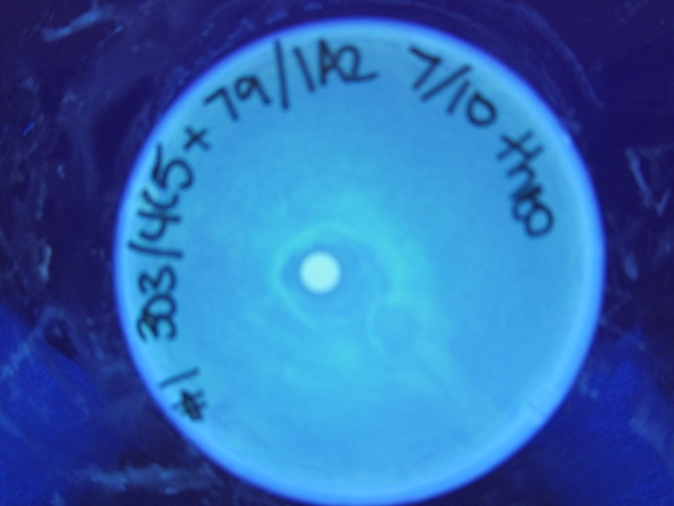
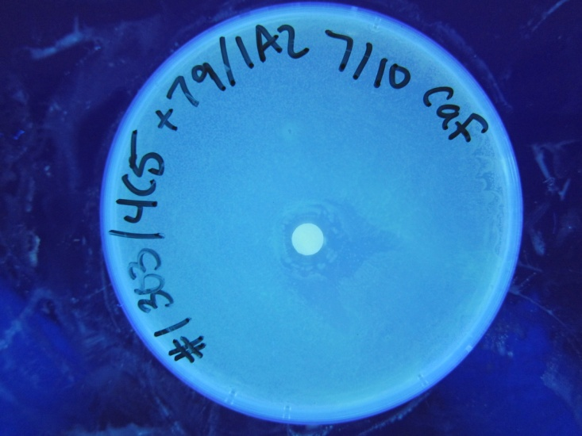
New co-transformation→ J119303/pSB4C5+J100079/pSB1A2

Slide 8
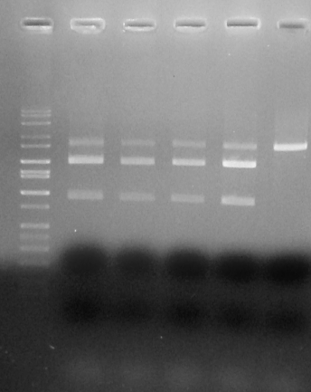
Gel from new Co-Transformations
Lane 1= Molecular Weight Mark
Lane 2= #1 303/4C5+79/1A2
Lane 3= #4 303/4C5+79/1A2
Lane 4= #5 303/4C5+79/1A2
Lane 5= #6 303/4C5+79/1A2
Lane 6= 3033/4C5 + Control
CDM→J119303=3274 bp
Biosensor→J100079=879 + 34 BBa_pre,suf= 913 bp
pSB4C5→3221 bp
pSB1A2→2079 bp
3,000
2,000
1,500
1,000
CDM/4C5
1A2
GFP

