Slide 1
Lab Meeting 10/25/2013
Catherine Doyle

Slide 2
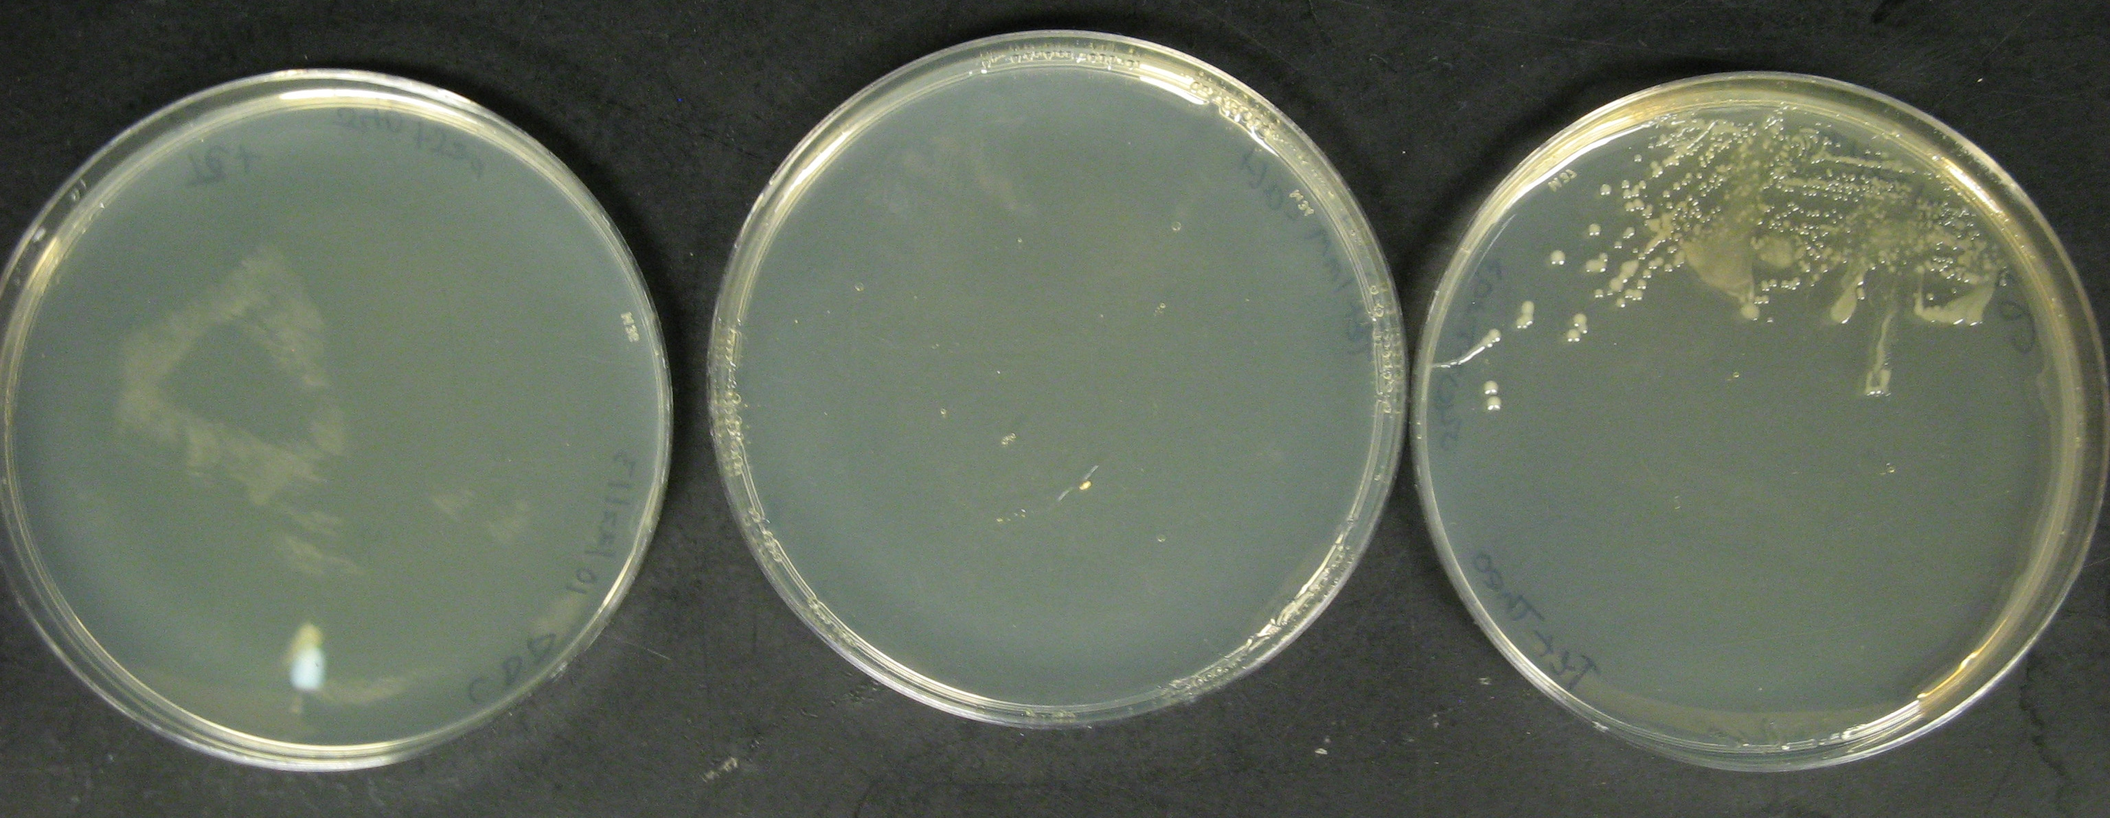
TET
TET + 1mMCaffeine
TET + 1mM Theophylline

Slide 3
c.Dog RBS
eCDM8
tetA
psB1A8
psB1A2
tetA
c.Dog RBS
eCDM8
psB1A8

Slide 4
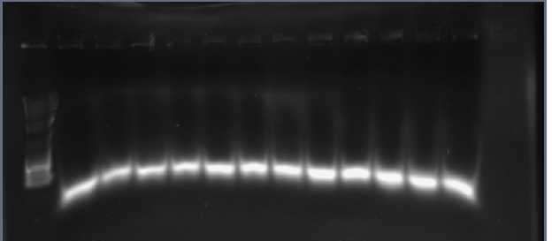
GGA Results
MW
1 2 3 4 5 6 7 8 9 10 C1 C2
Insert bp = 4100kb

Slide 5
Steps/Progress
Move tetA module to psb1A8
iPCR
GGA
Colony PCR
Verify through tetA resistance and PCR

Slide 6
Next Steps
Verify Insert
Finish program

