Slide 1
Coat Color in Vaccinium corymbosum
Aaron Deal
4-17-12

Slide 2
Background
Wax coat
Platelets and Rods = Color
β-diketones
pH and anthocyanins?
Extract and juice color

Slide 3
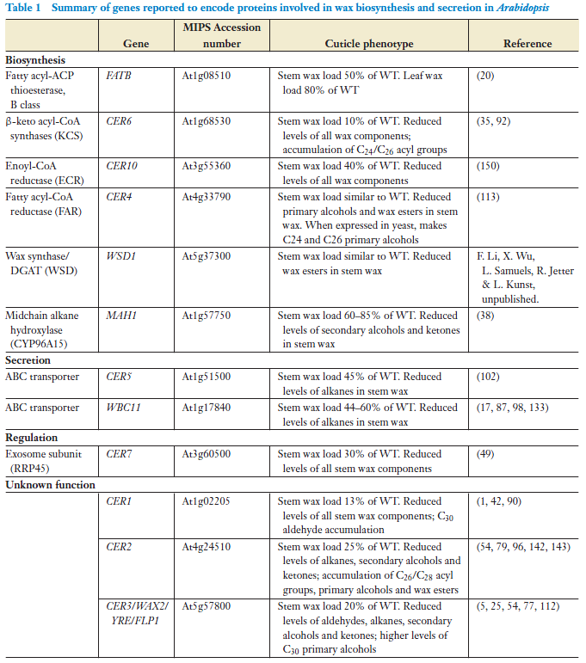
Target Gene Selection
Orthologs in Arabidopsis
FATB—role in both stem and leaf wax
CER6— central step for ketone and wax ester synthesis (see next slide)
WSD—cannot ignore a name like that!
MAH1—ketone synthesis (see following two slides)
WBCII—transporter. Involved in wax secretion instead of synthesis (like other 4 targets)

Slide 4
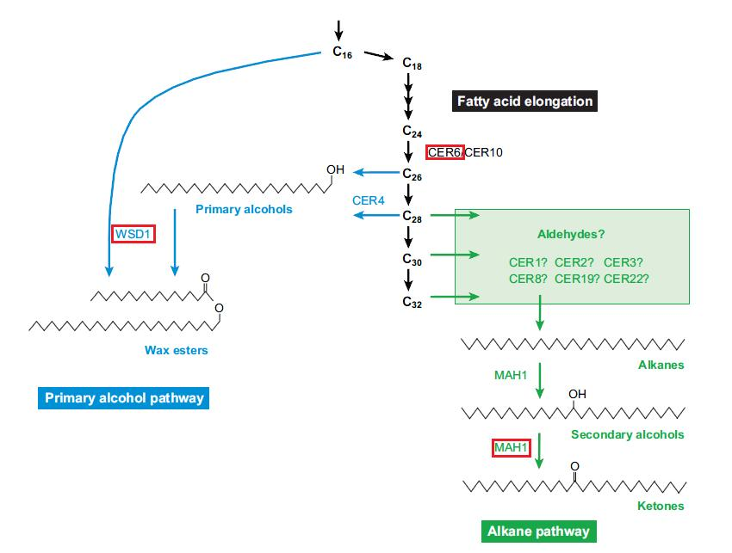

Slide 5
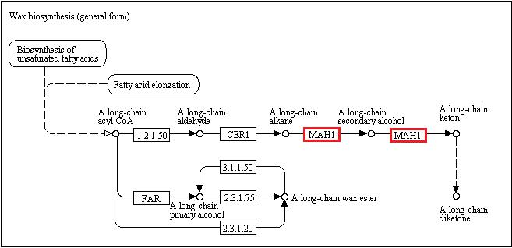

Slide 6
Scaffold Search
FASTA of Arabidopsis gene → tBLASTx against Vaccinium scaffold database → Top few hits were recorded based on E value
Results given as amino acid sequence alignments

Slide 7
Primers
Two pairs found for each scaffold (3’ and 5’)
WBCII – 2 Scaffolds
CER6 – 3 Scaffolds
WSD – 1 Scaffold
FATB – 1 Scaffold
MAH1 – 2 Scaffolds

Slide 8
ESTs
Begin with amino acid alignment of scaffold search → If no hits, use scaffold FASTA and search (tBLASTn) upstream of, and within, 3’ end
No ESTs for WSD or FATB
WBCII – 4 ESTs
CER6 – 1 EST
MAH1 – 2 ESTs

Slide 9
WBCII

Slide 10
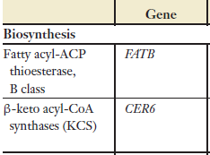
CER6

Slide 11
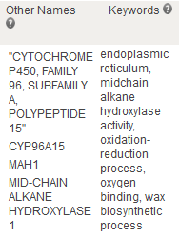
MAH1

Slide 12
New Scaffolds
Does the same EST appear in other scaffolds?
tBLASTx EST against scaffold database
All ESTs (except 1) returned the “parent” scaffold as well as new scaffolds
High number of new scaffolds for WBCII EST (likely the result of such a large family of transporter proteins)

Slide 13
WBCII
EST DR067855: 00004; 00495; 01882; 00012; 07909; 00779; 00714; 11598; 00355; 02244; 00809; 02234; 00126; 00350; 02006; 01110; 00282; 00742; 01812; 00045; 08837; 00332; 02508; 00913; 00507; 00118; 02687; 00560; 00214; 01191; 01030; 01994; 00365; 00781; 00630; 00040; 01209; 01838; 00881; 10517; 00227; 00262; 00504; 00927; 01770; 00038; 00368; 03502
EST CV190423: 00560; 09668; 01965; 01191; 00913; 00896; 00263; 00227; 01994; 00040; 00365; 00087
EST CF811331: 00779; 00809; 00355; 00714; 02006; 11598; 00004; 07909; 00495; 08837; 02234; 00012; 01882; 00045; 00126; 00350; 01110; 02244; 01812; 02508; 00282; 00742; 00332; 00913; 00507; 00118; 02687; 01030; 00560; 00214; 01191; 00365; 00781; 00630; 01838; 10517; 00227; 00881; 01209
EST DR067166: 00087; 00040; 01994; 00365; 00227; 02687; 00504; 00560; 00118; 09668; 01965; 01030; 00131; 00507; 00116; 01016; 00555; 00913

Slide 14
CER6
EST CF811643: 00137; 00431; 00133; 01322; 02309; 03134
Scaffold 00268 also generated this EST but was not returned by the EST tBLASTx

Slide 15
MAH1
EST DR066987: 00314; 01091; 04227; 09505; 00112; 00236; 00254; 00277
EST CV090972: 00236; 00730; 01607; 00254

