Slide 1
Lab Meeting
09/27/13

Slide 2
Program Update
Unafold arrived
Need to install g77 complier

Slide 3
Theophylline Detection Results

Slide 4
How much Theophylline do cells need to grow on plates?
Test growth at 0.4, 0.2, 0.1, 0.05, 0.0 mM of Theophylline
Look for visible GFP expression

Slide 5
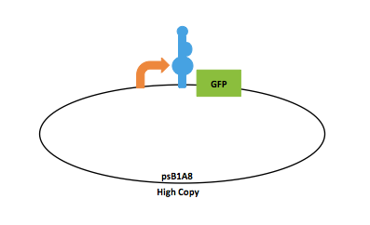

psB1A2
High copy
Grow o/n @ 37C
LB + Amp

Slide 6

Colony streak culture onto plates
LB + Amp
0.4mM Theo
100ug/ml Amp
0.2mM Theo
100ug/ml Amp
0.1mM Theo
100ug/ml Amp
0.05mM Theo
100ug/ml Amp
0.0mM Theo
100ug/ml Amp
Grow o/n @ 37C
Notes:
Looking gfp

Slide 7
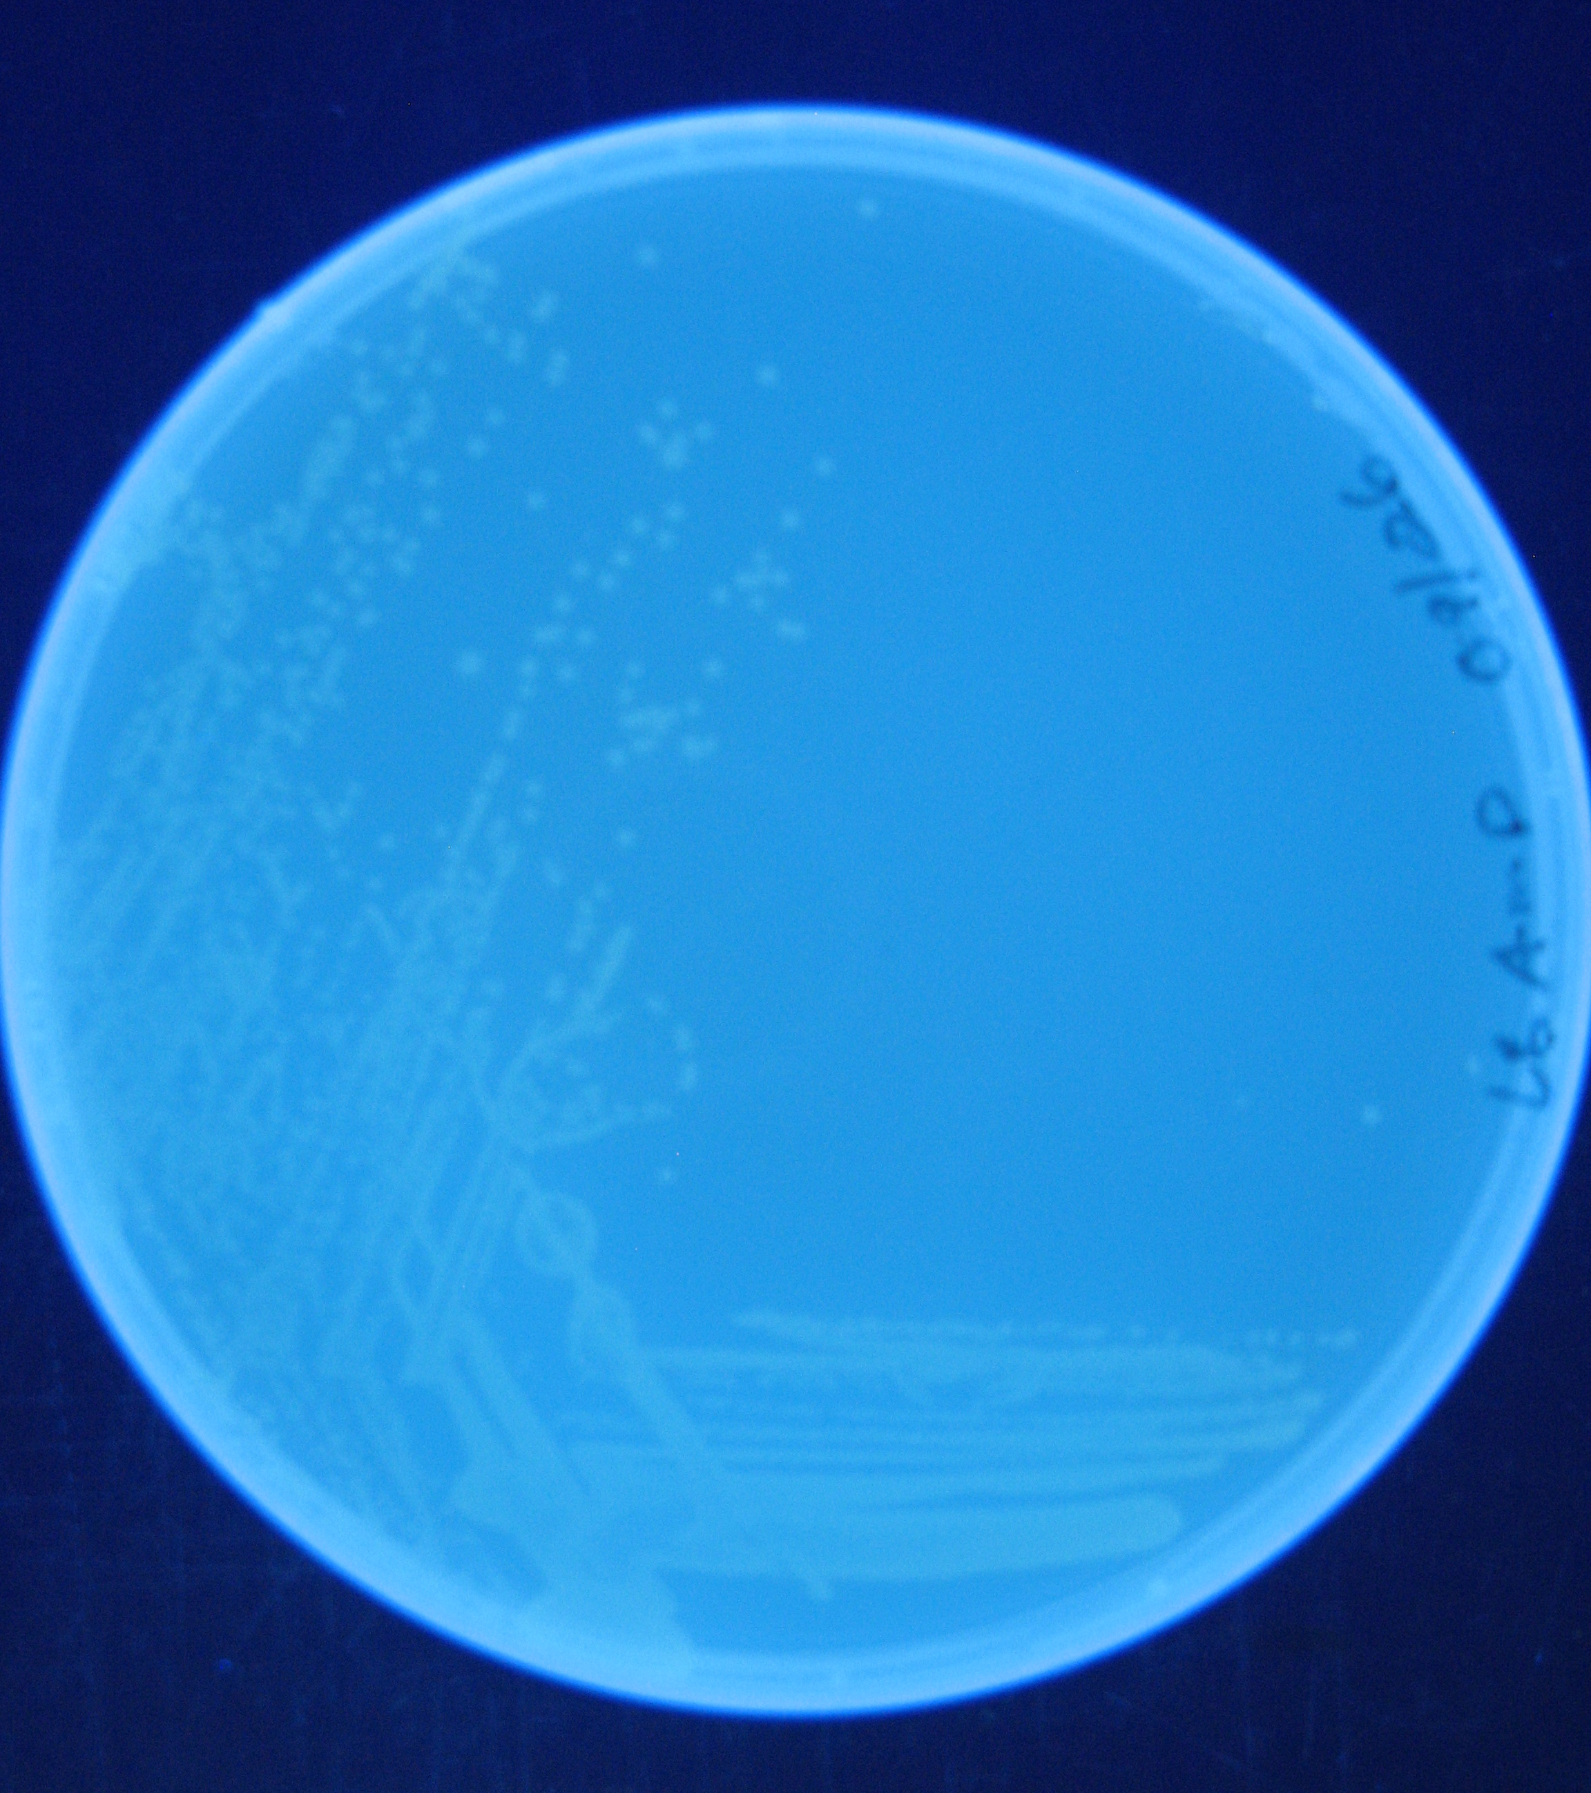
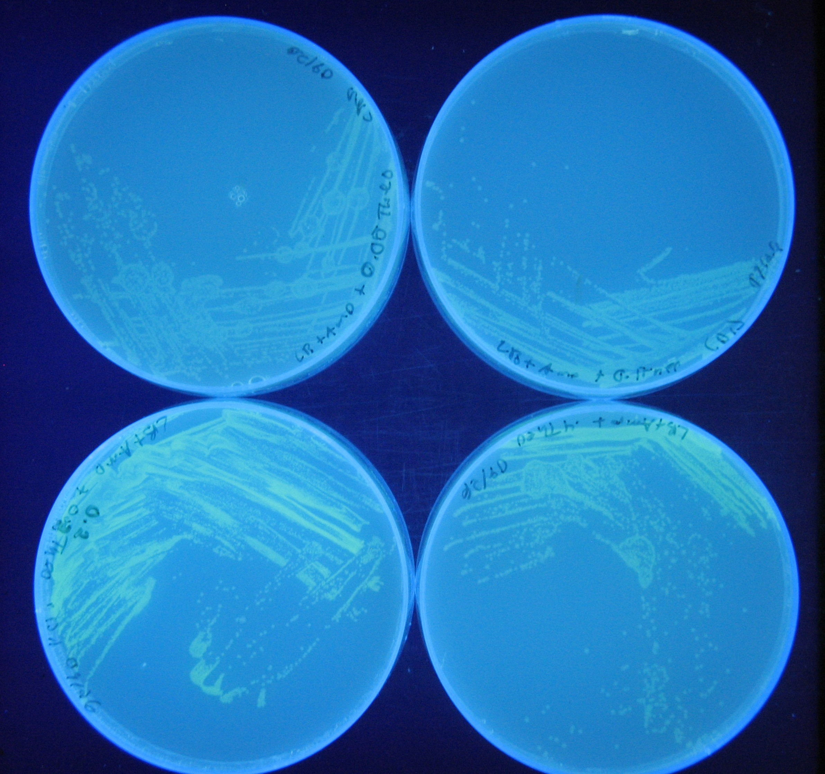
0.0mM Theophylline
0.05mM Theophylline
0.1mM Theophylline
0.2mM Theophylline
0.4mM Theophylline

Slide 8
How much Theophylline do cells need to grow with a fixed amount of tetA?
Test growth at 0.4, 0.2, 0.1, 0.05, and 0.0 mM of Theophylline
Also, test growth with 10ug/mL of tetA +/- Amp
Looking for visible growth

Slide 9
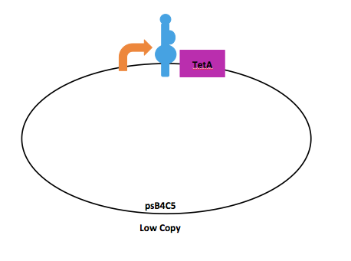
psB1A2
High copy
Grow o/n @ 37C
LB + AMP + Theophylline

Slide 10
Colony streak culture onto plates
LB + Amp + Theophylline
0.4mM Theo
100ug/ml Amp
10mg/ml tetA
0.2mM Theo
100ug/ml Amp
10mg/ml tetA
0.1mM Theo
100ug/ml Amp
10mg/ml tetA
0.05mM Theo
100ug/ml Amp
10mg/ml tetA
0.0mM Theo
100ug/ml Amp
10mg/ml tetA

Slide 11
Colony streak culture onto plates
LB + Amp + Theophylline
0.4mM Theo
10mg/ml tetA
0.2mM Theo
10mg/ml tetA
0.1mM Theo
10mg/ml tetA
0.05mM Theo
10mg/ml tetA
0.0mM Theo
10mg/ml tetA

Slide 12
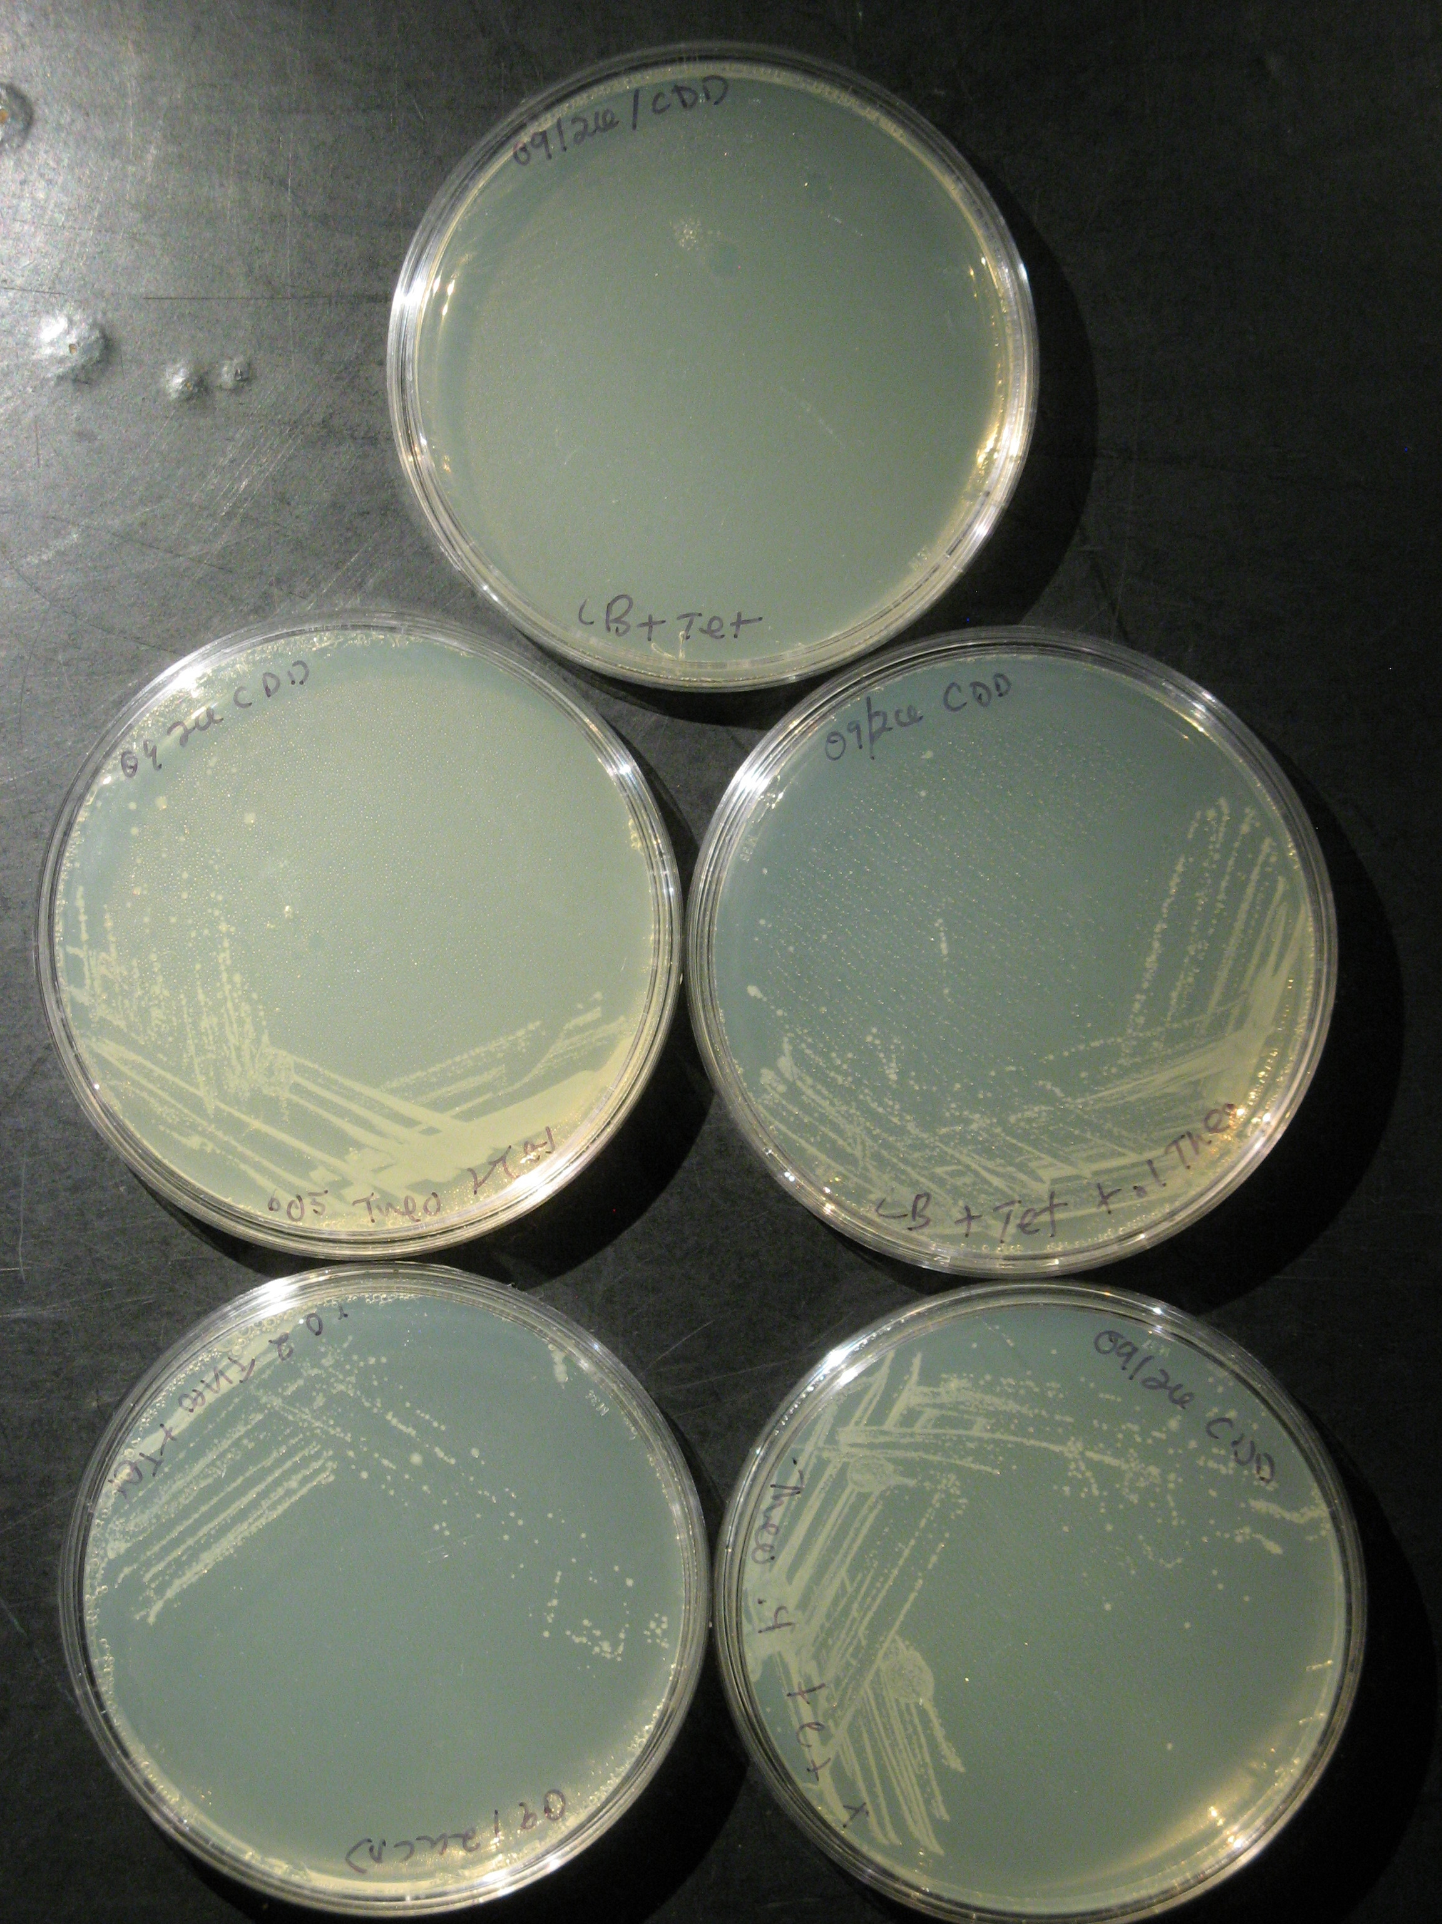
LB+TetA
0.0mM Theophylline
0.05mM Theophylline
0.1mM Theophylline
0.2mM Theophylline
0.4mM Theophylline

Slide 13
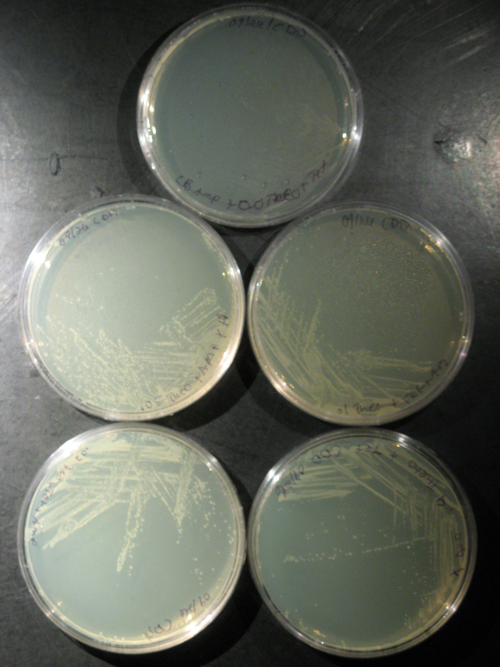
LB+AMP+TetA
0.0mM Theophylline
0.05mM Theophylline
0.1mM Theophylline
0.2mM Theophylline
0.4mM Theophylline

Slide 14
Conclusions
Cell expression of the reporter gene is robust in the presence of the theophylline
Therefore, ecdM8 is likely not being translated
Gst9 cloning a potential solution

Slide 15
Future Work
Finish Program
Develop 10 minute Preview Presentation
Start Evolution Experiment

