Slide 1
Ammeline Stuff
Winter and Spring 2014

Slide 2
Melamine deaminase coverts melamine into ammeline
Melamine is a common industrial chemical contaminant which should be absent from food and feed supplies due to melamine's toxicity. Read more: http://www.faqs.org/patents/app/20110008809#ixzz2lgh3EBFc
The enzyme removes two of the three amino groups from melamine, converting it successively to ammeline and ammelide. Formation of ammelide was much less effective, 15-fold slower than that of ammeline [Seffernick01].

Slide 3
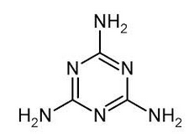
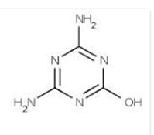
Melamine
Ammeline

Slide 4
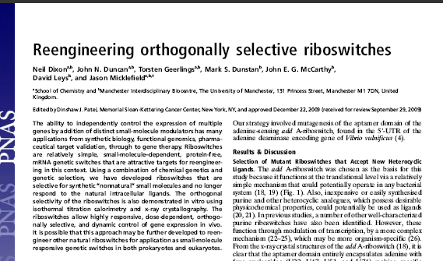

Slide 5
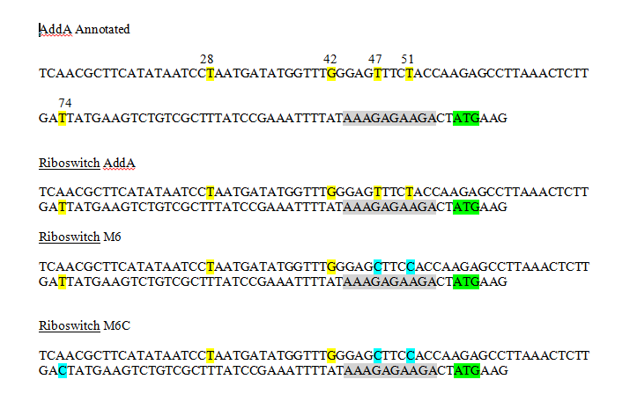

Slide 6
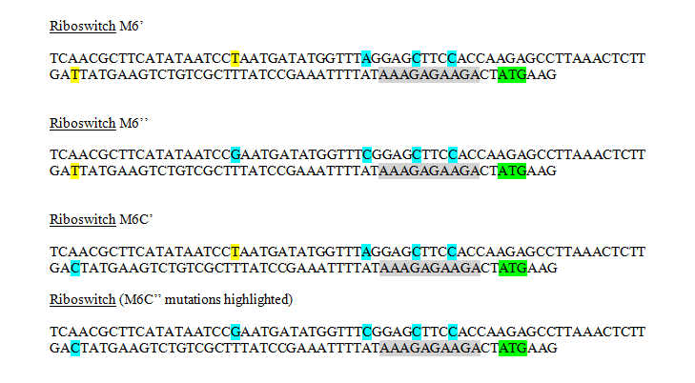

Slide 9
 |  | 7 | 8 | 9 | 10 | Ratio
J329 | A | 10609.74 | 12537.73 | 14760.97 | 16147.19 | 1.34
J331 | B | 9089.437 | 6664.247 | 7363.192 | 8347.812 | 1.00
J332 | C | 2412.019 | 3018.433 | 3072.481 | 3054.139 | 1.13
J333 | D | 9038.493 | 10502.51 | 15278.12 | 17952.15 | 1.70
J334 | E | 6559.626 | 9323.25 | 9154.15 | 13692.21 | 1.44
J335 | F | 2335.025 | 2840.359 | 4626.469 | 7957.378 | 2.43
J336 | G | 5107.558 | 5048.139 | 5099.409 | 7960.384 | 1.29
J337 | H | 1613.872 | 3809.175 | 2204.276 | 3246.691 | 1.01

Slide 10
E1 | E2 | E3 | E4 | NaOH | E5 | E6 | E7 | E8 | Thy | E9 | E10 | E11 | E12 | Amm
0.15 | 0.156 | 0.155 | 0.169 | 0.1575 | 0.155 | 0.149 | 0.178 | 0.158 | 0.16 | 0.155 | 0.217 | 0.225 | 0.153 | 0.1875
0.148 | 0.151 | 0.153 | 0.163 | 0.15375 | 0.151 | 0.148 | 0.172 | 0.152 | 0.15575 | 0.15 | 0.211 | 0.226 | 0.153 | 0.185
0.159 | 0.166 | 0.169 | 0.178 | 0.168 | 0.168 | 0.162 | 0.182 | 0.165 | 0.16925 | 0.159 | 0.222 | 0.242 | 0.165 | 0.197
0.203 | 0.211 | 0.22 | 0.228 | 0.2155 | 0.22 | 0.199 | 0.216 | 0.211 | 0.2115 | 0.181 | 0.267 | 0.296 | 0.199 | 0.23575
0.308 | 0.298 | 0.31 | 0.315 | 0.30775 | 0.308 | 0.272 | 0.291 | 0.311 | 0.2955 | 0.225 | 0.355 | 0.399 | 0.252 | 0.30775
0.364 | 0.433 | 0.45 | 0.448 | 0.42375 | 0.448 | 0.391 | 0.399 | 0.473 | 0.42775 | 0.304 | 0.488 | 0.52 | 0.353 | 0.41625
0.514 | 0.599 | 0.594 | 0.602 | 0.57725 | 0.616 | 0.534 | 0.555 | 0.639 | 0.586 | 0.453 | 0.645 | 0.665 | 0.527 | 0.5725
0.658 | 0.768 | 0.724 | 0.746 | 0.724 | 0.784 | 0.627 | 0.721 | 0.808 | 0.735 | 0.625 | 0.813 | 0.797 | 0.69 | 0.73125
0.76 | 0.915 | 0.825 | 0.869 | 0.84225 | 0.885 | 0.738 | 0.827 | 0.941 | 0.84775 | 0.743 | 0.948 | 0.891 | 0.795 | 0.84425
0.847 | 1.037 | 0.918 | 0.983 | 0.94625 | 0.964 | 0.815 | 0.924 | 1.059 | 0.9405 | 0.846 | 1.086 | 0.96 | 0.893 | 0.94625
0.917 | 1.144 | 1.022 | 1.095 | 1.0445 | 1.019 | 0.886 | 1.004 | 1.153 | 1.0155 | 0.928 | 1.199 | 1.025 | 0.966 | 1.0295
0.988 | 1.231 | 1.118 | 1.178 | 1.12875 | 1.069 | 0.964 | 1.091 | 1.231 | 1.08875 | 1.01 | 1.315 | 1.072 | 1.039 | 1.109
1.028 | 1.321 | 1.205 | 1.253 | 1.20175 | 1.124 | 1.04 | 1.139 | 1.311 | 1.1535 | 1.044 | 1.39 | 1.117 | 1.062 | 1.15325
1.047 | 1.366 | 1.29 | 1.318 | 1.25525 | 1.143 | 1.118 | 1.139 | 1.359 | 1.18975 | 1.069 | 1.428 | 1.137 | 1.076 | 1.1775
1.027 | 1.415 | 1.323 | 1.354 | 1.27975 | 1.153 | 1.192 | 1.116 | 1.4 | 1.21525 | 1.081 | 1.447 | 1.165 | 1.058 | 1.18775
1.002 | 1.431 | 1.353 | 1.384 | 1.2925 | 1.131 | 1.226 | 1.098 | 1.422 | 1.21925 | 1.073 | 1.47 | 1.153 | 1.038 | 1.1835
0.981 | 1.431 | 1.39 | 1.398 | 1.3 | 1.12 | 1.25 | 1.084 | 1.428 | 1.2205 | 1.072 | 1.463 | 1.146 | 1.018 | 1.17475
0.964 | 1.436 | 1.41 | 1.407 | 1.30425 | 1.108 | 1.278 | 1.076 | 1.427 | 1.22225 | 1.077 | 1.464 | 1.138 | 0.999 | 1.1695
0.948 | 1.454 | 1.416 | 1.414 | 1.308 | 1.097 | 1.307 | 1.072 | 1.423 | 1.22475 | 1.068 | 1.46 | 1.14 | 0.982 | 1.1625
0.931 | 1.466 | 1.416 | 1.419 | 1.308 | 1.087 | 1.325 | 1.073 | 1.416 | 1.22525 | 1.053 | 1.46 | 1.153 | 0.978 | 1.161
0.918 | 1.481 | 1.416 | 1.429 | 1.311 | 1.078 | 1.337 | 1.06 | 1.407 | 1.2205 | 1.023 | 1.463 | 1.161 | 0.962 | 1.15225

Slide 13
