Slide 1
Lab Meeting 09/20/2013
Catherine Doyle

Slide 2
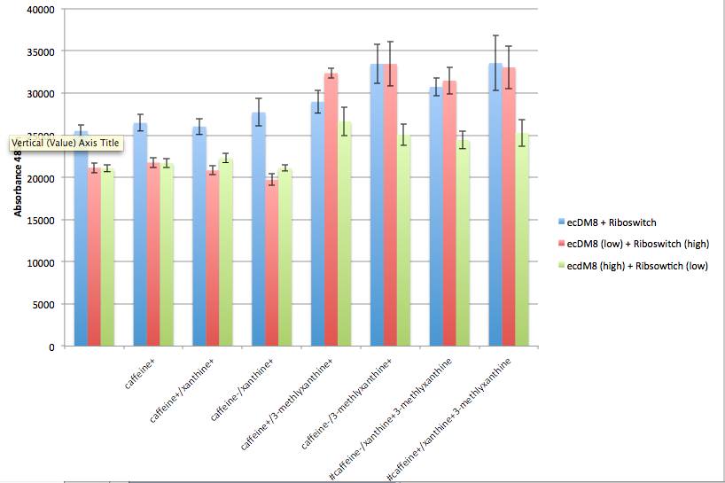
Caffeine Derivative Experiment Results

Slide 3
c.Dog RBS
eCDM8
GFP
psB1A8
High Copy

Slide 4
TetA
psB4C5
Low Copy

Slide 5
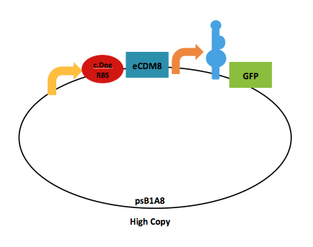
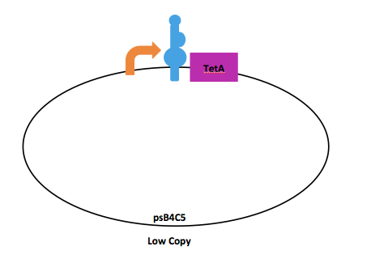

Slide 6
c.Dog RBS
eCDM8
GFP
psB1A8
High Copy

Slide 7
AdhE
psb4C5
High Copy

Slide 8
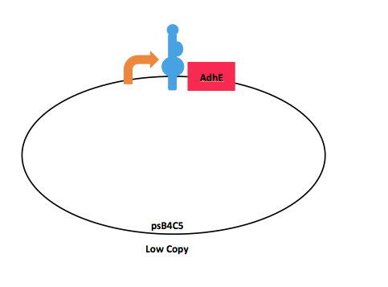

Slide 9
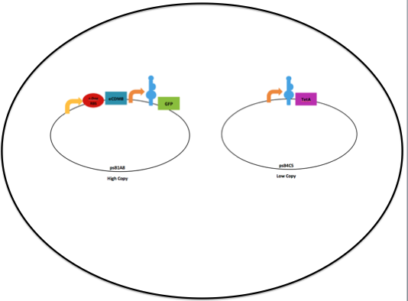
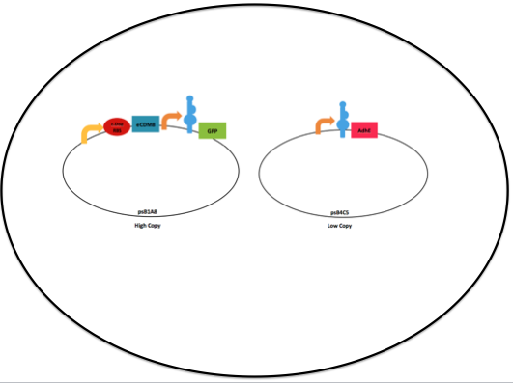
No AdhE- plasmid
No TetA gene
AdhE- cells
AdhE- cells
TetA added
No TetA added
TetA added
No TetA added

Slide 10
No AdhE- plasmid
No TetA gene
AdhE- cells
AdhE- cells
TetA added
No TetA added
TetA added
No TetA added
Grow at 37C O/N
Repeat for 36 Days:
Remove 100ul from each tube
200ul for Cell Density and GFP Expression
3X 100ul in 4.9ml of new LB
100ul on plate

Slide 11
No AdhE- plasmid
No TetA gene
AdhE- cells
AdhE- cells
TetA added
No TetA added
TetA added
No TetA added
Grow at 37C O/N
Repeat for 36 Days:
Remove 100ul from each tube
200ul for Cell Density and GFP Expression
3X 100ul in 4.9ml of new LB
100ul on plate
Increase TetA 0.005ul every three days
For plasmids with TetA resistance
(Will have to experimentally determine.

Slide 12
Ruling Out False Positives from TetA
Plate on LB Amp/Chlor
Plate on LB Amp/Chlor/TetA

Slide 13
Questions?
Whether we need a control where cells lacking tetA gene are treated the same way?
Whether we need a control where adhE-cells are lacking the adhE plasmid?
Is liquid better than plates?
Should we let them grow at 37C or room temperature?

