Slide 1
Plate Experiments

Slide 2
Procedure
J119140+J119303 (co-transformed tetracycline fitness module and eCDM8 gene), J119140+J1191304 (co-transformed tetracycline fitness module and eCDM8 gene), J100111 (tetracycline fitness module and eCDM8 on the same plasmid), and J119140 (tetracycline fitness module) were all grown on plates with the appropriate antibiotic based on resistance present in their plasmid, Tetracycline, and either a disc saturated in Caffeine or a disc saturate in Theophylline.

Slide 3
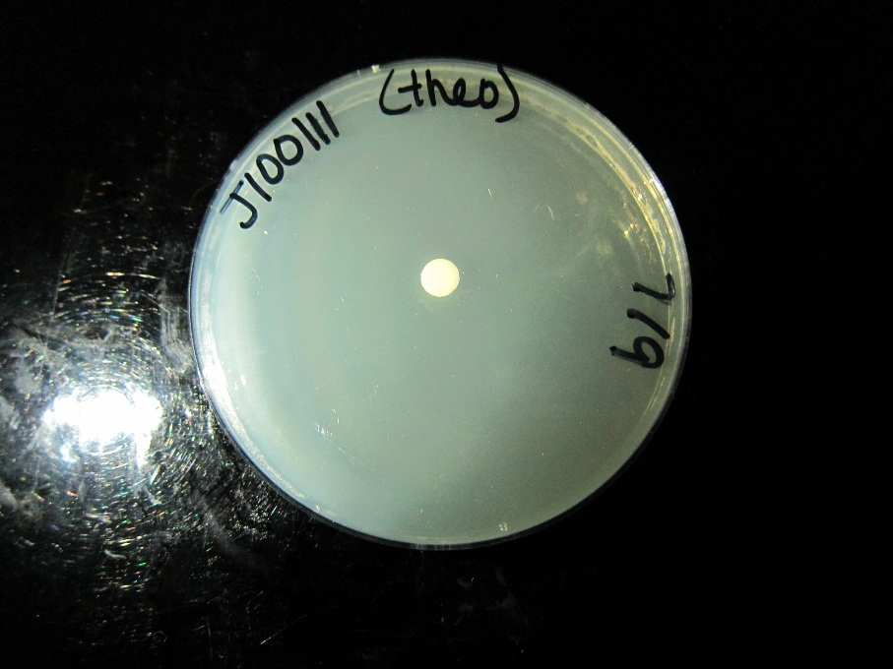
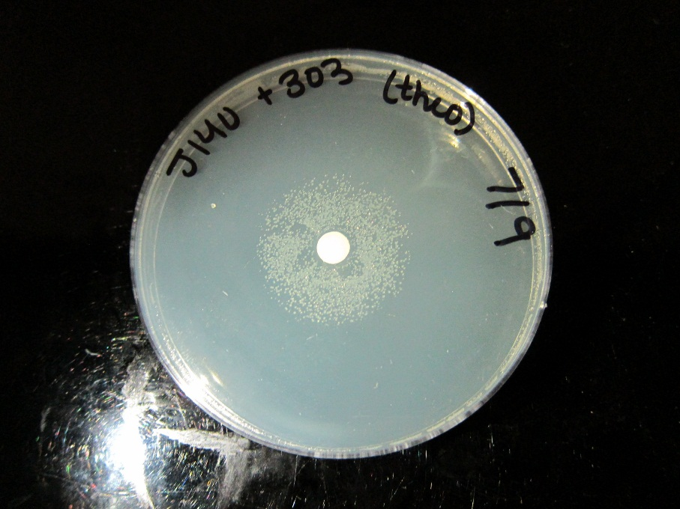
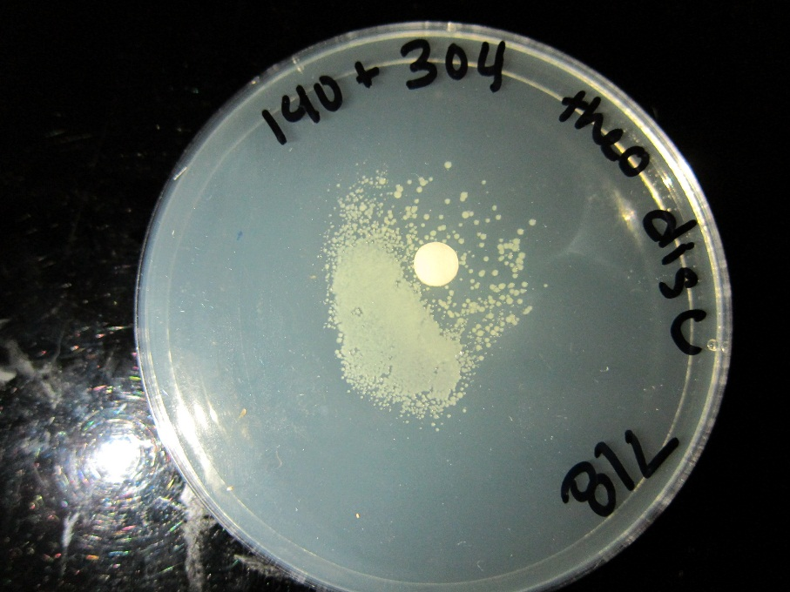
Results – Theophylline Disc
With the presence of a theophylline disc the co-transformed cells responded with growth around the Theophylline disc. This would be expected because the Theophylline would allow for transcription of the Tetracycline resistance gene. J100111 (which is the fitness module on the same plasmid as eCDM8) did not grow have any growth.

Slide 4
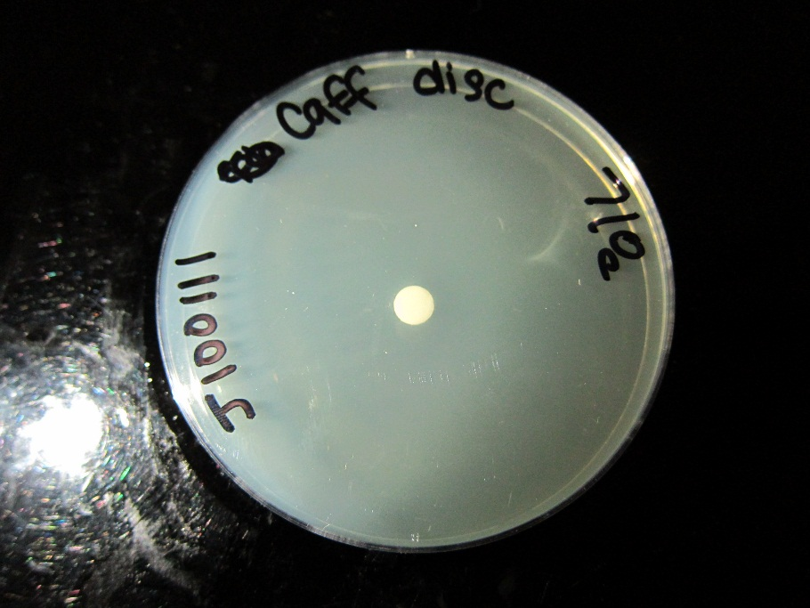
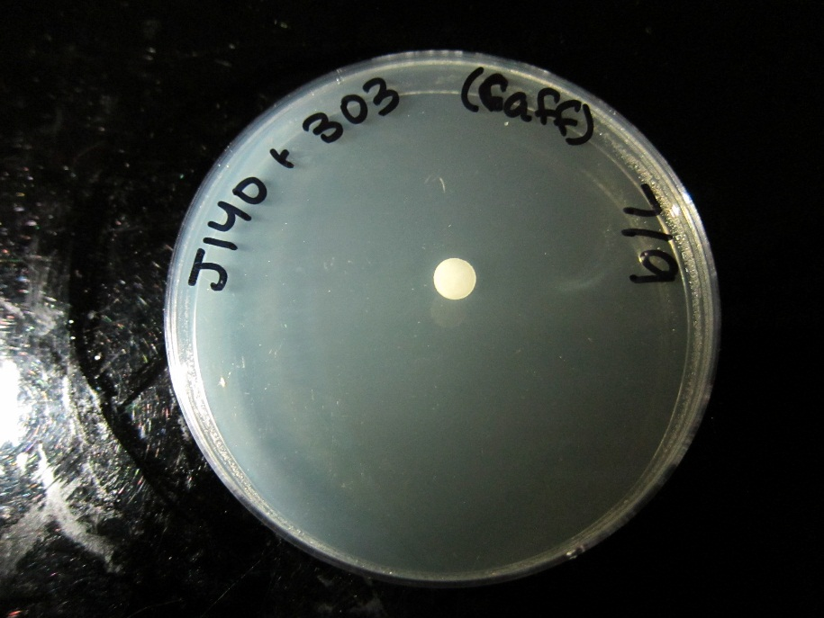
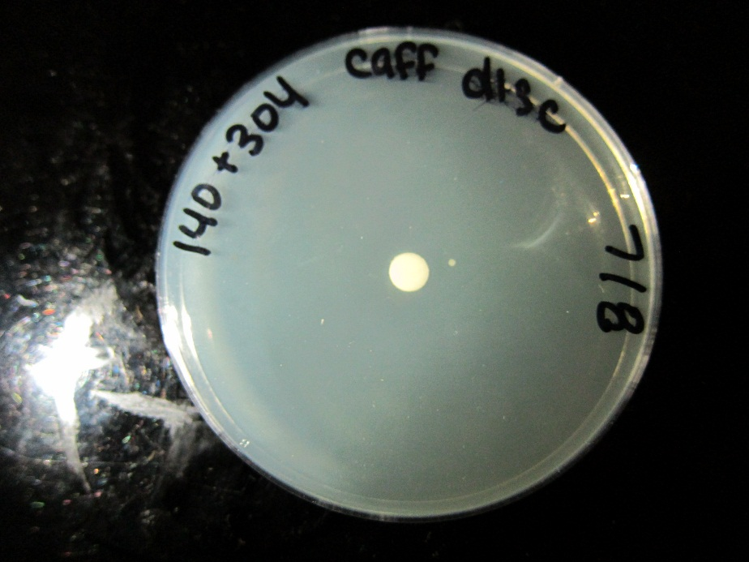
Results – Caffeine Disc
On the co-transformed cells containing J119140+J119304 there was one colony that formed. None of the other plates showed any growth response to the Caffeine disc. This shows that either Theophylline is either not present or there is some kind of problem preventing it to create Tetracycline resistance.

Slide 5
Possible error
Cells did not have prior exposure to Caffeine so they may not have had time to build up enough Tetracycline resistance before being killed by Tetracycline
J100111 did not grow under any conditions so there may be a problem with the cells we were using.

