Slide 1
Basic Molecular Cloning & Golden Gate Assembly

Slide 2
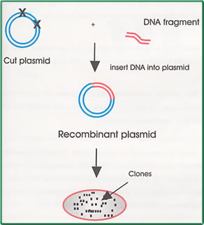
Basic Cloning

Slide 3
Restriction Enzymes
Proteins that cleave DNA molecules at specific sites, producing discrete fragments of DNA.
Isolates a single gene to place into a plasmid vector which will be expressed in the recombinant cell.
Type 1: complex random cuts within the DNA sequence
Type 2: specifically targets regions and cut in a relative close proximity of recognition sites

Slide 4
Ligation
Ligation is the process of joining two pieces of DNA from different sources together through the formation of a covalent bond.
DNA ligase is the enzyme used to catalyze this reaction.
DNA ligation requires ATP.

Slide 5
Transformation
After you create your new plasmid construct that contains your insert of interest , you will need to insert it into a bacterial host cell so that it can be replicated.
The transformed bacteria cells are grown on selective media (containing antibiotic) to select for cells that took up plasmid.

Slide 6
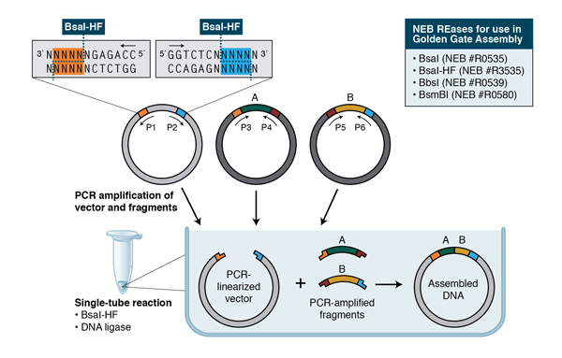
Golden Gate Assembly
The ability of type IIs restriction enzymes to produce 4 base pair sticky ends right next to their binding sites within one reaction.
Golden Gate Cloning is typically performed as an all-in-one-pot reaction. This means that all DNA parts, the type IIs restriction enzyme and a ligase are mixed in a PCR tube and put into a thermocycler.
The DNA parts get digested and ligated over and over again.

