Slide 1
Hidden Markov Models
Sean Callen
Joel Henningsen

Slide 2
Example
Discovering average yearly temperature at a particular location on Earth over a series of years using observed size of tree growth rings.
Possible states (hidden) – Hot (H) and Cold (C)
Possible observations – Small (S), Medium (M), and Large (L)
 | H | C
H | .7 | .3
C | .4 | .6
 | S | M | L
H | .1 | .4 | .5
C | .7 | .2 | .1

Slide 3
Notation
T = length of the observation sequence
N = number of states in the model
M = number of observation symbols
Q = {q₀, q₁, …, q_{N-1}} = distinct states of the Markov process
V = {0, 1, …, M-1} = set of possible observations
A = state transition probability matrix
B = observation probability matrix
π = initial state sequence
O = (O₀, O₁, …, O_{T-1}) = observation sequence

Slide 4
Example’s Notation
T = 4
N = 2
M = 3
Q = {H, C}
V = {0, 1, 2}, (0=S, 1=M, 2=L)
A = $\left[\begin{matrix}.7 & .3 \\ .4 & .6\end{matrix}\right]$
B = $\left[\begin{matrix}.1 & .4 & .5 \\ .7 & .2 & .1\end{matrix}\right]$
π = $\left[\begin{matrix}.6 & .4\end{matrix}\right]$
O = (0, 1, 0, 2)

Slide 5
The three problems
Given the model, find the probability of an observation sequence.
Given the model and an observation sequence, find the optimal state sequence.
Given an observation model, N, and M, determine a model to maximize the probability of O.

Slide 7
Problem 1
Finding the probability of an observation sequence.
1. Let α₀(i) = π_{i}b_{i}(O₀) for i = 0, 1, ..., N - 1
2. For t = 0, 1, ..., T - 1 and i = 0, 1, ..., N - 1; compute:
α_{t}(i) = [Σ (α_{t-1}(j) * a_{ji}) for j = 0 to j = N - 1] * b_{i}(O_{t})
3. P(O) = Σ (α_{T-1}(i)) for i = 0 to i = N - 1
Example: For O = (0, 1, 0, 2),
P(O) = .0096296
An observation sequence of small, medium, small, large has a probability of .96296%.

Slide 8
Problem 2
Finding the probability of a state sequence given an observation sequence.
X = {x₀, x₁, x₂, x₃}
O = (O₀, O₁, O₂, O₃)
P(X) = π_{x0}b_{x0}(O₀)a_{x0,x1}b_{x1}(O₁)a_{x1,x2}b_{x2}(O₂)a_{x2,x3}b_{x3}(O₃)
Let O = (0, 1, 0, 2)
P(HHCC) = .6(.1)(.7)(.4)(.3)(.7)(.6)(.1) = .000212

Slide 9
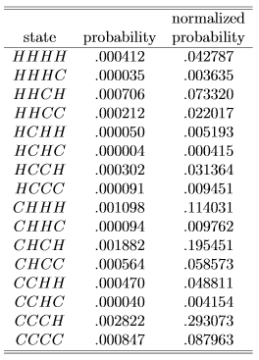
Problem 2
Finding the optimal state sequence.
To find the optimal state sequence, find the probability of having each element in each position by summing the normalized probabilities of states containing that element in that position. The optimal state sequence is contains the most probable element in each position. In this case the optimal state sequence is CHCH.

Slide 10
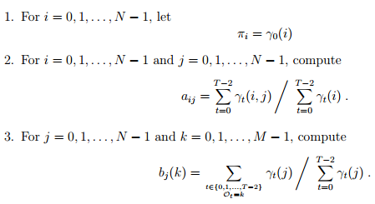
Problem 3
Given an observation sequence O and dimensions N and M, find an improved model, (A, B, π).
Initialize, λ = (A, B, π).
Compute α_{t}(i), β_{t}(i), γ_{t}(i, j) and γ_{t}(i).
Re-estimate the model λ = (A, B, π).
If P(O | λ) increases, goto 2.

