Slide 1
Boron
By: Brittany Elek and Thomas Pederson

Slide 2
Overview
Essential nutrient for plants
Warington study⁴
Deficiency
High rainfall & solubility of boric acid.
Inhibition of root elongation, leaf expansion, fruit sets.⁴
Decrease in crop yield and quality
Toxic at high levels
Necrotic leaves⁴

Slide 3
Uptake
Taken up as boric acid
Passive uptake
In normal conditions, boron concentration gradient is higher outside the plasma membrane.³
Boric acid can be passively diffused through the plasma membrane because it is an uncharged molecule.³

Slide 4
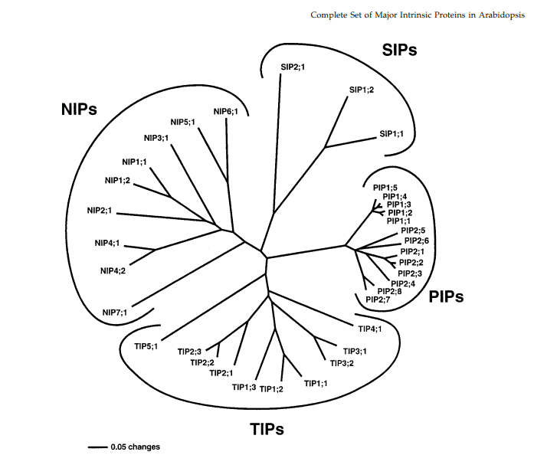
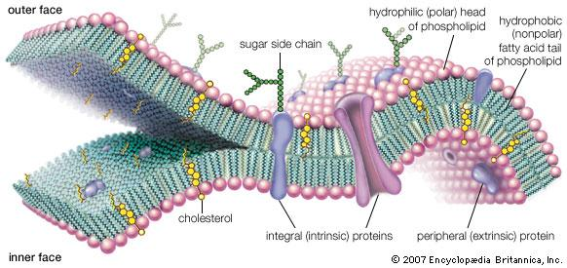
NIPs, PIPs, TIPs, and SIPs?
They’re MIPs (major intrinsic proteins)
Facilitate passive transport of polar (and nonpolar) molecules across membranes.¹
35 MIPs in Arabidopsis thaliana.¹
NIPs, PIPs, and boron.

Slide 5
Genes of Interest
Uptake genes
BOR1
NIP5;1
NIP6;1
Efflux genes
BOR4
BOT1

Slide 6
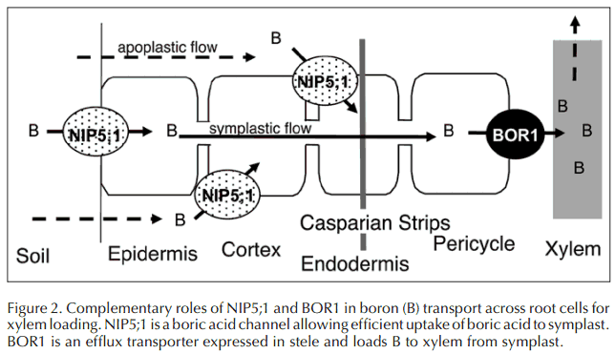
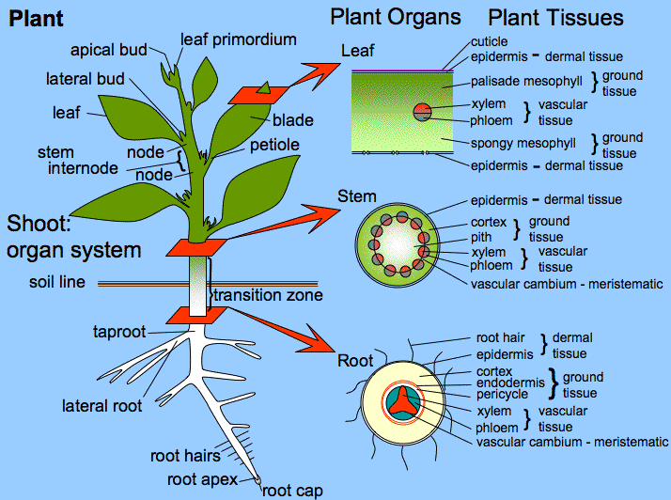
Boron Uptake Pathways
Channel mediated uptake
BOR1
Transports boron against the concentration gradient, borate exporter.^{[3]}
NIP5;1 vs. NIP6;1
Boric acid channels.³
http://4.bp.blogspot.com/_7MhVC-7dPGE/TN9780mstiI/AAAAAAAAAHA/PdhK6vh_yfg/s1600/Plantae+anatomy.gif

Slide 7
Boron Efflux Pathway
Endocytosis mediated efflux of BOR1
Occurs in toxic levels of boron.³
Expression of BOR4
Exports B from xylem into soil under toxic conditions.³
BOR1
BOR4
BOR4
Figure 3. Suspected role of BOR4 and BOR1 in boron (B) efflux . BOR4 is a paralog to BOR1 essential for (B) efflux, and BOR1 is endocytosed into the cell during efflux.
http://4.bp.blogspot.com/_7MhVC-7dPGE/TN9780mstiI/AAAAAAAAAHA/PdhK6vh_yfg/s1600/Plantae+anatomy.gif

Slide 8
Other Potential Genes
Uptake genes
NIP2;1- boron transporter found in rice.²
NIP3;1- ortholog to AtNIP5;1 found in rice.²
PIP2;3 and PIP2;7- found in rice, also thought to be expressed in Arabidopsis thaliana.²
Efflux genes
BOR2- ortholog to BOR4 found in barley and wheat.²
BOT1- homolog of BOR4 found barley.³

Slide 9
Sources
Works Cited
[1] Johanson, U. Et al (2001). The Complete Set of Genes Encoding Major Intrinsic Proteins in
Arabidopsis Provides a Framework for a New Nomenclature For Major Intrinsic Proteins in
Plants. Plant Physiology. (Vol. 126, pp. 1358-1369).
[2] Kumar, K. Et al (2013: May 28). Two rice plasma membrane intrinsic proteins, OsPIP2;4 and
OsPIP2;7, are involved in transport and providing tolerance to boron toxicity. Planta.
[3] Miwa, K. Et al (2010). Molecular Mechanisms of Boron Transport in Plants. Landes Bioscience.
[4] Tanaka, M., Fukiwara, Toru (2007: August 31). Physiological roles and transport mechanisms of
boron: perspectives from plants. Eur J Physiol.
Image sources
http://media-2.web.britannica.com/eb-media/74/53074-004-9F65D813.jpg
http://4.bp.blogspot.com/_7MhVC-7dPGE/TN9780mstiI/AAAAAAAAAHA/PdhK6vh_yfg/s1600/Plantae+anatomy.gif

