Slide 1
Lab Meeting
10-18-13

Slide 2
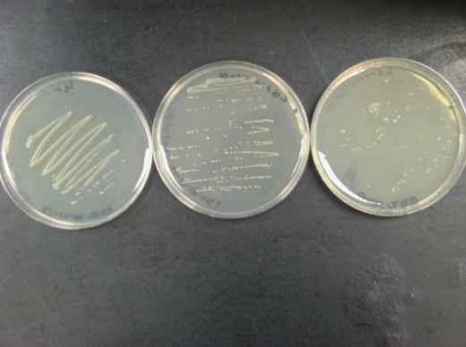
Results of Single Colony That Grew on Tet + Caffeine
Tet
Tet+ 0.1mM Caffeine
Tet+ 0.1mM Theophylline
Grown at 25C for 4 days

Slide 3
Results: ecdm8 + TetA
Tet
Tet+ 0.1mM Caffeine
Tet + 0.1mM Theophylline
Grown at 25C for 4 days

Slide 4
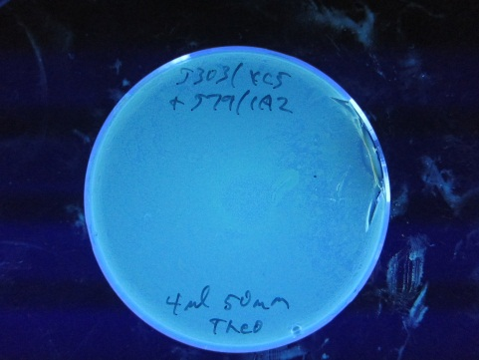
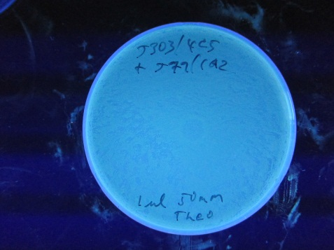
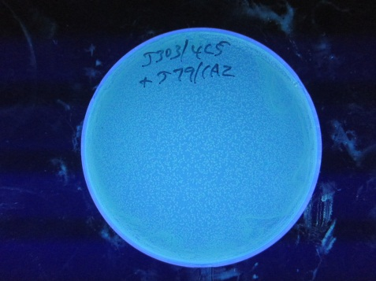
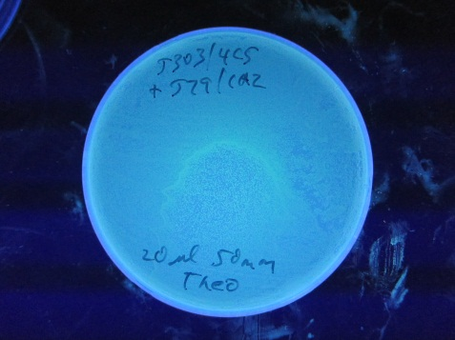
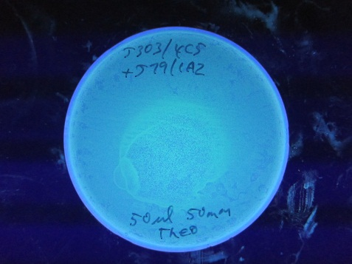
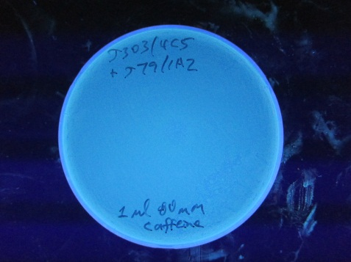
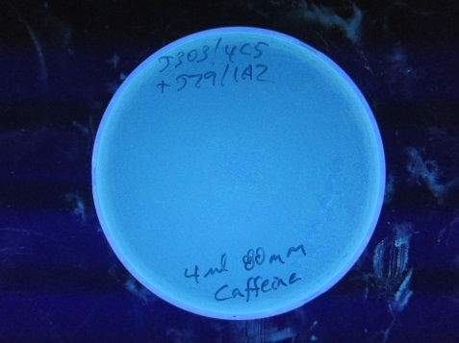
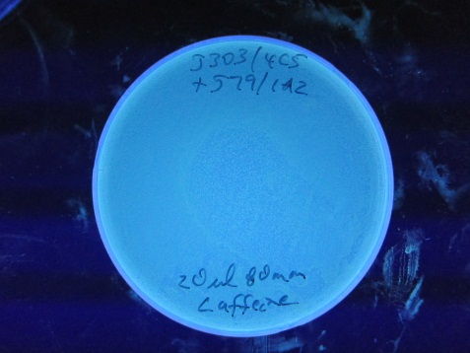
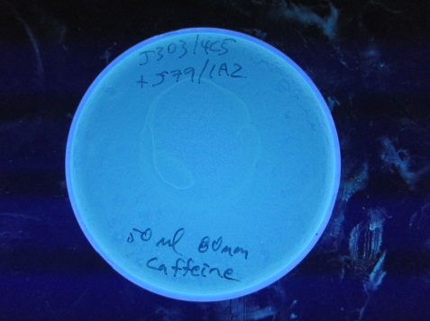
Drops of Theo or Caffeine on J303/4C5 + J79/1A2

Slide 5
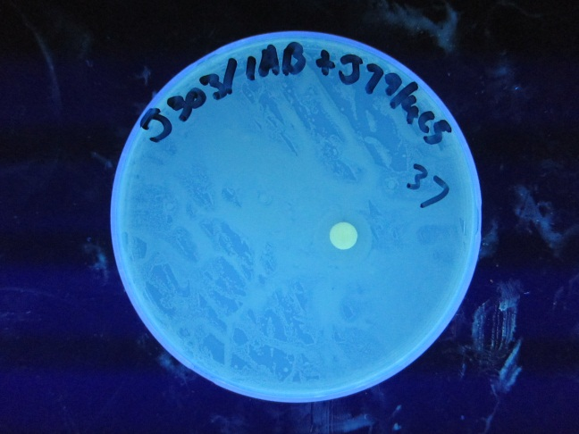
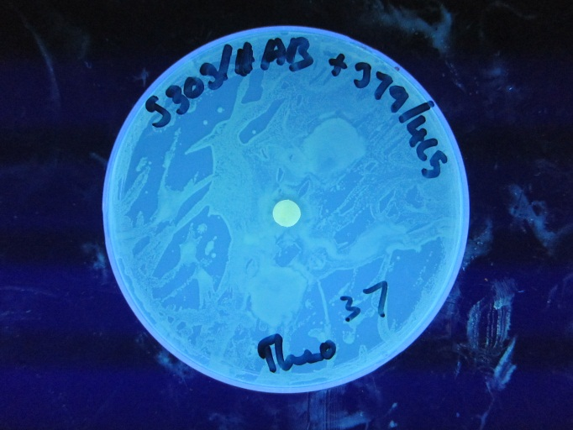
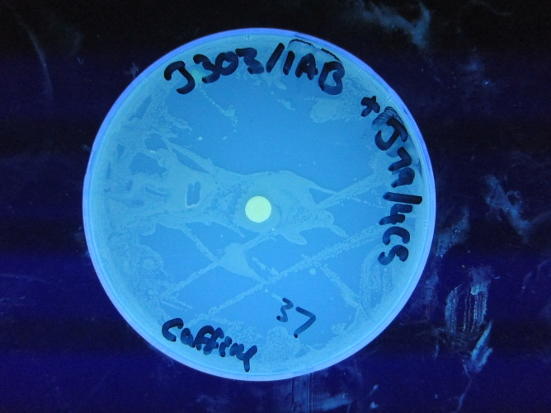
Disks of Theo or Caffeine on J303/1A2 + J79/4C5

Slide 6
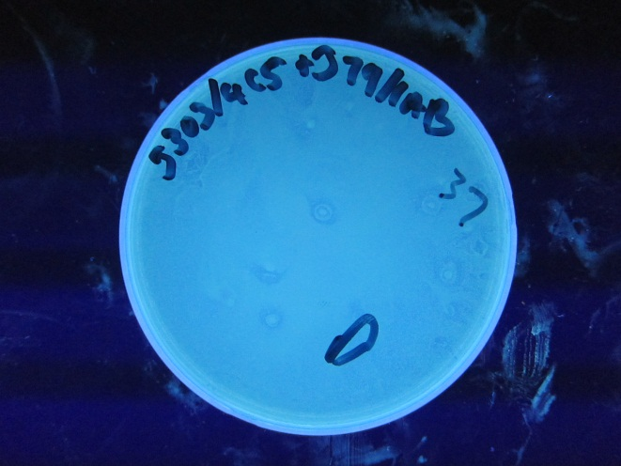
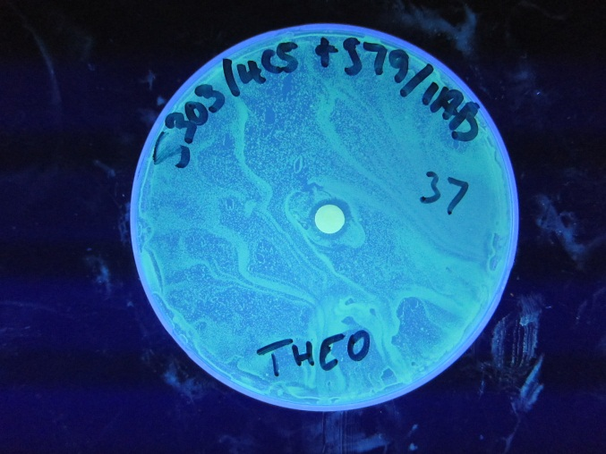
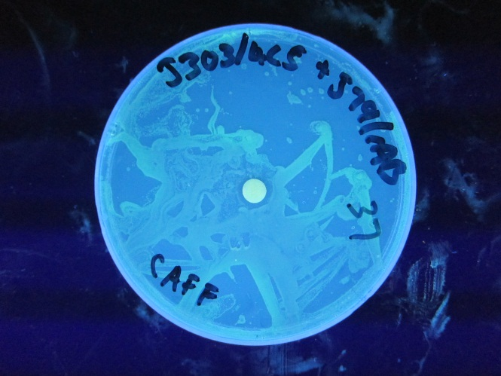
Disks of Theo or Caffeine on J303/4C5 + J79/1A2

Slide 7
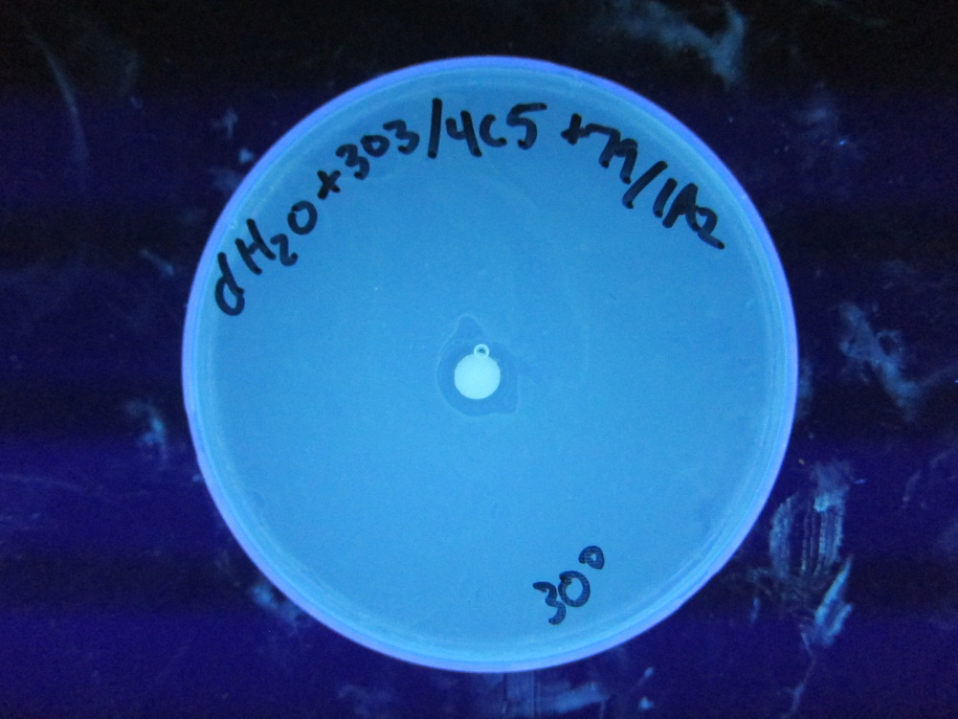
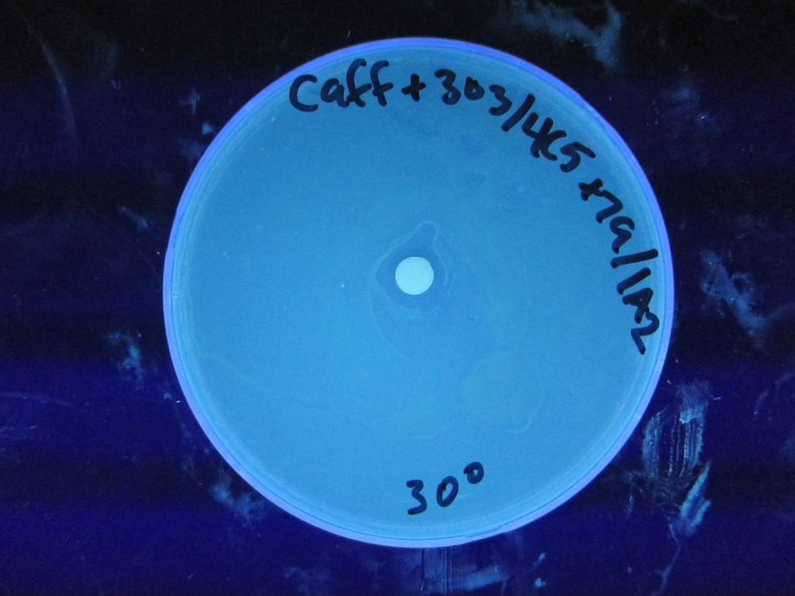
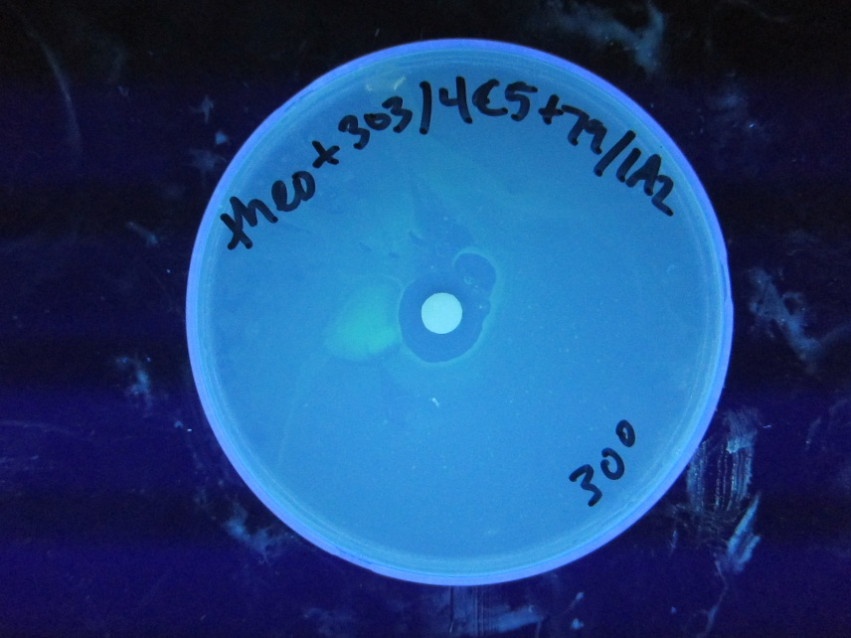
Disks of Theo or Caffeine on J303/4C5 + J79/1A2
30 Degrees C

Slide 8
Next Steps
Continue Running Experiment at 30C for 2 days
Finishing cloning ecdm8 downstream of TetA

