Slide 1
Floral Timing
Mike Nuttle

Slide 2
Strategy
Find sequence of interest in Arabidopsis
BLASTn against 454 scaffolds on blueberry devolvement site
tBLASTx to support a weak match (compare top scaffolds)
Align best matches
Submit best scaffolds to SSR program on blueberry devolvement site
Find appropriate primers near aligned sequences

Slide 3
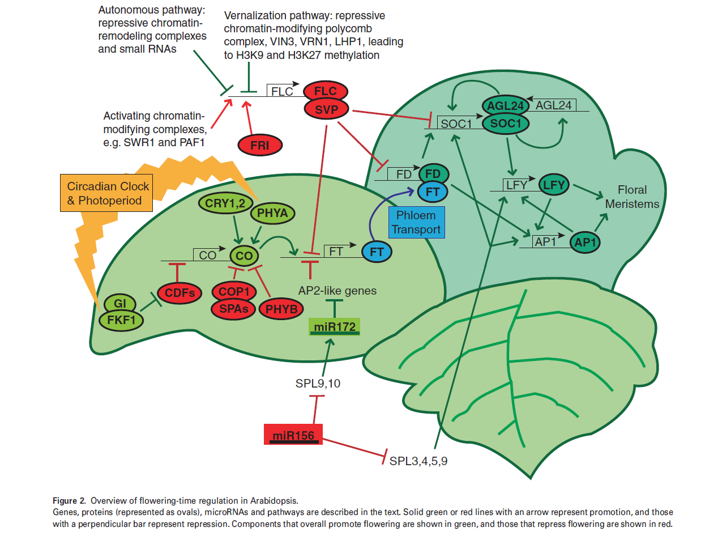
- appropriate primers were found
- appropriate primers could not be found

Slide 4
Troubles
Leafy (LFY)
An adequate ortholog was not found in the 454 blueberry database.
Phytochrome A (PHYA)
The scaffold that best corresponded was only 7,403bp. Therefore no SSRs meeting the minimal qualifications were found.

