Slide 1
Floral Timing
Mike Nuttle

Slide 2
Ortholog and Primer Strategy
Find sequence of interest in Arabidopsis
BLASTn against 454 scaffolds on blueberry devolvement site
tBLASTx to support a weak match (compare top scaffolds)
Align best matches
Submit best scaffolds to SSR program on blueberry devolvement site
Find appropriate primers near aligned sequences

Slide 3
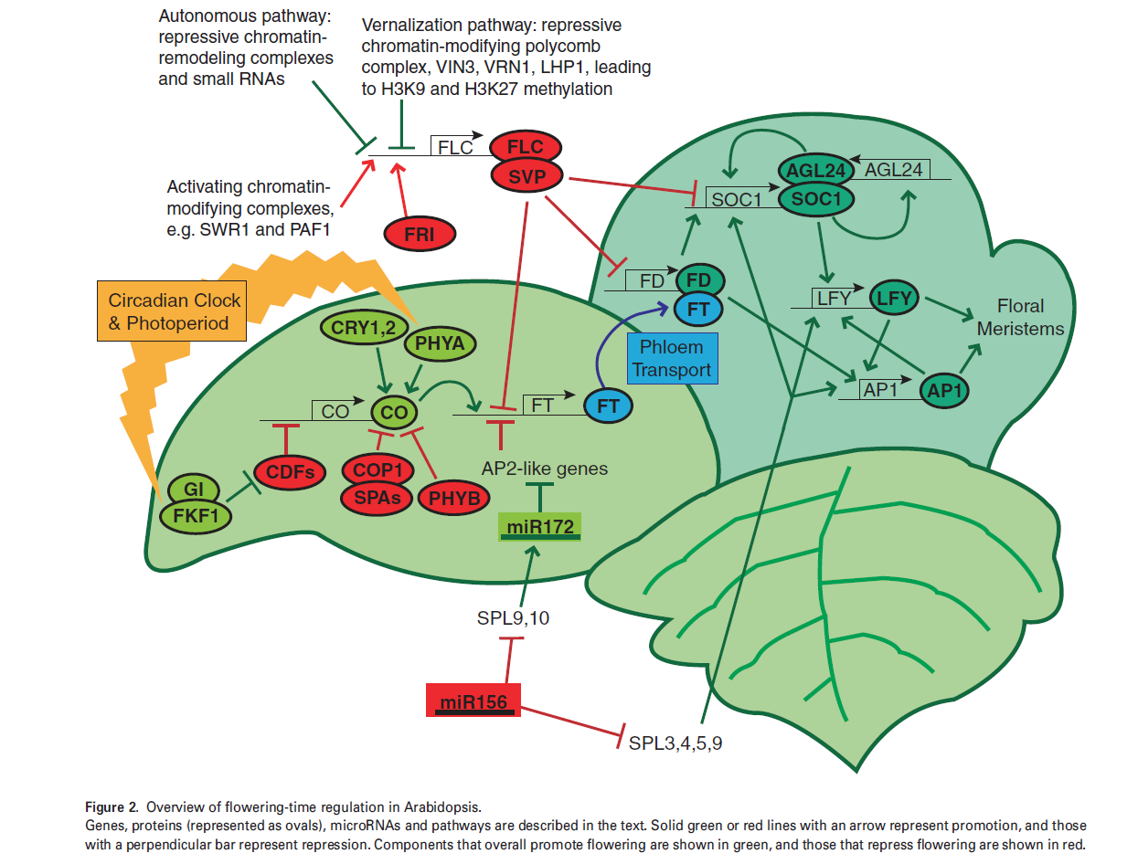
- appropriate primers were found
- appropriate primers could not be found

Slide 4
Troubles
Leafy (LFY)
An adequate ortholog was not found in the 454 blueberry database.
Phytochrome A (PHYA)
The scaffold that best corresponded was only 7,403bp. Therefore no SSRs meeting the minimal qualifications were found.

Slide 5
Expressed Sequence Tags (ESTs) Strategy
BLAST query sequence (see below) against blueberry EST database
Which query?
Start with a portion of sequence that aligned with Arabidopsis genome, near the 3’ end of the gene
If this didn’t produce hits search the scaffold the gene of interest was on for one of the primer sequences generated earlier, also towards the 3’ end of the gene, and use the “chunk” (region of scaffold in-between series of “N’s”) of scaffold it was found on
If this didn’t produce hits, use “chunks” of scaffold adjacent to portion containing the primer
Repeat for each corresponding scaffold for each gene
Assess hits with an e-value < .05

Slide 6
EST Confirmation
In order to see if the ESTs found were tags for the suspected gene…
The whole EST sequence was obtained from NCBI
EST sequences were BLASTed against NCBI’s entire nucleotide database
Top hits were compared with suspected gene

Slide 7
EST Results
FT- 2 very likely ESTs
GI- 1 very likely EST
CO- No good ESTs returned (from EST database)
LFY- no ortholog, nothing to submit
AP1- 3 very likely ESTs
CRY1- 1 very likely EST
CRY2- 1 very likely EST
CDF1- 1 very likely EST
PHYA- No good ESTs returned (from EST database)
PHYB- 1 unlikely EST returned, for a mitochondrial gene
COP1- 1 unlikely EST returned, for a mitochondrial gene

Slide 8
Paralog Identification
To see if any genes whose EST could be identified might have any potential paralogs…
Entire EST sequence was BLASTed against blueberry 454 scaffold database
Top hits were analyzed
Corresponding blueberry gene sequence was BLASTed against entire suspected scaffold with an aligning BLAST
Sequences usually aligned very well or not at all
Scaffold was considered to contain a potential paralog if sequences aligned well

Slide 9
Paralog Results
FT- 2 potential paralogs found
GI- No apparent paralogous hits from BLAST
CO- No EST found to BLAST back against 454 database
LFY- No EST found to BLAST back against 454 database
AP1- 10 scaffolds returned, needs further investigation
CRY1- No apparent paralogous hits from BLAST
CRY2- No apparent paralogous hits from BLAST
CDF1- 1 potential parolog found
PHYA- No EST found to BLAST back against 454 database
PHYB- No good EST to Blast back against 454 database
COP1- No good EST to Blast back against 454 database

Slide 10
Summary
Gene | Arabidopsis Ortholog? | PCR Primers? | EST? | Potential Paralog?
FT | Yes | Yes | Yes (2) | Yes
GI | Yes | Yes | Yes | No
CO | Yes | Yes | No | No
LFY | No | No | No | No
AP1 | Yes | Yes | Yes (3) | Maybe
CRY1 | Yes | Yes | Yes | No
CRY2 | Yes | Yes | Yes | No
CDF1 | Yes | Yes | Yes | Yes
PHYA | Yes | No | No | No
PHYB | Yes | Yes | No | No
COP1 | Yes | Yes | No | No

Slide 11
Further Investigations
Finish analyzing paralogs
Study all genes in aforementioned pathway in this method
Incorporate more genes into this pathway and inspect them in the same way
Further annotate blueberry genome to complete this research and streamline explorations like this

