Slide 1
Lab Meeting
10/11/13

Slide 2
Program Update
M-fold is installed and working

Slide 3
c.Dog RBS
eCDM8
TetA
psB4C5
psB1A8
low Copy
High Copy

Slide 4
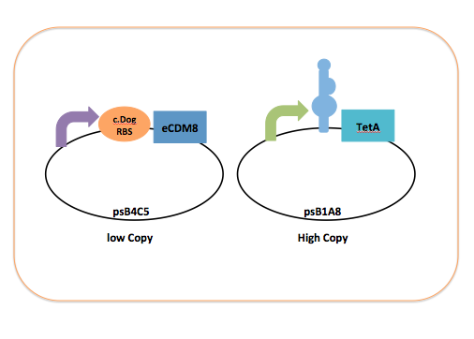
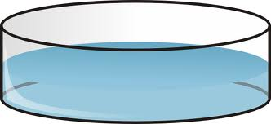
Grew O/N with LB + Chlor + Amp
+ 0.1mM Theophylline
LB + Tet
0.1mM Theo
10ug/ml Tet
0.1mM Caffeine
10ug/ml Tet
0.1mM 3-Methyl
10ug/ml Tet
0.1mM Xanthine
10ug/ml Tet

Slide 5
LB + Tet
0.1mM Theo
10ug/ml Tet
0.1mM Caffeine
10ug/ml Tet
0.1mM 3-Methyl
10ug/ml Tet
0.1mM Xanthine
10ug/ml Tet
No Growth
Growth
1 Colony
No Growth
No Growth

Slide 6
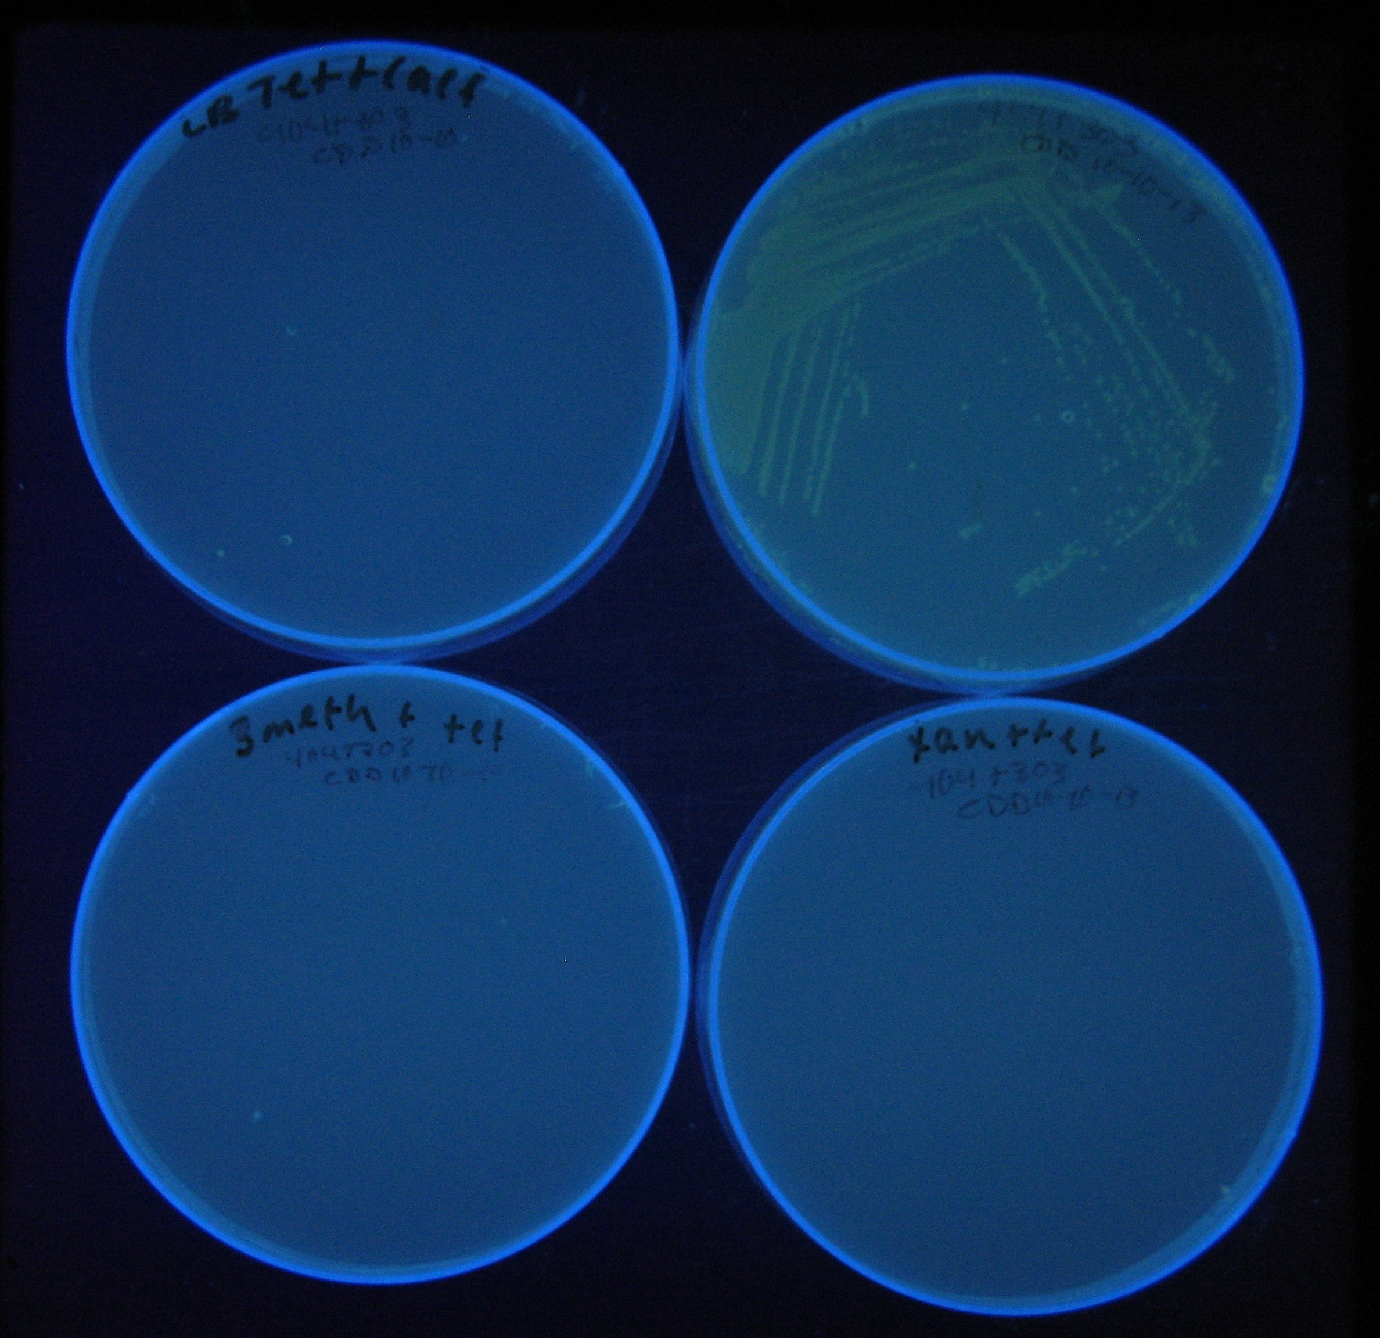
Results
0.1mM Caffeine
10ug/ml Tet
0.1mM Theo
10ug/ml Tet
Tet
0.1mM 3-Methyl
10ug/ml Tet
0.1mM Xanthine
10ug/ml Tet

Slide 7
Next Steps
Grow up single colony and test again on plates with caffeine and Tet
Continue cloning ecdm8 downstream of Teta fitness module
Continue trouble shooting program

