Slide 1
Lab Meeting
11-15-13

Slide 2
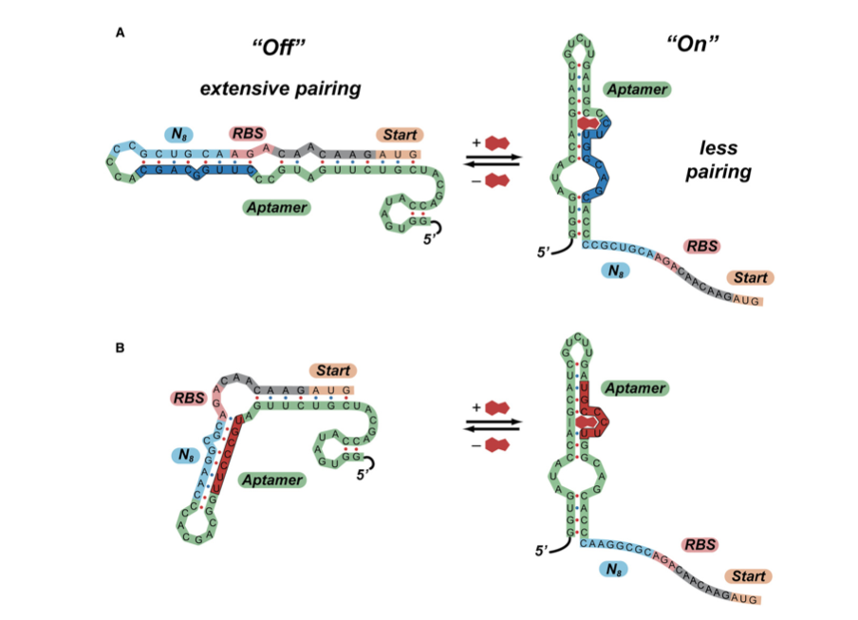
What we need to know:
How do they know where ΔG binds
How to constrain folding using Una-fold
What does difference mean?

Slide 3
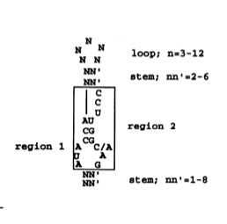
Theophylline Binding Sequence

Slide 4
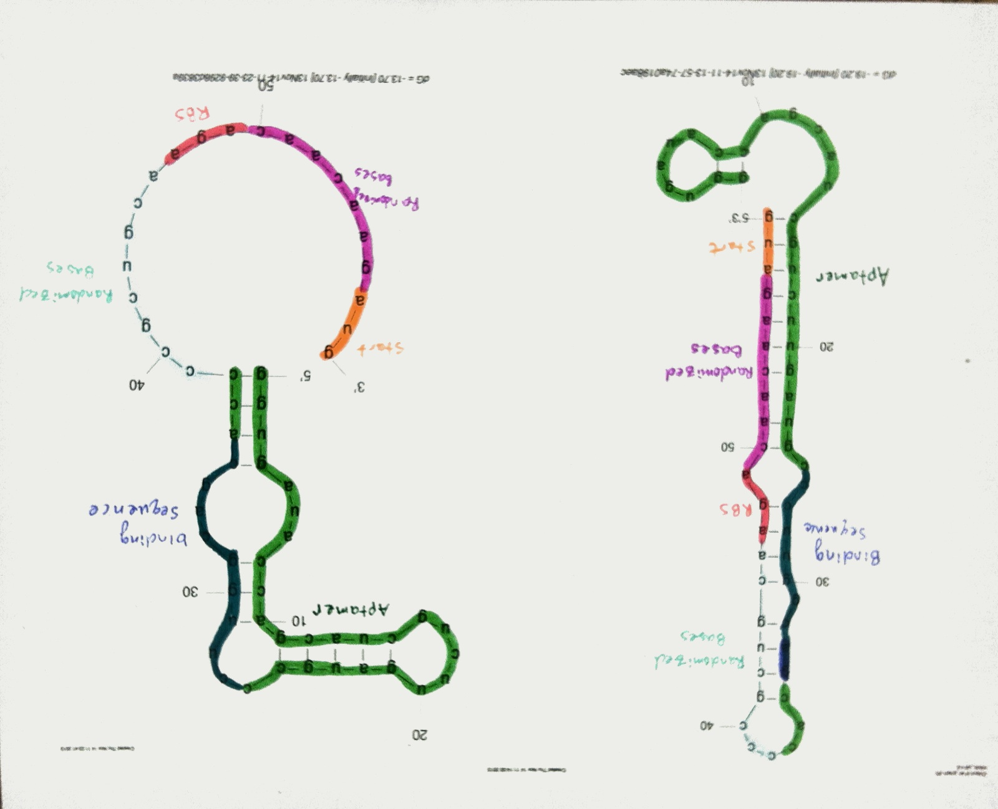
Lynch et al 8.1 Clone
OFF
ON
Theophylline
5 fixed bases
Theophylline binding
Sequence
Aptamer
Theophylline binding
Sequence
RBS
Randomized 8bp
Start
Aptamer
5 fixed bases
Start
Randomized
8bp
RBS
ΔG=-19.20 kcal/mol
ΔG=-13.70 kcal/mol
Difference is 5.5 kcal/mol

Slide 5
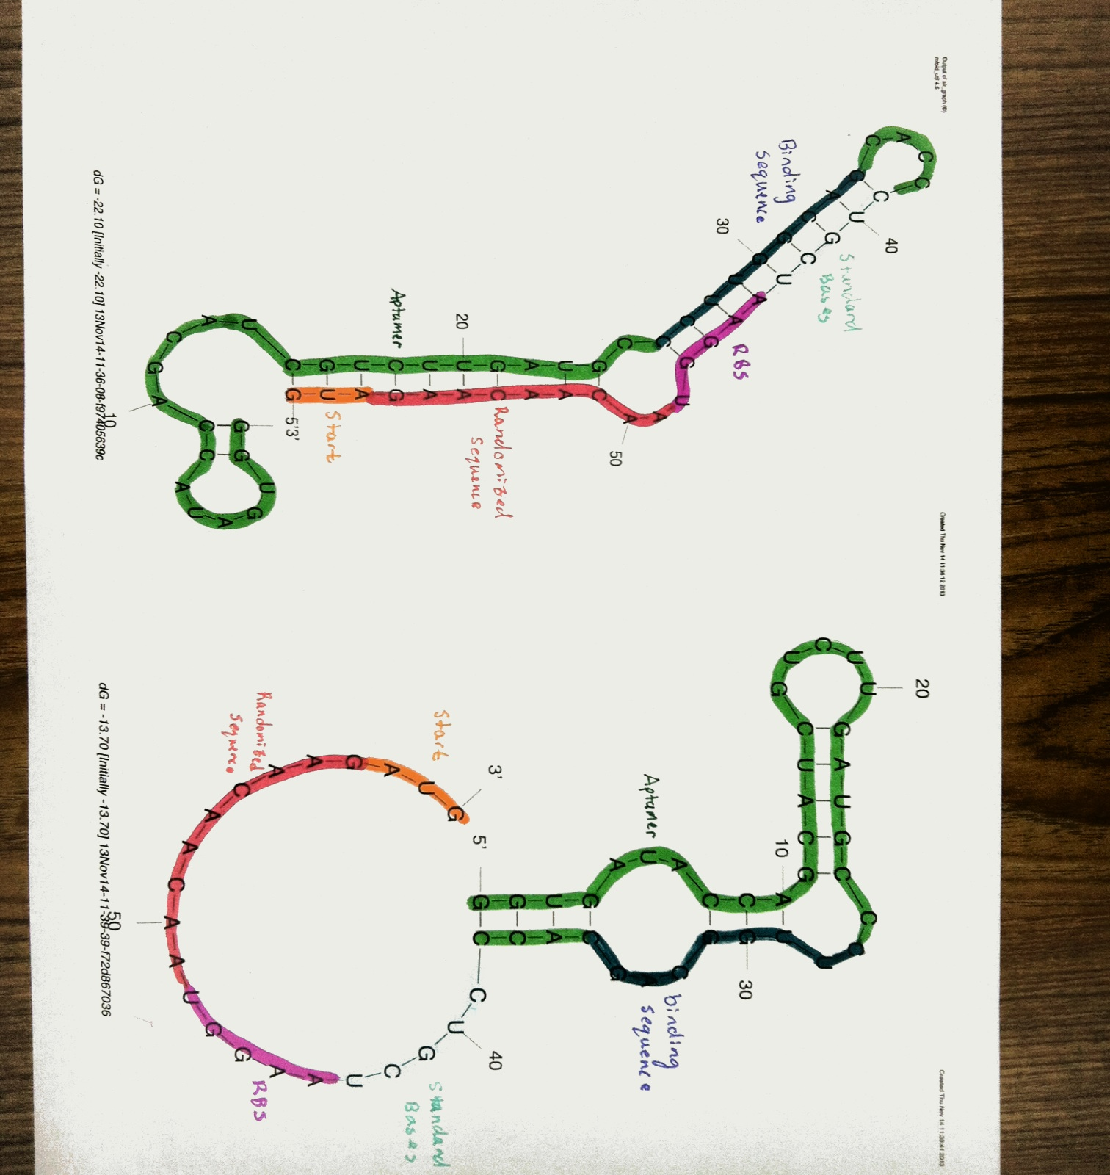
Riboswitch D
OFF
ON
Theophylline
5 fixed bases
Theophylline binding
Sequence
RBS
Theophylline binding
Sequence
Aptamer
5 fixed bases
Aptamer
Randomized 8bp
Start
Start
Randomized
8bp
RBS
ΔG=--22.10 kcal/mol
ΔG=-13.70 kcal/mol
Difference is 8.4 kcal/mol

Slide 6
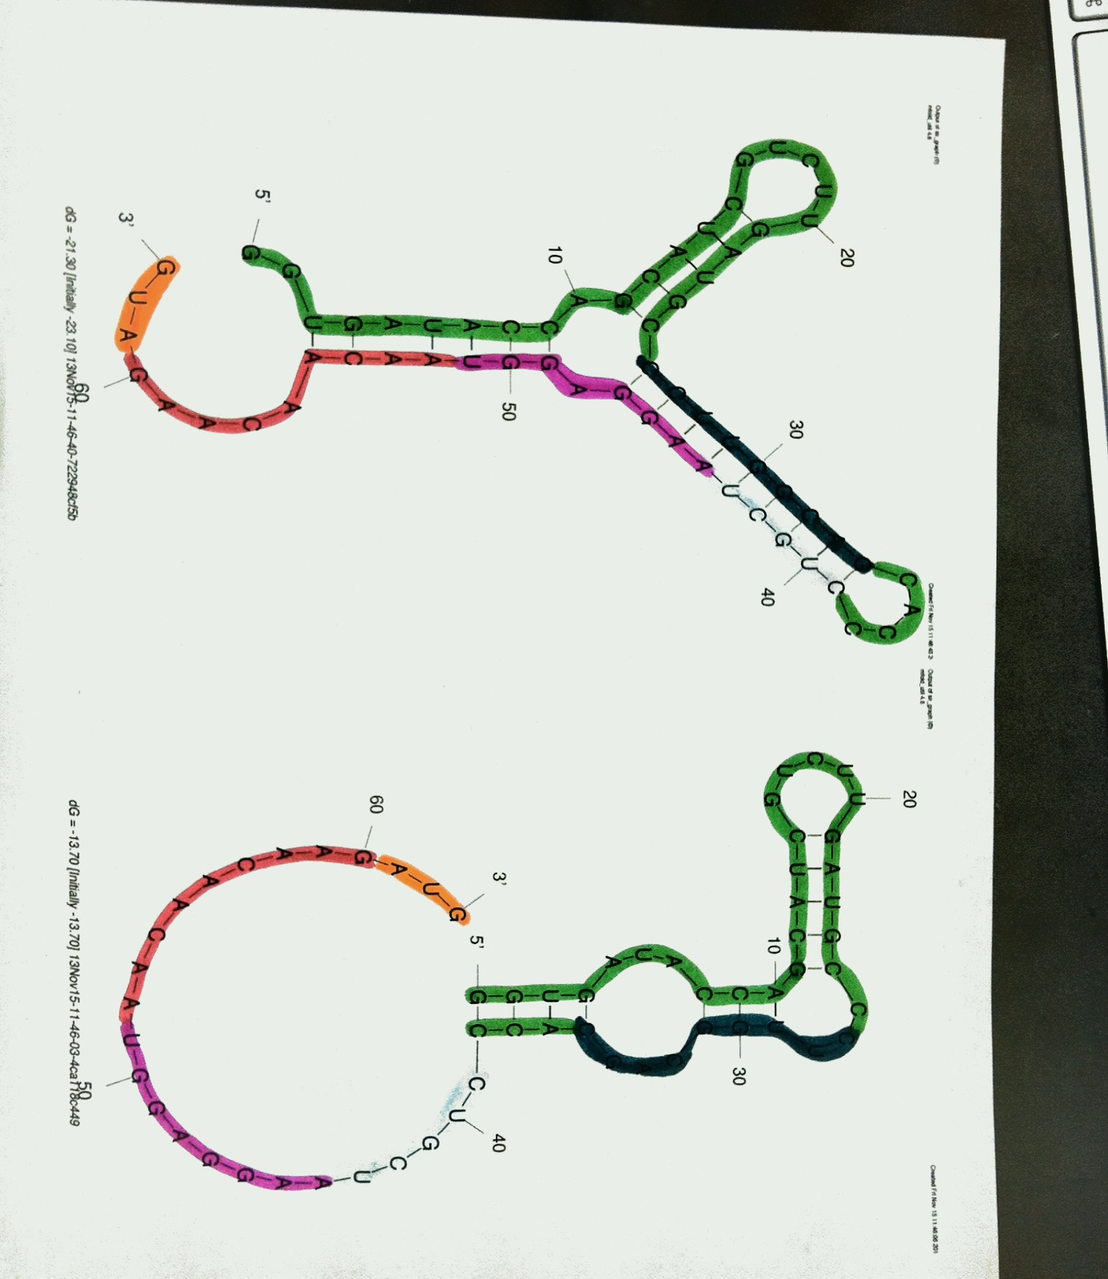
Riboswitch E
OFF
ON
Theophylline
Theophylline binding
Sequence
Theophylline binding
Sequence
5 fixed bases
RBS
Aptamer
Aptamer
5 fixed bases
Start
Randomized 8bp
Start
Randomized 8bp
RBS
ΔG=--23.10 kcal/mol
ΔG=-13.70 kcal/mol
Difference is 9.4 kcal/mol

Slide 7
Known Differences
 | Riboswitch D | Riboswitch E
Off | -22.10 | -23.10
ON | -13.7 | -13.7
Difference | 8.4 | 9.4

Slide 8
Program Results
 | Number of Sequences
Difference less than 9.2 | 13,551
Difference between 9.1 and 8.4 | 1,554

Slide 9
Riboswitch D
OFF
ON
Theophylline
5 fixed bases
Theophylline binding
Sequence
RBS
Theophylline binding
Sequence
Aptamer
5 fixed bases
Aptamer
Randomized 8bp
Start
Start
Randomized
8bp
RBS
ΔG=--22.10 kcal/mol
DG=-13.70 kcal/mol
Difference is 8.4 kcal/mol

Slide 10
Riboswitch E
OFF
ON
Theophylline
Theophylline binding
Sequence
Theophylline binding
Sequence
5 fixed bases
RBS
Aptamer
Aptamer
5 fixed bases
Start
Randomized 8bp
Start
Randomized 8bp
RBS
ΔG=--23.10 kcal/mol
DG=-13.70 kcal/mol
Difference is 9.4 kcal/mol

Slide 11
8/8 bind to 16sRNA
2 free bases in
OFF folding
5/5 bind to 16s RNA
1 free base in
OFF folding
E
D
5’
3’
RBS
3’
5’

Slide 12
Riboswitch D
OFF
ON
Theophylline
5 fixed bases
Theophylline binding
Sequence
RBS
Theophylline binding
Sequence
Aptamer
5 fixed bases
Aptamer
Randomized 8bp
Start
Start
Randomized
8bp
RBS
ΔG=--22.10 kcal/mol
ΔG=-13.70 kcal/mol
Difference is 8.4 kcal/mol

Slide 13
What’s Next?
Determine how to narrow down 1,554 candidates
Run 3-methylxanthine and caffeine through the program

