Slide 1
Allan Brown’s Wish List: EST Results
ANPER - anthocyanin permease
AOMT - anthocyanin O-methyltransferase
CHI - chalcone isomerase
DFR - dihydroflavonol 4-reductase
F3’H - flavonoid 3' hydroxylase
LDOX - leucoanthocyanidin dioxygenase
FLS- flavonol synthase
Myba1 - myb-related transcription factor
MycA1 - myc anthocyanin regulatory protein
UFGT - UDP-glucose:flavonoid 3-O-glucosyltransferase

Slide 2
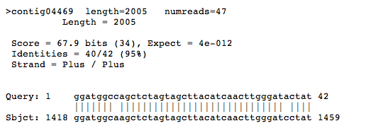
Allan Brown’s Wish List: EST Results
ANPER - anthocyanin permease
Towson Database

Slide 3
Allan Brown’s Wish List: EST Results
ANPER - anthocyanin permease
Towson Database
BLAST verified
BLAST invalid EST
BLAST surprise, wrong but interesting
BLAST match
gb|AY348872.1| Lycopersicon esculentum putative anthocyanin permease mRNA, complete cds

Slide 4
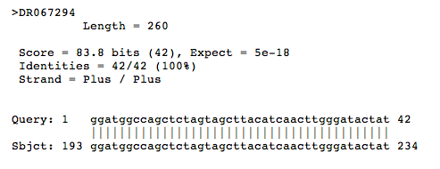
Allan Brown’s Wish List: EST Results
ANPER - anthocyanin permease
WSU Database
http://www.ncbi.nlm.nih.gov/nucest/DR067294

Slide 5
Allan Brown’s Wish List: EST Results
ANPER - anthocyanin permease
BLAST verified
BLAST invalid EST
BLAST surprise, wrong but interesting
WSU Database
http://www.ncbi.nlm.nih.gov/nucest/DR067294
BLAST match
PREDICTED: Vitis vinifera protein TRANSPARENT TESTA 12-like (LOC100250967),

Slide 6
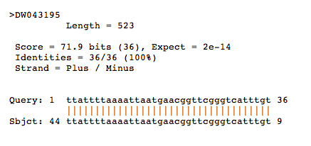
Allan Brown’s Wish List: EST Results
AOMT - anthocyanin O-methyltransferase
WSU Database
http://www.ncbi.nlm.nih.gov/nucest/DW043195

Slide 7
Allan Brown’s Wish List: EST Results
AOMT - anthocyanin O-methyltransferase
WSU Database
http://www.ncbi.nlm.nih.gov/nucest/DW043195
BLAST verified
BLAST invalid EST
BLAST surprise, wrong but interesting
BLAST match
Rhododendron catawbiense early light-induced protein 7 mRNA,

Slide 8
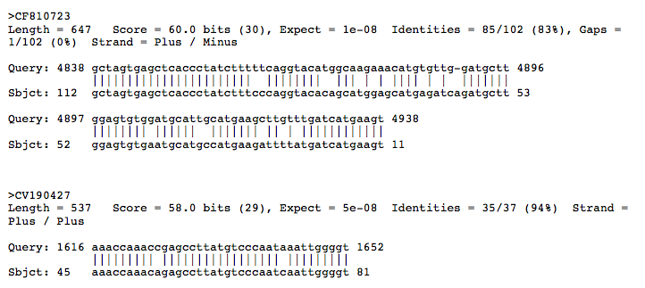
Allan Brown’s Wish List: EST Results
CHI - chalcone isomerase
http://www.ncbi.nlm.nih.gov/nucest/CF810723
http://www.ncbi.nlm.nih.gov/nucest/CV190427

Slide 9
Allan Brown’s Wish List: EST Results
BLAST verified
BLAST invalid EST
BLAST surprise, wrong but interesting
CHI - chalcone isomerase
http://www.ncbi.nlm.nih.gov/nucest/CF810723
BLAST match
component of oligomeric golgi complex 6
http://www.ncbi.nlm.nih.gov/nucest/CV190427
BLAST match
Liriodendron tulipifera clone BAC125P15 FLORICAULA/LEAFY-like
protein, glycyl-tRNA synthetase-like protein, and VARIANT IN
METHYLATION-like protein genes, complete cds; and integral
membrane protein gene, partial cds

Slide 10
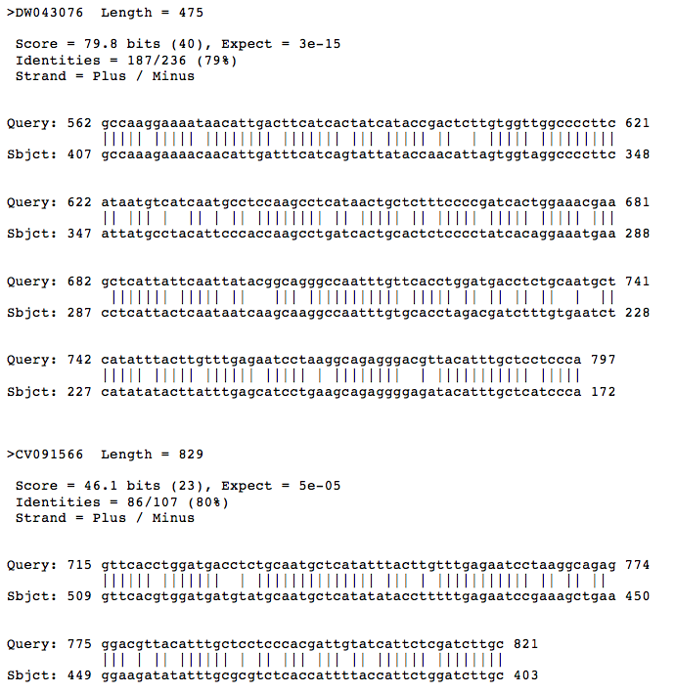
Allan Brown’s Wish List: EST Results
DFR - dihydroflavonol 4-reductase
http://www.ncbi.nlm.nih.gov/nucest/DW043076
http://www.ncbi.nlm.nih.gov/nucest/CV091566

Slide 11
Allan Brown’s Wish List: EST Results
DFR - dihydroflavonol 4-reductase
BLAST verified
BLAST invalid EST
BLAST surprise, wrong but interesting
http://www.ncbi.nlm.nih.gov/nucest/DW043076
BLAST match
Vaccinium macrocarpon dihydroflavonol 4-reductase mRNA
http://www.ncbi.nlm.nih.gov/nucest/CV091566
Vitis vinifera dihydroflavonol-4-reductase-like (LOC100267635)
BLAST match

Slide 12
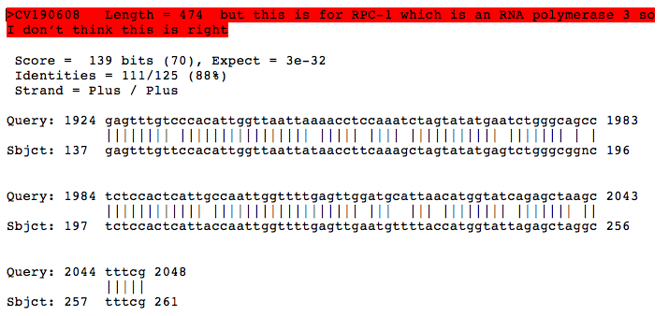
Allan Brown’s Wish List: EST Results
F3’H - flavonoid 3' hydroxylase

Slide 13
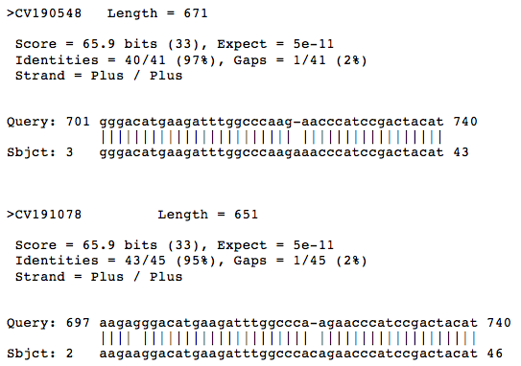
Allan Brown’s Wish List: EST Results
LDOX - leucoanthocyanidin dioxygenase
http://www.ncbi.nlm.nih.gov/nucest/CV091044
http://www.ncbi.nlm.nih.gov/nucest/CV190548
http://www.ncbi.nlm.nih.gov/nucest/CV191078

Slide 14
Allan Brown’s Wish List: EST Results
LDOX - leucoanthocyanidin dioxygenase
BLAST match
http://www.ncbi.nlm.nih.gov/nucest/CV091044
Vaccinium corymbosum anthocyanidin synthase (ans) mRNA
http://www.ncbi.nlm.nih.gov/nucest/CV190548
BLAST verified
BLAST invalid EST
BLAST surprise, wrong but interesting
BLAST match
Vaccinium corymbosum anthocyanidin synthase (ans) mRNA
http://www.ncbi.nlm.nih.gov/nucest/CV191078

Slide 15
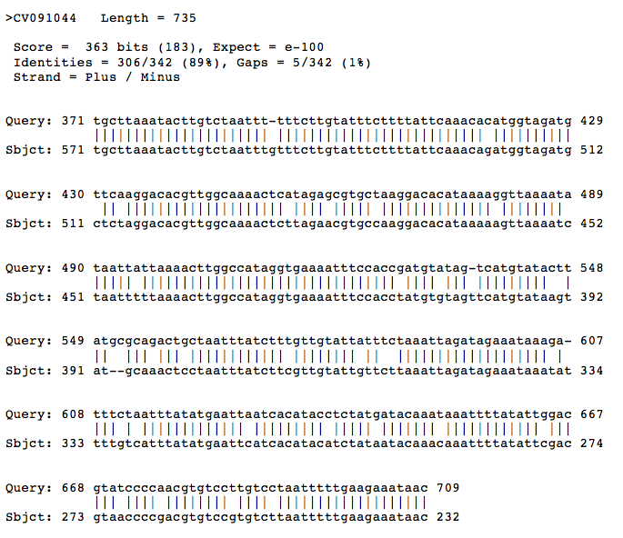
Allan Brown’s Wish List: EST Results
FLS- flavonol synthase
http://www.ncbi.nlm.nih.gov/nucest/CV091044

Slide 16
Allan Brown’s Wish List: EST Results
FLS- flavonol synthase
BLAST verified
BLAST invalid EST
BLAST surprise, wrong but interesting
http://www.ncbi.nlm.nih.gov/nucest/CV091044
BLAST match
Antirrhinum hispanicum slf-S5 gene for S locus F-box (SLF)-S5
protein and slf-S5A gene for S locus F-box (SLF)-S5A protein

Slide 17
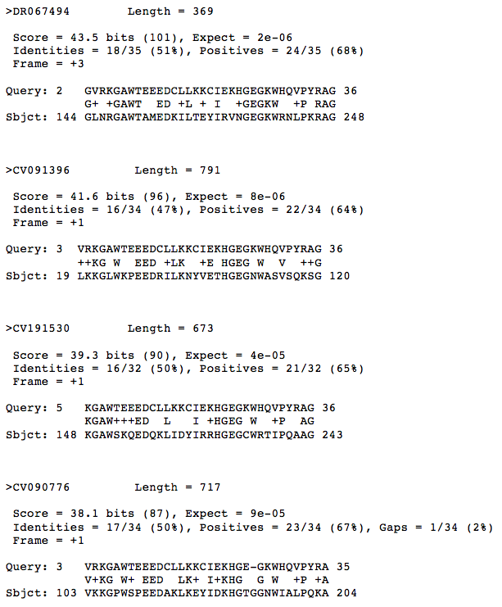
Allan Brown’s Wish List: EST Results
Myba1 - myb-related transcription factor
http://www.ncbi.nlm.nih.gov/nucest/DR067494
http://www.ncbi.nlm.nih.gov/nucest/CV091396
http://www.ncbi.nlm.nih.gov/nucest/CV191530
http://www.ncbi.nlm.nih.gov/nucest/CV090776

Slide 18
Allan Brown’s Wish List: EST Results
BLAST verified
BLAST invalid EST
Myba1 - myb-related transcription factor
http://www.ncbi.nlm.nih.gov/nucest/DR067494
Rubus idaeus Myb-related transcription factor gene
http://www.ncbi.nlm.nih.gov/nucest/CV091396
Populus trichocarpa predicted protein (MYB084)
http://www.ncbi.nlm.nih.gov/nucest/CV191530
Vaccinium myrtillus MYB1-like mRNA
http://www.ncbi.nlm.nih.gov/nucest/CV090776
Malus x domestica MYB24 mRNA, complete cds

Slide 19
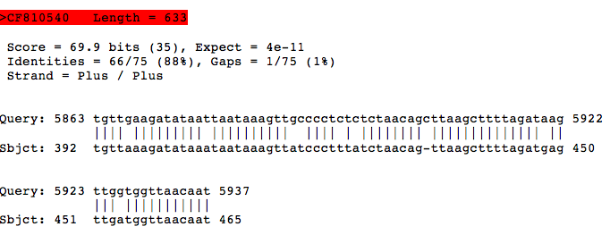
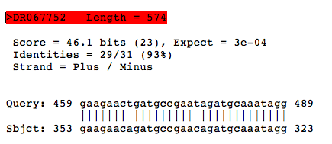
Allan Brown’s Wish List: EST Results
MycA1 - myc anthocyanin regulatory protein

Slide 20
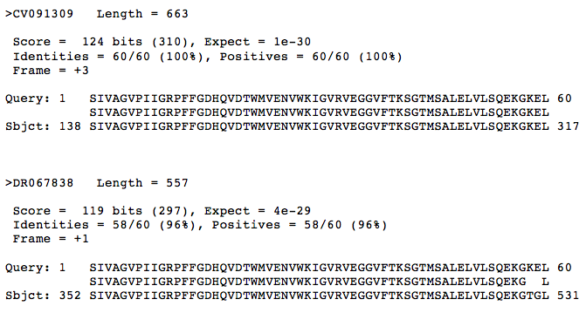
Allan Brown’s Wish List: EST Results
UFGT - UDP-glucose:flavonoid 3-O-glucosyltransferase
http://www.ncbi.nlm.nih.gov/nucest/CV091309
http://www.ncbi.nlm.nih.gov/nucest/DR067838

Slide 21
Allan Brown’s Wish List: EST Results
BLAST verified
BLAST invalid EST
UFGT - UDP-glucose:flavonoid 3-O-glucosyltransferase
BLAST match
Actinidia chinensis flavonoid 3-0-galactosyltransferase mRNA
http://www.ncbi.nlm.nih.gov/nucest/CV091309
BLAST match
Actinidia chinensis flavonoid 3-0-galactosyltransferase mRNA
http://www.ncbi.nlm.nih.gov/nucest/DR067838

Slide 22
Allan Brown’s Wish List: EST Results
BLAST verified
BLAST invalid EST
BLAST surprise, wrong but interesting
ANPER - anthocyanin permease
AOMT - anthocyanin O-methyltransferase
CHI - chalcone isomerase
DFR - dihydroflavonol 4-reductase
F3’H - flavonoid 3' hydroxylase
LDOX - leucoanthocyanidin dioxygenase
FLS- flavonol synthase
Myba1 - myb-related transcription factor
MycA1 - myc anthocyanin regulatory protein
UFGT - UDP-glucose:flavonoid 3-O-glucosyltransferase

Slide 23
Best Methods – avoid big scaffold chunks
BLAST verified
BLAST invalid EST
BLAST surprise, wrong but interesting
ANPER – short, 3’ end of scaffold
AOMT – tBLASTn carboxyl end protein, 3’ end scaffold
CHI – big chunk of scaffold near SSR site
DFR – grape cDNA
F3’H - big chunk of scaffold near SSR site
LDOX – medium chunk from scaffold
FLS - big chunk of scaffold
Myba1 – tBLASTn with peptide sequence
MycA1 - big chunk of scaffold
UFGT - tBLASTn with peptide sequence

Slide 24
What tool do we need to improve system?
1) BLAST grape (other plant) cDNA or protein sequence
2) collect scaffold hits (threshold E value < 0.001)
3) automatically BLAST scaffold against ESTs
4) Return full EST sequences and sources
5) From results:
Allow all ESTs to be BLASTed against NCBI to ID
All ESTs to be BLASTed against blueberry genome

Slide 25
What tool do we need to improve system?
1) Query ESTs and genome annotations with EC numbers
2) Web site that ranks SSR results: (user inputs)
3) Align ESTs or cDNAs with scaffolds to find introns
4) Tool for collecting all allele or paralog scaffolds
5) Visualize aligned sequences from #4
6) Visualize KEGG pathway map with personal results
7) Compare blueberry and grape annotations

