Slide 1
Central Dogma Theory

Slide 2
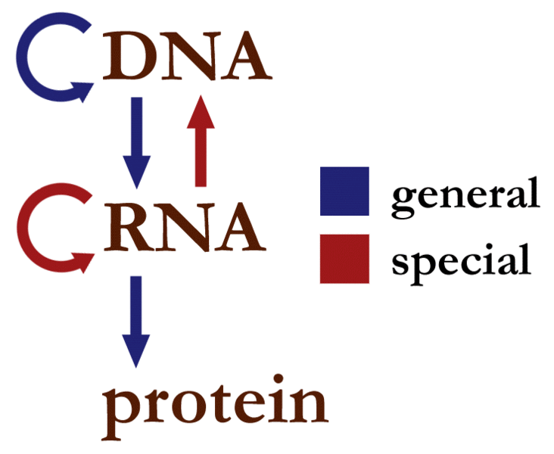
Flow of genetic information within a biological system.

Slide 3
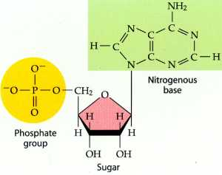
General Knowledge
DNA is composed of base pair triplets known as nucleotides.
Nucleotides are composed of a phosphate group, pentose sugar, and a nitrogenous base.
Bases
Adenine
Thymine (Uracil)
Cytosine
Guanine

Slide 4
http://www.youtube.com/watch?v=9kOGOY7vthk

