Slide 1
Development of the Theophylline Riboswitch
1 on 2 Meeting 09/03/13

Slide 2
Original Riboswitch Design (Desaia and Gallivan, 2004)
5’-GGTGATACCAGCATCGTCTTGATGCCCTTGGCAGCACC-3’
5 bp upstream
B-galactosidase: Translated Region
RBS
ATG
TGA

Slide 3
Original Riboswitch Design (Desaia and Gallivan, 2004)
B-galactosidase: Translated Region
Kpn1
Aptamer
5 bp
25 bp of RBS
Fwd Primer
RBS
Untranslated region
8bp spacer
Untranslated region
Notes:
TATAA

Slide 4
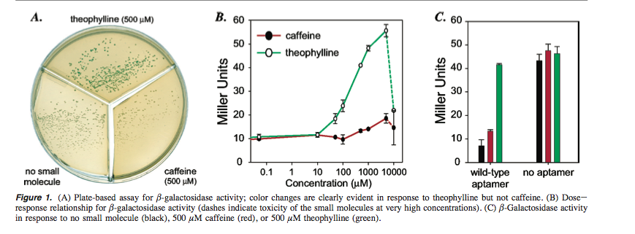
Results

Slide 5
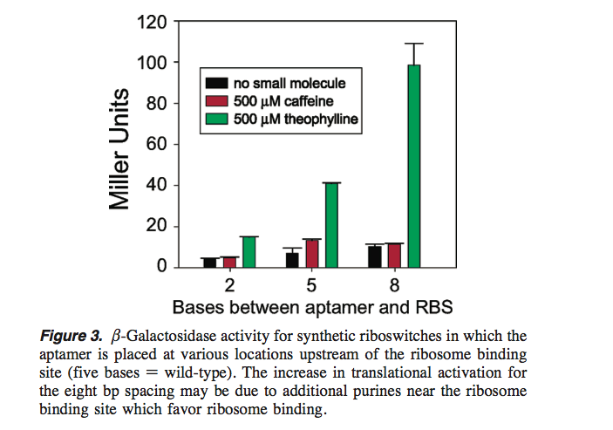
Results
Notes:
When we began our studies we hypothesized that theophylline binding to the aptamer would increase the secondary structure of the mRNA near the ribosome binding site (RBS)58

Slide 6
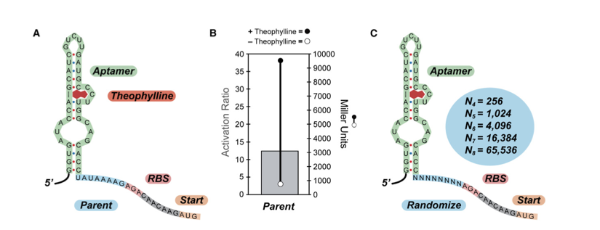
Paper published on mechanistic Insights into Riboswithces (Lynch et al., 2007)
Notes:
A) Sequence of a portion of the 50 region of the parent synthetic riboswitch with 8 bases separating the aptamer (green) and the ribosome binding site (pink); the AUG start codon (peach) is highlighted. The aptamer is shown in the secondary structure predicted for the theophylline aptamer by mFold and confirmed experimentally.
(B) Measures of the activity of the synthetic riboswitch shown in (A) when cloned upstream of the IS10-lacZ gene fusion and expressed in E. coli. Right axis: b-galactosidase activity in the absence (open circle) or presence of theophylline (1 mM, closed circle). Activities are expressed in Miller units, and the standard errors of the mean are less than the diameters of the circles. Left axis: the activation ratio of the synthetic riboswitch (gray bar), which is determined by taking the ratio of the activities in the presence and absence of theophylline.
(C) Sequence diagram of the randomized synthetic riboswitches. The aptamer is shown in green, the randomized regions in light blue, the ribosome binding site in pink, and the AUG start codon in peach. Theoretical library sizes are shown in the circle.

Slide 7
Selection

Slide 8
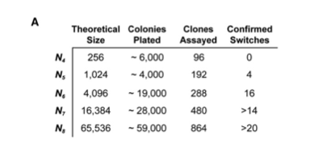
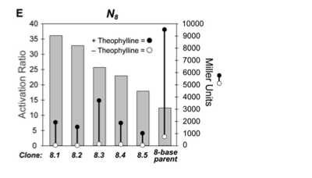
Results
Notes:
(A) Statistics for libraries assayed. (B–E) Measures of the activities of the synthetic riboswitches identified in the high-throughput screens. Each measurement is done in triplicate. For all panels: right axis, b-galactosidase activity in the absence (open circle) or presence of theophylline (1 mM, closed circle). Activities are expressed in Miller units, and the standard errors of the mean are less than the diameters of the circles. Left axis, the activation ratio of the synthetic riboswitches (gray bar), which are determined by taking the ratio of the activities in the presence and absence of theophylline.

Slide 9
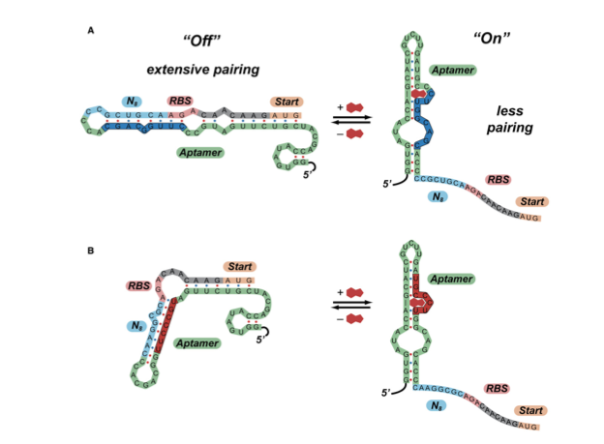
Results
8.1
8.2
Notes:
Figure 4. Predicted Mechanisms of Action of Synthetic Riboswitches
(A) Predicted mechanism of action of clone 8.1. In the absence of theophylline (left), the 50 region can adopt a highly folded structure that extensively pairs the region that includes ribosome binding site to part of the aptamer sequence (shown in dark blue). In the presence of theophylline (right), the secondary structure shifts, such that the ribosome binding site is exposed. The secondary structure shown for the theophylline aptamer predicted by mFold and is identical to the structure determined by NMR.
(B) Predicted mechanism of action of clone 8.2. In this case, the region containing the ribosome binding site pairs to a different region of the aptamer in the ‘‘off’’ state (shown in red). This demonstrates that several motifs may function as synthetic riboswitches.
in both cases, the calculated differences in free energy between the two structures are less than the free energy of theophylline binding (􏰍9.2 kcal/mol

Slide 10
Final Theophyline Riboswitch (Topp et al., 2010)
5 Riboswitches
Experiment with Mutation in the RBS to increase base pairing with Aptamer
Experiment with changing positions of the random sequencing of spacers

Slide 11
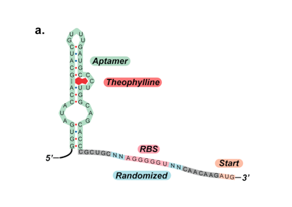
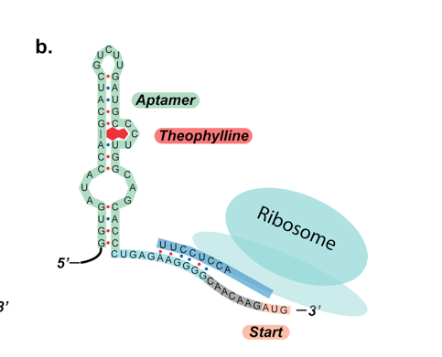
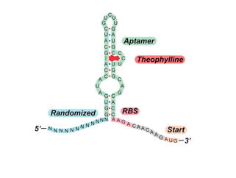
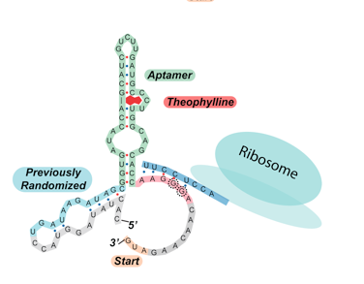
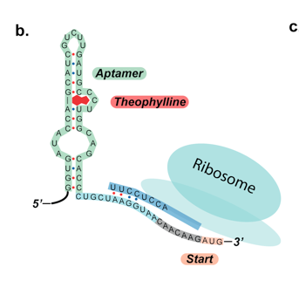
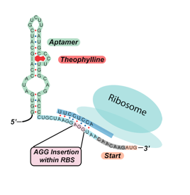
A
B
C
C2
D
E

Slide 12
RBS’ of Riboswitches
Riboswitch | A | B | C | C2 | D | E
Sequence | AAGGGG | AGGGGU | AAGA | AAGGGA | AAGGUAA | AAGGAGGU
BP with Ribosome | 6 | 7 | 0 | 5 | 4 | 8
RBS---Shine-Dalgarno sequence: AGGAGGU
Generated a library of randomized RBS sequences to see which one based paired to Aptamer

Slide 13
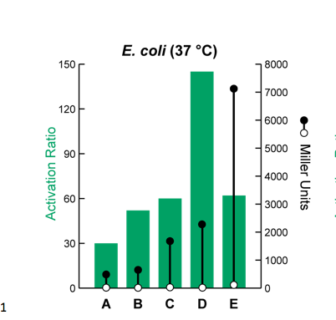
Results

Slide 14
Plan of Action
Write a python code that will generate randomized sequences for the 8bp spacer
The script will run the 65,536 combinations through M-fold
Have a certain number of candidates synthesized
Test candidates in the lab

Slide 15
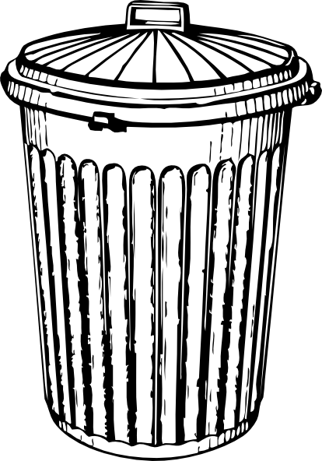
RBS
Aptamer
Mutate for 6,7,8 or base paring with RNA polymerase
Add Riboswitch w/o apatamer
Complete Riboswitch
Library of RBS’s
Randomize 8 bp between RBS and aptamer
Add two 8 bp spacers and ATG to RBS
65,536 Riboswitches
Riboswitch w/o Aptamer
Predict free energy of aptamer
M-fold
Riboswtiches with Calculated Free Energy
Filter out riboswitches too large of free energy
Riboswitches with greater free energy than aptamer
Putative Riboswitches

