Slide 1
Python Gene Expression in Liver Pre- and Post-Feeding
Elizabeth Brunner & Brian Johnson

Slide 2
Housekeeping Genes
Needed to confirm identity of 6 samples
Used files containing 25K genes sorted by FPKM
Common liver genes
Serum albumin like (alb-b)
Inter alpha-trypsin inhibitor, heavy chain 4
These and other genes were expressed in all liver samples
Notes:
First steps – while the code was being worked out
Collaborated with other liver group → google doc file to check various housekeeping genes across 6 samples

Slide 3
Methods: DESeq
DESeq
Analyzes RNAseq contigs
Normalized code, accounting for contig overrepresentation
Expected counts
Searching for “interesting genes”
Differential expression pattern between fed & non-fed
Supervised clustering
Correlated gene expression based on a GOI
Notes:
What we’re using to analyze
Definitions for the two types of clustering

Slide 4
Approach
Initial DESeq run creates “genes from carp” file
-List of “interesting” genes
Select biologically relevant genes
-OMIM/NCBI
Supervised clustering based on particular GOI
What has similar expression pattern?

Slide 5
Biologically “Interesting”
Transcription factors
May lead to signaling cascade
Is a gene part of a cascade?
Upstream/downstream candidates
Large differential gene expression
Liver’s function during digestion

Slide 6
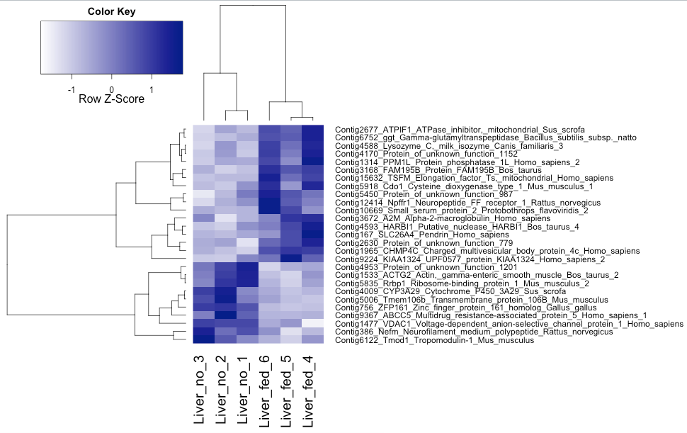
Expected genes from carp
Threshold = 0.012, using normalized counts
Roadblocks
Notes:
Roadblocks
Couldn’t get moving as quickly as we’d hoped due to changes in the R script
Neither of us really know how to use R beyond basic statistics

Slide 7
Candidate Genes
Protein of Unknown Function 779
GO Terms: anaphase-promoting complex
Get cells out of arrested mitosis
Promote cell division
Triggers sister chromatid separation
Protein K11-linked ubiquitination
Works with anaphase-promoting complex

Slide 8
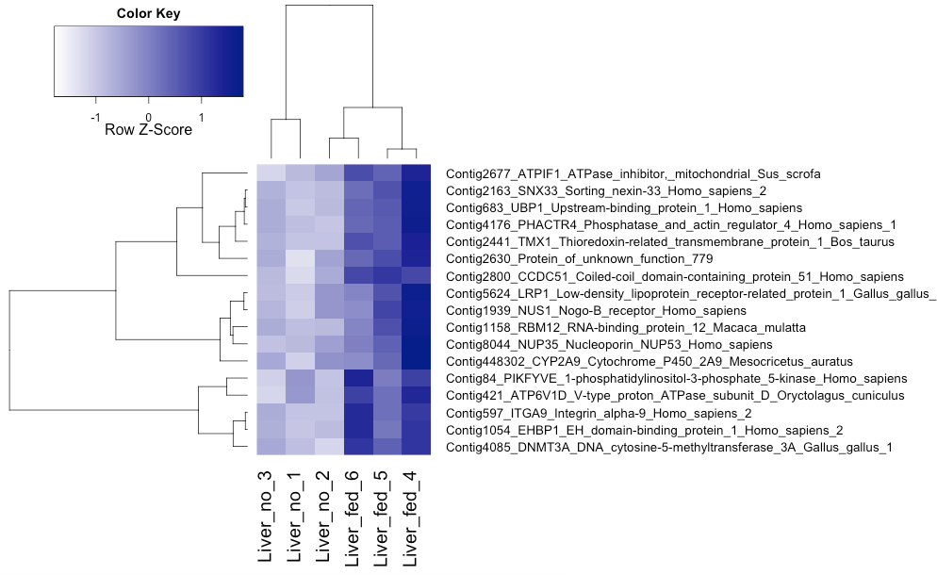
Supervised Clustering: puf_779
Threshold = 0.03, altered code to use normCounts instead of toSearch

Slide 9
Candidate Genes
Gamma-Glutamyltransferase 1 (GGT1)
Detoxification processes in the liver
Involved in functional group transfer from peptides to acceptors
Increased expression in fed snakes
Further candidate genes upstream

Slide 10
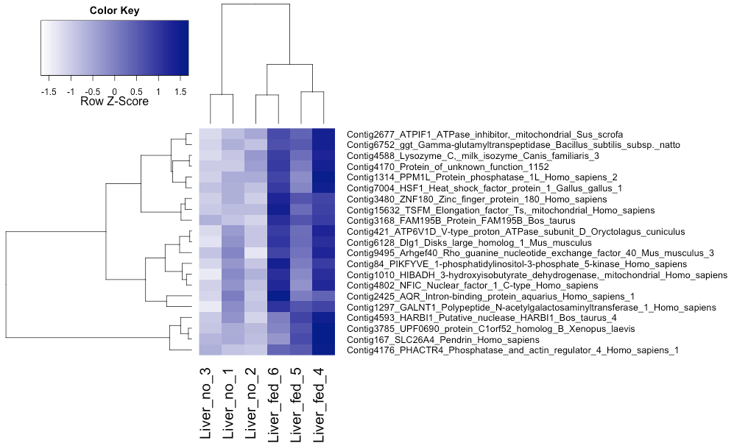
Supervised Clustering: GGT1
Threshold = 0.05, altered code to use normCounts instead of toSearch

Slide 11
Candidate Genes
GalNAc Transferase (GALNT1)
Oligosaccharide biosynthesis (step 1)
Transfers N-Acetyl Galactosamine to serine and threonine residues
Correlates with GGT expression pattern
Biological relevance?

Slide 12
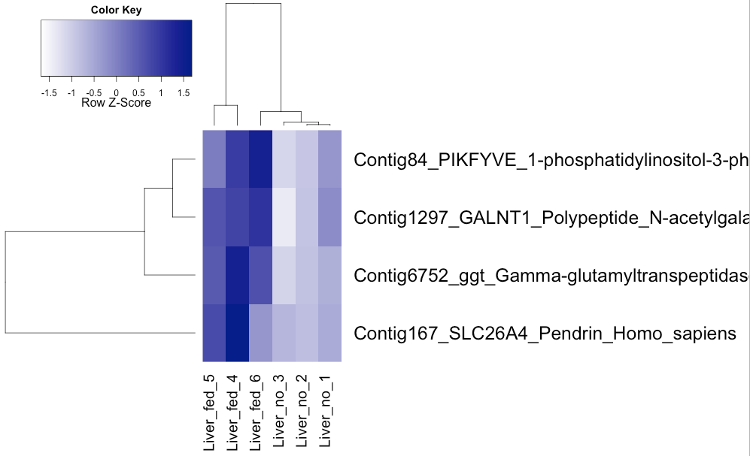
GALNT1
Threshold = 0.03
Are these parallel pathways?
Notes:
PIKFYVE: when it’s NOT active, knocking this out, inhibits insulin regulated glucose uptake
Low expression in liver
Could aid glucose uptake, more highly expressed in fed snakes
SLC isn’t functional in the liver – at this preliminary stage we aren’t sure if it’s relevant
General ion exchanger

Slide 13
Future Work
Validate potential biological pathways of our candidate genes
Run more supervised clustering for protein of unknown function candidate
Explore results further
Confirm normalization code R script for supervised clustering
KEGG pathways
Gene Ontology terms for all candidates
Notes:
We have a lot ahead of us.
Use gene ontology, more research into pathways – are they actually relevant candidates?
More supervized clustering for puf and research in OMIM for the candidates we got already
Clarify with other groups whether normalization edits for R script are correct – important for the levels of gene expression between fed and non-fed
Finally, use KEGG to research more into where our candidates fit in other pathways, if possible; GO terms to better understand gene function

Slide 14
References
“Anaphase-promoting Complex.” GeneOntology.org. http://amigo.geneontology.org/amigo/term/GO:0005680. Accessed 13 March 2016.
“Gamma-Glutamyltransferase 1; GGT1.” OMIM. http://omim.org/entry/612346. Accessed 13 March 2016.
Ikonomoy, OC., et al. (2008) “ArPIKfyve-PIKfyve interaction and role in insulin-regulated GLUT4 translocation and glucose transport in 3T3-L1 adipocytes.” Exp Cell Res. 313(11): 2404-2416.
“Protein K11-linked Ubiquitination.” GeneOntology.org. http://amigo.geneontology.org/amigo/term/GO:0070979. Accessed 13 March 2016.
“UDP-N-Acetyl-Alpha-D-Galactosamine: Polypeptide N-AcetylGalactosamineyltransferase 1; GALNT1.” OMIM. http://omim.org/entry/602273. Accessed 13 March 2016.

