Slide 1
Medicine
Notes:
1

Slide 6
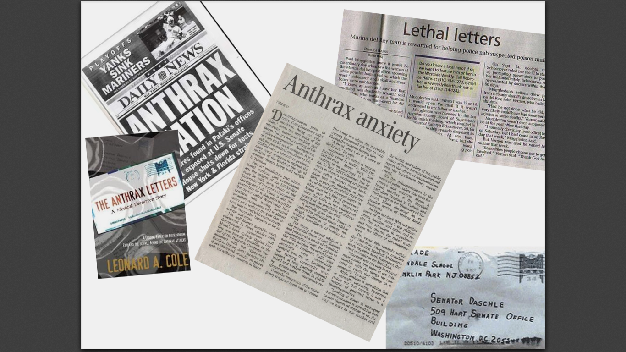

Slide 7
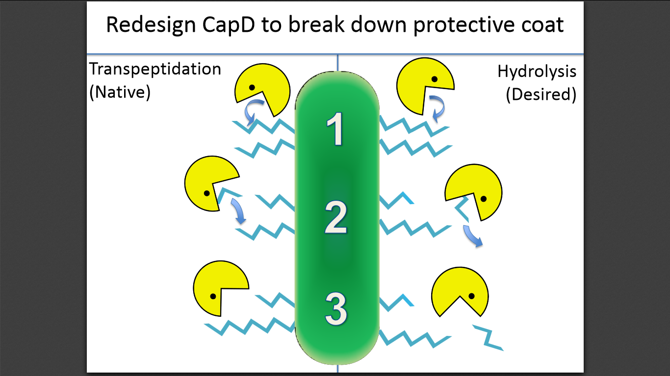

Slide 10
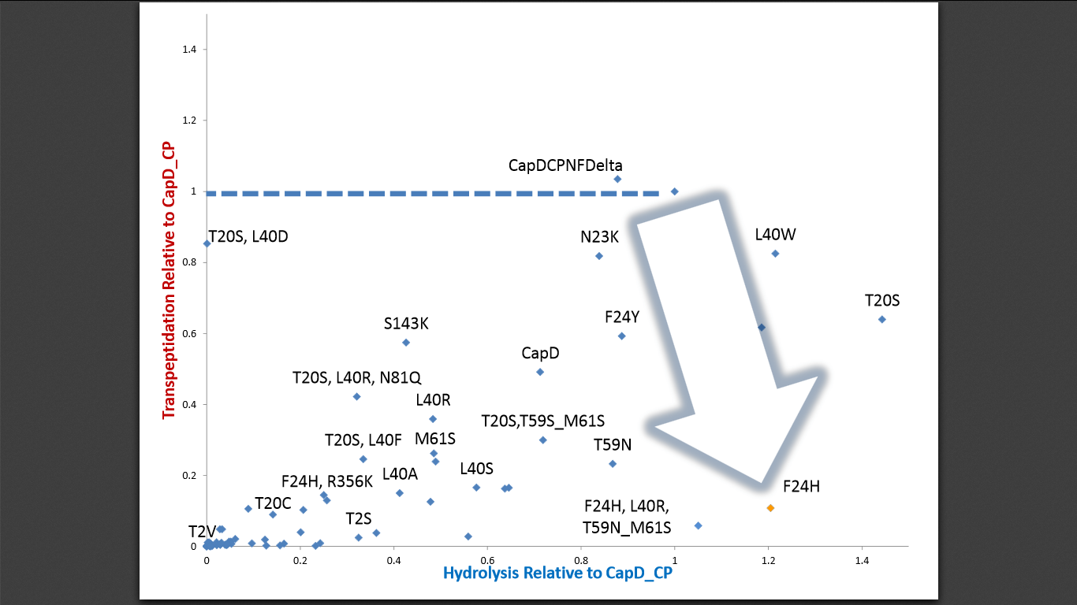
Designed, built, & tested 87 variants
Succeeded in altering the reaction specificity

