Slide 1
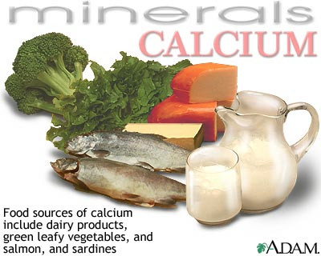
Calcium
Nisha Crouser and James Stewart

Slide 2
Role of calcium in humans
Building strong bones and teeth
Clotting blood
Sending and receiving nerve signals
Squeezing and relaxing muscles
Releasing hormones and other chemicals
Keeping a normal heartbeat

Slide 3
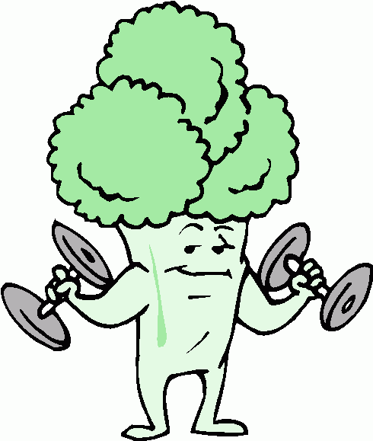
Strengthens Cell Walls
“Calcium builds strong bones!”
Calcium is critical in plant cell wall stability.
Calcium deficiency in plants can cause cell wall collapse.
This is an even bigger problem in younger tissues, as calcium is non-mobile once it is taken up into the cell wall.

Slide 4
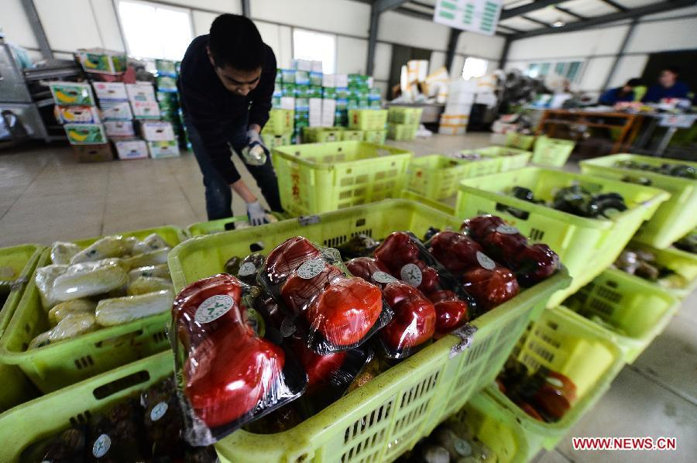
Keeps fruit firmer longer
Extra exposure to calcium leads to firmer fruit and delayed ripening.
spraying during development or application after picking
Calcium connects proteins and lipids in the cell membrane, stabilizing the cell surface.
Important during vegetable shipping and distribution

Slide 5
Calcium Localization in Cell
In some plants tissues, Ca²⁺ makes up 10% of total tissue dry weight.
High concentrations in vacuole, cell wall, ER, and chloroplast
Very low concentration in cytoplasm (0.1-0.2 micromolar)

Slide 6
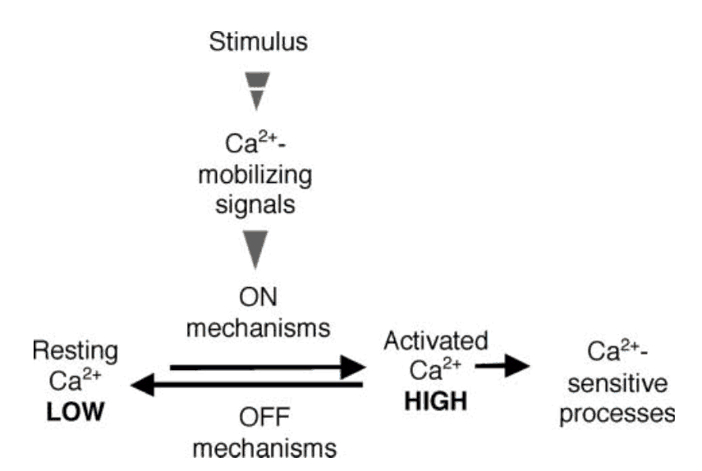
Calcium in Plant Signaling
Calcium is extremely important in signal transduction in the cell.
Changes in cytosolic Ca²⁺ concentration trigger events in the cell such as enzyme activation.
Ca²⁺ events often involve complex molecular interactions such as phosphorylation cascades.

Slide 7
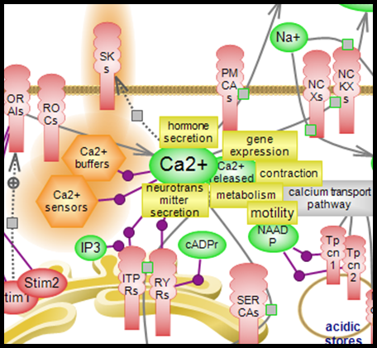
Calcium can be toxic to the plant
Calcium distribution must be strictly controlled.
many Ca²⁺ dependant enzymes are found in the cytoplasm.
If not sequestered in certain areas, Ca²⁺ ions can inadvertently trigger many responses.

Slide 8
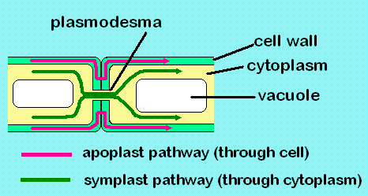
Uptake of Calcium
apoplast- spaces between the cells
Roots
Xylem
Shoot
* transported as Ca²⁺ or complexed with organic acids
(White, 2009)
symplast- through cytoplasm of cells linked together by plasmodesmata

Slide 9
Interactions with other minerals
Plants rarely lack calcium supply from soil
Calcium deficiency: acidic soil (high Al³⁺) and saline soils (high Na⁺)
Inverse relationship: high Ca²⁺ reduced uptake of Na⁺ and Al³⁺
High Mg²⁺ and K⁺ reduced Ca²⁺ uptake

Slide 10
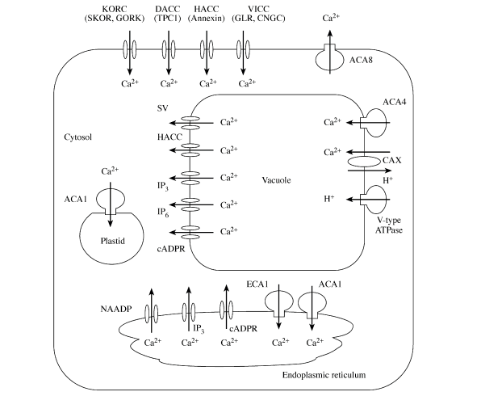

Slide 11
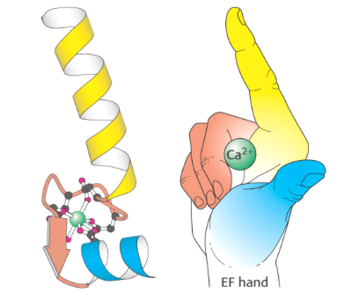
Ca²⁺ binding proteins
Calmodulin (CaM)
up to 4 Ca²⁺ molecules bind
Calcineurin B-like proteins
Calcium dependent protein kinases (CDPK)
Calreticulin, calsequestrin, calnectin
Ca²⁺ sequestering protein in ER, molecular chaperone

Slide 12
Ca²⁺ transport channels
Hyper-polarization activated channels
Annexin genes
Voltage-independent cation channels
glutamate receptor protein families (GLR)
members of cyclic nucleotide gated channel (CNGC)
Depolarization activated Ca²⁺ channels
TPC1- two pore calcium channel protein
Ca²⁺ permeable rectifying K⁺ channels (KORC)
SKOR
GORK

Slide 13
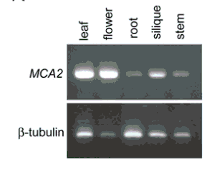
Ca²⁺ mechanosensitive channels
membrane proteins capable of responding to mechanical stress over a wide dynamic range of external mechanical stimuli
MSL gene family
MCA1 and MCA2 in Arabidopsis thaliana
overlapping and distinct roles
both involved in mediating Ca²⁺ uptake

Slide 14
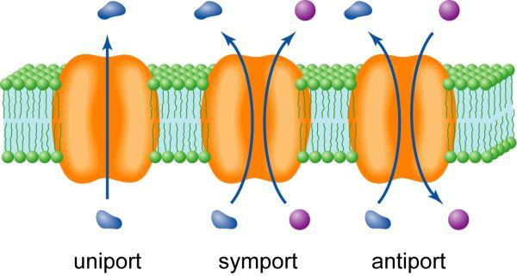
Ca²⁺ antiporters
CAX genes
Ca²⁺/proton exchanger
ECA/ACA gene family
Maintain low concentrations of cytosolic Ca²⁺
export Ca²⁺ to vacuoles, ER, plastids, and apoplast

Slide 15
Bibliography
Hirschi KD. “The calcium conundrum. Both versatile nutrient and specific signal.” Plant Physiology 136 (2004), 2438–2442.
Li, Legong, Beom-Gi Kim, Yong hwa Cheong, Girdhar K. Pandey, and Sheng Luan. “A Ca2+ signaling pathway regulates a K+ channel for low-K response in Arabidopsis.” Proc Natl Acad Sci U S A. 103.33 (2006), 12625-12630.
National Institutes of Health, Office of Dietary Supplements. Dietary Supplement Fact Sheet: Calcium. Accessed February 12, 2013.
Tuteja, Narendra, and Shilpi Mahajan. “Calcium Signaling Network in Plants: an Overview.” Plant Signaling & Behavior 2.2 (2007), 79-85.
White, P.J., and MR Broadley. “Calcium in plants.” Annals of Botany 92 (2003), 487-511.
White, P.J., and MR Broadley. “Biofortification of crops with seven mineral elements often lacking in human diets – iron, zinc, copper, calcium, magnesium, selenium and iodine.” New Phytol. 182 (2009), 49–84.

