Slide 1
CRISPR System
Caroline Vrana
Davidson College
Synthetic Biology
Summer 2012

Slide 2
Big Picture
Non-promoter gene regulation
Modular Selection Mechanism

Slide 3
Full version CRISPR sequence
Yellow= BioBrick prefix and suffix
Blue= leader sequence
Pink= CRISPR repeat
Greens= GFP target spacer
Reds= AmpR target spacer

Slide 4
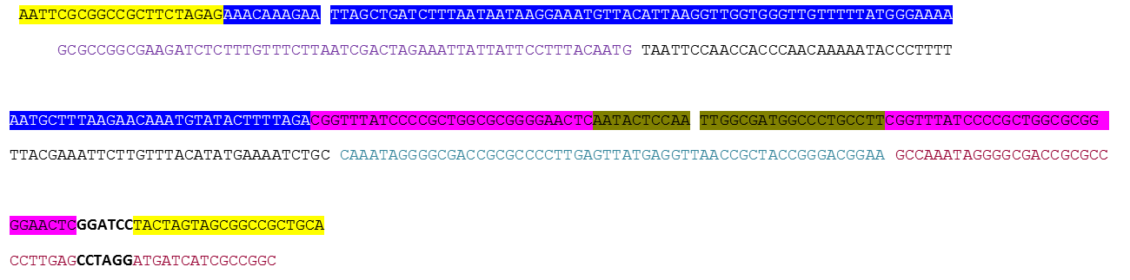
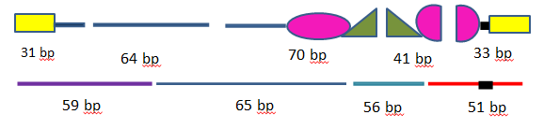
Simplified synthetic CRISPR sequence
BioBrick ends
Leader Sequence
CRISPR repeat
GFP target spacer
BamHI recognition site

Slide 5
Ligation combinations
Reporter Genes
GFP
  pSB1A8
  pSB4A8
  pSB1C8
  pSB4C8
RFP
  pSB1A8
  pSB4A8
  pSB1C8
  pSB4C8
CRISPR
  In pSB1K8
All ligations were successful and all in the GCAT-alog

Slide 6
Oligo Assembled CRISPR Experiment Results

Slide 7
Ratio of GFP fluorescence
Expected → no green in CRISPR colonies
Results → real green fluorescence

Slide 8
Company Synthesized CRISPR experiments

Slide 9
CRISPR in pSB1K8
GFP and RFP in pSB4A8
Expected → no growth
Results → no growth

Slide 10
CRISPR in pSB1K8
GFP and RFP in pSB4C8
Expected → no green fluorescence (only red)
Results → real green fluorescence

Slide 11
Conclusions/Future Steps
Company synthesized CRISPR System → didn’t destroy GFP
  Re-do experiment → more colonies to screen
Put into modular selection mechanism

Slide 13
Background
CRISPR
  Clustered Regularly Interspaced Short Palindromic Repeats
Functions as the prokaryotic “immune system”
Found first in E.coli in 1987
Found in 90% of archaea and 40% of bacteria tested so far

Slide 14
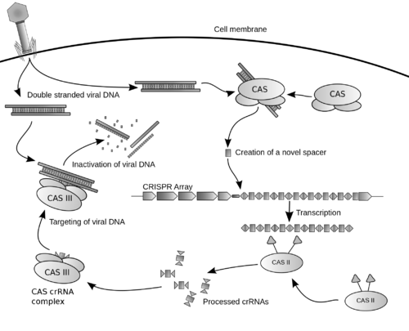
CRISPR process
www.wikipedia.org

Slide 15
Full version CRISPR sequence
Yellow= BioBrick prefix and suffix
Blue= leader sequence
Pink= CRISPR repeat
Greens= GFP target spacer
Reds= AmpR target spacer

Slide 16
Problems
Long turnaround time for synthetic CRISPR sequence
Sent off sequence to be synthesized
In the meantime…
  Simplified the sequence to only 1 target spacer and 2 CRISPR repeats
  Assembling sequence on my own from overlapping oligos

Slide 17
Simplified synthetic CRISPR sequence
BioBrick ends
Leader Sequence
CRISPR repeat
GFP target spacer
BamHI recognition site

Slide 18
Simplified Sequence
Includes:
  BioBrick prefix and suffix
  Leader sequence (in lieu of promoter)
  CRISPR repeats
  GFP target spacer
  BamHI recognition site → for expanding the sequence in the future

Slide 19
End goals
Co-transform E.coli cells with 2 plasmids
  1. Synthetic CRISPR sequence in Kan plasmid
  2. A target plasmid (including target spacer of GFP and/or AmpR)
Have the CRISPR plasmid destroy the target plasmid→ destroying the ampicillin resistance
Assess growth (or lack of growth)

Slide 20
Non-CRISPR plasmid
Ligating different combinations of inserts/plasmids
  GFP in non-AmpR plasmid
  RFP in AmpR plasmid
  GFP in AmpR plasmid

Slide 21

Ligations/Transformations
GFP
OR
GOI
RFP
OR
CRISPR

Slide 22
Ligation combinations
INSERTS
J04450 (RFP)
K091131 (GFP)
CRISPR sequence
PLASMIDS
pSB1A8
pSB4A8
pSB1C8
pSB4C8
pSB1K8

Slide 23
Parts- Inserts
GFP
  K091131
  pLacIQ1 + RBS + GFP + TT
  Originally in pSB1A2
RFP
  J04450
  pLacI + RBS + RFP + TT
  Originally in pSB1A2

Slide 24
Parts- Plasmids
pSB1A8
  J119043
pSB4A8
  J119048
pSB1C8
  J119045
pSB4C8
  J119049
pSB1K8
  J119046
  Cloning CRISPR sequence into here

Slide 25
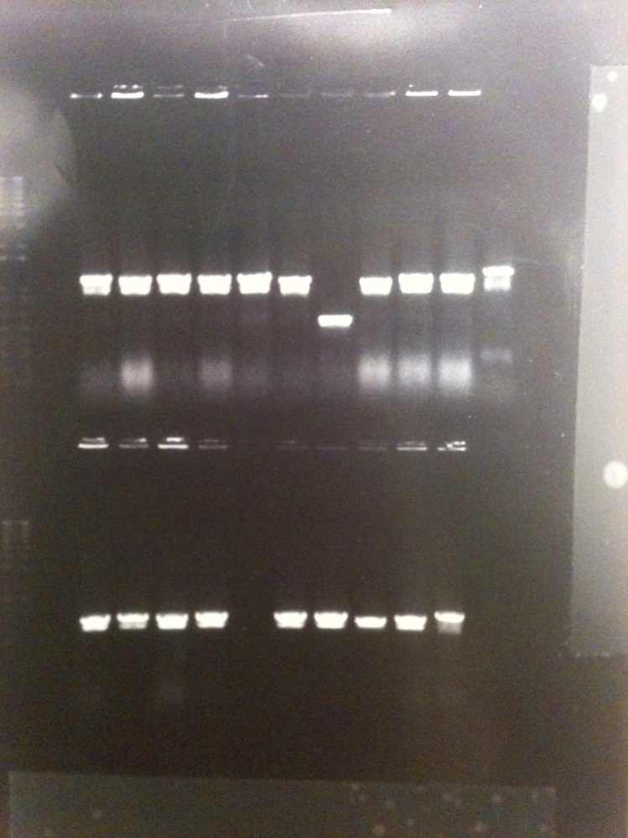
GFP in Amp plasmids
GFP and pSB1A8
  Some larger than negative control
  Sent off MP DNA of 2 colonies to be sequence verified
  Ligation worked
GFP and pSB4A8
  Experimental wells larger than negative control
  Sent off 2 colonies to be sequence verified
  Ligation worked

Slide 26
Problems with GFP
After sequence verification of ligations-
  Found 35 bp spontaneous insertion mutation
  Has been documented in the promoter before
  Will still work → but not as bright

Slide 27
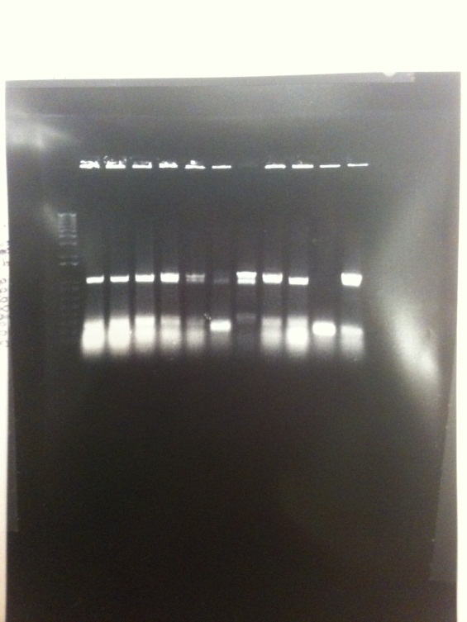
RFP in pSB4A8
Some colonies were visibly red
Colony PCR results
  Experimental DNA larger than negative control
  Sent off DNA from 2 colonies to be sequence verified
  Ligation worked

Slide 28
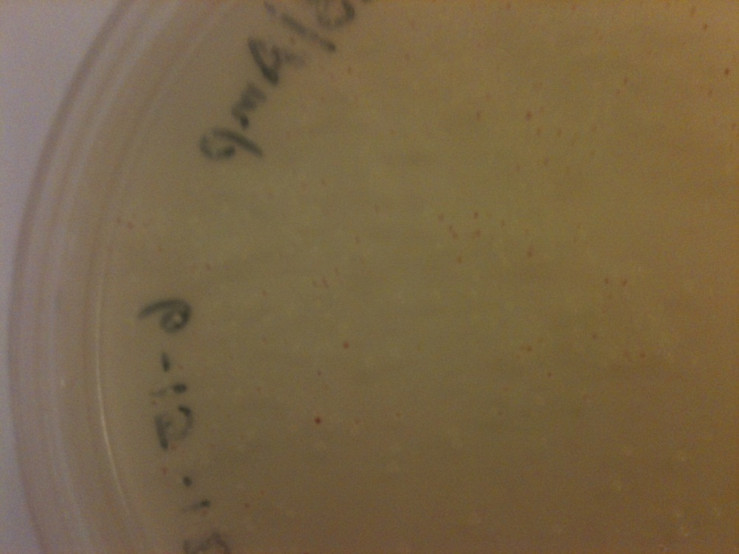
RFP in pSB1A8
RFP and pSB1A8
Some colonies glowed visibly red → no need to do colony PCR and sequence verification
Ligation worked

Slide 29
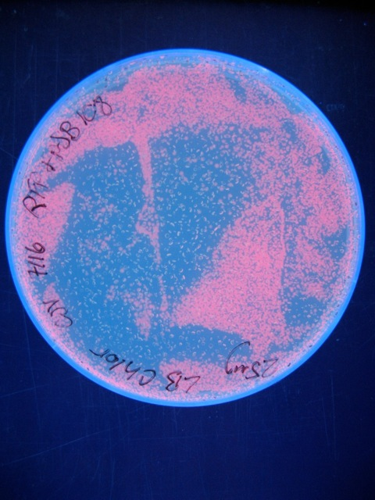
RFP in pSB1C8
Cells grown from glycerol stocks of RFP and pSB1C8
Ligation worked

Slide 30
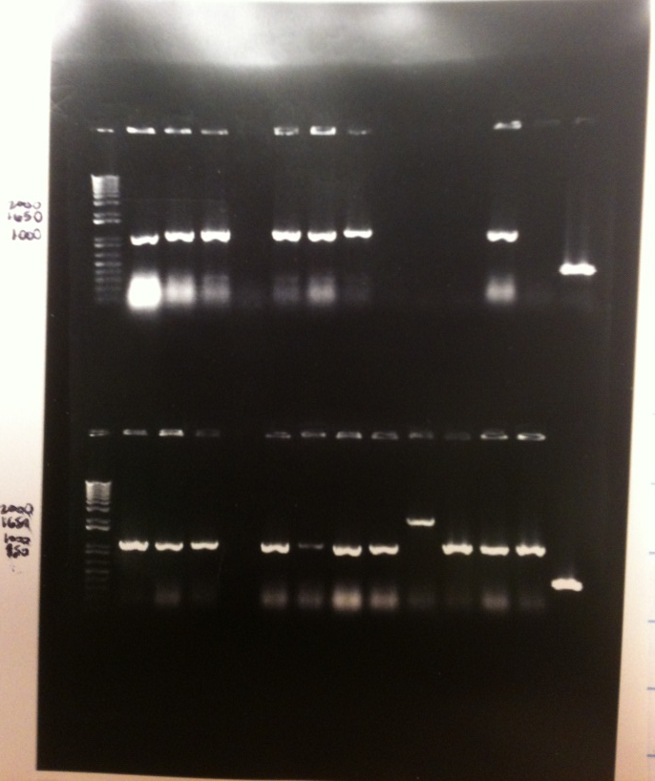
GFP and RFP in pSB4C8
Colony PCR
Most of the colonies are larger than negative control
Both red and green fluorescent colonies in later experiments
Ligation worked
Neg. control
GFP
RFP

Slide 31
Successful Ligations
8 possible combinations successfully ligated
Glycerol stocks made and located in GCAT-alog

Slide 32
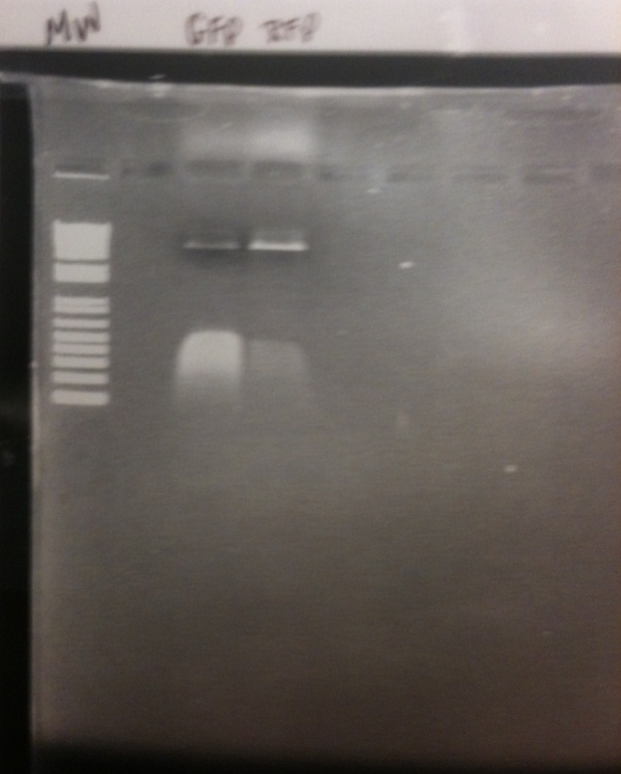
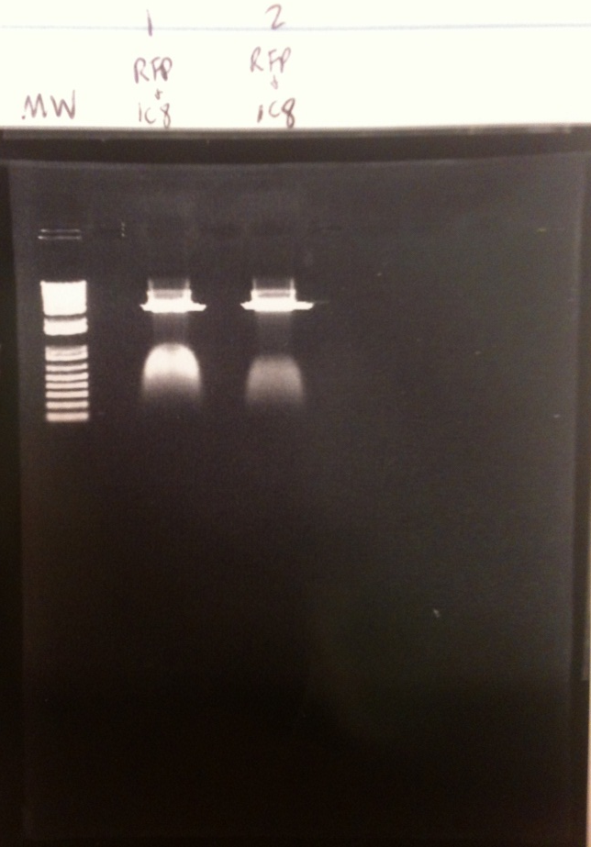
Problems with Cloramphenicol plasmids
GFP and RFP in pSB4C8
RFP in pSB1C8

Slide 33
CRISPR experiment
Oligos arrived on 7/6/12
Assembled by boiling
Ligated CRISPR sequence into pSB1K8 plasmid
Did colony PCR on 12 colonies

Slide 34
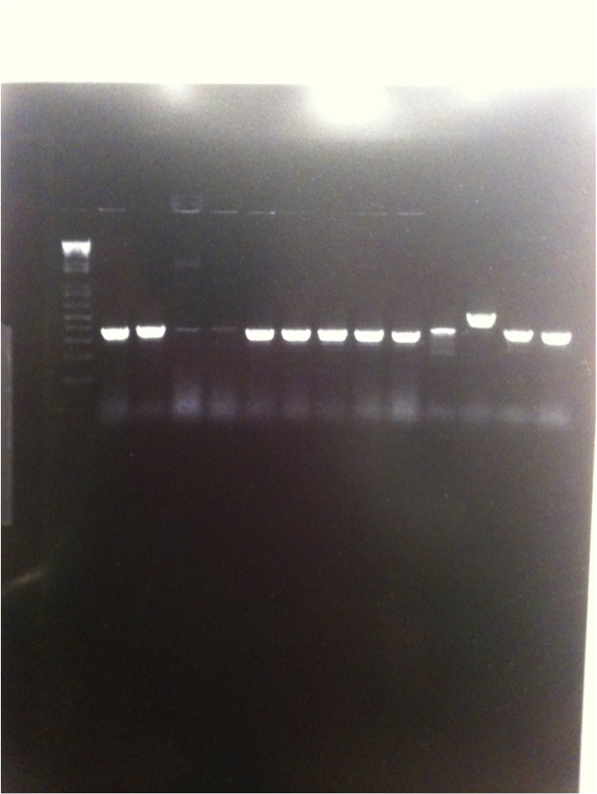
Colony PCR of CRISPR sequence
One colony seems to be the right length

Slide 35
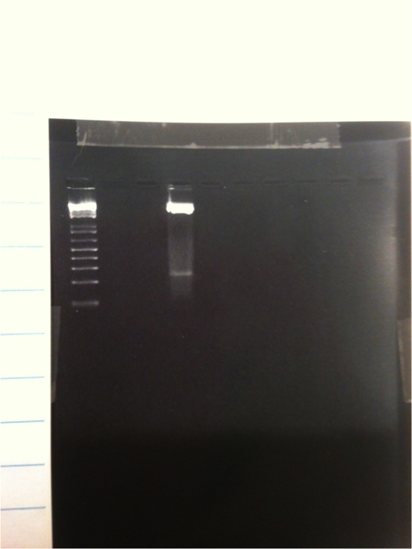
Length verification of CRISPR
Length verification of the one colony PCR product
Small smear of band seems to be right length (around 240)

Slide 36
CRISPR Experiment
Cotransformations
4 experimental conditions
  Only the CRISPR sequence
  Only GFP in pSB4A8 and RFP in pSB4A8
  Empty pSB1K8 plasmid, GFP and RFP in pSB4A8
  CRISPR sequence, GFP and RFP in pSB4A8

Slide 37


Co-Transformations
GFP
CRISPR
RFP
Selective Media

Slide 38
Results

Slide 39
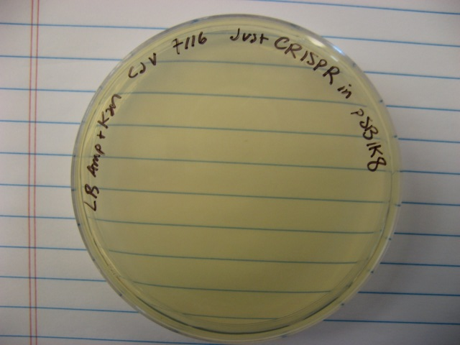
Only CRISPR sequence
Expected → no growth
Result → no growth

Slide 40
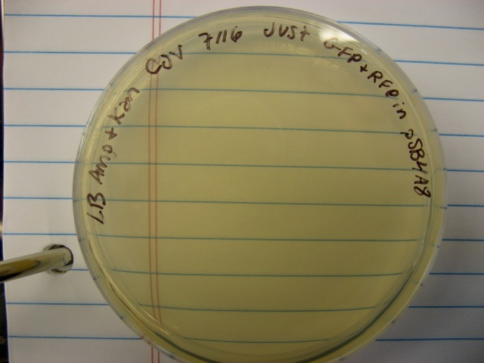
Only GFP and RFP in pSB4A8
Expected → no growth
Results → no growth

Slide 41
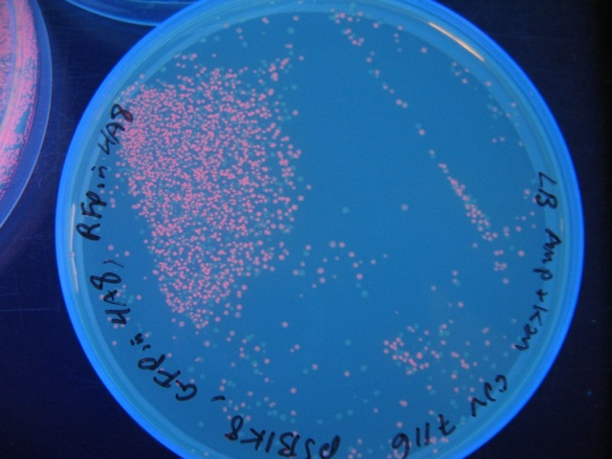
Empty pSB1K8, GFP in pSB4A8, RFP in pSB4A8
Expected → equal amounts of green and red colonies
Results → about equal amounts of green and red colonies

Slide 42
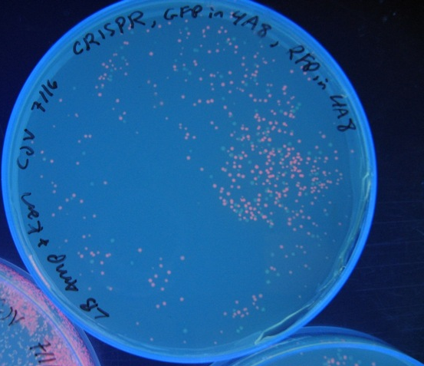
CRISPR sequence, GFP in pSB4A8, and RFP in pSB4A8
Expected → only red colonies
Results…

Slide 43
Ratio of GFP fluorescence

Slide 44
Conclusions
The CRISPR sequence did not destroy the plasmid containing GFP
Reason → 1 nucleotide missing in the GFP target spacer when compared to the GFP gene sequence

Slide 45
2nd CRISPR Sequence
Synthesized sequence from the company came 7/18
New Experiment
  Only GFP and RFP in pSB4A8
  Empty pSB1K8 plasmid, GFP and RFP in pSB4A8
  CRISPR, GFP and RFP in pSB4A8
  CRISPR, GFP and RFP in pSB4C8
The CRISPR should destroy plasmids containing GFP and Ampicillin resistance

Slide 46
GFP and RFP Fluorescence

Slide 47
GFP and RFP in pSB4A8
A plates only
- control

Slide 48
Empty pSB1K8
GFP and RFP in pSB4A8
K and A plates

Slide 49
Empty pSB1K8
GFP and RFP in pSB4C8
K and C plates

Slide 50
CRISPR in pSB1K8
GFP and RFP in pSB4A8

Slide 51
CRISPR in pSB1K8
GFP and RFP in pSB4C8

Slide 52
Conclusions
CRISPR system didn’t work
  Minimal GFP fluorescence and no RFP fluorescence

Slide 53
Future Steps
Continue working on synthetic CRISPR system
If/When the sequence works, find applications
Put CRISPR plasmid into cells → destroy something bad-ish only if the cell is making a product we want it to

Slide 54



E. coli
Product
stress
E. coli
Modular Selection
Beneficial

