Slide 1
HRS Cross
Enzymes that have mutations causing auxotroph’s

Slide 2
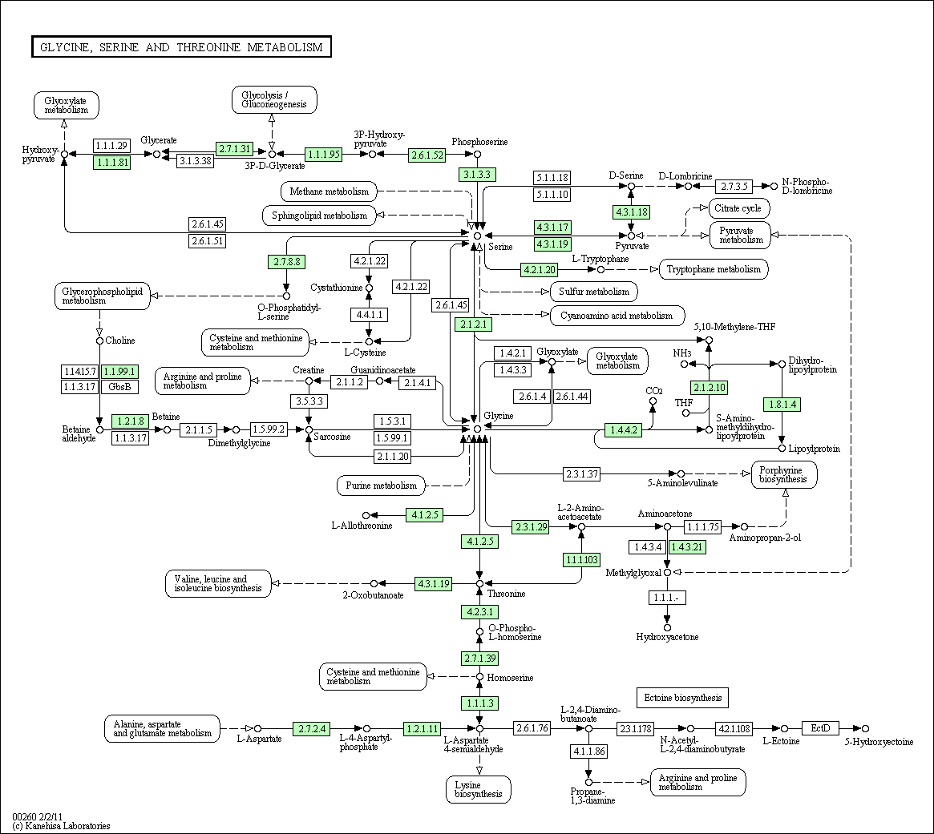
Threonine

Slide 3
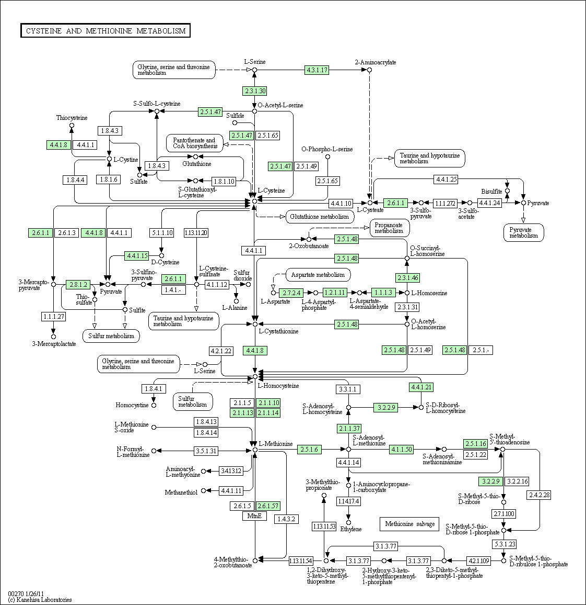
Methionine

Slide 4
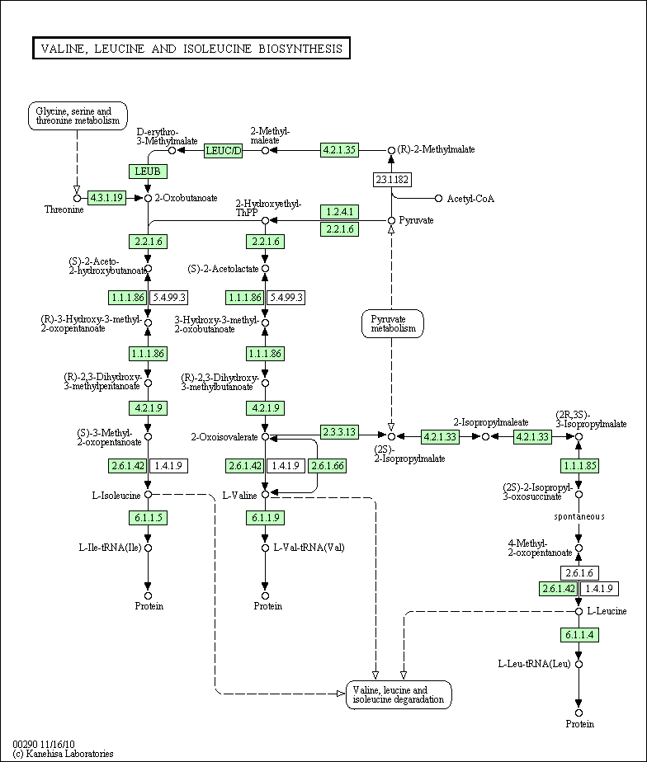
Leucine

Slide 5
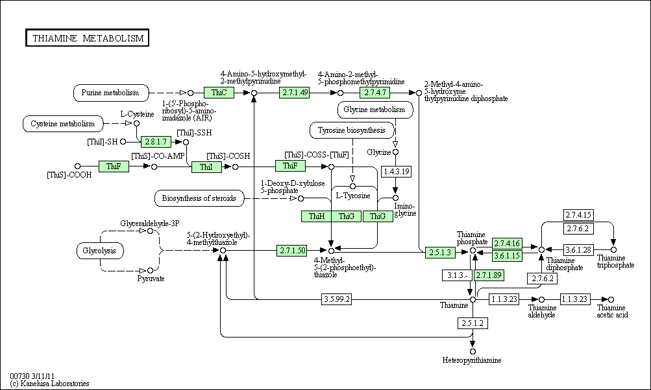
Thiamin

Slide 6
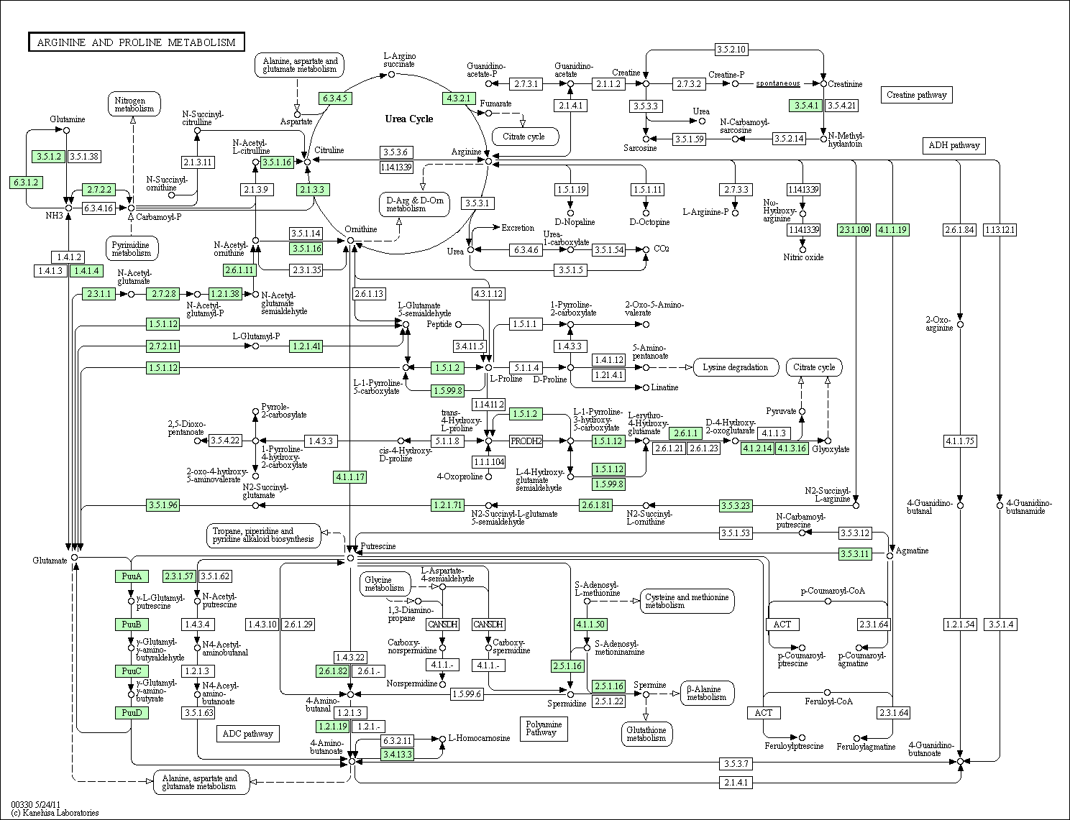
Arginine

Slide 7
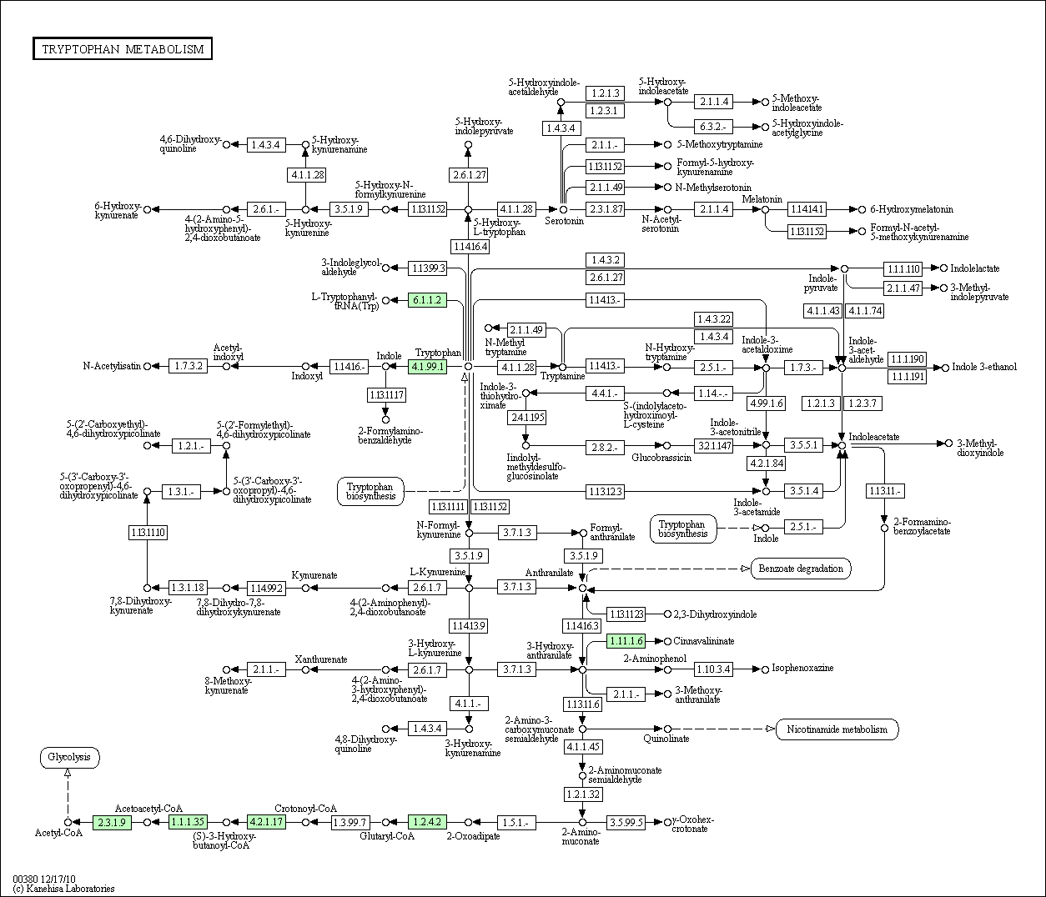
Tryptophan

Slide 8
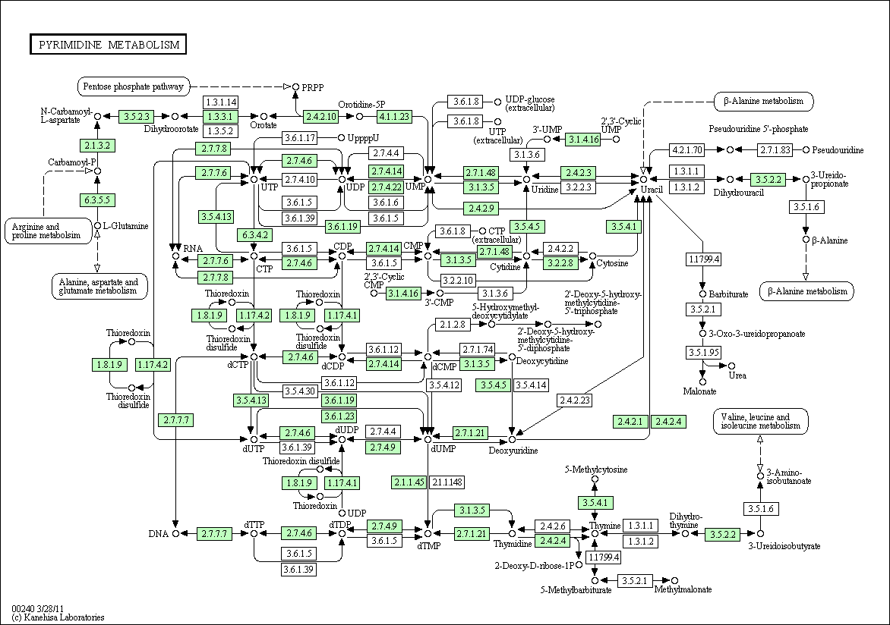
Thymine

Slide 9
Uracil

