Slide 1
The Search for Zinc Storage and Uptake Proteins in B. oleracea
Chris Polo and Katie Gwathmey

Slide 2
Benefits of Zinc
Necessary for for high plant growth
Functional subunit of >300 proteins
Role in key cellular processes
Role in mediating reactive oxygen species (ROS)
Notes:
Zinc finger proteins + RNA polymerases
Structure + catalytic role in enzymes, transcription factors, ribosomes
Approximately 1230 proteins contain bind to, transport zinc (PCR paper)
We found tons of zinc finger proteins/ or “zinc ion binding proteins” around each QTL
Involved in processes like transcription, translation, membrane integrity, reproduction (all necessary cell processes)
15-20 micrograms – lead to zinc deficiency + chlorotic leaves

Slide 3
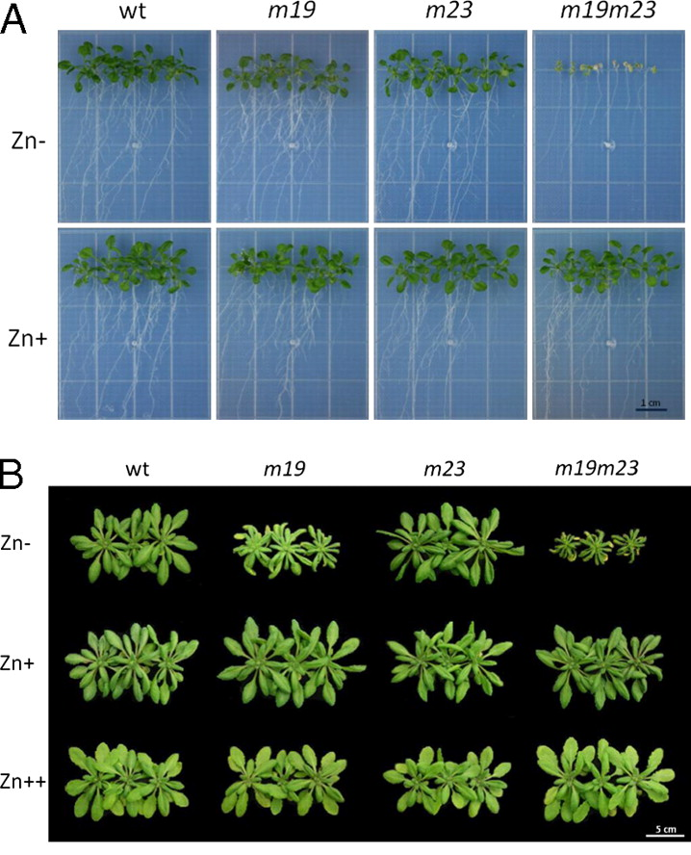
Notes:
Zn Deficiency (specifically ZIP promoters are knocked out) → more details to come (bZIP19 and bZIP23)
-lack of growth (when lacking proteins that are responsible for pulling Zn into the cell)
-more showing that if a plant does not get Zn (Zn- environment + no zip proteins = cannot grow)
Use it to show that

Slide 4
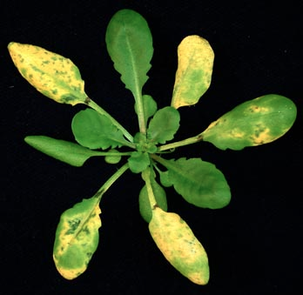
Negative Effects
Excessive concentrations:
Impair growth
Cause chlorosis
Interfere with cellular processes by binding with incorrect substrates in competition with Fe and Mg
Notes:
When in cytoplasm in excess amounts
-bind with incorrect substrates
-in competition with Fe and Mg
-mess up cellular problems
What does plant do to avoid Zn toxicity?
Optimum is somewhere in the middle
Image citation: http://www.mmg.msu.edu/faculty/he/HeFig._1.jpg

Slide 5
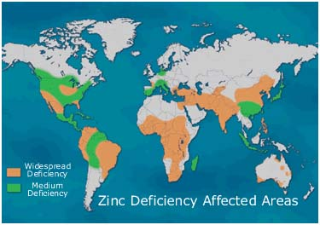
Zinc in the Environment
1/3 of worlds population experiences Zn deficiencies
Bioremediation
About 30% of agricultural soils are zinc deficient
Notes:
1/3 suffers from zinc deficiency
Children are more susceptible
Major Health issues: impair brain function + mental development + disturbances in immune system + physical development
Bioremediation of soils contaminated by industrial waste
Mining sites + industrial waste
Deficient
High pH + low soil content
Zinc deficiency can be caused by over production of crops
pH
http://download.springer.com/static/pdf/155/bok%253A978-94-007-4470-7.pdf?auth66=1398447449_47740dfae87bc96b17b6c72c7589ddf4&ext=.pdf
Why is zinc important for humans?
Explain what mediating ROS are
Explain bioremediation

Slide 6
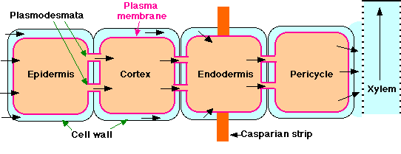
Zinc Uptake → Xylem
ZIP
Zn²⁺
HMA
Zn²⁺
Zn²⁺
PCR2
IRT
Zn²⁺
Zinc is dissolved/digested in soil and enters cell as cation Zn²⁺
ZIP and Iron Regulated Transporters transport Zn²⁺ into root cell cytosol
Zn²⁺ moves through symplast, through pericycle towards xylem
Plant Cadmium Resistance Protein and Heavy Metal ATPases move Zn²⁺ into the xylem
Notes:
http://www.pnas.org/content/107/22/10296/F3.expansion.html

Slide 7
Zinc Entrance to cell → Storage in Vacuole and Chloroplast
Vacuole
Zn²⁺
HMA2
HMA3
MTP1
Chloroplast
Zn²⁺
Zn²⁺
ZIP4*
ZIP4
ZIP proteins bring Zn²⁺ into leaves/shoots/plant cells where either used or sequestered in vacuoles
Heavy Metal ATPases and Metal Transport Protein (MTP1) transport Zn²⁺ into the vacuoles
Notes:
*specifically into the florets
Stored in chloroplasts as well as vacuoles
Chris talk about ZIP4
-MTP1 into vacuole
-HMA2 efflux from out of the membrane
-very basic – may not be exclusive to plasma membrane + HMA3

Slide 8
Fruits of our Labor: The proteins involved in Zn transport and storage
ZIP
ZIP1
ZIP2
ZIP3
ZIP4
Zip Transcription Factors
bZIP1
bZIP19
bZIP23
PCR2
IRT:
IRT1
IRT2
IRT3
HMA:
HMA2
HMA3
HMA4
MTP1/ZAT1

Slide 9
Zn QTL’s in B. Oleracea
Chromosome 6 – 3,555,943
Boron QTL
Chromosome 8 – 34,578,133
Chromosome 9.1- 3,555,943
Iron QTL
Chromosome 9.2 - 41,992,687
Boron QTL
Sodium QTL
Notes:
We were looking for none of the same genes for Sodium or Boron
However looking for Iron Regulated Transporters

Slide 10
Graphical Representations of Results

Slide 11
Graphical Representations of Results

Slide 12
Graphical Representations of Results

Slide 13
Graphical Representations of Results

Slide 14
Results- Chromosome 6
0
IGB
BLAST
-1,000,000
“ZIP 13”
PCR2
“Plant Cadmium Resistance Protein”
9,847,363
+1,000,000
19,847,363
Notes:
-Maybe image of the chromosome → zoomed in with BLAST on one side and IGB the other
-say that it was

Slide 15
IAA-alanine resistance protein 1 (IAR1)
Location: 824,728 bp away
Accession Number: AT1G68100.1
Biological process: metal ion transport, transmembrane transport
Has similar His residues and transmembrane domains ZIP proteins (Laswell et al.)
Located in: endoplasmic reticulum, extracellular region, membrane
Expressed in most plant cell types as well as most developmental stages
Notes:
Further papers: http://www.ncbi.nlm.nih.gov/pubmed/17028341
Papers state functions of protein in plant hormone auxin regulation
http://www.plantcell.org/content/12/12/2395.full
Similar structure to ZIP proteins
Cannot rescue yeast mutant phenotype
However, IAR1 may transport zinc, copper, or another inhibitory metal out of the ER and away from the hydrolases
Conserved His residues in transmembrane domains IV and V of the ZIPS = essential for metal transport in Arabdipsis IRT and conserved
http://www.arabidopsis.org/servlets/TairObject?id=137069&type=locus
Expressed in petal differentiation and expansion stage
Including expressed in plant cells
824,728 bp away

Slide 16
Plant Cadmium Resistance 12
Location: 412,423 bp away
Accession number: Q9SX26/AT1G68630.1
Biological Process: Unknown, may be involved in heavy metal transport based on structure
Located in: Potentially in membrane
Expressed in most plant cell types as well as most developmental stages
Notes:
TAIR: http://www.arabidopsis.org/servlets/TairObject?type=locus&name=AT1G68630
Uniprot:
http://www.uniprot.org/uniprot/Q9SX26
Has transmembrane helix → similar structure to PCR
“Arabidopsis PCR2 is a zinc exporter involved in both zinc extrusion and long-distance zinc transport”
-Song W.Y.; Choi K. S.; Kim do Y.
-maybe compare the two amino acid sequences?
http://www.plantcell.org/content/22/7/2237.long
http://www.plantcell.org/content/22/7/2237.full
-PCR2 – redistribution + detoxification
-PCR2 – removes from rootez – efflux transporter
-epidermal cells + xylem
-not overlapping with hama2
Plant Cadmium Resistance
Cadmium transporter but also involved in Zn transport
Localized in root epidermis and xylem parenchyma
Important in efflux of Zn as well as root to shoot transport
9,434,940-9,435,744

Slide 17
Results- Chromosome 8
24,578,133
BLAST
IGB*
-1,400,000
MTP1/ZAT
Present but unlabeled
HMA2/HMA4
H(+)- ATPase 5
H(+)- ATPase 1/2
34,578,133
HMA1
HMA2/HMA4
Ca²⁺ ATPase 7
bZIP1
+1,000,000
44,578,133
Notes:
IGB modified → everything was mislabled so determined these proteins via blast

Slide 18
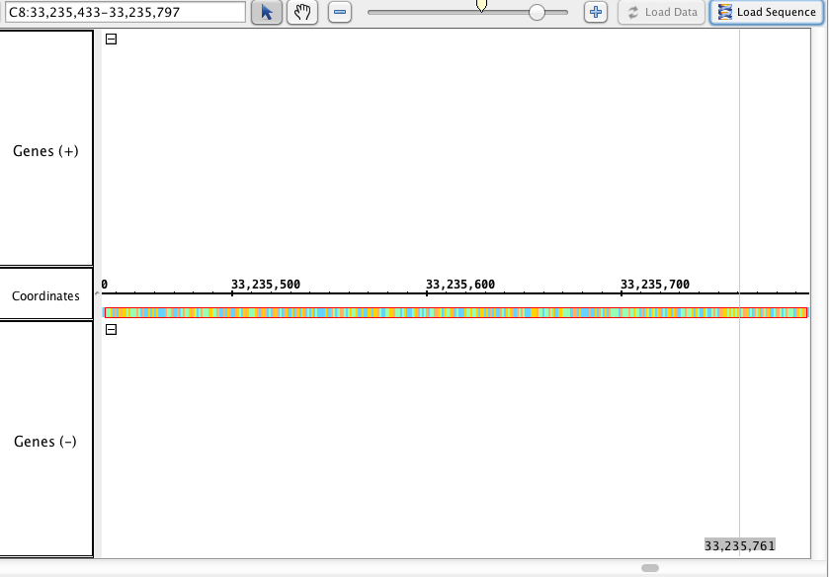
ZAT1/MTP1 Missed in IGB:

Slide 19
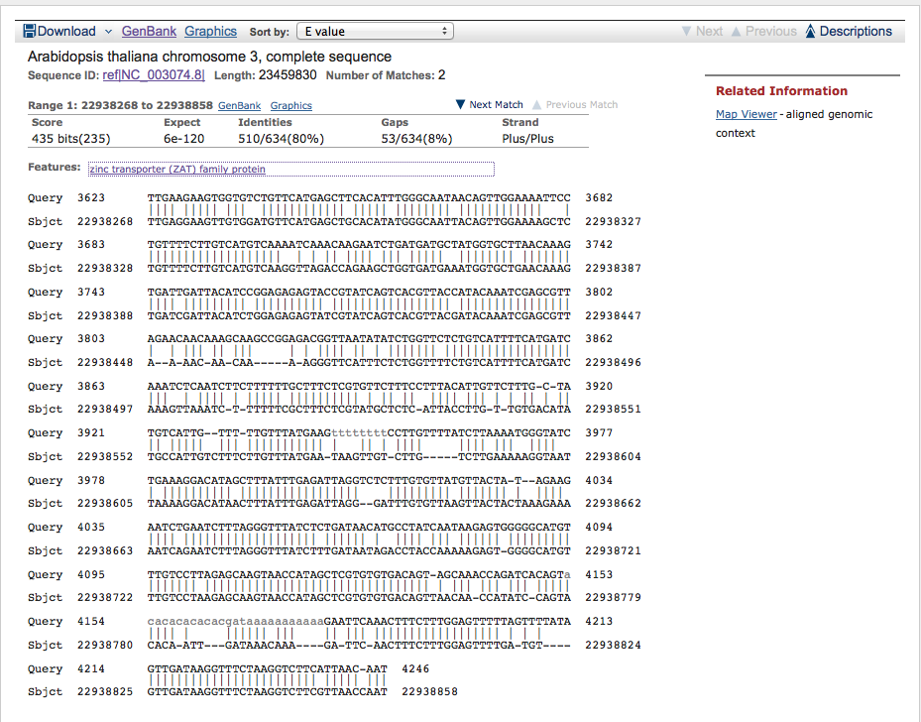
Blast Results:
80% Identity
E value: 6e⁻¹²⁰

Slide 20
MTPA1 – ZAT Family
Location: 1,342,700 bp away
Accession Number: AT3G61940.1
Member of Zinc transport (ZAT) Family
Cation diffusion facilitator
Movement of Zn²⁺ out of the cytosol
Located in membrane
Expression is unknown
Notes:
Efflux of metals out of cytoplasm → either into extraceulluar membrane or organelles
-MTP1 overexpressed then Zn becomes resistant to concentrations of Zn normally toxic
-mt1 can bind to Zn on metal blot →
-not sure on the exact mechanism of transport but either uses another cation to fuel transport across membrane or does not use antiport mechanism
-mRNA is expressed in all tissues with zinc
http://journal.frontiersin.org/Journal/10.3389/fpls.2013.00144/full
http://pcp.oxfordjournals.org/content/45/12/1749.long
-Catalytic
http://www.arabidopsis.org/servlets/TairObject?type=locus&name=AT3G61940
33,235,433-33,235,797

Slide 21
Notes:
-MTP1 → Zn transport (vacuolar transport + widely expressed in the plant_
-MTP3 → transport Zn and Co heterologously + more in root epidermis and cortex
Hyperaccumulators → mtp1 is highly expressed (able to sequester in vacuole more efficiently)
MTP8 is seen = higher transport efficiency

Slide 22
H(+)- ATPase 5
Location: 135,409 bp away AND 128,504 bp
Labeled as “Plasma membrane H(+)-ATPase”
Accession Number:AT2G24520.1
Biological Process: ATP biosynthetic process, ATP catabolic process, cation transport, metabolic transport
Molecular Function – “metal ion binding”
Located in plasma membranes
Expressed in most plant cell types as well as most developmental stages
Notes:
http://www.ncbi.nlm.nih.gov/protein/15224157?report=genbank&log$=protalign&blast_rank=1&RID=MSR4RUPX014
Specifics on pump are unknown but still a good lead → general cation pump and also close to the QTL
Same location as HMA2 and HMA4 querry hit (similar binding domains)
34,442,724-34,443,770 and 34,449,629 – 34,453,133

Slide 23
H(+)- ATPase 1/2
Location:75,077 bp away
Accession Number:AT4G30190.2
Biological Process: ATP biosynthetic process, ATP catabolic process, cation transport, metabolic transport
Molecular Function – “metal ion binding”
Located in Golgi apparatus, plasma membrane, plasmodesma, vacuolar membrane
Expressed in most plant cell types as well as most developmental stages
Notes:
Similar E-values and querry hits on NCBI blast for this sequence
http://www.arabidopsis.org/servlets/TairObject?type=locus&name=AT4G30190
Maybe not this one…
75,077 bp away
34,653,982-34,653,210

Slide 24
HMA1
Location: 656,827 bp away
Labeled as “Potassium-transporting ATPase B chain”
Accession Number:AT4G37270.1
Biological Process: ATP biosynthetic process, calcium ion transport, cation transport, metabolic process, metal ion transport, response to toxic substance, zinc ion homeostasis
P_{IB}-type ATPases ; zinc transporting ATPase activity
Located in chloroplast, chloroplast envelope, plasma membrane, plastid
Expressed in most plant cell types except root as well as most developmental stages
Notes:
http://www.arabidopsis.org/servlets/TairObject?type=locus&name=AT4G37270
“HMA1 contributes to Zn (II) detoxification under conditions of excess zinc by reducing Zn content of Arabidopsis thaliana plastids”
http://www.ncbi.nlm.nih.gov/pubmed/19207208
ATP hydrolysis drives pumping of cations across membrane
Against the electrochemical gradient
8 transmembrane segments
“zinc, copper, cadmium, and cobalt activate ATPase of AtHMA”
http://www.ncbi.nlm.nih.gov/pubmed/18252706
34,921,306-34,921,138

Slide 25
Ca²⁺ ATPase 7
Location: 757,562 bp away
Accession Number:AT2G22950.1
Biological Process: calcium ion transmembrane transport, cation transport, cellular zinc homeostasis, pollen development
Located in plasma membrane
Expressed in collective leaf structure, flower, petal, pollen, pollen tube and during mature pollen stage and petal differentiation and expansion
Notes:
-calmodulin binding
-http://www.arabidopsis.org/servlets/TairObject?type=locus&name=AT2G22950
-lots of articles on how it is used in the development of pollen

Slide 26
Results – Chromosome 9-1
498,943
BLAST
IGB*
-2,060,000
HMA2/HMA4
Ca²⁺ ATPase 2
3,558,943
Copper Ion Transporter
bZIP1
+1,200,000
4,758,943

Slide 27
Copper Transporter 1 (COPT1) - IGB
Location: 4,068,689-4,069,617
Accession Number: AT5G59030.1
Biological Process: Copper ion transport, root development
Located in: Membrane
Molecular Function: Copper ion transmembrane transporter activity
Expressed in: Most plant cell types as well as most developmental stages

Slide 28
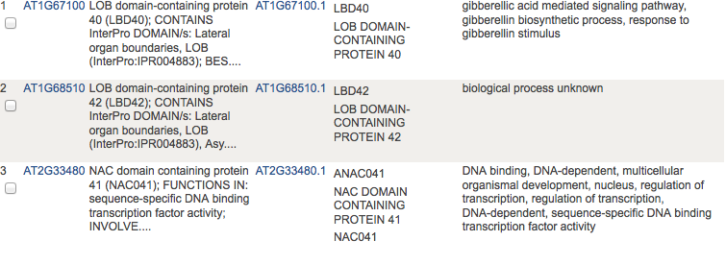
bZIP1- Blast
Name on IGB: Arm repeat-containing protein-like protein
Name on NCBI: U-box domain containing protein 41
Location: 4,747,155 - 4,748,429
Accession Number: NP_201062

Slide 29
HMA2-Blast
Name on IGB: Calcium transporting ATPase
Name on NCBI: Calcium-transporting ATPase2 (ACA2)
Location: 514,673 - 519,143
Accession Number: NP_191999
Where HMA2 was supposed to be located (514,950-517,671), ACA2 was completely encompassing the HMA2 location.

Slide 30
HMA4 - Blast
Same situation as HMA2
Location: 515,232-517,871
ACA2 also completely encompassed the location of HMA4 on Chromosome 9

Slide 31
Results – Chromosome 9-2
40,382,687
BLAST
IGB*
-1,600,000
HMA2
Conserved Hypothetical Protein
41,992,687
ZIP2
Present but unlabeled
IGB:
No Results except for:
Zinc Finger Proteins
Zinc Ion Binding Proteins
+1,000,000
42,992,687

Slide 32
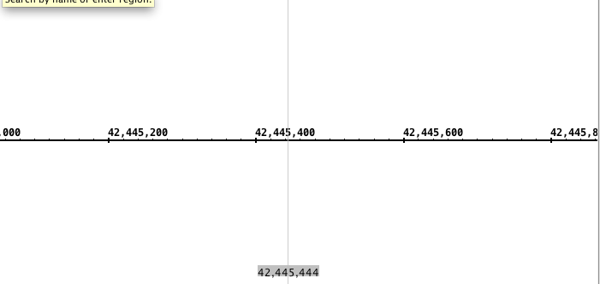
ZIP2 - Blast
Was not located on IGB.
Potential missing protein

Slide 33
HMA2 - Blast
Location: 40,587,673-40,597,074
Location of Conserved Hypothetical protein:
40,592,575 - 40,591,703
The protein found on IGB could be a partial sequence of the HMA2 protein.

Slide 34
Conclusions
Final thoughts?

Slide 35
Lit. Cited
1. NCBI “Arabidopsis gene ZIP4, encoding ZIP4;cation transmembrane transporter” Acessed 2.18.14 <http://www.ncbi.nlm.nih.gov/IEB/Research/Acembly/av.cgi?db=ara&term=zip4&submit=Go.>
2. Tair “Locus AT1610970” Acessed 2.18.14 <http://www.arabidopsis.org/servlets/TairObject?type=locus&name=AT1G10970.>
3. Assuncao, A., Herrero E. & Aarts, M. Arabidopsis thaliana transcription factors bZIP18 and bZIP23 regulate the adaptation to zinc deficiency. Proc Natl Acad 107(22), 10296-10301 (2010).
4. Claus, J., Bohmann, A. & Chavarria-Krauser, A. Zinc uptake and radial transport in roots of Arabidopsis thaliana: a modeling approach to understand accumulation. Ann Bot 112 (2), 369-380 (2012).
5. Eide, D. Zinc transporters and the cellular trafficking of zinc. Biochimica et Biophysica Acta 1763, 711-722 (2006).
6. Eren, E. & Arguello, J. Arabidospis HMA2, a Divalent Heavy Metal-Transporting P1B-Type ATPase, is involved in cytoplasmic Zn2+ Homeostasis. Plant Physiol 136 (3), 3712-3723 (2004).
7. Grotz, N. et al. Identification of a fmily of zinc transporter genes from Arabidopsis that respond to zinc deficiency. Proc. Natl. Acad. Sci. 2, 7220-7224 (1998).
8. Grotz, N., Fox, T. & Eide, D. Identification of a family of zinc transporter genes from Arabidopsis that respond to zinc deficiency. Proc. Natl. Acad. Sci. 95(12), 7220-7224 (1998).
9. Grotz, N. & Guerinot, M. Molecular aspects of Cu, Fe and Zn homeostasis in plants. Biochimica et Biophysica Acta 1763(7), 585-608 (2006).
10. Hoffman, N. Nicotianamine in Zinc and Iron Homeostasis. The Plant Cell 24(2), 373 (2012).
11. Milner, M., Seamon, J., Craft, E. & Kochian, L. Transport properties of membranes of the ZIP family in plants and their role in Zn and Mn homeostasis. J. Exp. Bot. 64 (1), 369-381 (2013).
12. Morel, M. et al. AtHMA3, a P1B-ATPase Allowing Cd/Zn/Co/Pb Vacuolar Storage in Arabidopsis. Plant Physiol. 148(2), 894-904 (2009).
13. Ricachenevsky, F., Menguer, P., Sperotto, R., Williams, L. & Fett, J. Roles of plant metal tolerance proteins (MTP) in metal storage and potential use in biofortification strategies. Front. Plant Sci. 4, 02/24/14 (2013).
14. Song, W. & et al. Arabidopsis PCR2 is a Zinc Exporeter Involved in Both Zinc Extrusion and Long-Distance Zinc transport. American Society of Plant Biologists 22 (7), 2237-2252 (2010).

Slide 36
PCRs and ZAT1/MTP1
0
24,578,133
0
31,992,6897
6,334,150-6,338,787
3,558,943
9,435,359-9,435,577
9,847,363
33,235,433 – 33,235,797
34,578,133
41,992,687
37,587,369 -37,623,000
49,041,858-49,040,752
19,847,363
44,578,133
13,558,943
51,992,6897

Slide 37
ZIPs and BZIPs
0
24,578,133
0
31,992,6897
1,204,821- 1,204,486
4,471,806- 4,472,477
3,558,943
6,336,927- 6,337,696
4,747,521- 4,748,336
27,478,676 – 27,478,906
9,847,363
34,578,133
41,992,687
34,992,885 – 43,993,553
42,445,498-42,445,391
14,200,498- 13,200,833
39,033,251- 39,033,706
49,050,708-49,050,175
51,141,323- 51,142,090
19,847,363
44,578,133
13,558,943
51,992,6897
Notes:
ZIP1 –orange
ZIP2- grey
ZIP3- bright green
ZIP4- bright blue
bZIP1 - purple
bZP19 – pink
bZIP23 – light blue

Slide 40
HMA’s
24,578,133
0
31,992,6897
0
227,239 – 227,838
514,950 – 517,671
34,801,324- 34,802,922
3,558,943
9,847,363
31,086,791 – 31,087,624
40,587,673 to 40,597,074
34,449,735 – 34,450,334
41,992,687
34,578,133
15,234,564 to 15,235,163
35,038,232 – 35,038,570
8,682,633 to 8,683,323
18,812,512 – 18,814,275
40,039,387 to 40,041,361
10,126,438- 10,128,403
48,986,696 – 48,987,220
19,847,363
44,578,133
13,558,943
51,992,6897
Notes:
HMA2= purple
HMA3 =green
HMA4 =black

Slide 41
Visual Representation of Results:
Notes:
Example of all graphs we did – HMA’s, ZIPs, and then IRTs/PCR/MAT1
HMA2- light purple
HMA3- pink
HMA4- dark purple
Maybe include PCR/ZAT1/ZIPS
Exclude IRTs/bZIP transcription factors

