Slide 1
Time of Flowering
An Update on the Project
Austin Mudd
Notes:
My project is on the time of flowering, and this is a current update on the state of the project.

Slide 2
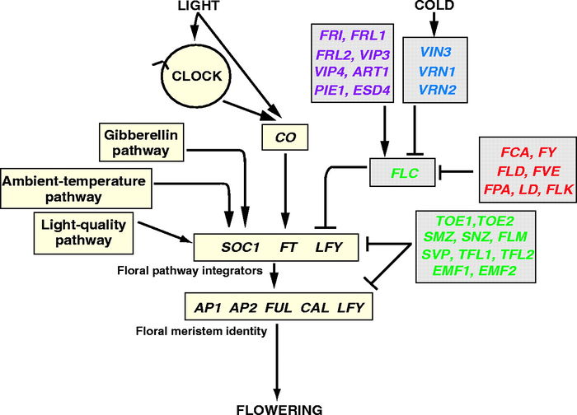
Henderson and Dean, 2004
Notes:
Allow me to first introduce you to the flowering pathway in Arabidopsis, my primary model organism. This image, from a paper published in 2004, shows a very simple model for the overall flowering pathway. Various proteins and pathways activate or repress the floral pathway integrators, which in turn activate the floral meristem identity genes, resulting in flowering.

Slide 3
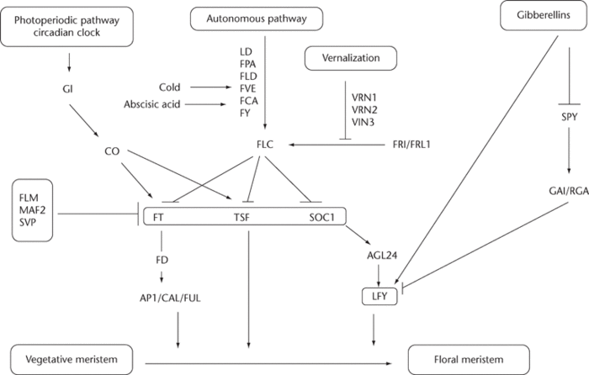
Schneitz, 2009
Notes:
A paper in 2009 found this pathway to be more complex, instead of simply one group of genes inhibiting another group of genes and stopping flowering. The pathways, as well, interact with specific genes, such as the gibberellins pathway interacting with LFY instead of all floral pathway integrators. Now, remember what this red box has encircled because although it seems simple here, it will not be on the next slide.

Slide 4
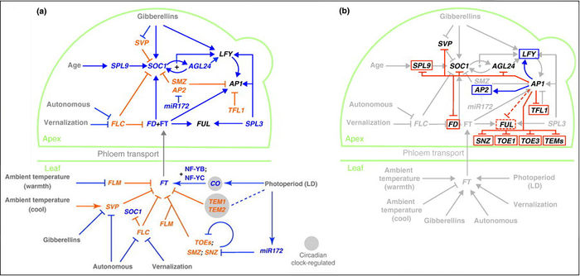
Wellmer and Riechmann, 2010; Ferrier et al., 2011
Notes:
The red box on the previous slide highlighted the floral pathway integrators and the floral meristem identity genes. Looking at the updated version of this pathway from 2010 and 2011, these interactions are not simply one-way activation, but instead an extremely complex map. Moreover, recent “genome-wide studies have uncovered new molecular interactions.”

Slide 5
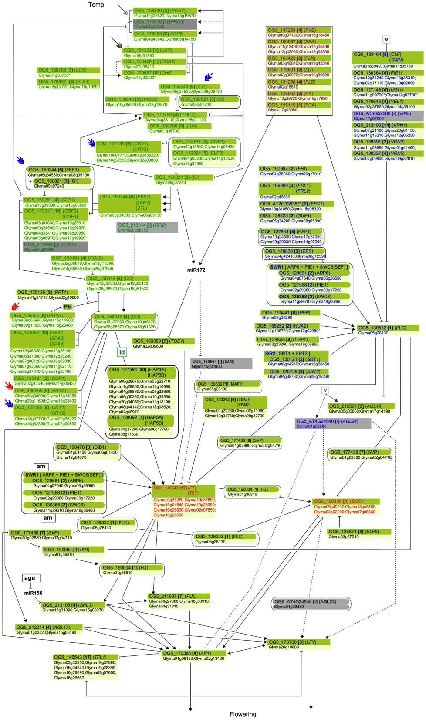
Jung et al., 2012
Notes:
In reality, the flowering pathway looks much more like this. In fact, this 2012 paper notes that this “simplified pathway diagram ... [only] contains most of the Arabidopsis flowering-time genes and their putative soybean orthologues.” The true pathway has many more interactions and genes.

Slide 6
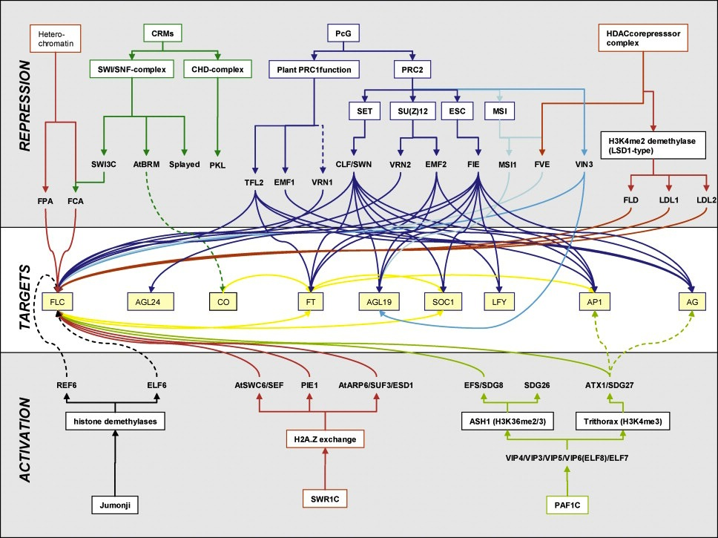
Farrona et al., 2008
Notes:
This is another way of examining the flowering pathway by examining the activators and repressors of 9 key target genes. This, however, is as convoluted and difficult to follow as the pathway diagram in the last slide.

Slide 7
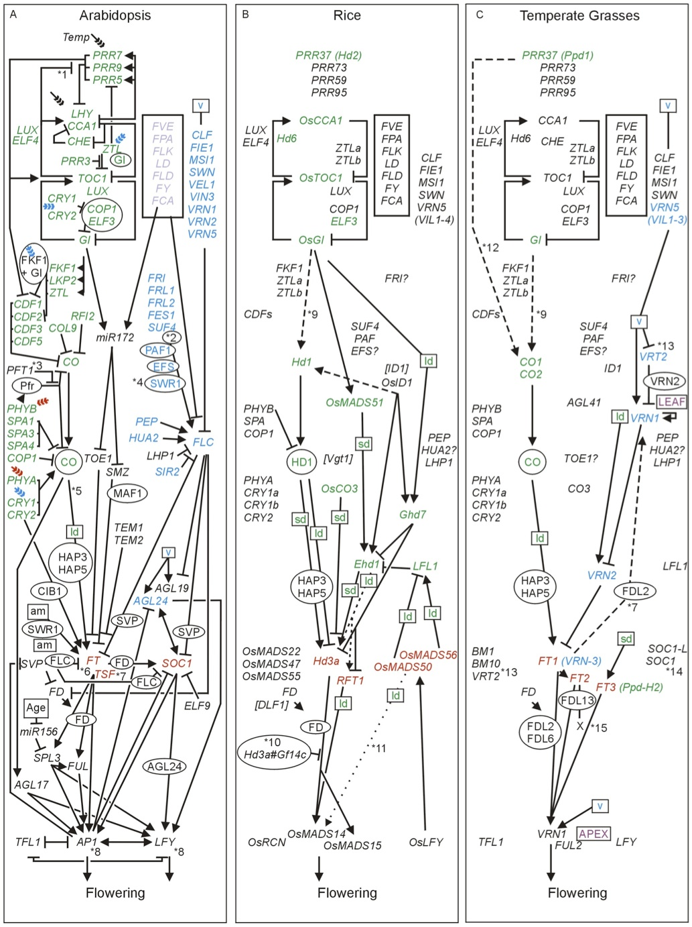
Higgins et al., 2010
Notes:
Arabidopsis is not the only organism with an extremely complex flowering pathway. The flowering pathways for rice and temperate grasses, which are in the middle and right respectively, are similarly complex.

Slide 8
Current Status
Identified and described the functions of 205 Arabidopsis genes
181 of these genes are confirmed flowering genes
The remaining 24 genes “belong to [homolog groups] with known Arabidopsis flowering genes”
Found AA sequences for all 205 Arabidopsis genes
Found grape or strawberry orthologs for 19 of these genes
Notes:
Where am I in the process?

