Slide 1
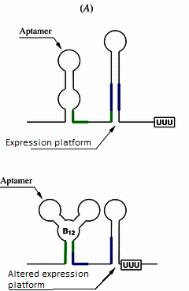
Riboswitches – General function
A two-part sequence in RNA that regulates gene translation
Found in bacteria, some plants and fungi
Aptamer – binds to a specific ligand
Expression platform – changes shape when the aptamer is bound

Slide 2
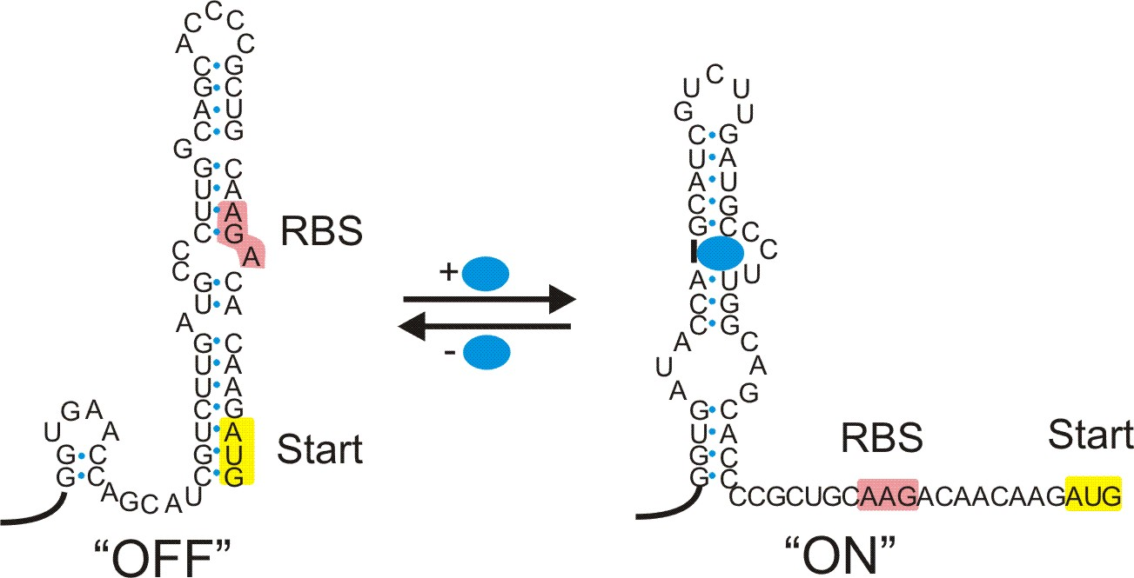
Our riboswitch
Located in the fitness module
Naturally coils up the ribosomal binding site
When bound, releases the ribosomal binding site

Slide 3
Our riboswitch
Theophylline gene is translated, leading to tetrocycline resistance
Binds to caffeine demethylase, which is our key metabolite

