Slide 1
Iron
EMILY KEATOR
PHOEBE PARRISH
http://media.moddb.com/images/downloads/1/59/58967/iron-man.jpg

Slide 2
Importance of Iron
Fe deficiency = leading nutritional disorder
Low solubility of Fe → limiting nutrient for plants
High reactivity of Fe → formation of ROS (very harmful)

Slide 3
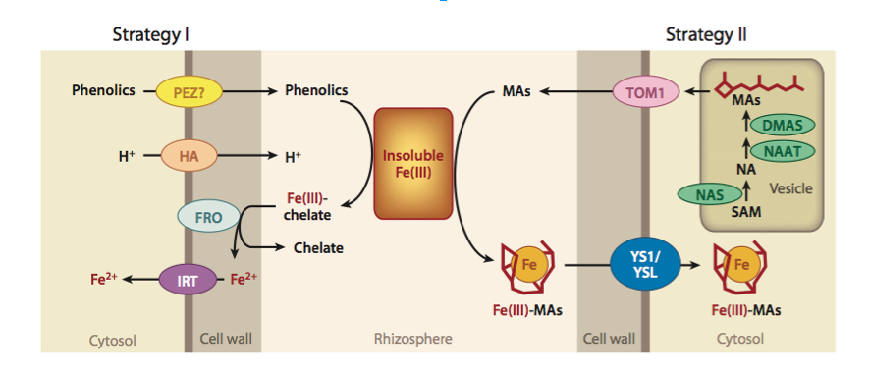
Strategies of Iron Uptake
Strategy I: Non-graminaceous plants
Arabidopsis thaliana
Broccoli
Strategy II: Graminaceous plants
Rice
Grasses
Kobayashi & Nishizawa 2012
Notes:
HA genes = H+-ATPase pumps

Slide 4
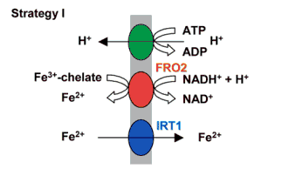
Fe Uptake from the Soil
Extrusion of H⁺ ions → increase Fe³⁺ solubility
2. Chelated Fe³⁺ → Fe²⁺ + chelate
3. Fe²⁺ transporter brings Fe²⁺ into cell
Hell & Stephan 2003
Notes:
Chelation: binding of metal ions by organic compounds--ex: hemoglobin, chlorophyll (porphyrin ring with metal atom at the center)

Slide 5
Extrusion of H⁺ Ions: AHA Genes
Fe more soluble in acidic soils
H⁺-ATPase pump
Generates electrical potential
Generates chemical gradient of protons
Catalytic polypeptide is phosphorylated & dephosphorylated
Major consumer of cellular ATP (25-50%)
Notes:
Electrical potential = - inside cell, + in plasma membrane
AHA3, AHA9 found in flowers
(Sussman, Harper et al)

Slide 6
Reduction of Fe³⁺ → Fe²⁺
Necessary for absorption by plant
Electrons effluxed into the soil
Fe³⁺-chelate + e⁻ → Fe²⁺ + chelate
FRO2, FRO1
Notes:
Robinson et. al. 1999

Slide 7
FRO2, FRO1
Encodes a ferric-chelate reductase (ferric reduction oxidase)
Flavocytochrome: transports ions across the membrane.
Intramembranous binding sites → heme
Cytoplasmic binding sites → nucleotide cofactors
Root epidermis
FRO1 and FRO2: 61.9% sequence identity (90.5% similarity)
Notes:
(Robinson et. al., 1999)
Binding sites (intramemb. and cytoplasmic are both for donating and transferring electrons)

Slide 8
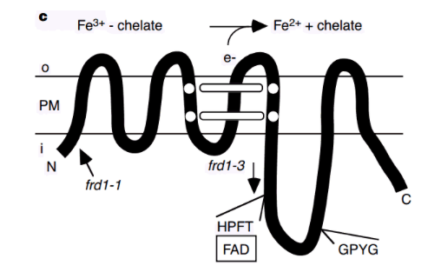
Fig. 1: Structure of FRO2. i=inside cell, o=outside cell. Image courtesy Robinson et. al. 1999
Notes:
Robinson et. al. 1999
Fe³⁺ is complexed with chelate in an organic form; FRO2 helps release it as free iron (Fe²⁺) so that the cell can take it up. (Robinson et. al. 1999)

Slide 9
Transport of Fe²⁺ into Cell: IRT1
Responsible for the majority of Fe uptake
Expression:
Root external cell layers → Fe uptake
Flowers → Fe for maturing pollen
Overexpression → oxidative stress
Activity tightly controlled by monoubiquitination
Maintained in EE compartments
Cycled to membrane for uptake activity
Trafficked to vacuole for degradation
Notes:
1st bullet → necessary for Fe homeostasis as well as plant growth & development
3rd bullet → ubiquitin = regulatory protein that attaches to a substrate protein, can affect its cellular location & activity

Slide 10
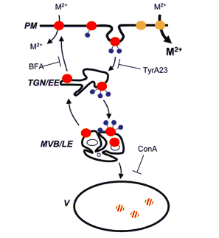
IRT1 Cycling

Slide 11
Intercellular Transport
Xylem: efflux transporters
Loading → Transport → Unloading
Genes involved:
FRD3 (citrate chelation → provide shoots with usable Fe)
PEZ1, FPN1/IREG1 (xylem loading)
Phloem: influx transporters
Loading → Transport → Unloading
Genes involved:
YSL1, YSL2 (transport Fe-NA complexes)
Notes:
Xylem = dead cells
Phloem = living cells
FRD3 = citrate efflux, chelator
(Kobayashi & Nishizawa 2012)

Slide 12
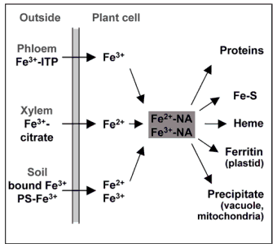
Iron Pathways
Fig. 2: Depicts Iron transport into the cell (by Strategy I or II), where Fe is then complexed with NA. Usually Fe is then sent to proteins, iron-sulfur cluster (for photosynthesis), or heme (for cytochrome); ferritin and precipitate pathways are in use for iron excess. Hell et. al. 2002
Notes:
Hell et. al. 2002

Slide 13
Intracellular Storage
Fe used in cellular functions
Excess accumulation → cytotoxicity
Fe homeostasis
Fe storage
Chloroplasts (80-90% of cellular Fe)
Mitochondria
Plastids (amyloplasts)
Vacuoles
Notes:
(Kobayashi & Nishizawa 2012)
--Chloroplasts, Fe used to transport electrons b/w photosystems in photosynthesis
--Mitochondria: used in respiration
--Vacuoles: Fe pool to avoid cytotoxicity

Slide 14
Ferritins (FER1)
Fe²⁺ reacts with O₂ → harmful compounds
Store excess iron
Complex Fe²⁺ molecules together
Usually expressed only if excess Fe
< 4500 iron atoms, readily-usable form
Amyloplasts and vacuoles
Common in pollen and anthers
FER1 → major ferritin gene in leaves
Only one of 4 ferritin genes expressed in pollen and anthers
Regulated by IRDS (Iron-Dependent Regulatory Sequence)
Notes:
--Plants store excess iron using ferritin proteins to avoid the highly reactive Fe²⁺ from reacting with O₂ to form harmful compounds
--Ferritins essentially complex Fe²⁺ molecules together to keep them from reacting
--Able to store up to 4500 iron atoms in a readily-usable form (Briat et. al., 1999)
--Iron homeostasis is important for avoiding iron poisoning in the plant.
--Iron accumulates in plastids (generally amyloplasts), stored by ferritin
--Particularly appears in the pollen and anther of the flowers
--FER1 is main ferritin gene in leaves; likely associated with iron accumulation in pollen and anthers (being the only one of the four ferritin genes expressed in those structures) (Roschzttardtz et. al. 2013)
--Ferritins are usually expressed only if there is excess iron present to store
--Often a vacuolar pool of iron collects
--Regulated by IDRS, Iron-Dependent Regulatory Sequence

Slide 15
Other Storage-Related Genes
VIT1
Tonoplastic iron transporter
Roots and shoots (vasculature)
Fe²⁺ → vacuole
Seeds/embryo development
Resisted by NRAMP3 and NRAMP4 (germination)
Vacuole → Fe²⁺
IREG1
Moves Fe into vacuole
PIC1
Permease In Chloroplasts 1
MIT
Mitochondrial Iron Transporter
Notes:
Tonoplastic (vacuolar membrane) iron transporter
--Abundant in roots and shoots (vasculature)
--supposed to bring Fe²⁺ into the vacuole (especially important in seeds)
--localizes to vacuolar membrane and is expressed more often in seed/embryo development (Grotz et. al., 2006)
--Resisted by NRAMP3 and NRAMP4, natural resistance-associated membrane protein, which transports iron out of vacuole; these two proteins are most active in germination of seeds
PIC1
--Permease In Chloroplasts 1: involved in regulating iron compartmentalization in chloroplasts.
MIT
--Mitochondrial Iron Transporter

Slide 16
Regulation of Fe Deficiency Responses
Environmental fluctuations in Fe
Regulatory genes: FIT1, bHLH38 & 39
Transcribed when Fe deficiency is sensed in roots
FIT1 forms heterodimers with bHLH38 & 39
Directly control transcription of IRT1 and FRO2
Increases Fe content in shoots even w/ Fe sufficiency
Notes:
FIT = Fe-Regulated-Like Iron Deficiency-Induced Transcription factor
bHLH = Basic helix-loop-helix transcription factors that regulate IRT1 and FRO2

Slide 17
References
Barberon M et al. Monoubiquitin-dependent endocytosis of the iron-regulated transporter 1 (IRT1) transporter controls iron uptake in plants. PNAS, 2011. 108(32):E450-E458.
Briat, JF et. al. Regulation of plant ferritin synthesis: how and why. Cellular and Molecular Life Sciences, 1999. 56:155-166.
Grotz, N et. al. Molecular aspects of Cu, Fe, and Zn homeostasis in plants. Biochemica et Biophysica Acta, 2006. 1763:595-608.
Harper JF et al. The Arabidopsis thaliana plasma membrane H⁺-ATPase multigene family. The Journal of Biological Chemistry, 1990. 265(23):13601-13608.
Hell, R et. al. Iron uptake, trafficking, and homeostasis in plants. Planta, 2003. 216:541-551.
Kim, S et. al. Mining iron: iron uptake and transport in plants. FEBS Letters, 2007. 581:2273-2280.
Kobayashi T, Nishizawa NK. Iron uptake, translocation, and regulation in higher plants. Annual Review of Plant Biology, 2012. 63:131-52.
Matsuoka, K et. al. Gibberellin-induced expression of Fe uptake-related genes in Arabidopsis. Plant Cell Physiol., 2014. 55(1):87-98.
Robinson, NJ et. al. A ferric-chelate reductase for iron uptake from soil. Nature, 1999. 397:694-697.
Roschzttardtz, H et. al. New insights into Fe localization in plant tissues. Frontiers In Plant Science, 2013. 4:1-11.
Seo, PJ et. al. A golgi-localized MATE transporter mediates iron homeostasis under osmotic stress in Arabidopsis. BIochemical Journal, 2012. 442:551-561.
Sussman MR. Molecular analysis of proteins in the plant plasma membrane. Annual Review of Plant Physiology and Plant Molecular Biology, 1994. 45:211-34.
Vert, G et. al. IRT1, an Arabidopsis transporter essential for iron uptake from the soil and for plant growth. The Plant Cell, 2002. 14:1223-1233.

