Slide 1
Tutorial: Finding tRNAs
Puneet Lakhmani

Slide 2
Outline
ARAGORN
tRNA Finder
tRNA scan-SE
tRNADB-CE

Slide 3
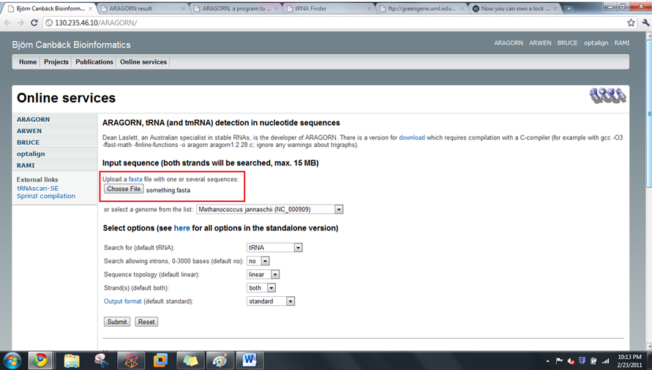
ARAGORN

Slide 4
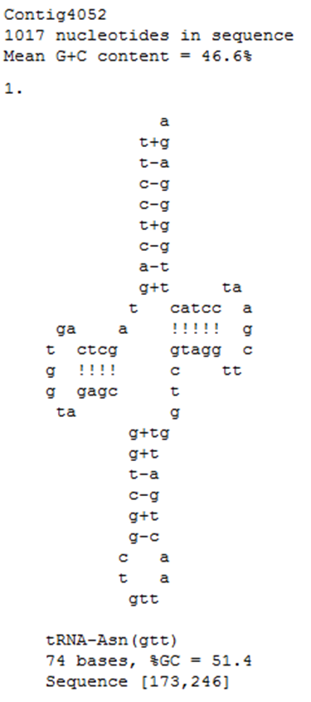
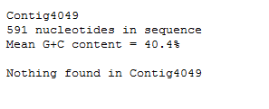
ARAGORN

Slide 5
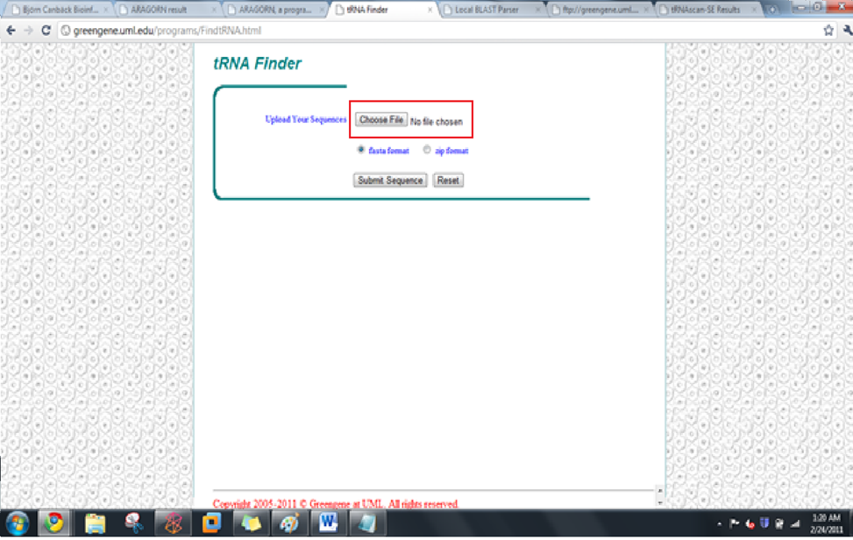
tRNA Finder

Slide 6
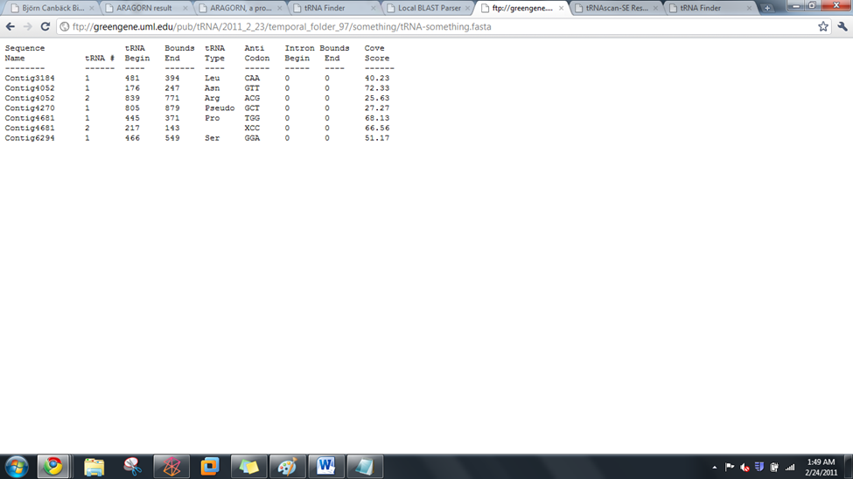
tRNA Finder

Slide 7
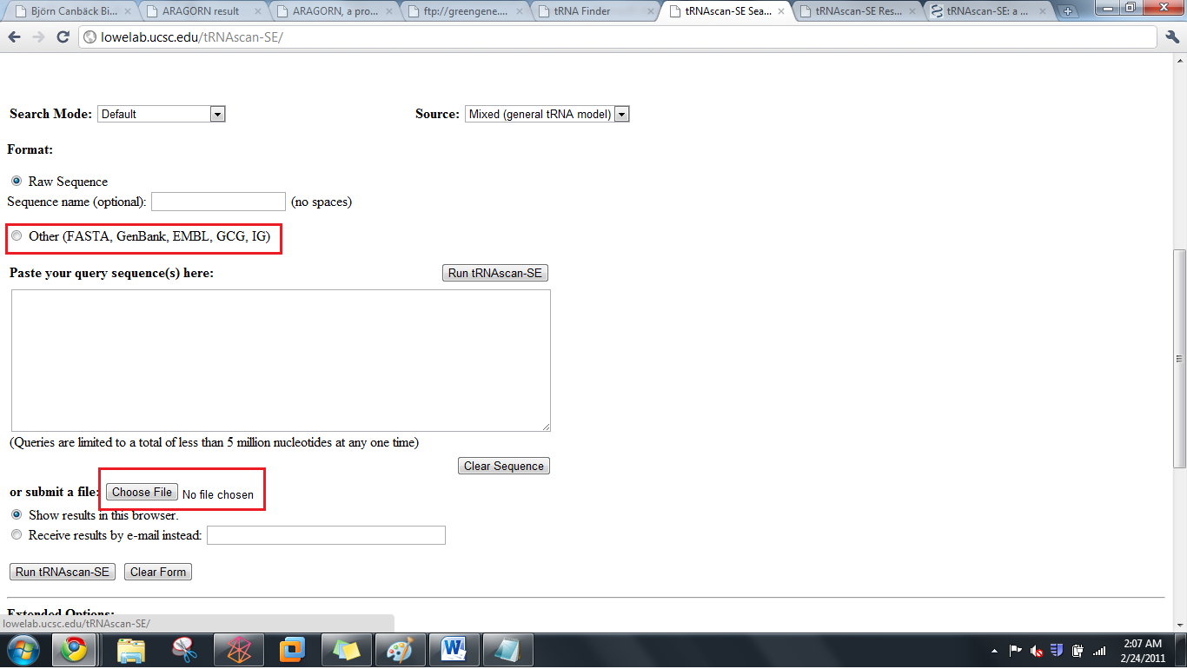
tRNA scan-se

Slide 8
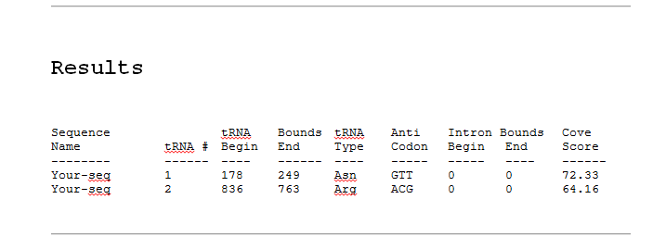
tRNA scan-se

Slide 9
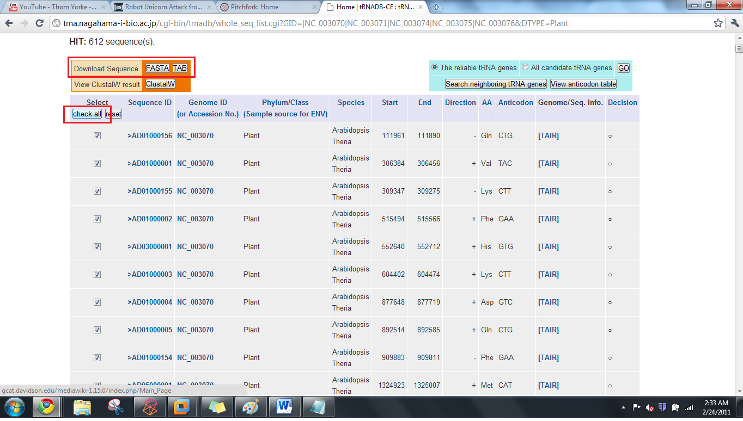
tRNADB-CE

Slide 10
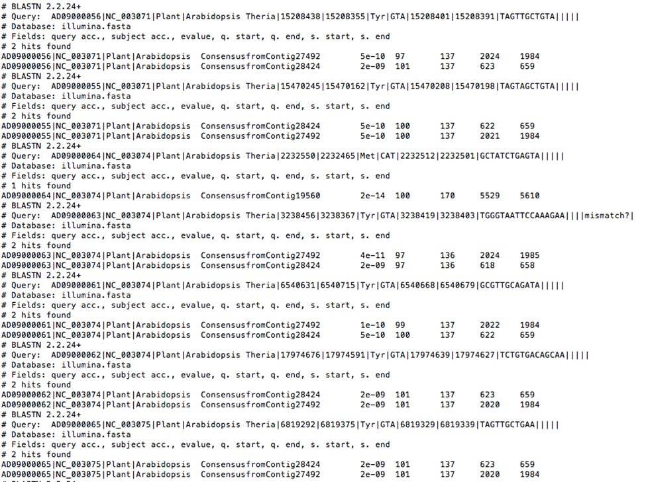
tRNADB-CE

