Slide 1
The arcAB System
and How It Affects Promoters
Meredith Nakano
Betsy Gammon
Summer 2012
Davidson College
Synthetic Biology Research

Slide 2
LuxI Long Promoter
Short Sequence
CATCTCTTTATCCTTACCTATTGTTTGTCGCAAGTTTTGCGTGTTATATATCATTAAAACGGTAATGGATTGACATTTGATTCTAATAAATTGGATTTTTGTCACACTATTGTATCGCTGGGAATACAATTACTTAACATAAGCACCTGTAGGATCGTACAGGTTTACGCAAGAAAATGGTTTGTTATAGTCGAATA
arcA binding site 1
arcA binding site 2
LuxR binding site
Long Sequence

Slide 3
Cyd Promoter – Short Sequence
AACTAATTTCAGCCTTATAACTCACACATTTTAAACATAAATGTCAGTAAAGTTACCTTATTGAAACATGATTAACATAATTTGTAGGAATTGATATTTATCAATGTATAAGTCTTGGAAATGGGCATCAAAAAGAGATAAATTGTTCTCG
arcA Binding Site
activates
Fnr Binding Site
represses

Slide 4
Cyd Promoter – Long Sequence
AACTAATTTCAGCCTTATAACTCACACATTTTAAACATAAATGTCAGTAAAGTTACCTTATTGAAACATGATTAACATAATTTGTAGGAATTGATATTTATCAATGTATAAGTCTTGGAAATGGGCATCAAAAAGAGATAAATTGTTCTCGATCAAAT
arcA Binding Site
activates
Fnr Binding Site
represses
Fnr Binding Site
represses

Slide 5
FadB Promoter- Long sequence
Fad R site
activates
ArcA site
Represses
ATCGGCATTTCTTTAATCTTTTGTTTGCATATTTTTAACACAAAATACACACTTCGACTCATCTGGTACGACCAGATCACCTTGC
Fis site
Represses

Slide 6
FadB Promoter- Short sequence
ArcA site
Represses
ATCGGCATTTCTTTAATCTTTTGTTTGCATATTTTTAACACAAAATACACACTTCGACTCA
Fis site
Represses

Slide 7
Big Picture
Gas communication between E. coli
Modular selection- stress response
The on/off switch- maximal control

Slide 8
Goals for the summer:
Construct plasmids with luxI, cyd, or fadB promoters, RBS, and reporter gene.
Assemble promoters with oligos.
Ligate RBS and RFP/GFP into plasmid.
Control arcAB with DTT and H₂O₂.

Slide 9
Phase 1 – Build and Clone Complete
luxI Long, fadB long, fadB short, cydLong, cydShort
RBS
GFP/RFP
pSB1A2

Slide 10
New composite parts:
J100083: long luxI+RBS+GFP
J100086: short Cyd+RBS+GFP
J100084: long Cyd+RBS+GFP
J100077: short fadB+RBS+RFP
J100078: long fadB+RBS+RFP
Next step: start testing functionality with stressors (DTT and hydrogen peroxide)

Slide 11
cyd and luxI Testing:
Did not respond to DTT as we thought they would

Slide 12
fadB Testing:

Slide 13
A few experiments with DTT and hydrogen peroxide➔ the fadB promoter did not respond
Idea: use oleic acid to help activate FadR

Slide 15
Promoter | DTT only | DTT & H₂O₂ | DTT & Oleic Acid
cyd long | Uncertain | None | Not tested
cyd short | Uncertain | None | Not tested
luxI long | None | None | Not tested
fadB long | None | None | Induced
fadB short | Induced (?) | None | None

Slide 16
In the future…
arcBcyt
arcB
cyt
arcB
Missing amino acids 23-77
Partially active in aerobic conditions
Notes:
ArcBcyt is shorter than ArcB so it is not a transmembrane protein and is more receptive to DTT.

Slide 17
In the future…
arcBcyt
Test other stressors and oleic acid

Slide 19
What is the big picture?
E. coli cell 1
Drug
Stress
E. coli cell 2
No Drug
No Stress

Slide 20
What is my system?
The arcAB system in E. coli
Stress
Stress
arcB
arcB
arcA^{P}
OR
arcA^{P}
OFF
ON
luxI,
fadB
cydAP
RBS
Gene
RBS
Gene

Slide 21
What is my system?
H₂0₂
H₂0₂
(Stress)
(Stress)
arcB
arcB
arcA^{P}
arcA^{P}
ON
OFF
luxI
(fadB)
cydAP
RBS
GFP
RBS
GFP

Slide 22
In aerobic conditions:
P
Off
AACTAATTTCAGCCTTATAACTCACACATTTTAAACATAAATGTCAGTAAAGTTACCTTATTGAAACATGATTAACATAATTTGTAGGAATTGATATTTATCAATGTATAAGTCTTGGAAATGGGCATCAAAAAGAGATAAATTGTTCTCG
arcA Binding Site
activates
Fnr Binding Site
represses

Slide 23
In microaerobic conditions:
(oxygen levels below 20%)
arcB
On
arcA
P
AACTAATTTCAGCCTTATAACTCACACATTTTAAACATAAATGTCAGTAAAGTTACCTTATTGAAACATGATTAACATAATTTGTAGGAATTGATATTTATCAATGTATAAGTCTTGGAAATGGGCATCAAAAAGAGATAAATTGTTCTCG
arcA Binding Site
activates
Fnr Binding Site
represses

Slide 24
In anaerobic conditions:
(oxygen levels below 7-10%)
On
Off
arcB
Intermediate
arcA
P
Fnr
AACTAATTTCAGCCTTATAACTCACACATTTTAAACATAAATGTCAGTAAAGTTACCTTATTGAAACATGATTAACATAATTTGTAGGAATTGATATTTATCAATGTATAAGTCTTGGAAATGGGCATCAAAAAGAGATAAATTGTTCTCG
arcA Binding Site
activates
Fnr Binding Site
represses

Slide 25
In aerobic conditions with DTT:
DTT
arcB
On
arcA
P
AACTAATTTCAGCCTTATAACTCACACATTTTAAACATAAATGTCAGTAAAGTTACCTTATTGAAACATGATTAACATAATTTGTAGGAATTGATATTTATCAATGTATAAGTCTTGGAAATGGGCATCAAAAAGAGATAAATTGTTCTCG
arcA Binding Site
activates
Fnr Binding Site
represses

Slide 26
Repression
luxI
fadB
Activation
cydA

Slide 27
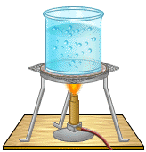
Assembling oligos
promoter
pSB1A2

Slide 28
Promoters were assembled correctly
New Parts:
J100067: fadB long sequence
J100068: fadB short sequence
J100074: luxI long sequence
J100075: Cyd long sequence
J100076: Cyd short sequence
Next step: clone promoter upstream of RBS-RFP/GFP

Slide 29
Testing hydrogen peroxide concentrations- Round 1

Slide 30
Testing hydrogen peroxide concentrations- Round 2

Slide 31
Testing DTT concentrations-

Slide 32
Conclusion:
Safe [H₂O₂] are between 0.01% and 0.06% but ideal are 0.03-0.04%.
DTT slows growth but does not kill cells.
Next step:
Assemble promoters with oligos

Slide 33
Ligation, transformation, plating:
v
v
v
experimentals
v
Negative control

Slide 34
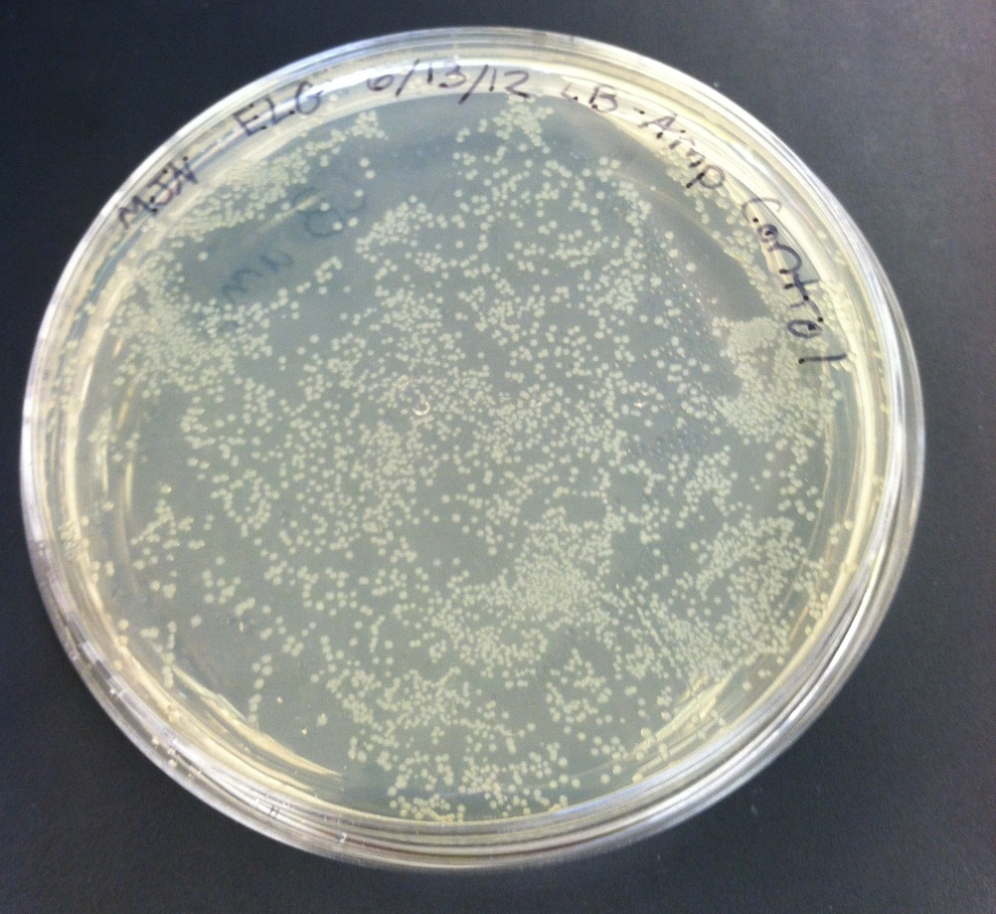
Negative control– high background

Slide 35
Round 2- reduce background
Reassembled oligos, ligated, transformed, and plated
Colony- PCR.

Slide 36
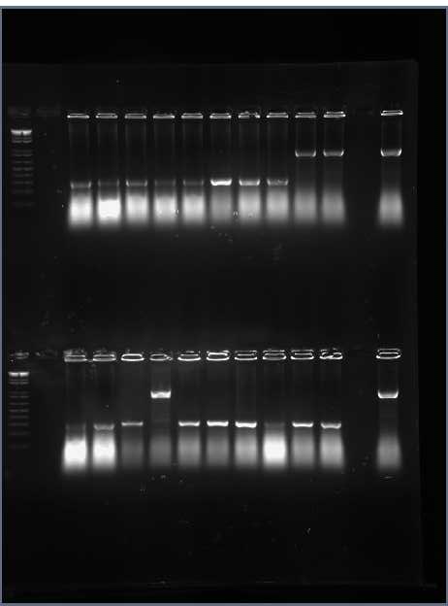
fadB long promoter
fadB short

Slide 37
CydShort
LuxI Long
CydLong
Next step: grow cells from successful colonies – length verify

Slide 38
Re-ligate
luxI, cydAP, fadB
luxI, cydAP
luxI, cydAP
RBS
GFP
Digestion
Ligation

Slide 39
Religate
luxI, cydAP, fadB
luxI, cydAP, fadB
luxI, cydAP
RBS
GFP
Digestion

Slide 40
Religate
luxI, cydAP, fadB
luxI, cydAP, fadB
luxI, cydAP, fadB
RBS
GFP/RFP
Digestion
Ligation

Slide 41
Prediction: DTT reduces RFP expresssion (repression of arcAB system)

Slide 42
Experiment with 0.04% hydrogen peroxide and DTT.
All cells died

Slide 43
Phase II - testing
LuxI, fadB
Response
CydLong, Short
Stress – DTT/H₂O₂

Slide 44
The Effect of DTT Concentration after 16 Hour Incubation
Expected: For cyd, 5mM DTT for each promoter would have higher fluorescence/cell than the 0mM. Opposite effect for luxI.
Results: Cells with 5mM DTT had lower fluorescence than those with 0mM DTT.
Improvements: Only need to test 1 colony for each promoter. Need to look at a smaller time frame.

Slide 45
LuxI Long with DTT
Notes:
luxI with DTT increased in fluorescence

Slide 46
LuxI Long With DTT and Hydrogen Peroxide
Notes:
0.01% hydrogen peroxide, cells died but we expected fluorescence to increase.

Slide 47
CydLong with DTT
Notes:
Expected increased fluorescence and that’s what we got.

Slide 48
CydLong with DTT and Hydrogen Peroxide
Notes:
Expected to see a decrease in fluorescence, and we did, but so did the control.

Slide 49
CydShort with DTT
Notes:
Same story as cyd long

Slide 50
CydShort with DTT and Hydrogen Peroxide

Slide 51
Two New ideas for fadB:
Clone the promoter, RBS, RFP insert into pSB4K8
Low copy number, kan resistance
FadR may not be activating or “de-repressing” fadB long
Oleic acid may activate FadR

Slide 52
*used diluted LB amp 10 ug/mL

Slide 53
DTT had no effect on either promoter

Slide 56
Conclusions so far:
DTT not working as expected
Amp makes peroxide
Cells are more sensitive to H₂O₂

Slide 57
Oleic acid difference in short promoter
pSB1A2

Slide 58
pSB4K8

Slide 61
Modularity of Synthetic Biology
Bad
H₂0₂
Bad
H₂0₂
Good
Good
arcB
arcB
H202
H202
arcA^{P}
arcA^{P}
Drug
Drug
luxI, fadB
RFP
RFP
cydAP
RBS
GFP
RBS
GFP

Slide 62
What is the big picture?
E. coli cell 1
Drug
Stress
E. coli cell 2
No Drug
No Stress

Slide 63
In the future…
Add LuxR and 30C6 to the LuxI promoter
arcA^{P}
30C6
LuxR
LuxI
Notes:
Adding LuxR may allow luxI promoter to work as predicted because luxI functions in vivo in the presence of LuxR and 30C6, and LuxR activates luxI.

Slide 64
In the future…
Add LuxR and 30C6 to the LuxI promoter.
arcBcyt
arcB
cyt
arcB
Missing amino acids 23-77
Partially active in aerobic conditions
Notes:
ArcBcyt is shorter than ArcB so it is not a transmembrane protein and is more receptive to DTT.

Slide 65
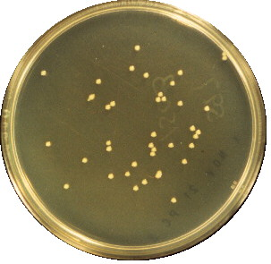
Gas communication is a tool

Slide 66
Acknowledgements
I would like to thank the Howard Hughes Medical Institute for funding this research. I am also grateful for the assistance and inspiration from Meredith Nakano. I am indebted to Dr. Campbell for his guidance and help as well.

