Slide 1
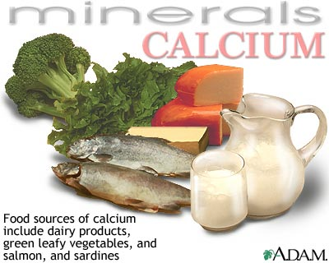
Calcium
Nisha Crouser and James Stewart

Slide 2
Role of calcium in humans
Building strong bones and teeth
Clotting blood
Sending and receiving nerve signals
Squeezing and relaxing muscles
Releasing hormones and other chemicals
Keeping a normal heartbeat

Slide 3
Strengthens Cell Walls
“Calcium builds strong bones!”
critical in plant cell wall stability
Calcium deficiency can cause cell wall collapse.
This is an even bigger problem in younger tissues, as calcium is non-mobile once it is taken up into the cell wall.

Slide 4
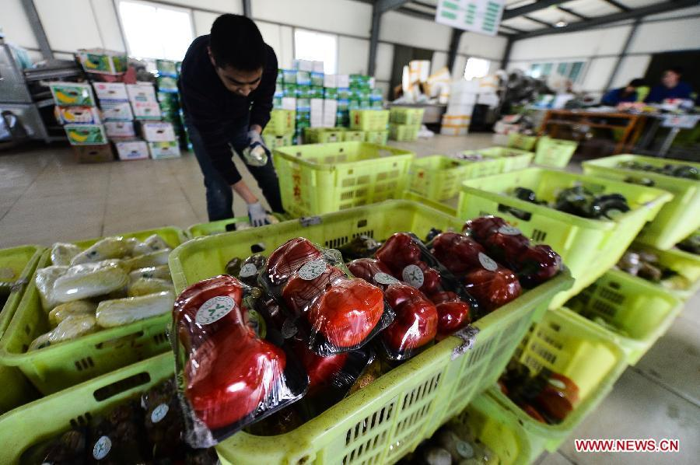
Keeps fruit firmer longer
Extra exposure to calcium leads to firmer fruit and delayed ripening.
spraying during development or application after picking
*Important during vegetable shipping and distribution

Slide 5
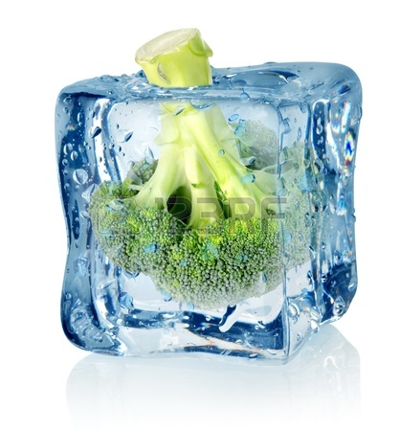
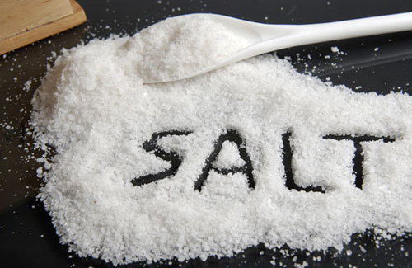
Ca²⁺ in the Stress Response
Can ameliorate many stresses, including cold, heat, drought, salinity, and osmolarity.
When a plant is stressed, Ca²⁺ ions can be exchanged with other cations as a response.
Particularly K⁺, Na⁺, and H⁺.

Slide 6
Interactions with other minerals
Plants rarely lack adequate calcium from the soil
Calcium deficiency: acidic soil (high Al³⁺) and saline soils (high Na⁺)
Inverse relationship: high Ca²⁺ reduced uptake of Na⁺ and Al³⁺
High Mg²⁺ and K⁺ reduced Ca²⁺ uptake

Slide 7
Calcium Localization in Cell
In some plants tissues, Ca²⁺ makes up 10% of total tissue dry weight.
High concentrations in vacuole, cell wall, ER, and chloroplast
Very low concentration in cytoplasm (0.1-0.2 micromolar)
Ca²⁺ can be extremely toxic in high cytoplasmic concentrations.

Slide 8
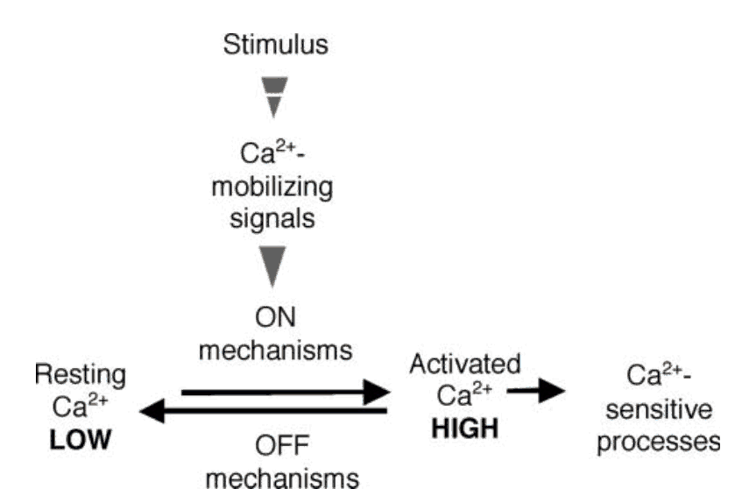
Calcium in Plant Signaling
Calcium is extremely important in signal transduction in the cell.
Changes in cytosolic Ca²⁺ concentration trigger events in the cell such as enzyme activation.
calcium levels must be strictly monitored to avoid toxicity
Ca²⁺ events often involve complex molecular interactions such as phosphorylation cascades.

Slide 9
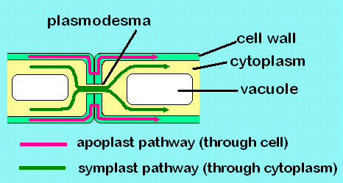
Uptake of Calcium
apoplast- spaces between the cells
Roots
Xylem
Shoot
* transported as Ca²⁺ or complexed with organic acids
(White, 2009)
symplast- through cytoplasm of cells linked together by plasmodesmata

Slide 10
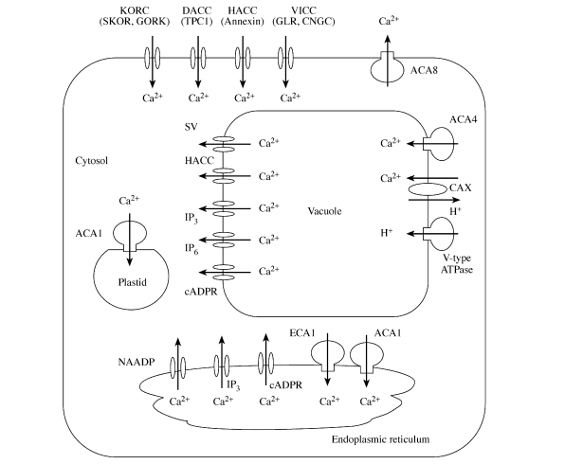

Slide 11
-1,000,000 bp
ECA1
51,344,258
CDPK
51,512,157
Calmodulin
33,900,215
C2
C3
QTL
52,207,948
QTL
34,459,806
Annexin
52,274,901
ECA1
34,776,724
Black = IGB and BLAST
Green = IGB only
= Good candidate
+1,000,000 bp

Slide 12
-1,000,000 bp
5,408,394
Calmodulin
5,444,956
CDPK
5,644,713
C4
C5
CAX2
6,056,506
QTL
6,212,518
QTL
1,131,076
Calmodulin
1,147,487
CDPK
1,646,469
Glutamate
Receptor
1,724,341
Black = IGB and BLAST
Green = IGB only
= Good candidate
+1,000,000 bp

Slide 13
-1,000,000 bp
Calcium-binding EF-hand
33,005,817
GORK (K+ Channel)
46,164,686
Calcineurin B
46,248,037
C6
C7
CDPK
46,936,727
QTL
34,088,688
QTL
47,012,082
SOS3
47,089,631
MCA1
47,091,489
CDPK
34,439,828
ECA1
47,618,999
Black = IGB and BLAST
Green = IGB only
= Good candidate
Calmodulin
47,934,287
+1,000,000 bp

Slide 14
-1,000,000 bp
C8
Calmodulin
30,692,291
QTL
30,785,808
ECA1 (H-ATPase)
31,087,897
CDPK
31,220,232
Black = IGB and BLAST
Green = IGB only
= Good candidate
+1,000,000 bp

Slide 15
Great Candidate Genes
Annexin
CAX2
Calmodulin
Calcium Dependent Protein Kinase (CDPK)
Mca1 and Mca2
SOS2 and SOS3

Slide 16
Annexin
Located 66,953 bp away from QTL on chromosome 2
Calcium binding protein that is localized in the cytoplasm
Associated with hyperpolarization voltage channels
When cytosolic Ca²⁺ increases, they relocate to the plasma membrane
They may be involved in the Golgi-mediated secretion of polysaccharides.
Expressed in all parts of plant including the flower

Slide 17
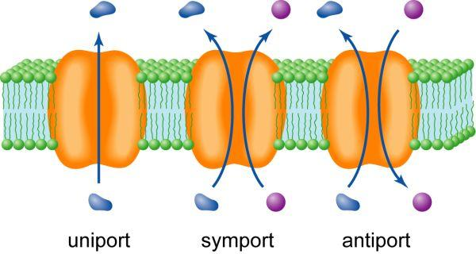
Cax2: Ca²⁺/H⁺ antiporter
Located 156,012 bp away from QTL on chromosome 4
Vacuolar H⁺/Ca²⁺ antiporter; play a central role in Ca²⁺ and metal sequestration into the vacuole
Important in maintaining low levels of cytosolic Ca²⁺
Expressed throughout the plant and strongly expressed in flower tissue, vascular tissue and in the apical meristem of young plants

Slide 18
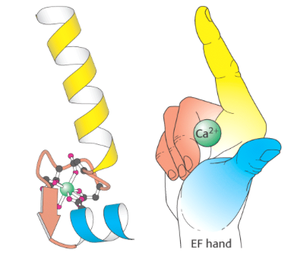
Calmodulin
Located 15,000 bp away from QTL on chromosome 5 (IGB) and 93,517 bp away on chromosome 8
Multifunctional intermediate messenger protein that transduces calcium signals
found in all eukaryotic cells
can bind up to 4 Ca²⁺ molecules

Slide 19
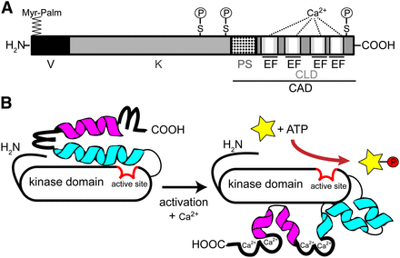
Calcium-dependent protein kinase
Located 75,355 bp away from QTL on chromosome 7
encodes structurally conserved, unimolecular calcium sensor/protein kinase effector proteins
CDPKs perceive intracellular changes in Ca²⁺ concentration
Triggers specific phosphorylation events to initiate further downstream signaling processes

Slide 20
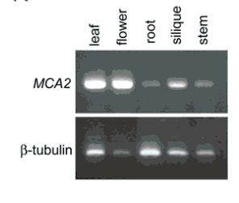
Mca1 and Mca2
Located 79407 away from QTL on choromosome 7
membrane proteins capable of responding to mechanical stress over a wide dynamic range of external mechanical stimuli
MCA1 and MCA2 in Arabidopsis thaliana
Paralogs of one another
both involved in mediating Ca²⁺ uptake

Slide 21
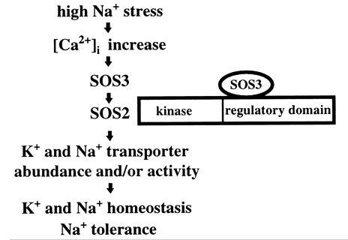
SOS2 and SOS3
Located 77,549 away from QTL on chromosome 7
SOS2 and SOS3 are required for intracellular Na+ and K+ homeostasis and plant tolerance to high Na+ and low K+ environments.
SOS3 is an EF hand type calcium-binding protein, which regulates SOS2 expression.

Slide 22
Bibliography
Hirschi KD. “The calcium conundrum. Both versatile nutrient and specific signal.” Plant Physiology 136 (2004), 2438–2442.
Li, Legong, Beom-Gi Kim, Yong hwa Cheong, Girdhar K. Pandey, and Sheng Luan. “A Ca2+ signaling pathway regulates a K+ channel for low-K response in Arabidopsis.” Proc Natl Acad Sci U S A. 103.33 (2006), 12625-12630.
National Institutes of Health, Office of Dietary Supplements. Dietary Supplement Fact Sheet: Calcium. Accessed February 12, 2013.
Schulz, Philipp. “Calicum-Dependent Protein Kinases: Hubs in Plant Stress Signaling and Development”. Plant Physiology (2013).
Tuteja, Narendra, and Shilpi Mahajan. “Calcium Signaling Network in Plants: an Overview.” Plant Signaling & Behavior 2.2 (2007), 79-85.
White, P.J., and MR Broadley. “Calcium in plants.” Annals of Botany 92 (2003), 487-511.
White, P.J., and MR Broadley. “Biofortification of crops with seven mineral elements often lacking in human diets – iron, zinc, copper, calcium, magnesium, selenium and iodine.” New Phytol. 182 (2009), 49–84.

