Slide 1
MWSU Gibson assembly progress

Slide 2
Original Recipe and Results
8ul 2x Rapid Ligase Buffer
8ul 2x PCR Master Mix
1ul Taq DNA Ligase Buffer
0.5 ul Taq DNA Ligase
0.25 ul T5 Exonuclease
__ul DNA
20 ul Total Volume

Slide 3
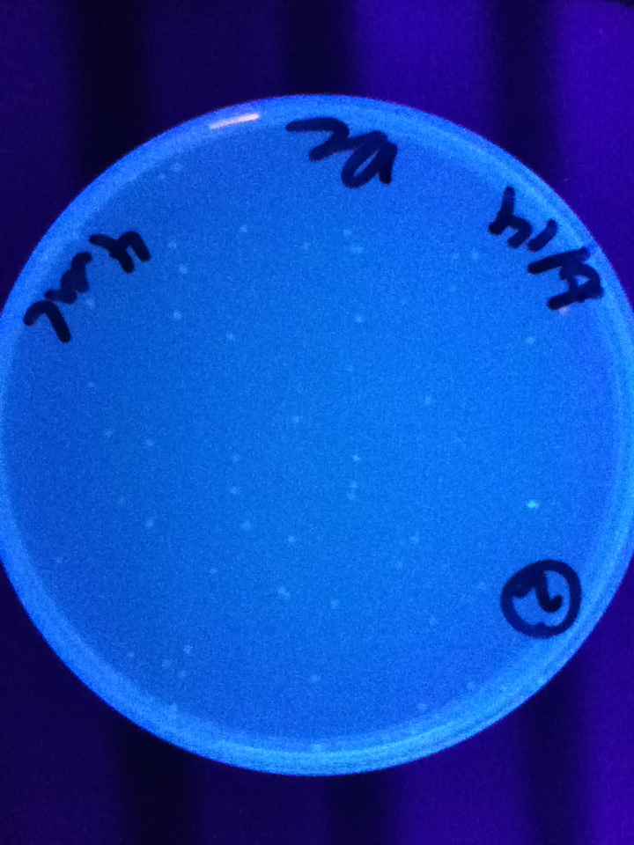
Notes:
First successful MWSU Gibson Assembly Reaction

Slide 4
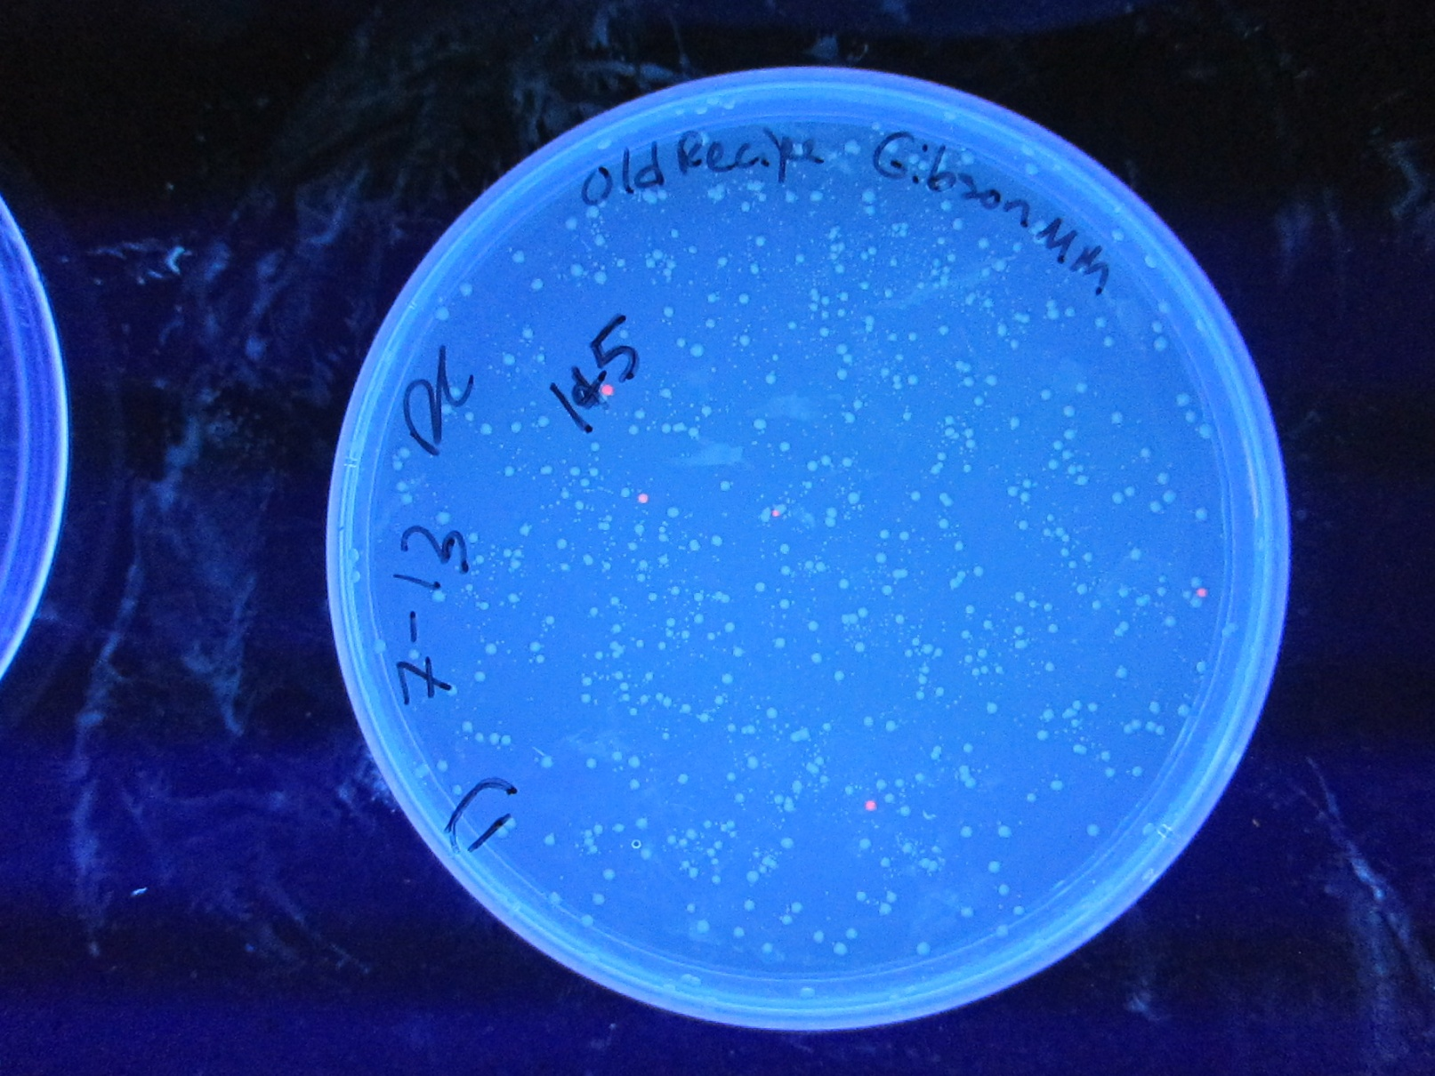
More Recent Attempt at Same Recipe
Notes:
Total volume approximately 20 ul (microliters)

Slide 5
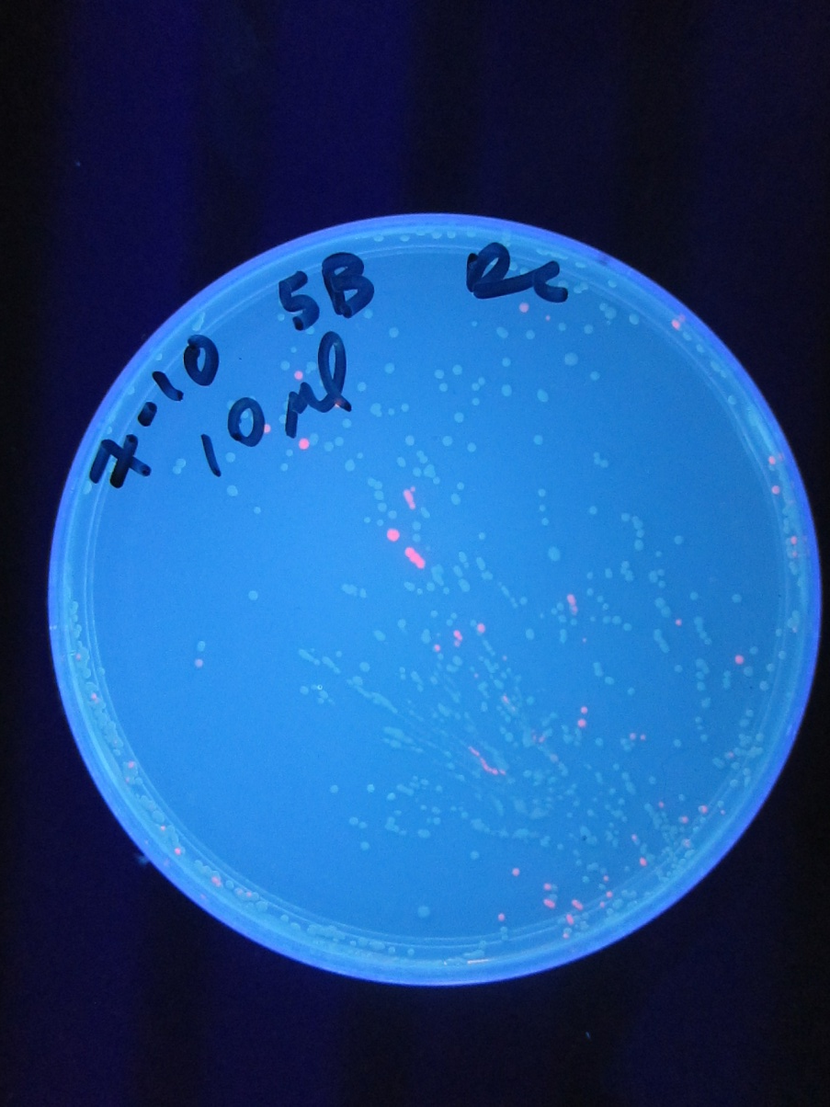
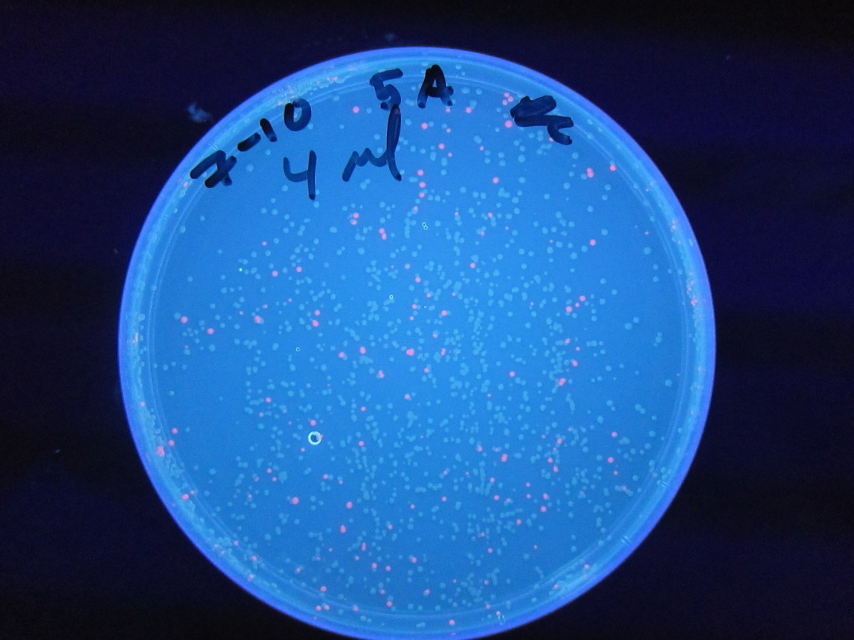
NEB Gibson Master Mix Control
Notes:
Total Volume 4 ul on left, and 10 ul on right

Slide 6
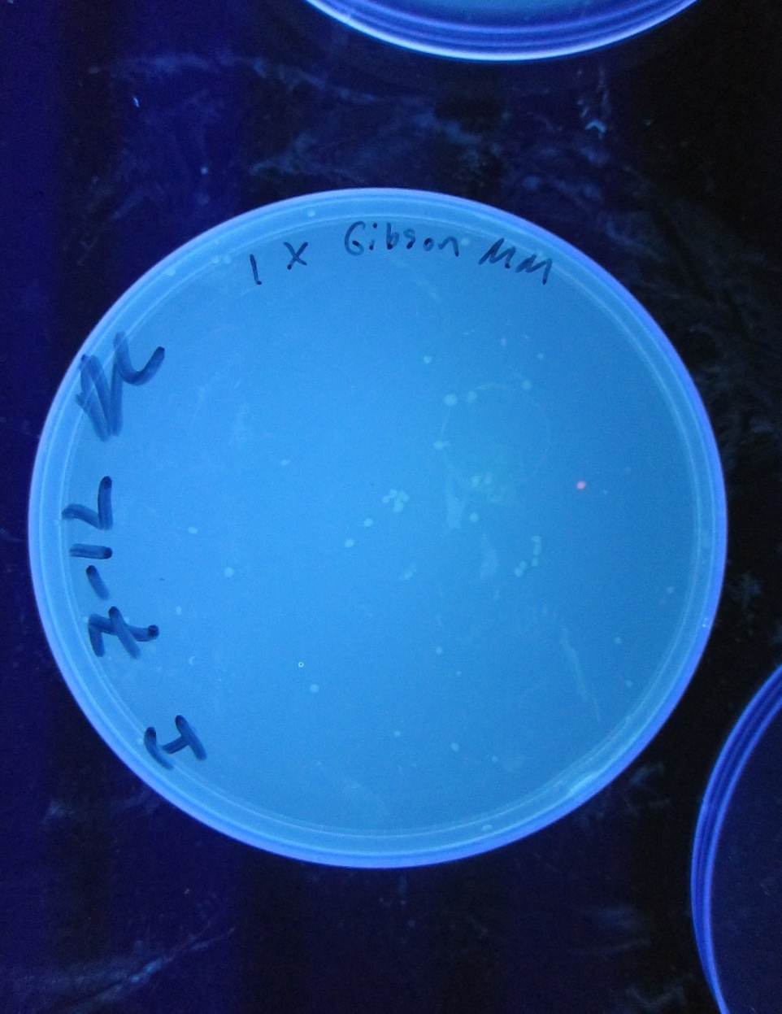
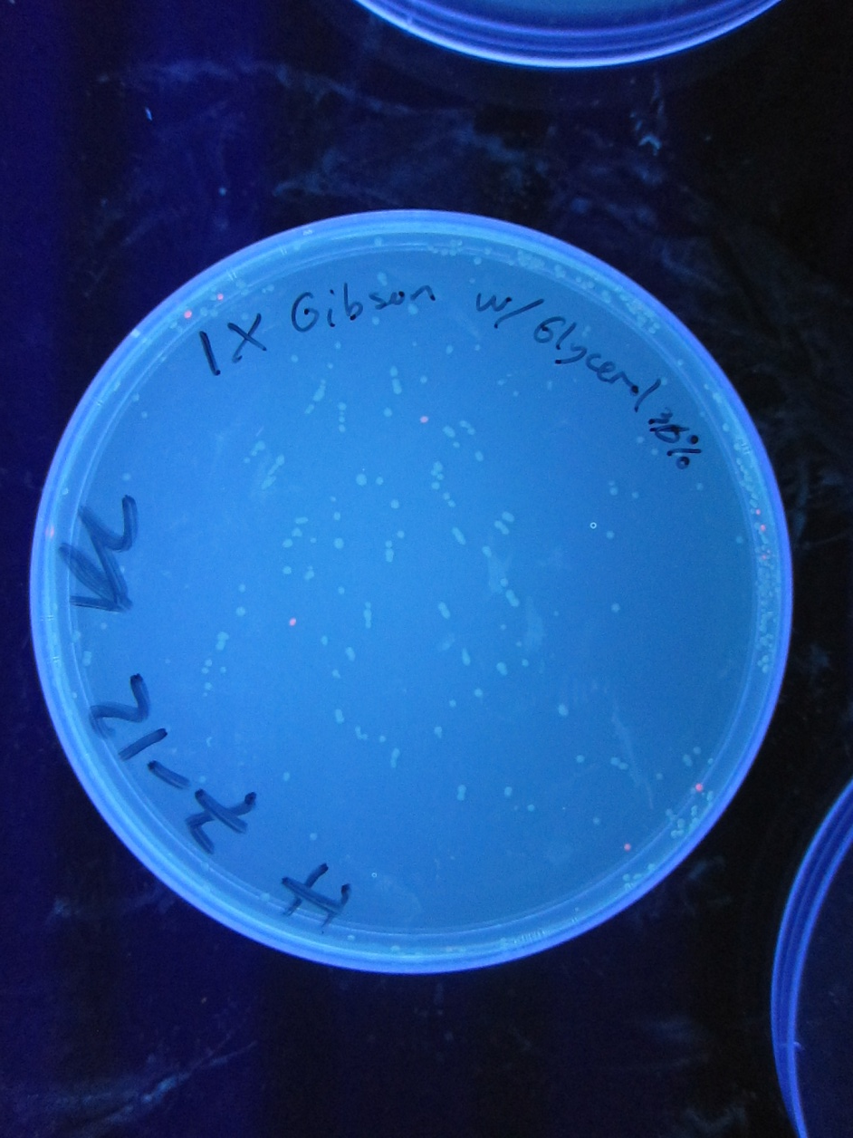
NEBGibson ½ Recommended Concentration of Master Mix
Notes:
Total Volume 4 ul for both reactions

Slide 7
Gibson Reaction Times (0, 20, 60, 120, 240 minutes at 50 degrees Celcius)
Master Mix
1.6ul Part 1 (23.4 ng)
4 ul Part 5 (225 ng)
9 ul (NEB) Gibson Master Mix
21.4 ul dH2O
36 ul Total /
8 ul were used for the 20, 60, 120 and 240 time variations while the remaining master mix was frozen as the 0 time

Slide 9
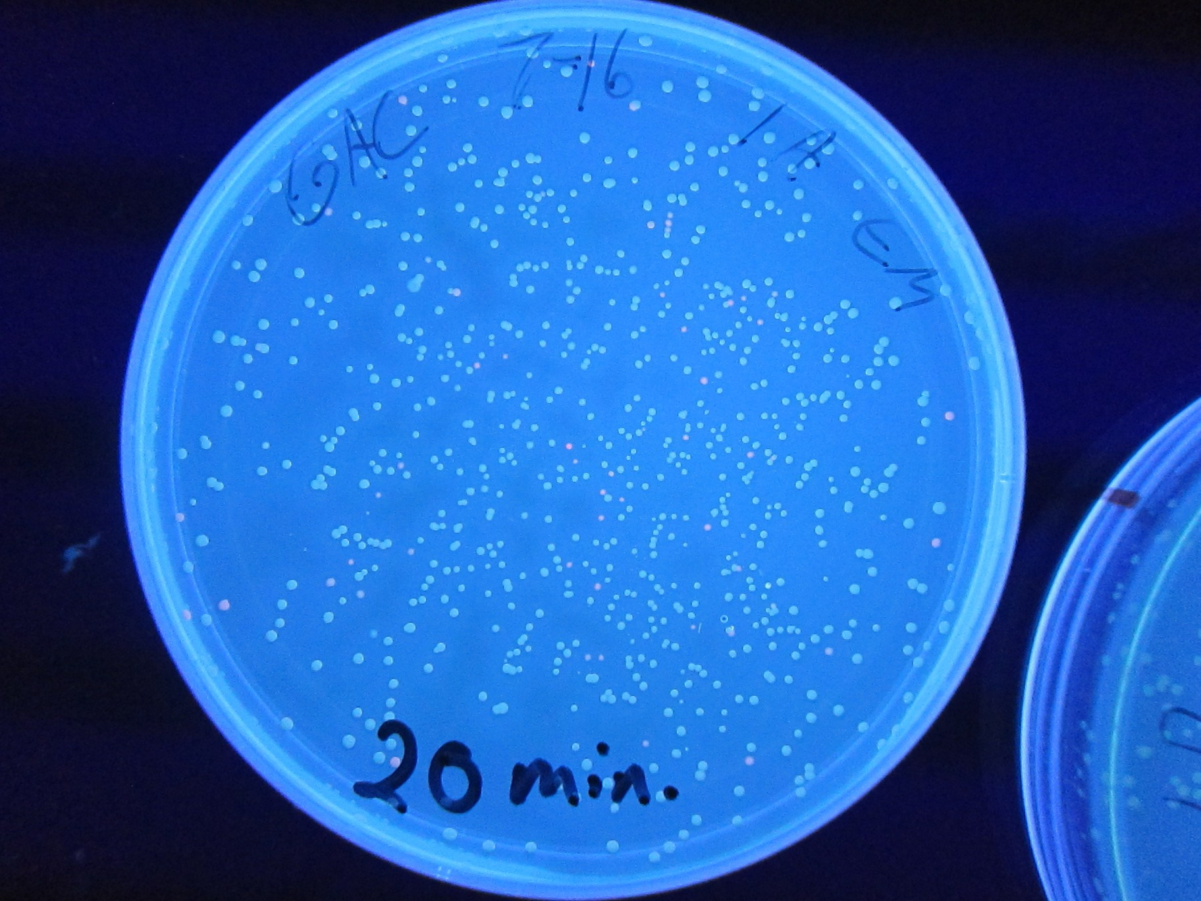

Slide 10
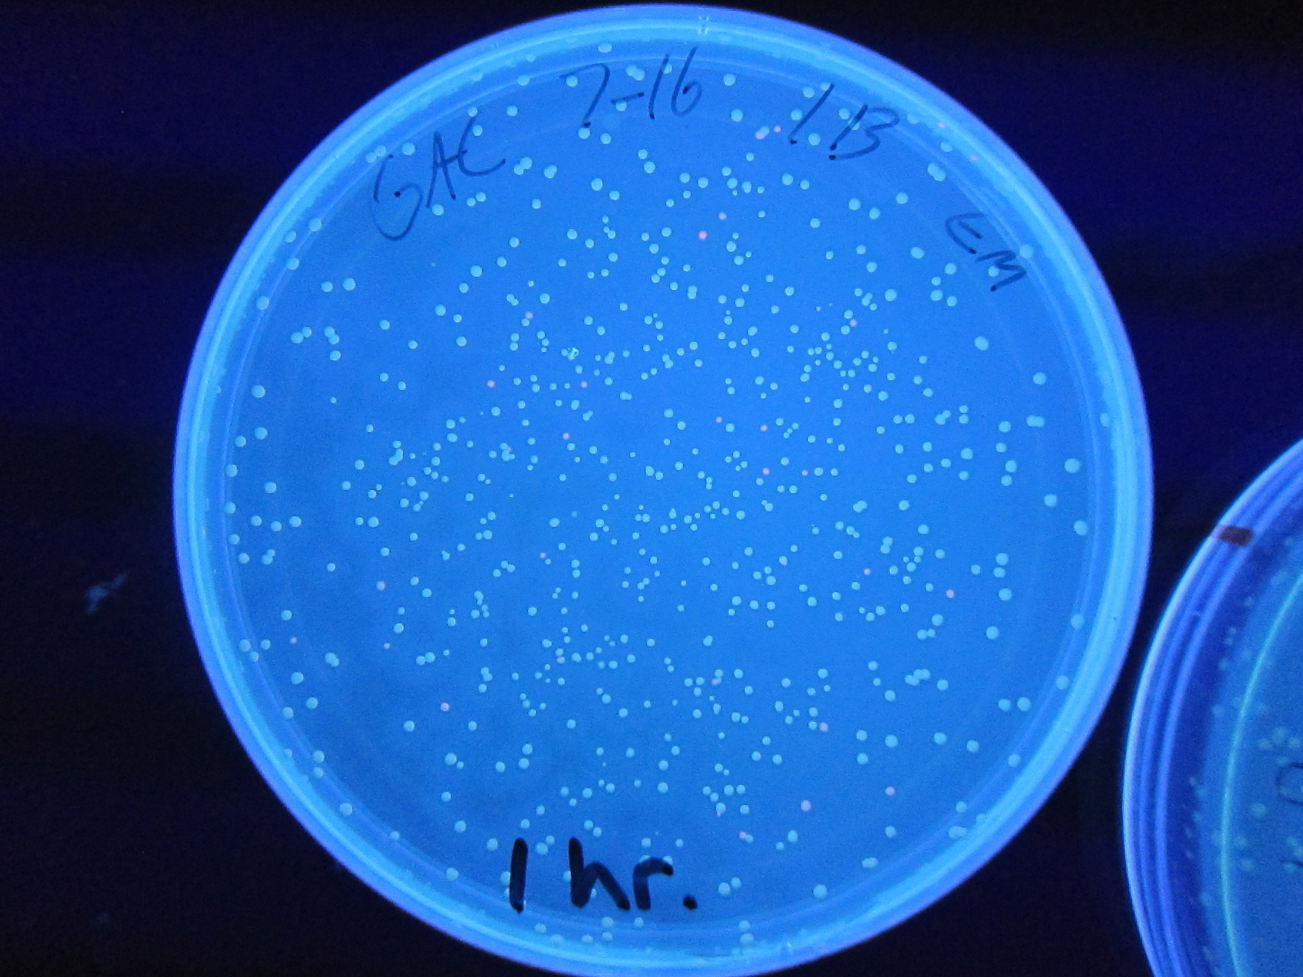

Slide 11
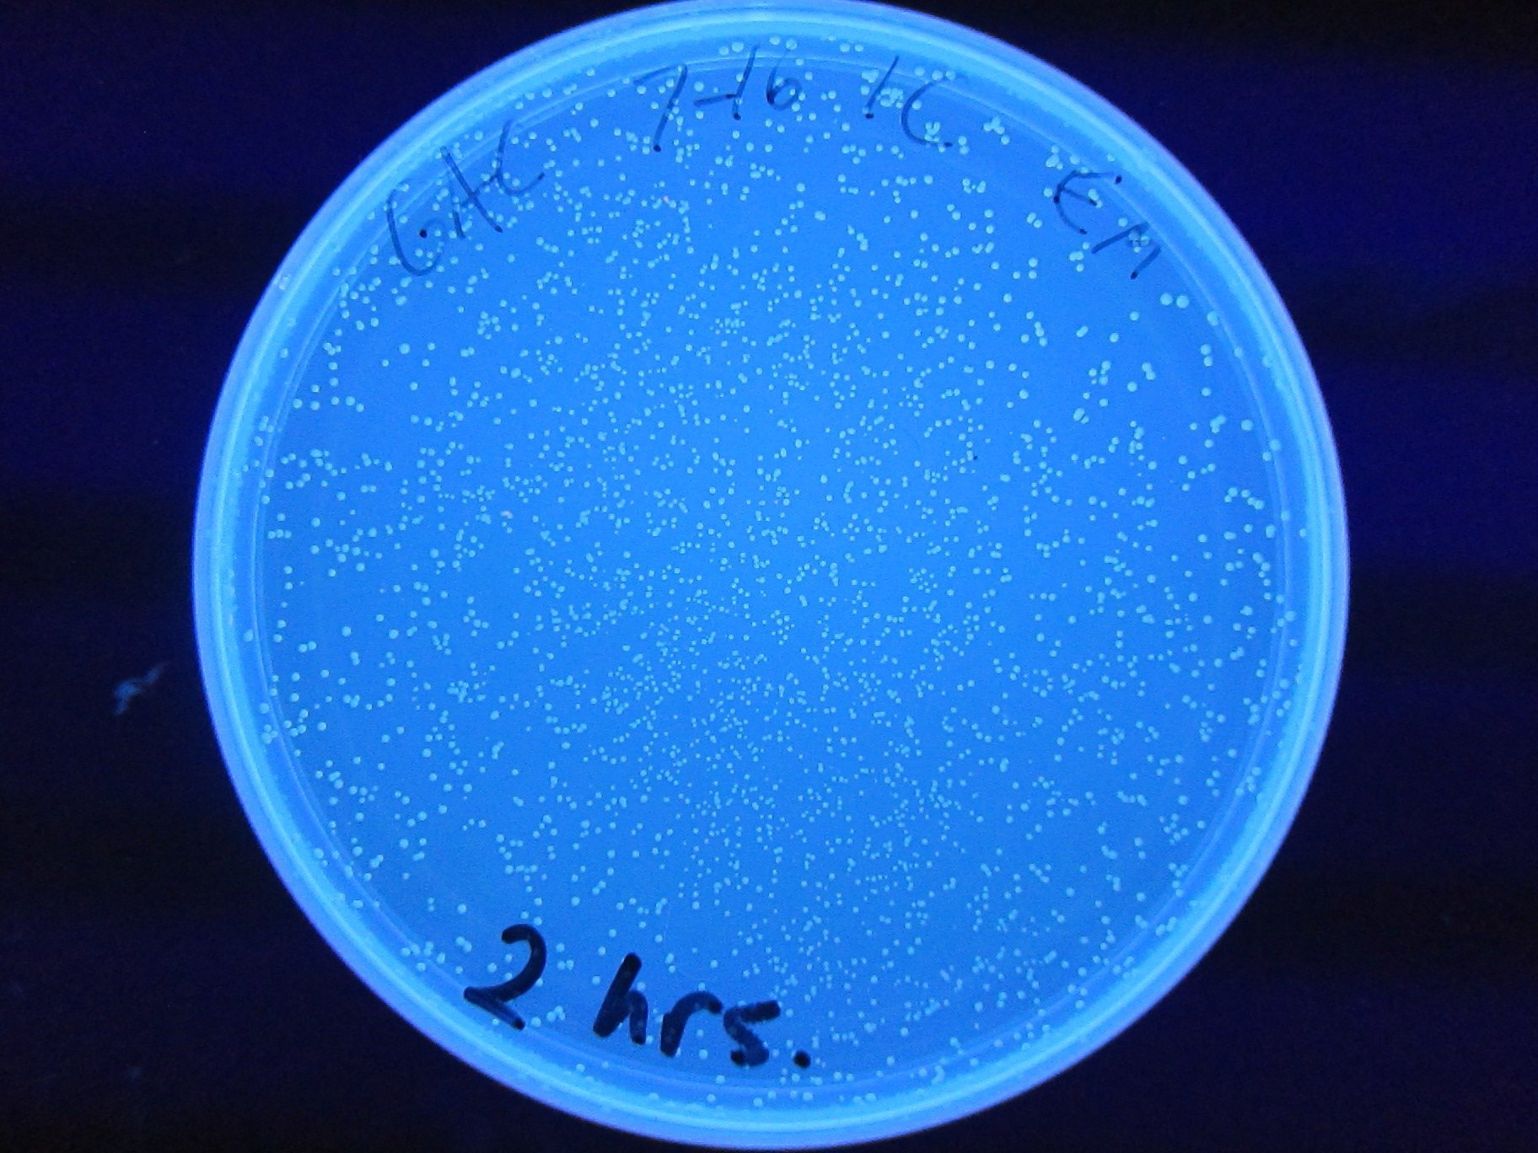
Notes:
There are red colonies less than or equal to 1%

Slide 12
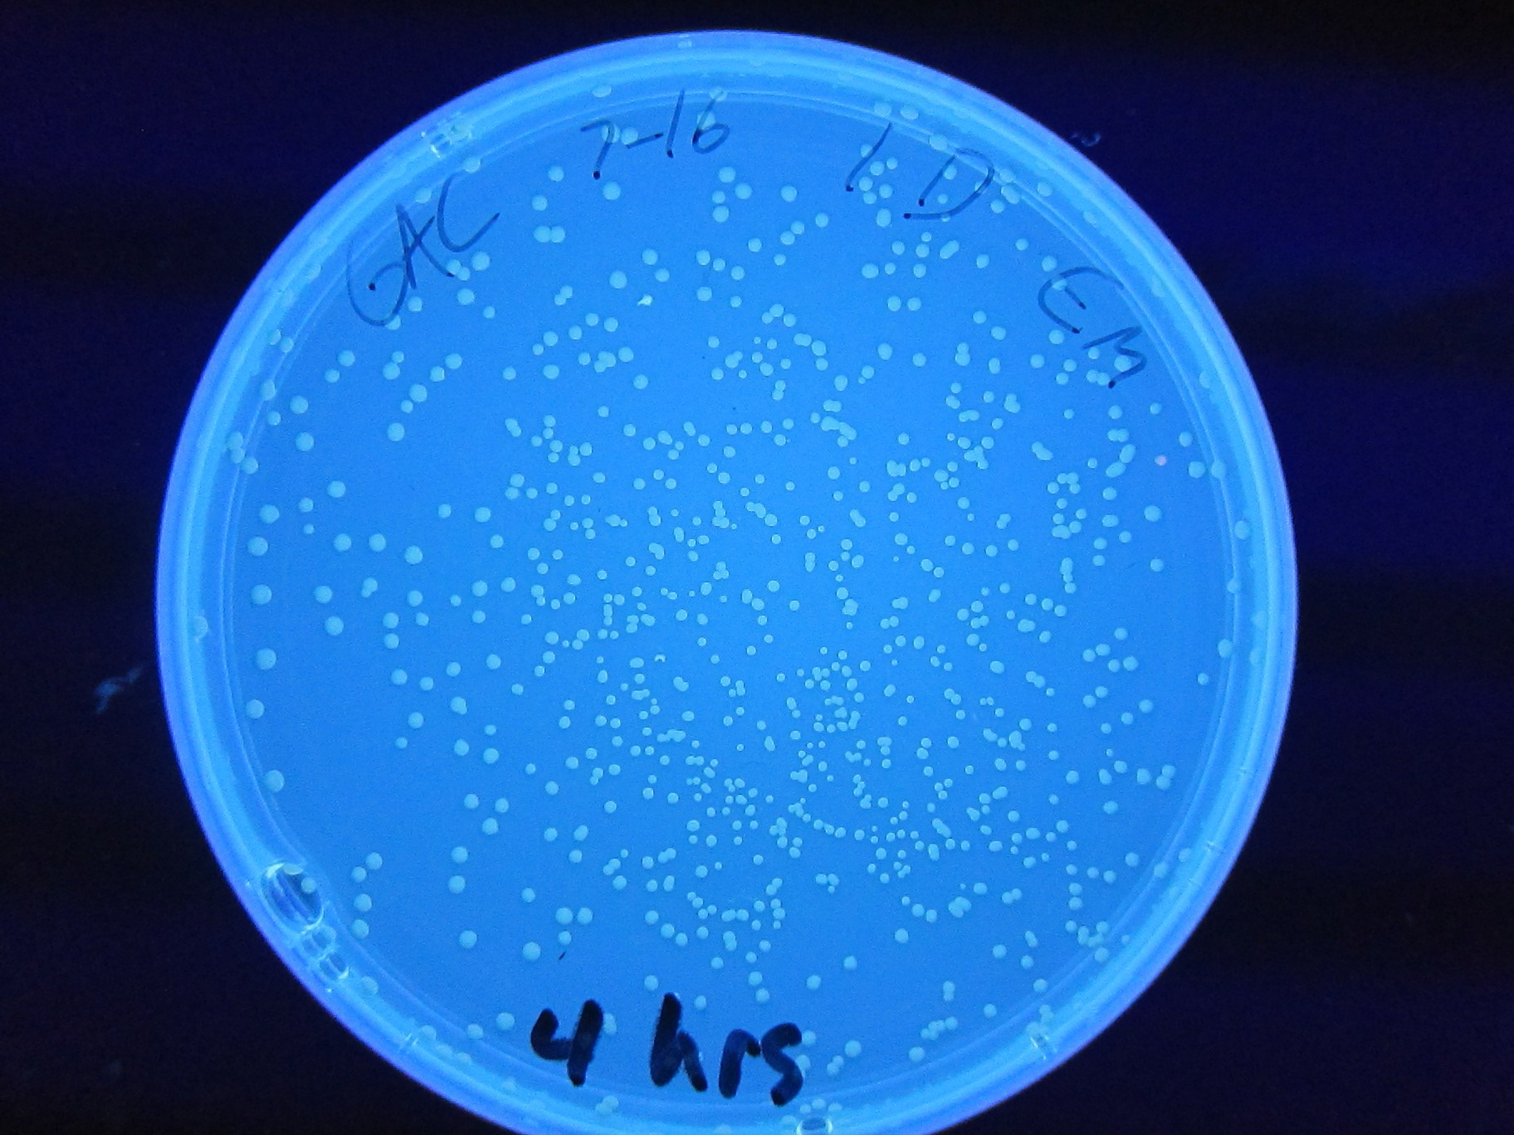

Slide 13
Issues
Background noise
Efficacy of PCR parts

