Slide 1
PCR
By: Kelly and Kathryn

Slide 2
What exactly is PCR?
PCR stands for “polymerase chain reaction” and is a lab technique used to clone segments of DNA.
Two main components:
1) Specification
2) Amplification
Developed in 1983 by Kary Mullis.

Slide 3
How Does it Work?
Initialization
Denaturation
Annealing
Extension
Final Elongation
Final Hold

Slide 4
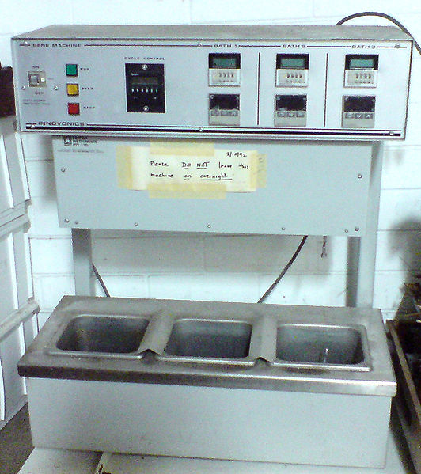
Initialization
Optional – only required for polymerases that need heat
1 – 9 minutes of heating to around 95⁰C

Slide 5
1) Denaturation
Heat (95⁰C) for around 25 seconds.
DNA melting of template by disrupting hydrogen bonds between complementary bases.
At the end, you have a single strand of DNA.

Slide 6
2) Annealing
Cool (60⁰C) for 30 seconds
Allows primers to bind to the single stranded DNA
Polymerase binds to the primer-template hybrid and begins DNA formation

Slide 7
3) Extension
With the temperature 75-80⁰C, ideal for Taq polymerase, the DNA polymerase synthesizes a new DNA strand complementary to the template in a 5’ to 3’ direction.
This can occur at a thousand bases per minute.
Exponential amplification.

Slide 8
Final Elongation
Occurs at around 72⁰C for 5-15 minutes
Ensures any remaining single-stranded DNA is fully extended

Slide 9
Final Hold
The product is stored at low temperatures (5-15⁰C).

Slide 10
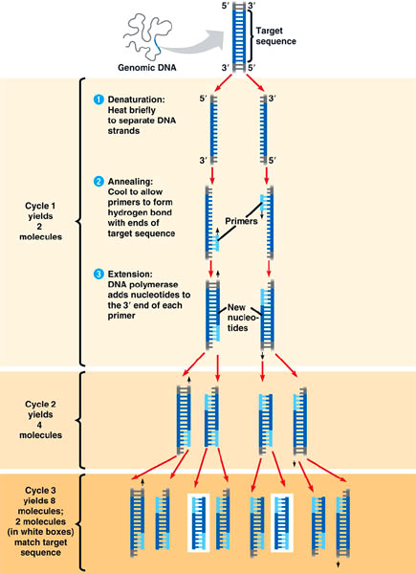

Slide 11
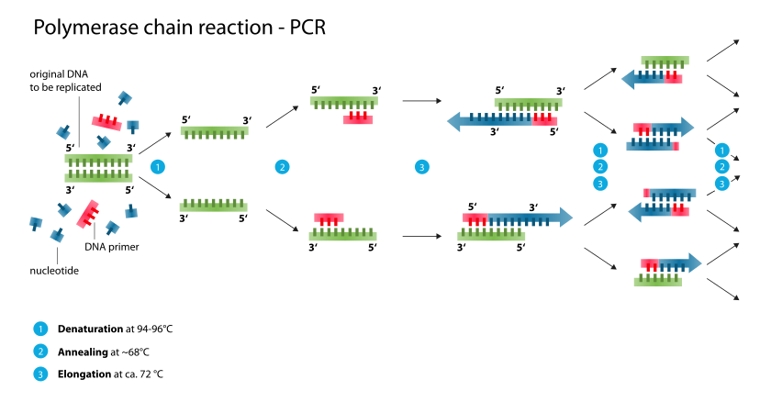

Slide 12
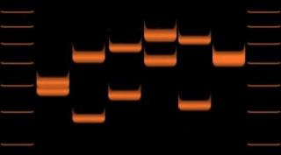
Reading a Gel
Ethidium bromide binds to the DNA fragments in the gel and fluoresces under UV light, appearing as bands.
Each band contains DNA fragments of similar size, travelling the same distance through the gel).

Slide 13
Amplification and Specificity
PCA allows for a small amount of DNA, and a specific portion of it, to amplify exponentially
The DNA polymerase loses activity throughout the process, and the reaction slows as reagents (e.g. dNTPs) become limited.

Slide 14
Potential Errors
PCR is very sensitive.
Contamination is a major threat, causing amplification of spurious DNA product which affects specificity.

Slide 15
Applications
Biotechnology
Clinical diagnoses, gene therapy, evolutionary studies
Forensics
DNA profiling, genetic fingerprinting, identification, parental testing
Medicine
Diagnosing diseases, tissue typing
Genetic research
Mutation detection, biomarker analysis, protein analysis, gene expression analysis

