Slide 1
Fruit Firmness
Stewart Dalton

Slide 2
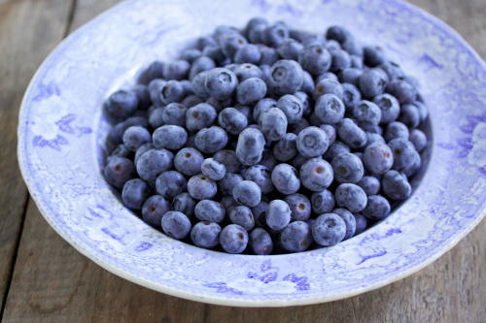
The issue
Blueberries have a short post-harvest life
It does not take long before they become soft and “mushy”
Most people prefer firm blueberries when they eat them
Blueberry softening vs. overripe softening
http://gourmandistan.com/tag/bread/

Slide 3
Economic implications
If we can identify the genes that cause blueberries to lose their firmness, they can be modified
Genetically altered blueberries may be able to maintain an optimal firmness level 2-3 times longer
Produce positive economic yields for those involved in the blueberry industry

Slide 4
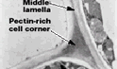
What causes fruit firmness?
The cell wall and the middle lamella
Comprised of complex polysaccharides such as cellulose, hemicellulose and pectin
Middle lamella fills the space between adjacent cell walls

Slide 5
What causes fruit to soften?
The degradation of the cell walls and middle lamella are directly responsible for decreases in fruit firmness
Pectin is the primary carbohydrate that makes up the middle lamella
As pectin gets degraded, the middle lamella is broken down and cell walls are no longer held so tight together
Thus, the fruit softens

Slide 6
Pectinase protein family
It was found that the pectinase protein family is responsible for the break down of pectin
pectin esterase (EC 3.1.1.11) http://www.ncbi.nlm.nih.gov/protein/82097 (Tomato)
-polygalacturonase (EC 3.2.1.15) http://www.ncbi.nlm.nih.gov/protein/AAA34177.1 (Tomato)
-pectate lyase (EC 4.2.3.2) http://www.ncbi.nlm.nih.gov/protein/AEE74778.1 (Arabidopsis)
-pectin lyase (EC 1.4.2.10)

Slide 7
Expansin protein family
Although more involved in the ripening softening process, some expansin proteins may still play an important role in overripe softening
A paper identified the Le-ESP1 gene as one that encodes for an expansin protein involved in the overripe softening process
Another candidate expansin gene from the tomato: http://www.ncbi.nlm.nih.gov/protein/AAC63088.1

Slide 8
Further investigations
Find and identify more enzymes that are involved in the break down of the cell wall and the middle lamella
Investigate what activates pectinases and other enzymes to initiate the break down of the cell wall and middle lamella
Locate the genes that I have found on the blueberry genome

