Slide 1
Sodium Biofortification
A. Malcolm Campbell, Davidson College Biology, 2014
What does Na⁺ do in a plant?
How does Na⁺ get into a cell?
How does Na⁺ get out of a cell?
Where is Na⁺ stored in plants?
How does Na⁺ get to Florette?
How do plants tolerate Na⁺ (salt stress)?
What ions influence Na⁺ in plants?

Slide 2
What does Na⁺ do in a plant?
not required for the growth of most land plants
strong inhibitory effect on many enzymes
High Na⁺ at root surface disrupts potassium nutrition
K⁺ influences cell turgor, membrane potential, & enzyme activity (Lazof and Bernstein, 1999)
K⁺ uptake via KUP1 inhibited by Na⁺ (Kim et al., 1998; Fu and Luan, 1998; Fu and Luan, 1998)
23-230 ppm sodium in soil is acceptable (www.dpi.nsw.gov.au/agriculture/resources/soils/testing/interpret)

Slide 3
How does Na⁺ get into a cell?
No transport systems specifically for Na⁺ uptake
Na⁺ enters root cells through cation channels
voltage-independent cation channels (major entry route)
voltage-dependent cation channels
plasma membrane potential (MP) root cells ~ -130 mV
negative potential facilitates entry of Na⁺
HKT1 low affinity Na⁺ transporter at high external Na⁺ (Rubio et al., 1995)
Function of AtHKT1 in plants is unclear
Not known how PMP3 regulates membrane potential
PMP3 ortholog of RCI2A &RCI2B in Arabidopsis (Medina et al., 2001; Nylander et al., 2001)
Arabidopsis RCI2A complements yeast pmp3/sna1 salt sensitivity
Na+ in Arabidopsis root is SAS1

Slide 4
How does Na⁺ get out of a cell?
Na⁺/H⁺ exchanger in vacuole membrane and plasma membrane
Na⁺ in vacuole removes from cytoplasm (good)
Balance low extracellular osmotic potential created by salt stress.

Slide 5
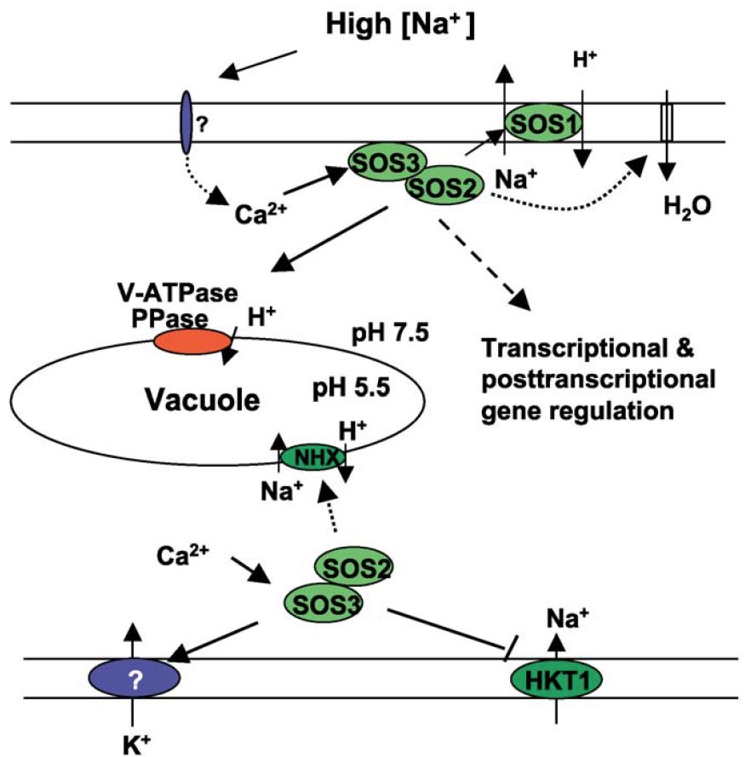
vacuolar H⁺-pyrophosphatase (AVP1)
AtNHX1
Ca²⁺-binding protein SOS3 is similar to the beta subunit of calcineurin (Liu and Zhu, 1998)
SOS3 does not function through a phosphatase (Halfter et al., 2000)
Notes:
High extracellular concentrations of salt elicit a rise in cytosolic Ca2+ concentrations. The Ca2+ sensor SOS3 upon the perception of this Ca2+ signal interacts with and activates the protein kinase SOS2. Activated SOS2 then regulates the activities of ion transporters or transcriptional activators to regulate ion homeostasis or gene expression. The SOS2 targets include the SOS1 Na+/H+ antiporter, the vacuolar Na+/H+ exchangers NHX, and the Na+ transporter HKT1.

Slide 6
Where is Na⁺ stored in plants?
NOK2 sequester Na⁺ in vacuole with transport K⁺
NHX1 up regulated by NaCl
siz1 and pho2 mutations reduce Na⁺ uptake & accumulation

Slide 7
How does Na⁺ get to Florette?
SAS1⁻ increased Na⁺ in aerial parts, roots unchanged (Nublat et al., 2001)
SOS1 controls Na⁺ loading into and/or retrieval from xylem
SOS1 extrudes Na⁺ in root epidermal cells (Shi et al., 2002a)
SOS1 is expressed around vascular tissues (Shi et al., 2002a)

Slide 8
Salt tolerance / Salt stress
Increased salt tolerance if overexpressing ROS scavenging enzymes:
superoxide dismutase
Catalase
GST
LEA enzymes (biosynthesis of osmolytes, hormones, or detoxification) functions of this group are ill defined:
RD (responsive to dehydration)
COR (cold-regulated)
LTI (low temperature-induced)
KIN (cold induced)
LEA-like proteins induced by salt, drought, low temp., & ABA

Slide 9
Salt tolerance / Salt stress
Overexpression of HARDY improved the instantaneous water use efficiency (WUE) under drought stress by reducing transpiration (E) and under salt stress by improving photosynthesis (A), through reducing Na+ accumulation in leaves, and reducing E. However, HARDY improved the growth of drought-stressed transgenic plants as compared to the wild type by delaying water depletion from soil and preventing rapid decline in A
DREB subfamily A-4 of ERF/AP2 transcription factor

Slide 10
What ions influence Na⁺ in plants?
Increased calcium protects plants under sodium stress
AtACA4 vacuolar Ca²⁺-ATPase increased the salt tolerance | (Geisler et al., 2001)
Ca²⁺/H⁺ antiporter AtCAX1 increased sensitivity to ionic stress
Extra glutamate receptor AtGluR2 → Ca²⁺-deficient & salt sensitive (Kim et al., 2001)

Slide 11
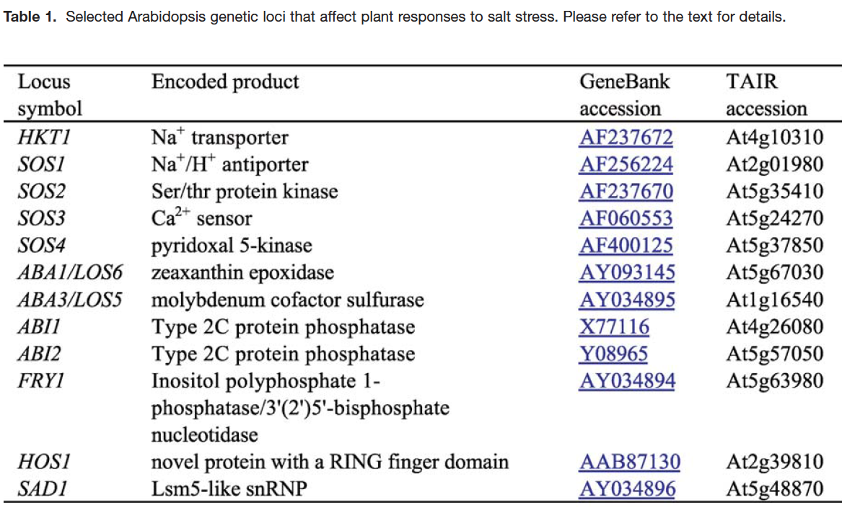
Notes:
High extracellular concentrations of salt elicit a rise in cytosolic Ca2+ concentrations. The Ca2+ sensor SOS3 upon the perception of this Ca2+ signal interacts with and activates the protein kinase SOS2. Activated SOS2 then regulates the activities of ion transporters or transcriptional activators to regulate ion homeostasis or gene expression. The SOS2 targets include the SOS1 Na+/H+ antiporter, the vacuolar Na+/H+ exchangers NHX, and the Na+ transporter HKT1.

Slide 12
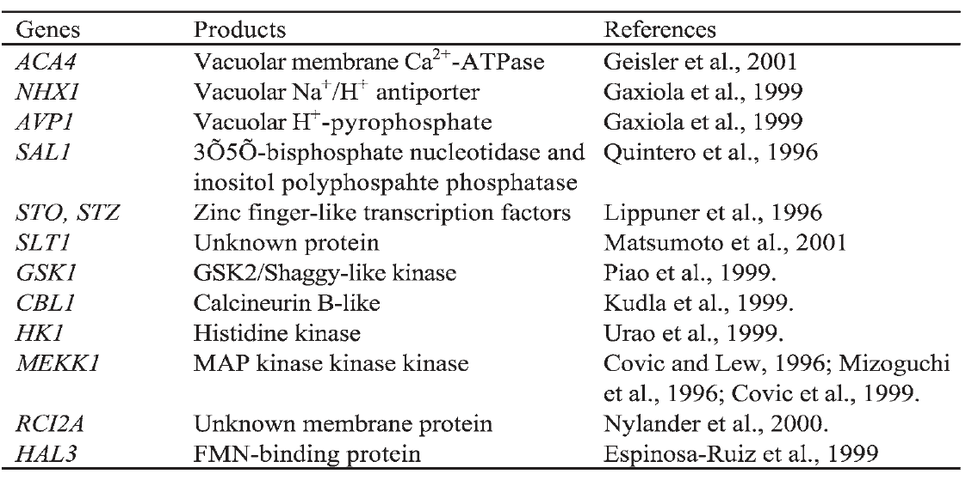
Notes:
Table 2. Some Arabidopsis genes that compliment salt sensitive phenotypes of yeast mutants or increase yeast salt tolerance when expressed in respective yeast strains.

Slide 13
My QTLs
C09 Bn-C9-p41992687
C06 Bn-C6-p03981788
C02 Bn-C2-p49684079
C08 Bn-C8-p24127988
A10 7-8 MBP
A02 22-24 MBP
A07 22-25 MBP
A08 ?

Slide 14
http://www.madmartian.com/broc/brocpics.htm

Slide 15
http://www.madmartian.com/broc/brocpics.htm

Slide 16
References
Liming Xiong and Jian-Kang Zhu. 2012. Salt Tolerance. The Arabidopsis Book, Number 1 2002. The American Society of Plant Biologists. DOI: http://dx.doi.org/10.1199/tab.0048
Increased tolerance to salt stress in the phosphate-accumulating Arabidopsis mutants siz1 and pho2. Miura K, Sato A, Ohta M, Furukawa J.
Overexpression of HARDY, an AP2/ERF gene from Arabidopsis, improves drought and salt tolerance by reducing transpiration and sodium uptake in transgenic Trifolium alexandrinum L. Abogadallah GM, Nada RM, Malinowski R, Quick P. Planta. 2011 Jun;233(6):1265-76. doi: 10.1007/s00425-011-1382-3. Epub 2011 Feb 22.

