Slide 1
Lab Meeting
11-22-13

Slide 2
Known Differences
Switch | Difference | Characteristic
Riboswitch A | 15.8 | Low ON and Low OFF
Riboswitch B | 10.2 | Low ON and Medium OFF
Riboswitch C | 15.7 | Medium On Medium OFF
Riboswitch D | 8.4 | Medium ON and High OFF
Riboswitch E | 9.4 | High ON and Medium OFF

Slide 3
Results
 | Number of Sequences
Difference less than 9.2 | 13,551
Difference between 9.1 and 8.4 | 1,817
Start Codon Base Pairs | 179
RBS Base pairs | 14
Riboswitch D Lost

Slide 4
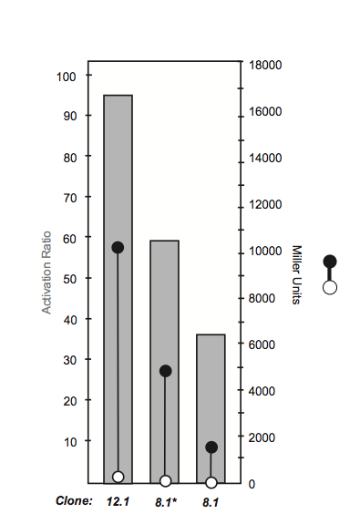
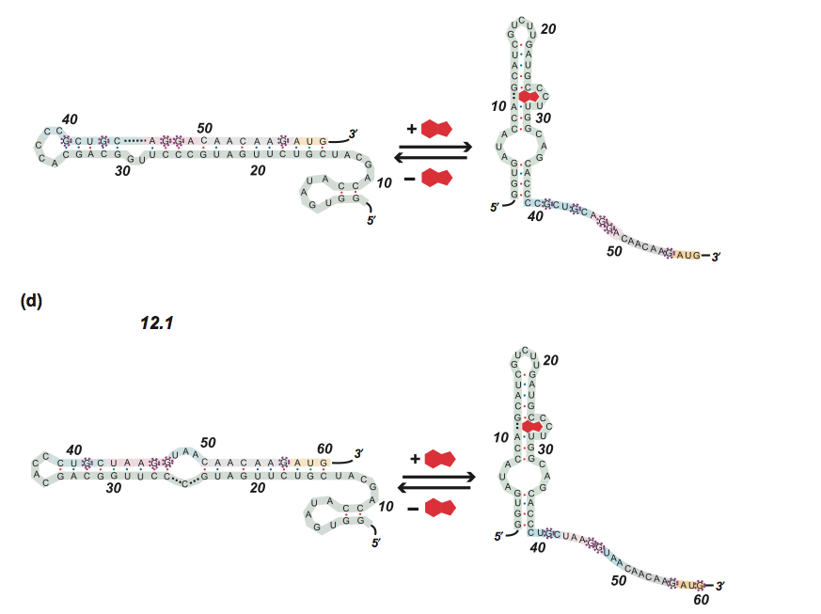
Why Riboswitch D is lost?
Riboswitch D

Slide 5
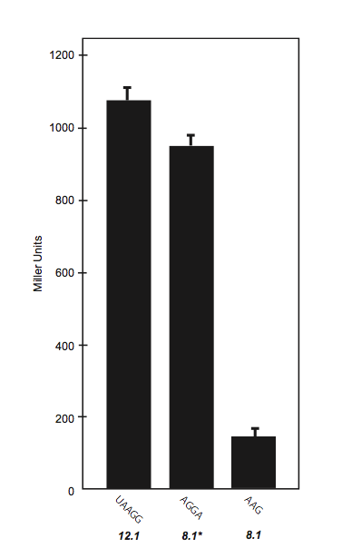
Why the RBS is important

Slide 7
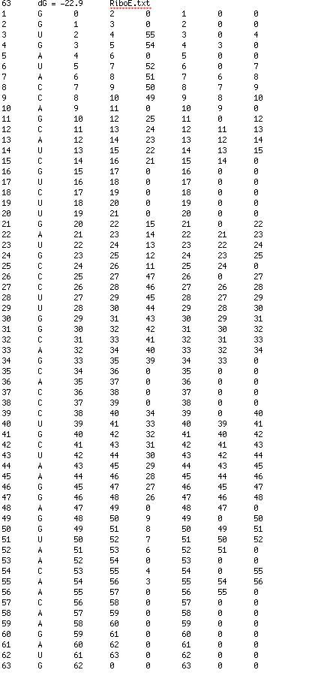
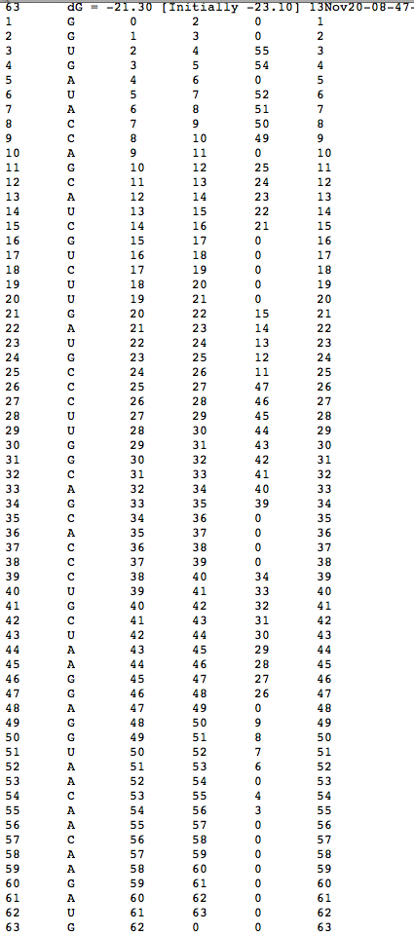
E

Slide 8
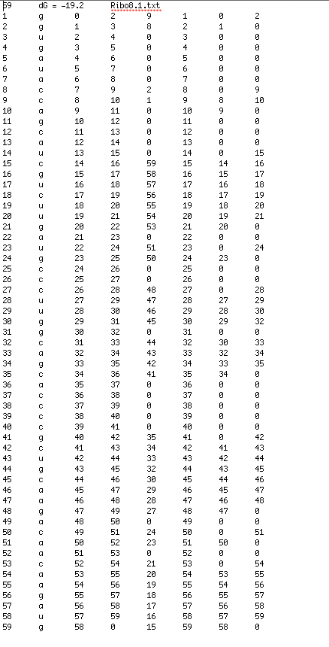
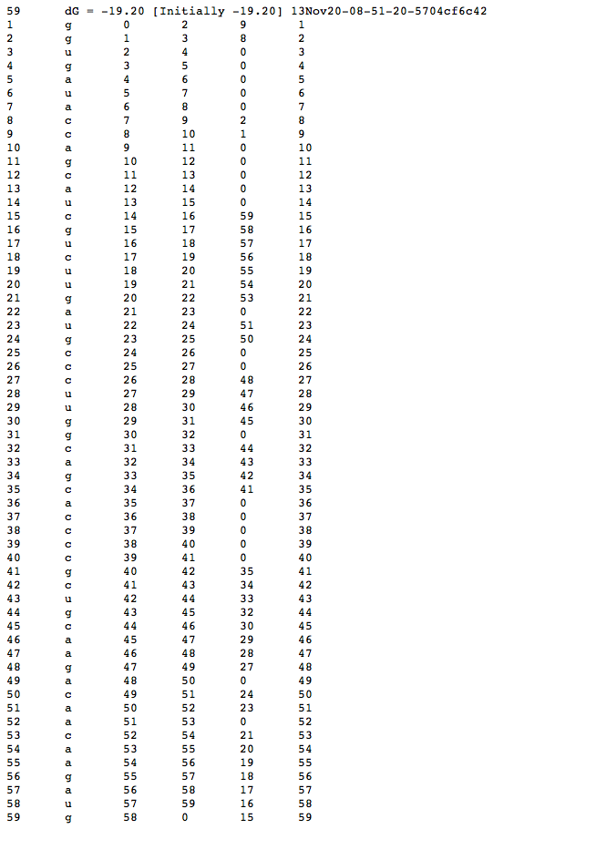
8.1

Slide 9
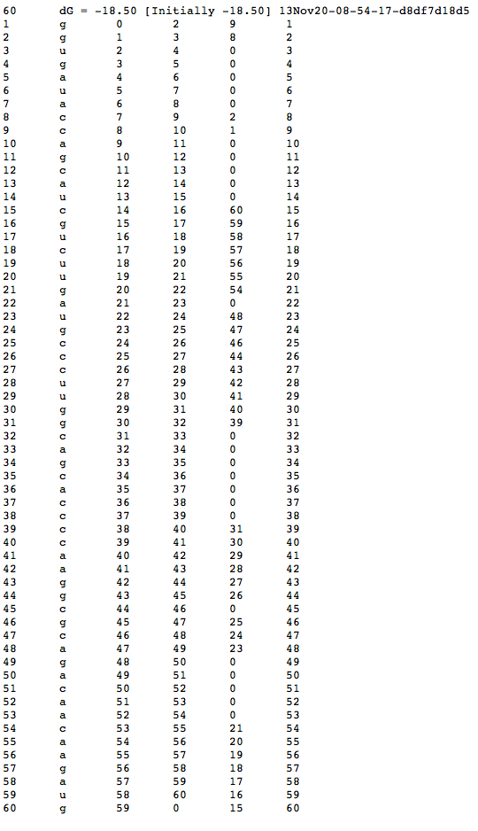
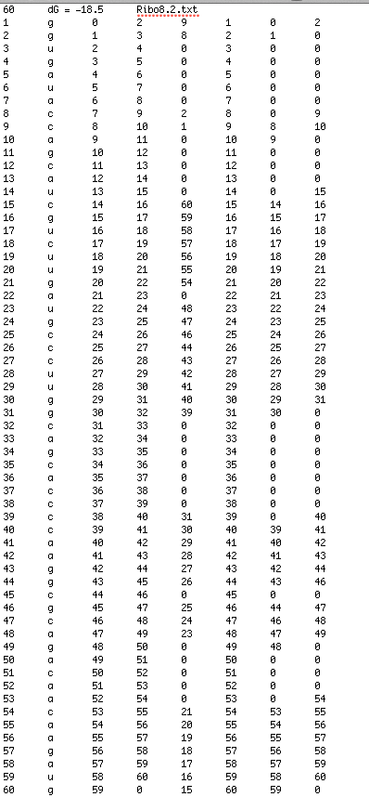
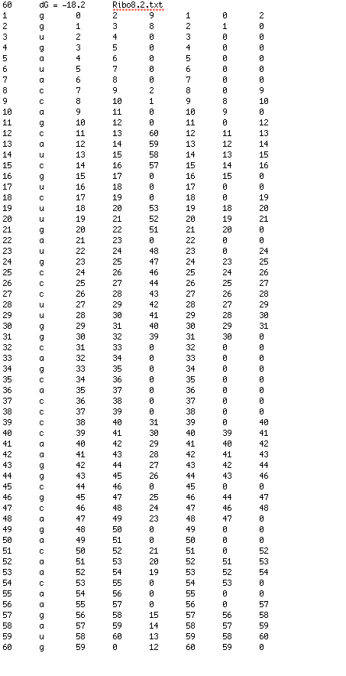
8.2

Slide 10
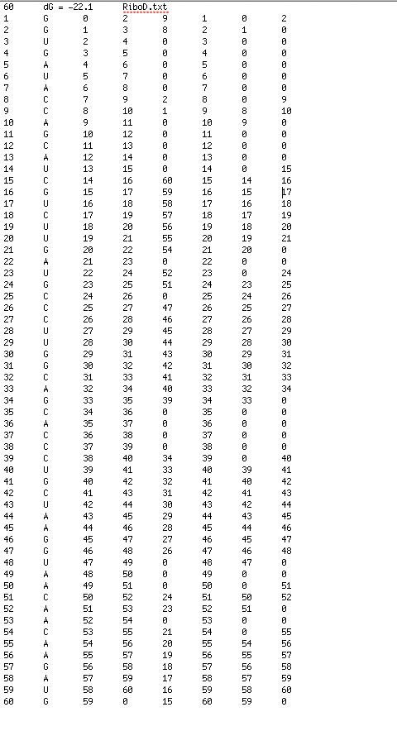
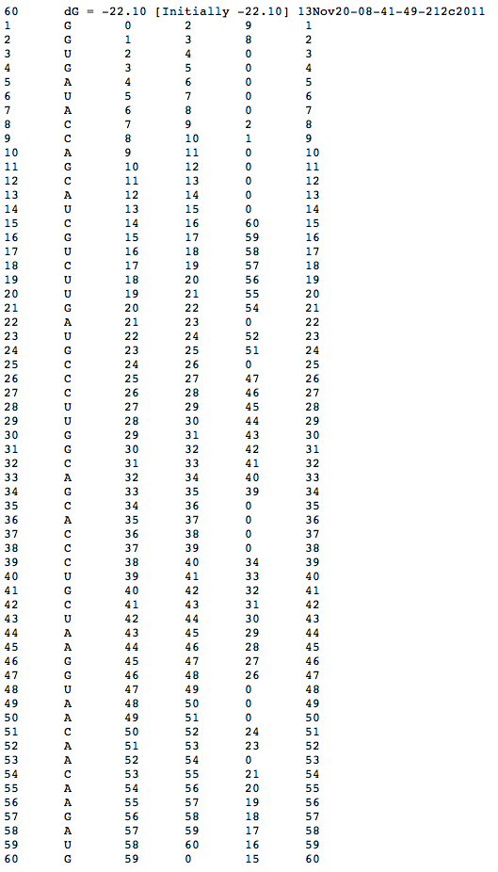
D

