Slide 1
Coat Color in Vaccinium corymbosum
Aaron Deal
Bio

Slide 2
What makes a blueberry blue?
Wax coat ¹
Platelets and Rods (surface structures visualized through SEM) = Color
β-diketones
pH and anthocyanins?
Extract and juice color ²

Slide 3
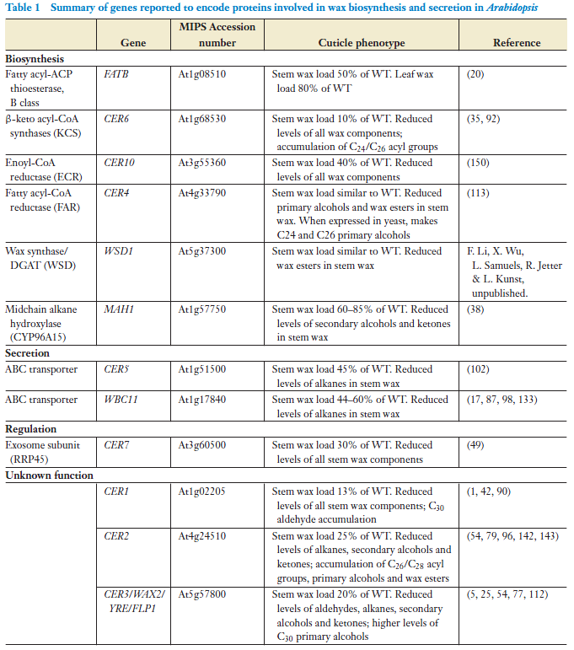
Target Gene Selection
Orthologs in Arabidopsis
FATB—role in both stem and leaf wax
CER6— central step for ketone and wax ester synthesis (see next slide)
WSD—cannot ignore a name like that!
MAH1—ketone synthesis (see following two slides)
WBCII—transporter. Involved in wax secretion instead of synthesis (like other 4 targets)
(Samuels et al., 2008)

Slide 4
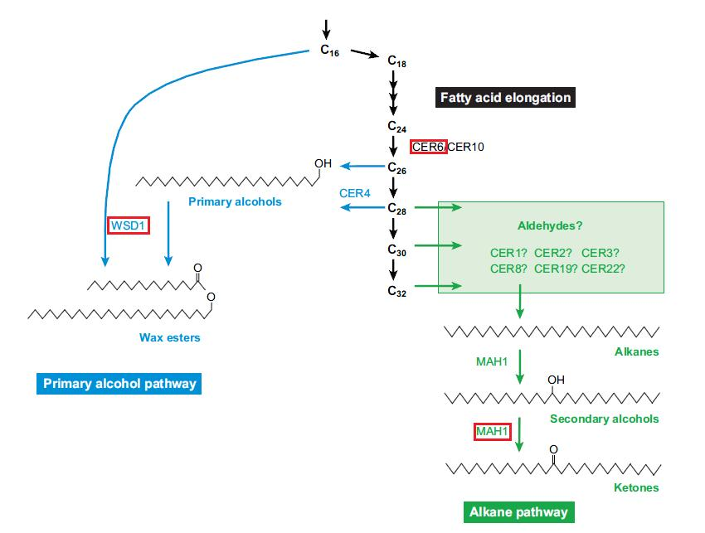
(Samuels et al., 2008)

Slide 5
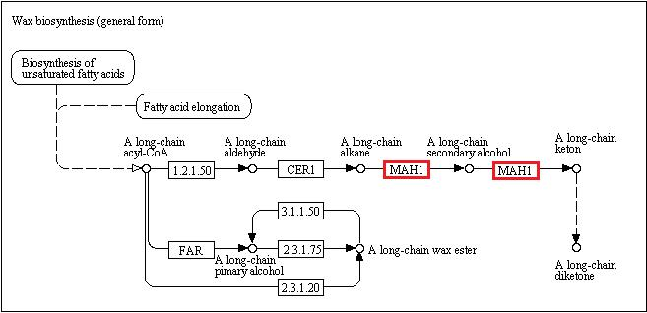
Modified from http://www.genome.jp/kegg-bin/show_pathway?map00073

Slide 6
Scaffold Search
FASTA of Arabidopsis gene → tBLASTx against Vaccinium scaffold database → Top few hits were recorded based on E value (<0.0001)
Results given as amino acid sequence alignments

Slide 7
Primers
Two pairs found for each scaffold (3’ and 5’)
WBCII – 2 Scaffolds
CER6 – 3 Scaffolds
WSD – 1 Scaffold
FATB – 1 Scaffold
MAH1 – 2 Scaffolds
Only scaffolds with primer results were used for EST searches.

Slide 8
EST Search Method
Scaffold 00137 (145956—147476)
Score = 258 bits (557), Expect(2) = e-115
Identities = 115/151 (76%), Positives = 122/151 (80%)
Frame = -1 / +2
Query: 1926 *SLTTSGIKTG*RSIQSDHGPSLGVLIVRLHFHTAELHLKPLPNAICQTRSPLLILPLDS 1747
*SLT SGI TG SIQS HGPSLGV +V LHF TAELHL PLPNAICQ RSP ILPLDS
Sbjct: 145976 *SLTISGIWTGYLSIQSCHGPSLGVPMVLLHFQTAELHLNPLPNAICQIRSPFFILPLDS 146155
Query: 1746 M*LSSYHNDEDDVLPKRCSVILEASTCSPDSCRFFWSSSITALPPA*MQKCSKASLKSGM 1567
M* SSYHN++D+VLP R VI +ASTCS DS RFFWSSSITALPPA MQK S A LKSGM
Sbjct: 146156 M*FSSYHNEDDEVLPNR*RVIRDASTCSVDSWRFFWSSSITALPPAWMQK*SNACLKSGM 146335
Query: 1566 YGFHFGLKILRPIRDVRKRSCSDAGRTKGPV 1474
GFH GLKI RP+R RKRSCSDAGRT GP+
Sbjct: 146336 *GFHLGLKIFRPMRVKRKRSCSDAGRTNGPI 146428
Example from CER6 tBLASTx result. The highlighted region is found in the 3’ end of the aligning region (noted in parentheses beside scaffold number) and is a continous sequence (no *). These two qualities make the region a prime candidate for the EST search.
The highlighted region was submitted to a tBLASTn against the EST database on the Vaccinium website (dev.vaccinium.org).

Slide 9
EST Search Method
If the tBLASTx, as described in the previous slide, did not provide significant results (E value <0.0001) when submitted to EST searches, the scaffold FASTA was used to generate queries (nucleotides within 1000bp of the 3’ aligning region).
No ESTs for WSD or FATB
WBCII – 4 ESTs
CER6 – 1 EST
MAH1 – 2 ESTs

Slide 10
WBCII

Slide 11
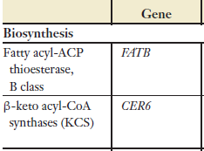
CER6
(Samuels et al., 2008)

Slide 12
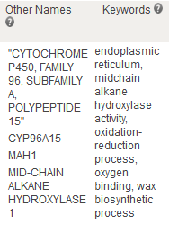
MAH1
www.arabidopsis.org

Slide 13
New Scaffolds
Does the same EST appear in other scaffolds?
tBLASTx EST against scaffold database
All ESTs (except 1) returned the “parent” scaffold as well as new scaffolds
High number of new scaffolds for WBCII EST (likely the result of such a large family of transporter proteins)

Slide 14
WBCII
EST DR067855: 00004; 00495; 01882; 00012; 07909; 00779; 00714; 11598; 00355; 02244; 00809; 02234; 00126; 00350; 02006; 01110; 00282; 00742; 01812; 00045; 08837; 00332; 02508; 00913; 00507; 00118; 02687; 00560; 00214; 01191; 01030; 01994; 00365; 00781; 00630; 00040; 01209; 01838; 00881; 10517; 00227; 00262; 00504; 00927; 01770; 00038; 00368; 03502
EST CV190423: 00560; 09668; 01965; 01191; 00913; 00896; 00263; 00227; 01994; 00040; 00365; 00087
EST CF811331: 00779; 00809; 00355; 00714; 02006; 11598; 00004; 07909; 00495; 08837; 02234; 00012; 01882; 00045; 00126; 00350; 01110; 02244; 01812; 02508; 00282; 00742; 00332; 00913; 00507; 00118; 02687; 01030; 00560; 00214; 01191; 00365; 00781; 00630; 01838; 10517; 00227; 00881; 01209
EST DR067166: 00087; 00040; 01994; 00365; 00227; 02687; 00504; 00560; 00118; 09668; 01965; 01030; 00131; 00507; 00116; 01016; 00555; 00913

Slide 15
CER6
EST CF811643: 00137; 00431; 00133; 01322; 02309; 03134
Scaffold 00268 also generated this EST but was not returned by the EST tBLASTx

Slide 16
MAH1
EST DR066987: 00314; 01091; 04227; 09505; 00112; 00236; 00254; 00277
EST CV090972: 00236; 00730; 01607; 00254

Slide 17
References
Albrigo, L., Lyrene, P., and Freeman, B. 1980. Waxes and other surface characteristics of fruit and leaves of native Vaccinium elliotti chapm. J. Amer. Soc Hort. Sci. 105: 230-235.
Sapers, G., Burgher, A., Phillips, J., Jones, S., and Stone, E. 1984. Color and composition of highbush blueberry cultivars. J. Amer. Soc. Hort. Sci. 109: 105-111.
Samuels, L., Kunst, L., and Jetter, R. 2008. Sealing plant surfaces: Cuticular wax formation by epidermal cells. Annu. Rev. Plant Biol. 59: 683-707.

