Slide 1
Gibson Assembly Size Control
What is the smallest segment of DNA that can be used?

Slide 2
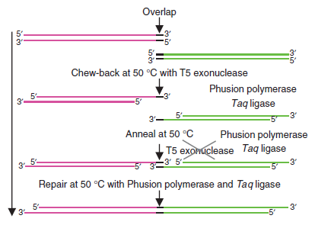
Premise
Using Gibson assembly methods allows the joining of any two pieces of DNA by designing primers that add the adjoining strand sequence to each of the two strands

Slide 3
Size Limits
There are some suggestions that these methods are limited to fragments of 250bp or larger.
The following design will lay out 4 experimental variations in size that will allow us to see for ourselves what the smallest size that can be assembled is.
The variations are 75bp, 150bp, 225bp, and 300bp which represent the increase of vector(1A2) DNA added in front of the promoter sequence.
While the promoter sequence will have consistent increases in size, the RFP construct (see next slide) will remain static, only changing in the sequence addition that makes it compatible with the variations in the promoter.

Slide 4

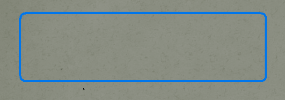
Templates/Primer 20 mers( / )
La3
La2
Ra
J119022 (35bp)
psb1a2
La1
La
Rb
RFP
TT
Lb
J119044 (2900bp)
psb1a2 BR
Notes:
Promoter is J23100

Slide 5

PCR Part Designs-Promoter Template
1) RbLa3_For/RaLb_Rev (75bp)
2) RbLa2_For/RaLb_Rev (150bp)
3)RbLa1_For/RaLb_Rev (225bp)
4)RbLa_For/RaLb_Rev (300bp)
Rb
Lb
Rb
Lb
75 in vector
Rb
Lb
150 in vector
Rb
Lb
225 in vector
Notes:
The green boxes depicted above represent the 20 bp’s that are added on to create fragments of DNA that overlap with the fragments we want to ligate them to. This method can allow for many pieces of DNA to be added together at once and to construct circular plasmids, however in this particular experiment we are using only two fragments of DNA which will ligate to eachother in two places to make a single plasmid. We can then transform completed fragments into E. Coli and screen for Red colonies.

Slide 6
PCR Part Designs-RFP Template
1) RaLb_For/RbLa3_Rev
psb1a2 BR
2)RaLb_For/RbLa2_Rev
3) RaLb_For/RbLa1_Rev
4)RaLb_For/RbLa_Rev
Ra
RFP
La3
Ra
RFP
La2
Ra
RFP
La1
Ra
RFP
La
Notes:
Like in the previous depiction, the blue squares represent the 20 bp of the adjoining fragments which are added during pcr based on our primer designs.

