Slide 1
Drought Stress
Erich Baker

Slide 2
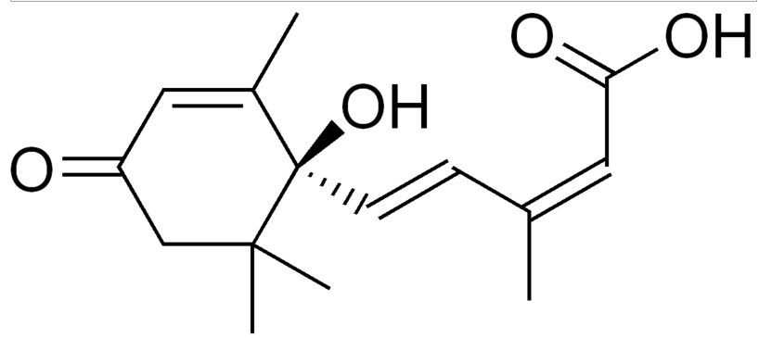
Most drought stress genes ABA-dependent.
Resource conservation mode
Common to many stress response pathways
In drought, often produced in roots, then migrates
Over 300 ABA-induced genes identified (2006)

Slide 3
Inhibits division of cells, slowing growth
Synthesis of cuticle and osmoprotectants
Closing of stomata
Inhibits fruit ripening, seed germination
Downregulates photosynthesis
Just adding ABA will inhibit growth, need to selectively activate pathways.

Slide 4
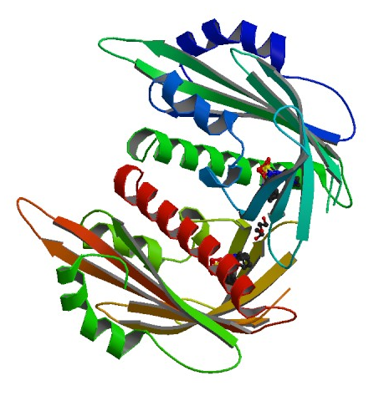
PYR/PYL is ABA receptor
Inhibits PP2C which normally inhibits SnRK2
Activating SnRK2 activates a wide array of molecules

Slide 5
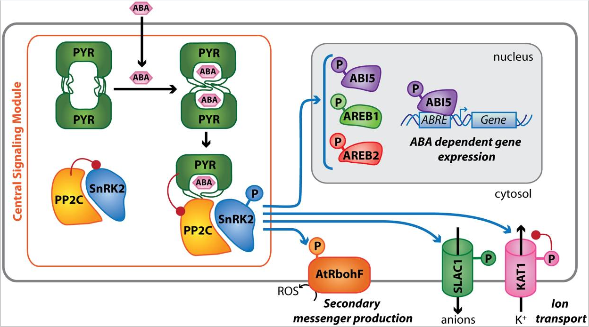

Slide 7
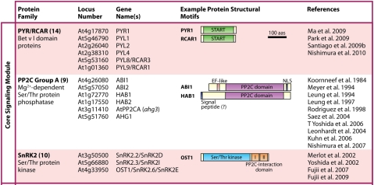

Slide 8
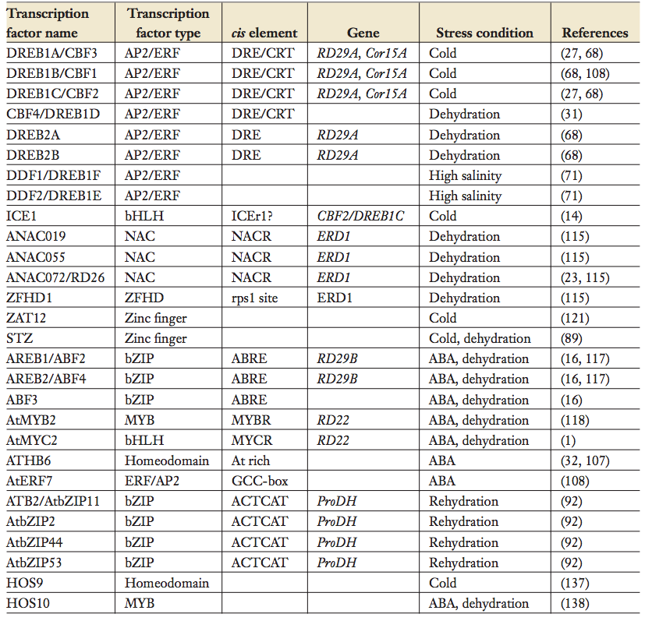

Slide 9
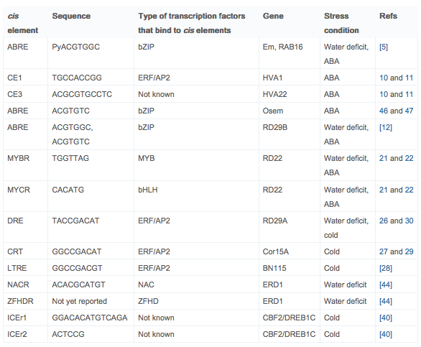

Slide 10
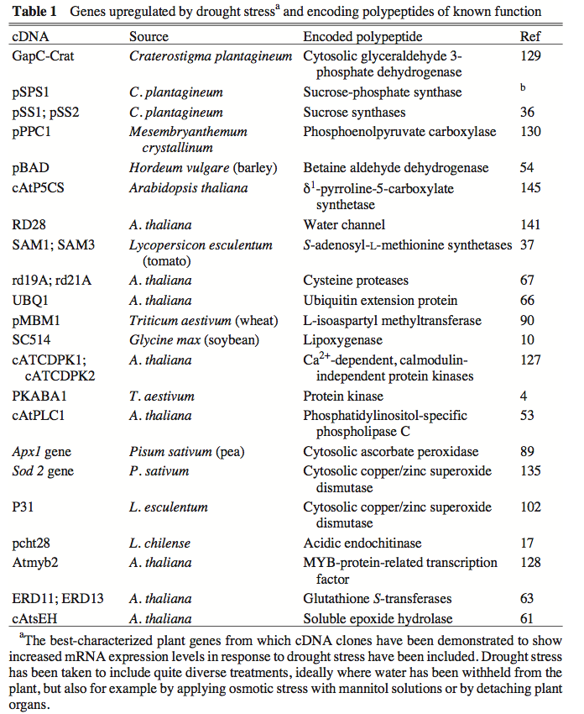

Slide 11
Some Important Drought Stress Pathways to Consider
MYB transcription factor causes increased cuticle wax deposition
MPKs and ExtCaMs regulate stomatal closure
NAC transcription factors and M6PR synthesize osmoprotectants
ABA represses IPTs and CKXs, slows cell division

