Slide 1
Mg²⁺ Uptake and Storage in B. oleracea
Eric Sawyer and Hannah Itell

Slide 2
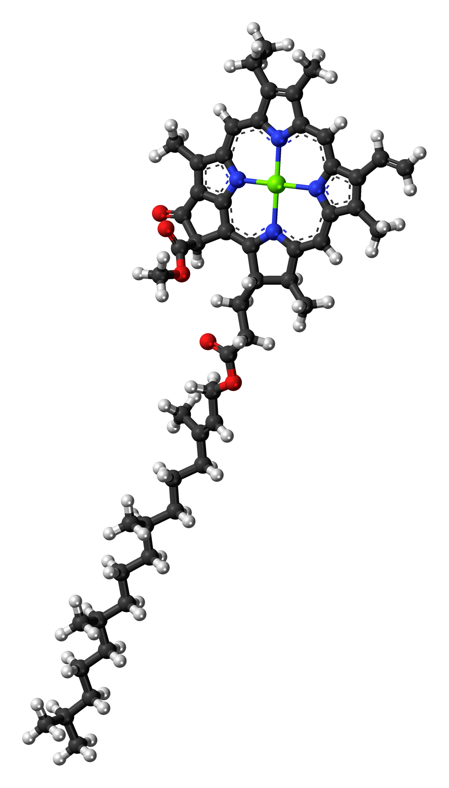
Biological roles for Mg²⁺
chlorophyll
common cofactor (RNA pol, kinases, ATPases, …)
most Mg²⁺ is not free in cytoplasm (ATP/nucleotide-chelated or in organelles) < 2 mM
chlorophyll a
Notes:
ERIC http://upload.wikimedia.org/wikipedia/commons/0/04/Chlorophyll-a-3D-balls.png public domain

Slide 3
Biological roles for Mg²⁺
vacuole: 3-13 mM Mg²⁺
highest [Mg²⁺]: thylakoid lumen (30-50 mM), but importers unknown!
Mg²⁺ uptake hindered by acidic soils
Mg²⁺ deficiency can lead to Al³⁺ toxicity; transporter competition
chlorophyll a
Notes:
http://upload.wikimedia.org/wikipedia/commons/0/04/Chlorophyll-a-3D-balls.png public domain0
HANNAH

Slide 4
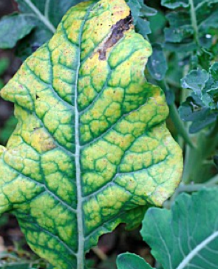
Signs of Mg²⁺ deficiency
chlorophyll breakdown
impaired sugar mobilization from leaves
reduced growth, particularly roots
Notes:
http://www.gardenworldimages.com/Details.aspx?ID=29427&TypeID=1
HANNAH

Slide 5
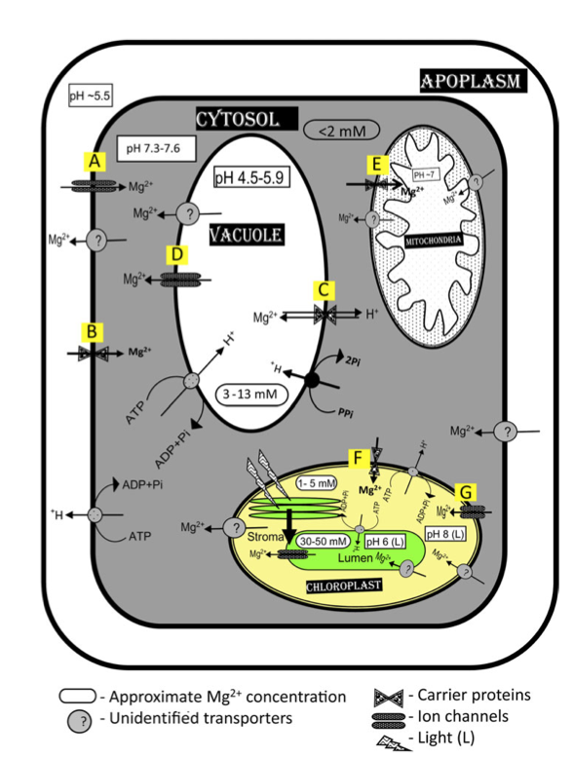
Mg²⁺ biochemistry
Cation channels
MGT
MHX
Slow activating vacuolar channels (SVs)
MGT5
MGT10 and FACCs
Bose et al. (2011)
Notes:
ERIC

Slide 6
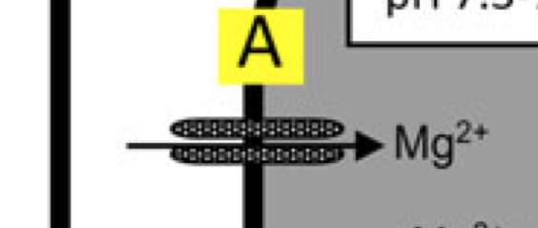
1. Mg²⁺ channels (plasma membrane)
Hyperpolarization-activated
Depolarization-activated
Voltage-independent
Cyclic nucleotide-activated
Non-selective ion channels
AtCNGC10 (A. thaliana): mediates Mg²⁺ mobilization through the plant

Slide 7
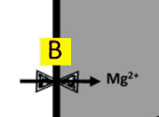
2. Mg²⁺ Carrier Proteins (plasma membrane)
Proteins of Interest: AtMGT1, 7a, 9, 10
“MGT” = Magnesium Transporter Family
AtMGT7a and AtMGT9 are low affinity
Mg²⁺ transporters
AtMGT1 and AtMGT10 are high affinity Mg2+ transporters
Sensitive to Al³⁺

Slide 8
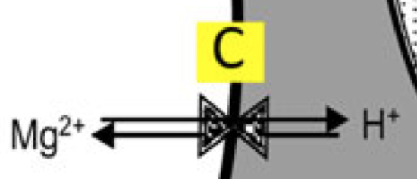
3. MHX (Mg²⁺/H⁺ exchanger, vacuole)
Mg²⁺ storage in vacuole
H⁺ export (V-ATPases acidify vacuole)
Might regulate cellular pH
Regulates loading of Mg²⁺ into the xylem (possibly via decreased vacuole import)
expression can be hormonally induced (auxin and abscisic acid)
vacuole
cytoplasm

Slide 9
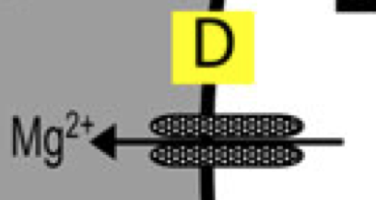
4. SV channel (vacuole)
slow activating vacuolar channels
export Mg²⁺ into cytoplasm
encoded by TPC1
thousands of SV channels per vacuole
voltage-gated, weak and non-specific
cytoplasm
vacuole

Slide 10
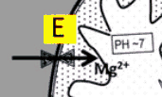
5. AtMGT5 (mitochondria)
Speculated to regulate Mg²⁺ transport across mitochondrial membrane
Not sensitive to Al³⁺
Help maintain normal functioning of mitochondria

Slide 11
6. AtMGT10 and FACCs (chloroplast)
AtMGT10: exclusive carrier protein
for Mg²⁺
Sensitive to Al³⁺
Fast activating chloroplast channels
Completely blocked by Gd³⁺
Transports Mg³⁺, Na⁺, K⁺, Ca²⁺

Slide 12
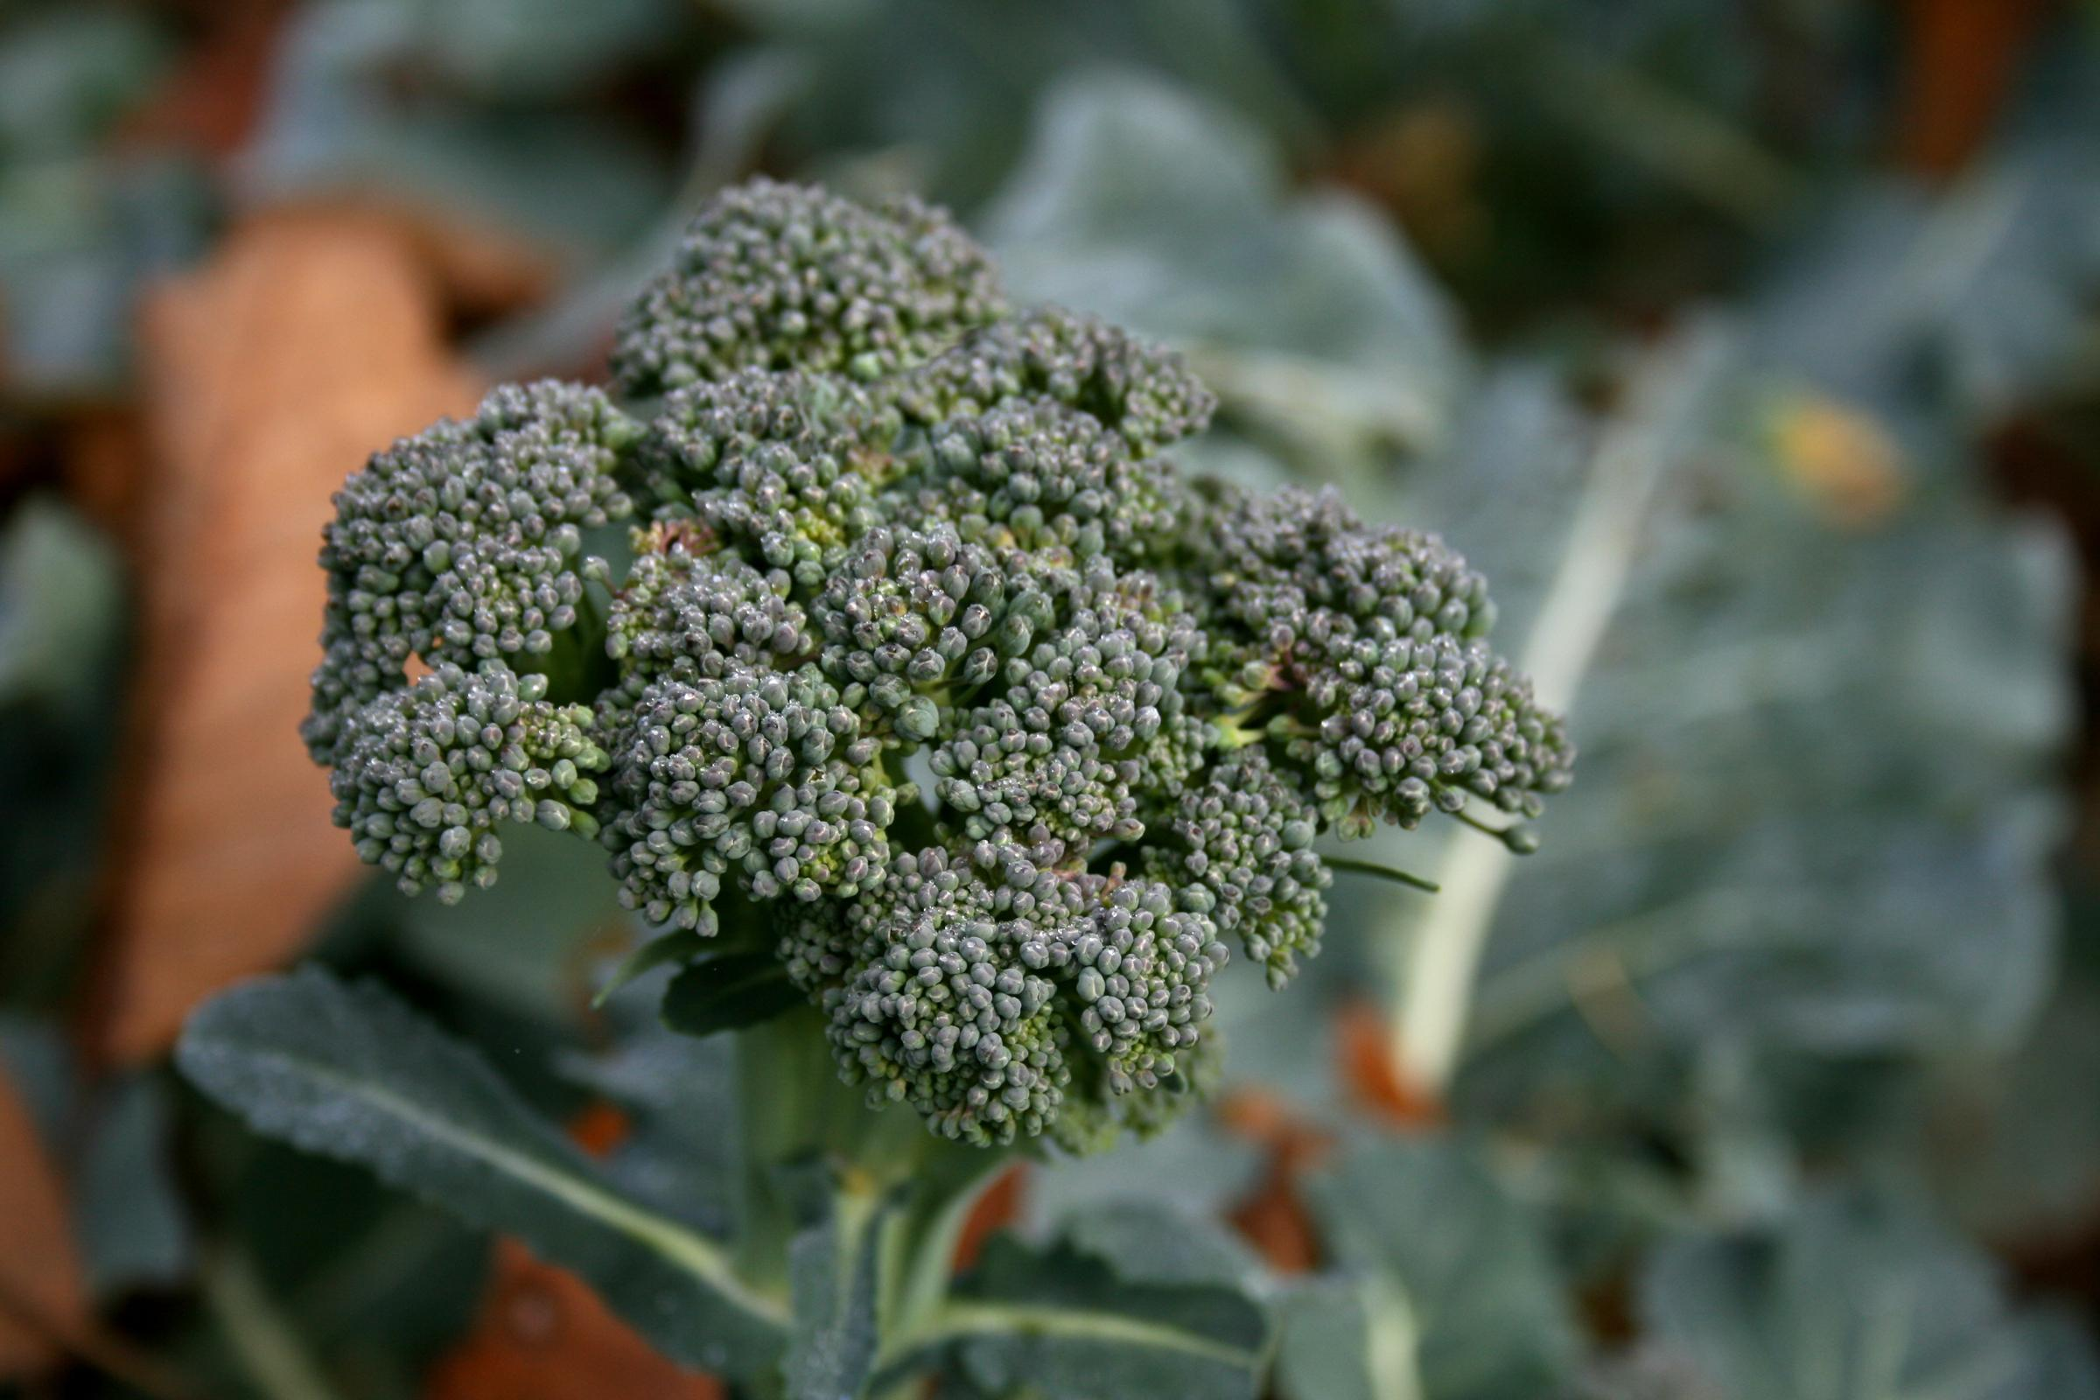
Prospects for broccoli
Some Mg²⁺ transporters broadly conserved
Fewer plant-specific transporters known and characterized
Recently evolved mammalian Mg²⁺ transporters: caution for gene finding
B. oleracea
Notes:
ERIC http://commons.wikimedia.org/wiki/File:Brokolice_1.jpg: public domain (B. oleracea)

Slide 13
References
Bose, J. et al. 2010. Role of magnesium in alleviation of aluminium toxicity in plants. Journal of Experimental Botany 62: 2251-2264.
Hermans, C. et al. 2010. Systems analysis of the responses to long-term magnesium deficiency and restoration in Arabidopsis thaliana. New Phytologist 187: 132-144.
Perez, V. et al. 2008. Homeostatic control of slow vacuolar channels by luminal cations and evaluation of the channel-mediated tonoplast Ca²⁺ fluxes in situ. Journal of Experimental Botany 59: 3845-3855.

