Slide 1
Zinc Uptake and Storage in Arabidopsis thaliana
Chris Polo and Katie Gwathmey

Slide 2
Benefits of Zinc
Necessary for for high plant growth
Functional subunit of <300 proteins
Role in key cellular processes
Role in mediating ROS
1/3 of worlds population experiences Zn deficiencies
Bioremediation
Notes:
Zinc finger proteins + RNA polymerases
Structure + catalytic role in enzymes, transcription factors, ribosomes
Approximately 1230 proteins contain bind to, transport zinc (PCR paper)
Involved in processes like transcription, translation, membrane integrity, reproduction (all necessary cell processes)
1/3 suffers from zinc deficiency
Bioremediation of soils contaminated by industrial waste
15-20 micrograms – lead to zinc deficiency + chlorotic leaves

Slide 3
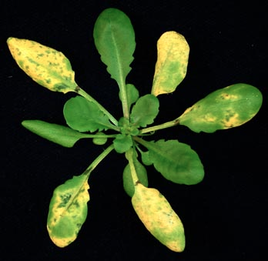
Negative Effects
Excessive concentrations:
Impair growth
Cause chlorosis
Interfere with cellular processes by binding with incorrect substrates in competition with Fe and Mg
Notes:
When in cytoplasm in excess amounts
-bind with incorrect substrates
-in competition with Fe and Mg
-mess up cellular problems
Optimum is somewhere in the middle
Image citation: http://www.mmg.msu.edu/faculty/he/HeFig._1.jpg

Slide 4
Nutrient Uptake
Digestion in soil
Chelators + acidification of rhizosphere
Uptake of Zn²⁺ into root cells
ZIP protein family
IRTs
Transfer of Zn²⁺ through symplast, through pericycle into xylem
PRC2
HMAs
Transport of Zn²⁺ to leaves and shoots
HMAs
Immediate use of Zn²⁺ or stored in vacuoles within plant cells
MTPs
Notes:
Root cells secrete chelators and acidify rhizosphere
Dissolve zinc + form cation Zn²⁺ that is able to enter the cell
Specific chelators are currently unknown
Zn⁺ alone can cause harmful reactions within the plant and therefore they need chelators → molecular chaperones
Transmembrane proteins: distribute + prevent cytoplasmic concentrations

Slide 5
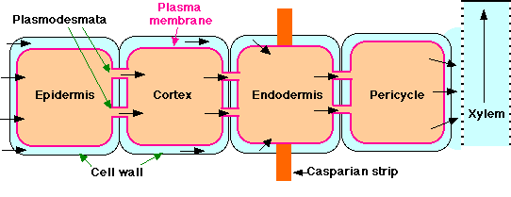
General Diagram: Root Uptake → Xylem
ZIP
Zn²⁺
HMA
PCR2
Zn²⁺
IRT
Zn²⁺
Notes:
http://www.pnas.org/content/107/22/10296/F3.expansion.html

Slide 6
ZIP
Associated Zinc Transporters
IRT1
IRT2
IRT3
Four main ZIP proteins
12 have been identified
Play a role in the structure of Zinc transporter proteins
ZIP1
ZIP2
ZIP3
ZIP4
Transcription Factors
bZIP19
bZIP23
Notes:
http://jxb.oxfordjournals.org/content/64/1/369.long
http://www.ncbi.nlm.nih.gov/pmc/articles/PMC2890486/
http://www.ncbi.nlm.nih.gov/IEB/Research/Acembly/av.cgi?db=ara&term=zip4&submit=Go
http://www.arabidopsis.org/servlets/TairObject?type=locus&name=AT1G10970

Slide 7
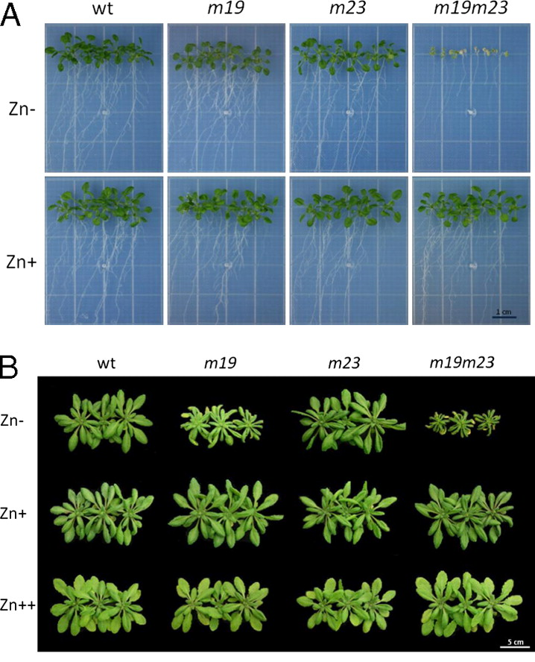
Notes:
Zn Deficiency (specifically ZIP promoters are knocked out) → more details to come (bZIP19 and bZIP23)
-lack of growth (when lacking proteins that are responsible for pulling Zn into the cell)
-more showing that if a plant does not get Zn (Zn- environment + no zip proteins = cannot grow)

Slide 8
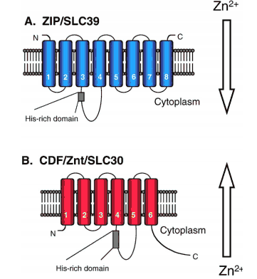

Slide 9
Chelators + Phytochelators
Nicotianamine (NA)
Nonproteinogenic amino acid binds to Zn²⁺ and Fe
Potential root to shoot transport
Glutathione
Organic acids
All chelators and phytochelators not yet identified
Notes:
‘molecular chaperones’ - prevent potential deleterious reactions within the cell
-Not as well studied/ not as many of them identified
-

Slide 10
Heavy Metal ATPases (HMA)
8 member family in Arabidopsis
HMA2, HMA3, HMA4 relevant to Zn uptake
P_{IB}-type ATPases
Localized in vascular bundles and plasma membrane
Movement of Zn²⁺ into apoplast, xylem or vacuoles
Efflux of Zn²⁺ from the cytoplasm
Notes:
ATP hydrolysis drives pumping of cations across membrane
Against the electrochemical gradient
8 transmembrane segments

Slide 11
HMA’s
HMA4
more specific to transport of Zn²⁺ from pericycle into xylem
Efficient shoot→ leaf transport
HMA2 more widespread in vascular tissues
Zn²⁺ cytoplasmic homeostasis
HMA3 localized in vacuolar membrane
Less understood but may be important in excess Zn translocation to vacuoles
Important in Cd transport as well
Notes:
-Hma4 mutant accumulated Zn in roots but no transport to leaves
-localized

Slide 12
PCR2
Plant Cadmium Resistance
Cadmium transporter but also involved in Zn transport
Localized in root epidermis and xylem parenchyma
Important in efflux of Zn as well as root to shoot transport
Notes:
http://www.plantcell.org/content/22/7/2237.full
-PCR2 – redistribution + detoxification
-PCR2 – removes from rootez – efflux transporter
-epidermal cells + xylem
-not overlapping with hama2

Slide 13
Vacuolar Storage
Zn²⁺
HMA2
MTP1
HMA3
Zn²⁺
Zn²⁺
ZIP4*
ZIP4
Notes:
*specifically into the florets
Chris talk about ZIP4
-MTP1 into vacuole
-HMA2 efflux from out of the membrane
-very basic – may not be exclusive to plasma membrane + HMA3

Slide 14
Vacuolar Sequestration
Cation Diffusion Facilitator (CDF)
Efflux of metals out of cytoplasm → either into extraceulluar membrane or organelles
12 predicted proteins in Arabidopsis
Mtp1 or ZAT1 = only one identified specific to Zn²⁺ transport

Slide 15
MTP1/ZAT1
Metal Transport Protein or Zinc transporter of Arabidopsis thaliana
mRNA present in all tissues containing Zn but localized to membrane of vacuoles
Evidence that transporter is key in transport of Zn into vacuoles
Notes:
-MTP1 overexpressed then Zn becomes resistant to concentrations of Zn normally toxic
-mt1 can bind to Zn on metal blot →
-not sure on the exact mechanism of transport but either uses another cation to fuel transport across membrane or does not use antiport mechanism
http://journal.frontiersin.org/Journal/10.3389/fpls.2013.00144/full
http://pcp.oxfordjournals.org/content/45/12/1749.long
-Catalytic

Slide 16
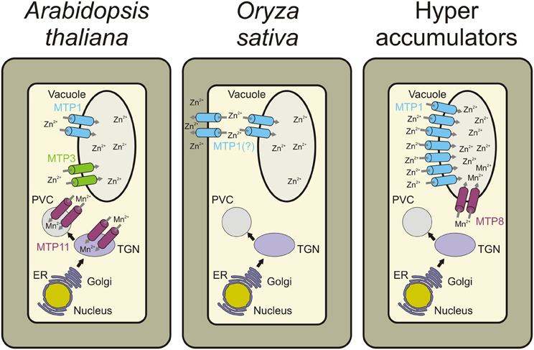
Vacuolar storage
http://journal.frontiersin.org/Journal/10.3389/fpls.2013.00144/full
Notes:
-MTP1 → Zn transport (vacuolar transport + widely expressed in the plant_
-MTP3 → transport Zn and Co heterologously + more in root epidermis and cortex
Hyperaccumulators → mtp1 is highly expressed (able to sequester in vacuole more efficiently)
MTP8 is seen = higher transport efficiency

Slide 17
Lit. Cited
1. NCBI “Arabidopsis gene ZIP4, encoding ZIP4;cation transmembrane transporter” Acessed 2.18.14 <http://www.ncbi.nlm.nih.gov/IEB/Research/Acembly/av.cgi?db=ara&term=zip4&submit=Go.>
2. Tair “Locus AT1610970” Acessed 2.18.14 <http://www.arabidopsis.org/servlets/TairObject?type=locus&name=AT1G10970.>
3. Assuncao, A., Herrero E. & Aarts, M. Arabidopsis thaliana transcription factors bZIP18 and bZIP23 regulate the adaptation to zinc deficiency. Proc Natl Acad 107(22), 10296-10301 (2010).
4. Claus, J., Bohmann, A. & Chavarria-Krauser, A. Zinc uptake and radial transport in roots of Arabidopsis thaliana: a modeling approach to understand accumulation. Ann Bot 112 (2), 369-380 (2012).
5. Eide, D. Zinc transporters and the cellular trafficking of zinc. Biochimica et Biophysica Acta 1763, 711-722 (2006).
6. Eren, E. & Arguello, J. Arabidospis HMA2, a Divalent Heavy Metal-Transporting P1B-Type ATPase, is involved in cytoplasmic Zn2+ Homeostasis. Plant Physiol 136 (3), 3712-3723 (2004).
7. Grotz, N. et al. Identification of a fmily of zinc transporter genes from Arabidopsis that respond to zinc deficiency. Proc. Natl. Acad. Sci. 2, 7220-7224 (1998).
8. Grotz, N., Fox, T. & Eide, D. Identification of a family of zinc transporter genes from Arabidopsis that respond to zinc deficiency. Proc. Natl. Acad. Sci. 95(12), 7220-7224 (1998).
9. Grotz, N. & Guerinot, M. Molecular aspects of Cu, Fe and Zn homeostasis in plants. Biochimica et Biophysica Acta 1763(7), 585-608 (2006).
10. Hoffman, N. Nicotianamine in Zinc and Iron Homeostasis. The Plant Cell 24(2), 373 (2012).
11. Milner, M., Seamon, J., Craft, E. & Kochian, L. Transport properties of membranes of the ZIP family in plants and their role in Zn and Mn homeostasis. J. Exp. Bot. 64 (1), 369-381 (2013).
12. Morel, M. et al. AtHMA3, a P1B-ATPase Allowing Cd/Zn/Co/Pb Vacuolar Storage in Arabidopsis. Plant Physiol. 148(2), 894-904 (2009).
13. Ricachenevsky, F., Menguer, P., Sperotto, R., Williams, L. & Fett, J. Roles of plant metal tolerance proteins (MTP) in metal storage and potential use in biofortification strategies. Front. Plant Sci. 4, 02/24/14 (2013).
14. Song, W. & et al. Arabidopsis PCR2 is a Zinc Exporeter Involved in Both Zinc Extrusion and Long-Distance Zinc transport. American Society of Plant Biologists 22 (7), 2237-2252 (2010).

