Slide 1
Theophylline Responsive Riboswitches
Becca Evans
Summer 2012

Slide 2
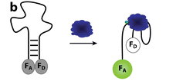
Aptamers
Short nucleic acid sequence that binds to a specific small molecule or ligand

Slide 3
Riboswitch
Translational control
Contains aptamer sequence
In 5’ untranslated region of mRNA
Untranslated Region
GOI: Translated Region
RBS
ATG
TGA

Slide 4
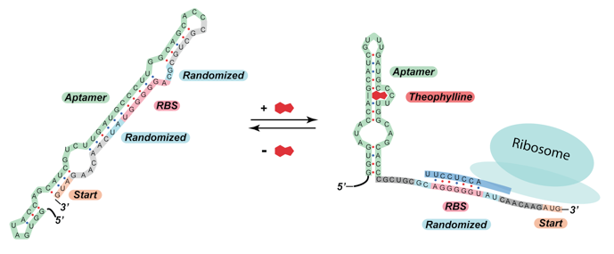
Riboswitches

Slide 5
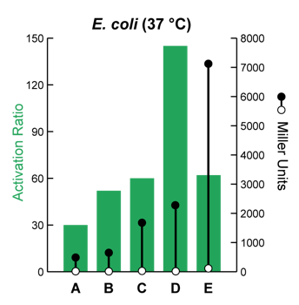
Different Riboswitches in E. coli

Slide 6
Assembly parts
Riboswitch
BsaI
BsaI
Superfolder GFP
EcoRI
EcoRI
PstI
PstI
Empty pSB1K8

Slide 7
Final device
Riboswitch
Superfolder GFP

Slide 8
Golden Gate Assembly
GGA to assembly three sections
Other pieces of DNA present in reaction
Only desired combination
Resistance to kanamycin
Riboswitch
Superfolder GFP
pSB1K8

Slide 9
}

Slide 10
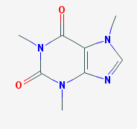
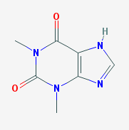
Theophylline vs. Caffeine
Caffeine
Theophylline

Slide 11
}

Slide 13
Future Research
Pathway for optimization
Caffeine → Theophylline
Reward cells for production of theophylline
yCDM metabolizes caffeine into theophylline

Slide 14
Theophylline vs. Caffeine
Caffeine
Theophylline

Slide 15
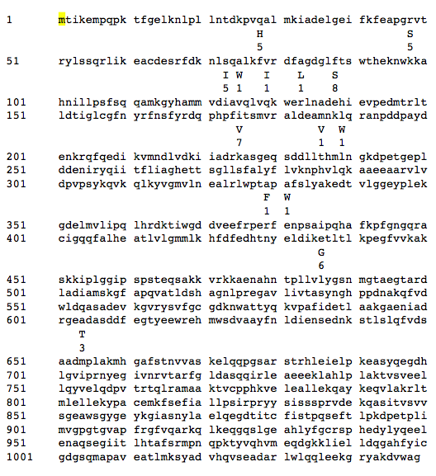
Amino Acid Sequence with Mutations

Slide 16
Acknowledgements
Aptamer picture: Cho, Eun Jeong, Joo-Woon Lee, Andrew D. Ellington. Applications of Aptamers as Sensors. Annual Review of Analytical Chemistry. July 2009.
Riboswitch sequence and original data: Shana Topp, Colleen M. K. Reynoso, Jessica C. Seeliger, Ian S. Goldlust, Shawn K. Desai, Doroth ́ee Murat, Aimee Shen, Aaron W. Puri, Arash Komeili, Carolyn R. Bertozzi, June R. Scott, and Justin P. Gallivan. Synthetic Riboswitches That Induce Gene Expression in Diverse Bacterial Species. Applied and Environmental Microbiology. December 2012.
Caffeine metabolism enzyme: Joshua K. Michener, Christina D. Smolke. High-throughput enzyme evolution in Saccharomyces cerevisiae using a synthetic RNA switch. Metabolic Engineering. April 2012.

Slide 18
Selection Module: Idea 1

Slide 19
Selection Module: Idea 1

Slide 20
Selection Module: Idea 1

Slide 21
Selection Module: Idea 2
Use riboswitch that responds to product D
Reward the cell for producing product D
Attach riboswitch to beneficial gene

Slide 22
Riboswitch at DNA level

Slide 23
Different Riboswitches in E. coli
Most responsive

Slide 24
Assembly
Oligo assembly for riboswitch
Riboswitch includes promoter, aptamer and RBS
PCR for superfolder GFP
Ligate into parts into separate plasmids

Slide 25
Complication
Riboswitch must be directly beside superfolder GFP
Start codon used in riboswitch folding

Slide 26
Complication
Riboswitch must be directly beside superfolder GFP
Start codon used in riboswitch folding

Slide 27
Solution
Use golden gate assembly to attach riboswitch to superfolder GFP

Slide 28
Solution
Use golden gate assembly to attach riboswitch to superfolder GFP
Bba
atgc
tacg
gagacc
ctctgg
Bba
T5 promoter
Riboswitch
BsaI
Lac operator
Bba
gagacc atgc
ctctgg tacg
Bba
BsaI
GFP

Slide 29
Solution
Digested with BsaI
Bba
tacg
T5 promoter
Riboswitch
Lac operator
atgc
Bba
GFP

Slide 30
Riboswitch: Sequencing Results
Top strand—desired sequence starting from Bba prefix to Bba suffix
Bottom strand—sequencing results

Slide 31
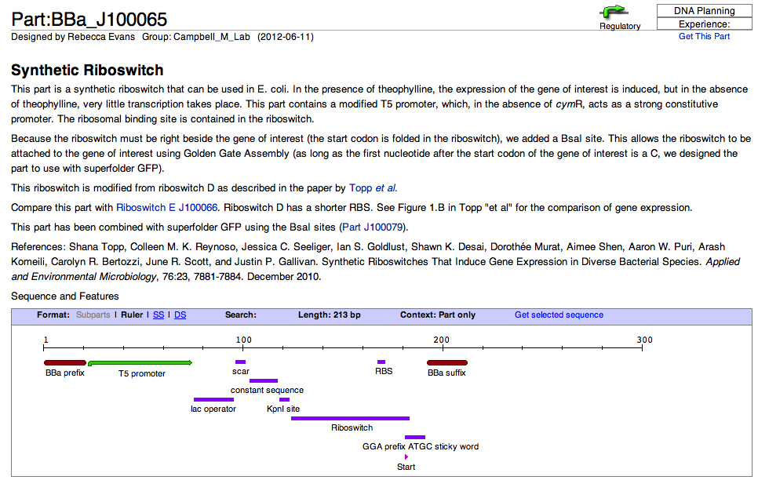

Slide 32
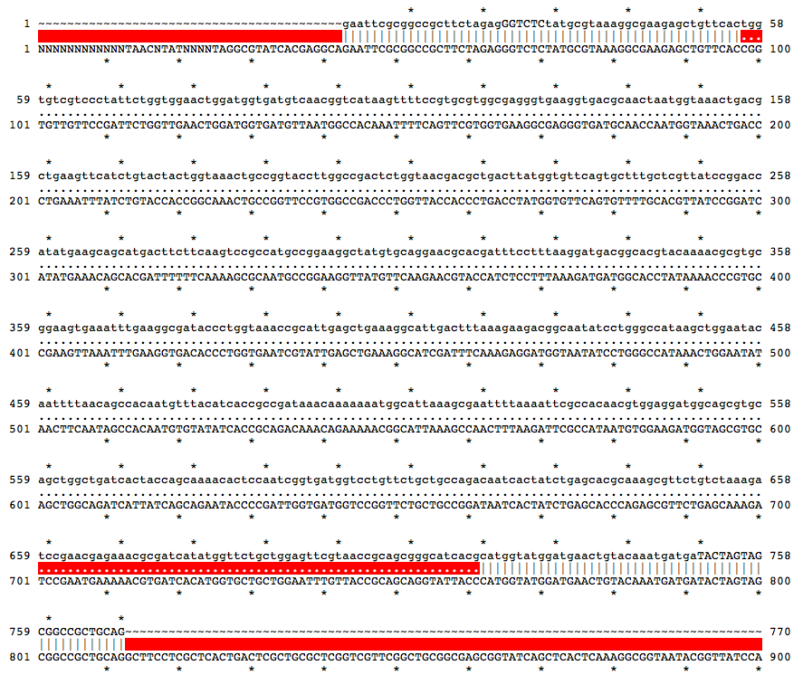
GFP: Sequencing Results

Slide 33
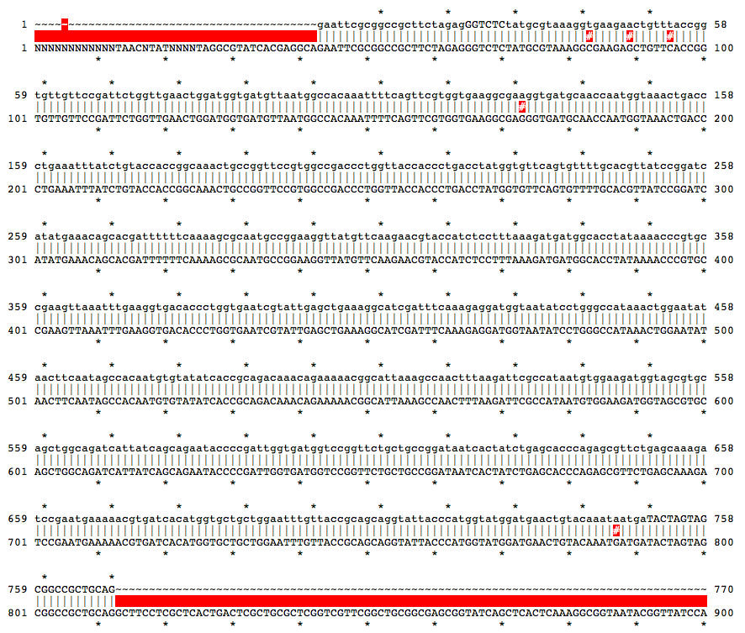
GFP: Codon Optimized

Slide 34
Riboswitch Digestion
BsaI
EcoRI

Slide 35
GFP Digestion
BsaI
PstI

Slide 36
Vector Plasmid Digestion
EcoRI
PstI
Empty pSB1K8

Slide 37
Attaching Riboswitch to GFP
Cut plasmids with restriction enzymes
Clean DNA (Ethanol precipitation)
Perform Golden Gate Assembly with
Riboswitch
Superfolder GFP
pSB1K8

Slide 38
Golden Gate Assembly
Use Golden Gate assembly to assembly three sections
Other pieces of DNA present in reaction
Only one way to assemble and gain resistance to kanamycin

Slide 39
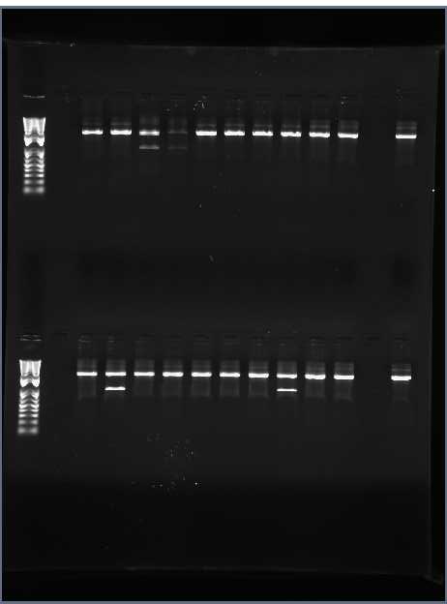
Ligation Screen
Colonies 3 and 4
Riboswitch D
Riboswitch E
Colonies 2 and 8

Slide 40
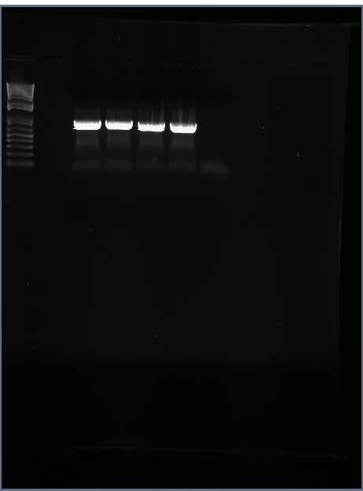
PCR with Specific Primers
Forward primer: first top oligo for riboswitch
Reverse primer: reverse primer for GFP

Slide 41
Conclusions
Riboswitch D responds to theophylline
With increasing concentrations of theophylline, there is increased GFP production
It does not respond to caffeine

Slide 42
Enzyme for Caffeine Metabolism
Michener and Smolke used this enzyme in a high-throughput enzyme evolution
Made enzyme that metabolizes caffeine to theophylline in yeast

Slide 43
Next Steps
Synthesize this enzyme with mutations and test in E. coli
Link theophylline production to E. coli survival
Optimize caffeine to theophylline pathway

