Slide 1
Lab Meeting
11/08/13

Slide 2
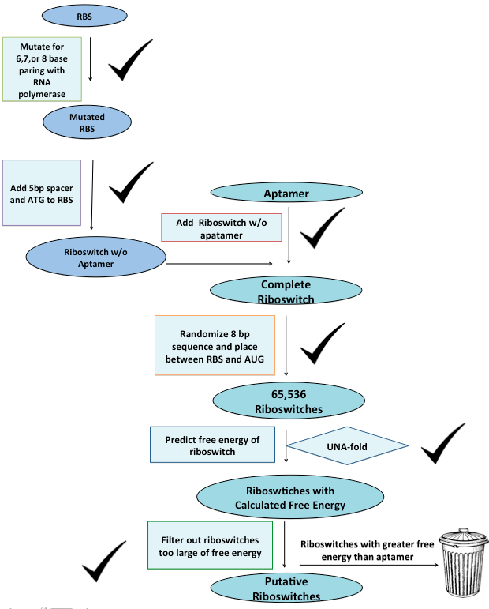

Slide 3
Data Analysis
Command | Time
Generate 65,536 combinations | 10 minutes 30secs
Generate 16,384 combinations and calculate free energy | 30minutes 30secs

Slide 4
Next Steps
Analyze Data
Determine other qualifiers to eliminate candidates
The lowest Delta G
Base pairing to aptamer
Complete folded structure

Slide 5
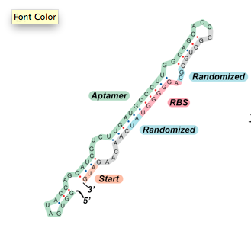
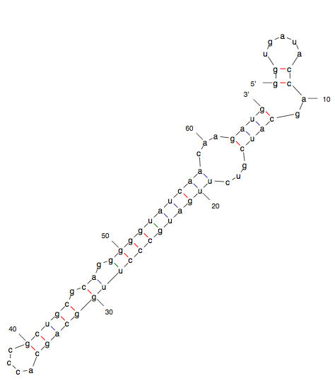
A
B
C
Notes:
ggugauaccagcaucgucuugaugcccuuggcagcacccgcugcgcaggggguaucaacaagaug

Slide 6
Sequence Alignment of Riboswitch B
Notes:
ggugauaccagcaucgucuugaugcccuuggcagcacccgcugcgcaggggguaucaacaagaug

Slide 7
Next Steps
Generate folded structures for candidates
Run 3-methylxanthine and caffeine through the program

