Slide 1
Using Golden Gate Assembly to Test Bacterial Promoter Hypotheses
GCAT Synthetic Biology Workshop
2014

Slide 2
GGA with Annealed Oligos
Destination plasmid
BsaI
BsaI
GFP
RFP
+
Sticky End
Sticky End
Annealed oligos
Product
GFP
RFP

Slide 3
Anneal Oligos
Mix oligos with annealing buffer and dH20
1 ul 100 uM Top strand oligo
1 ul 100 uM Bottom strand oligo
2 ul 10X oligo annealing buffer (1 M NaCl, 100 mM Tris)
16 ul dH20
Boil 4 minutes in beaker with ~400 ml H2O
Turn off heat and let cool > 2 hours

Slide 4
Oligo Concentration
Calculate concentration (ng/ul) of oligos
Annealing reduced concentration from 100 uM to 5 uM
Example uses 40 bp oligos
670 ug/umol-bp x 40 bp x 5 umol/L x 10⁻⁶ L/ul
= 0.13 ug/ul = 130 ng/ul

Slide 5
Dilution of Oligos
GGA will use 20 ng of Receiving plasmide J100091, which is ~3000 bp
Calculate annealed oligo amount
20 ng plasmid x (40 bp oligos/3000 bp plasmid)
= 0.27 ng oligos
Dilution of oligos
(130 ng/ul) / (0.27 ng/ul) = 481
Add 1 ul of Annealed oligos to 480 ul dH2O

Slide 6
Golden Gate Assembly Reaction
20 cycles
37° C for 1 minute
16° C for 1 minute
37° C for 15 minutes

Slide 7
Transformation of Competent Cells
Thaw one tube JM109 Competent Cells (50 ul)
Add 50 ul dilution buffer for each transformation (up to 8 transformations/tube)
Add 50 ul diluted cells to GGA reaction tube
Mix gently and incubate on ice 5 min.
Plate onto LB + Amp

Slide 8
What is the consensus sequence for the two elements of a bacterial promoter?
-10 element = t₈₀a₉₅t₄₅a₆₀a₅₀t₉₆
Optimal position is -10, but position varies from -18 to -9 from center of -10 element to TSS at +1
Subscripts indicate percentage of time the base is present
-35 element = t₈₂T₈₄G₇₈A₆₅C₅₄A₄₅
Position varies, but spacing between -35 and -10 elements is 16-18 bp in 90% of known promoters
Optimal spacing is 17 bp
Subscripts indicate percentage of time the base is present
Source: Genes IX, 2008, by Benjamin Lewin

Slide 9
Transcription Initiation
RNAP binds to DNA and engages in direct exchange of one sequence for another
Affinity of RNAP for nonspecific DNA decreased by Sigma factor
RNAP + Sigma “touches down” at -35 element
Contact is extended to -10 element, covering ~77 bp in “closed” binary complex
Melting is facillitated by A+T content of -10 element - of ~12 bp from -10 element to +1 produces “open” binary complex
Incorporation of NTPs forms ternary complex, and multiple rounds of abortive initiation occur
Change in RNAP structure occurs, Sigma factor is released or changes form, and it covers ~50 bp
RNAP clears the promoter, shortens to cover only 30-40 bp, and elongation occurs at a rate of ~40 nt/sec

Slide 10
pTac Promoter
Hybrid promoter constructed from pTrp and pLac promoters in E. coli
Efficiency of promotion measure to be 2-3 times great than pTrp and 7-11 times greater than pLac
Perfect matches to -1- and -35 consensus sequences and 16 bp between them
-35 -10 +1
DeBoer HA, Comstock LJ, Vasser M (1982) PNAS 80, 21-25.

Slide 11
Mutation #3

Slide 12
Mutation #4

Slide 13
Mutation #5

Slide 14
Mutation F

Slide 15
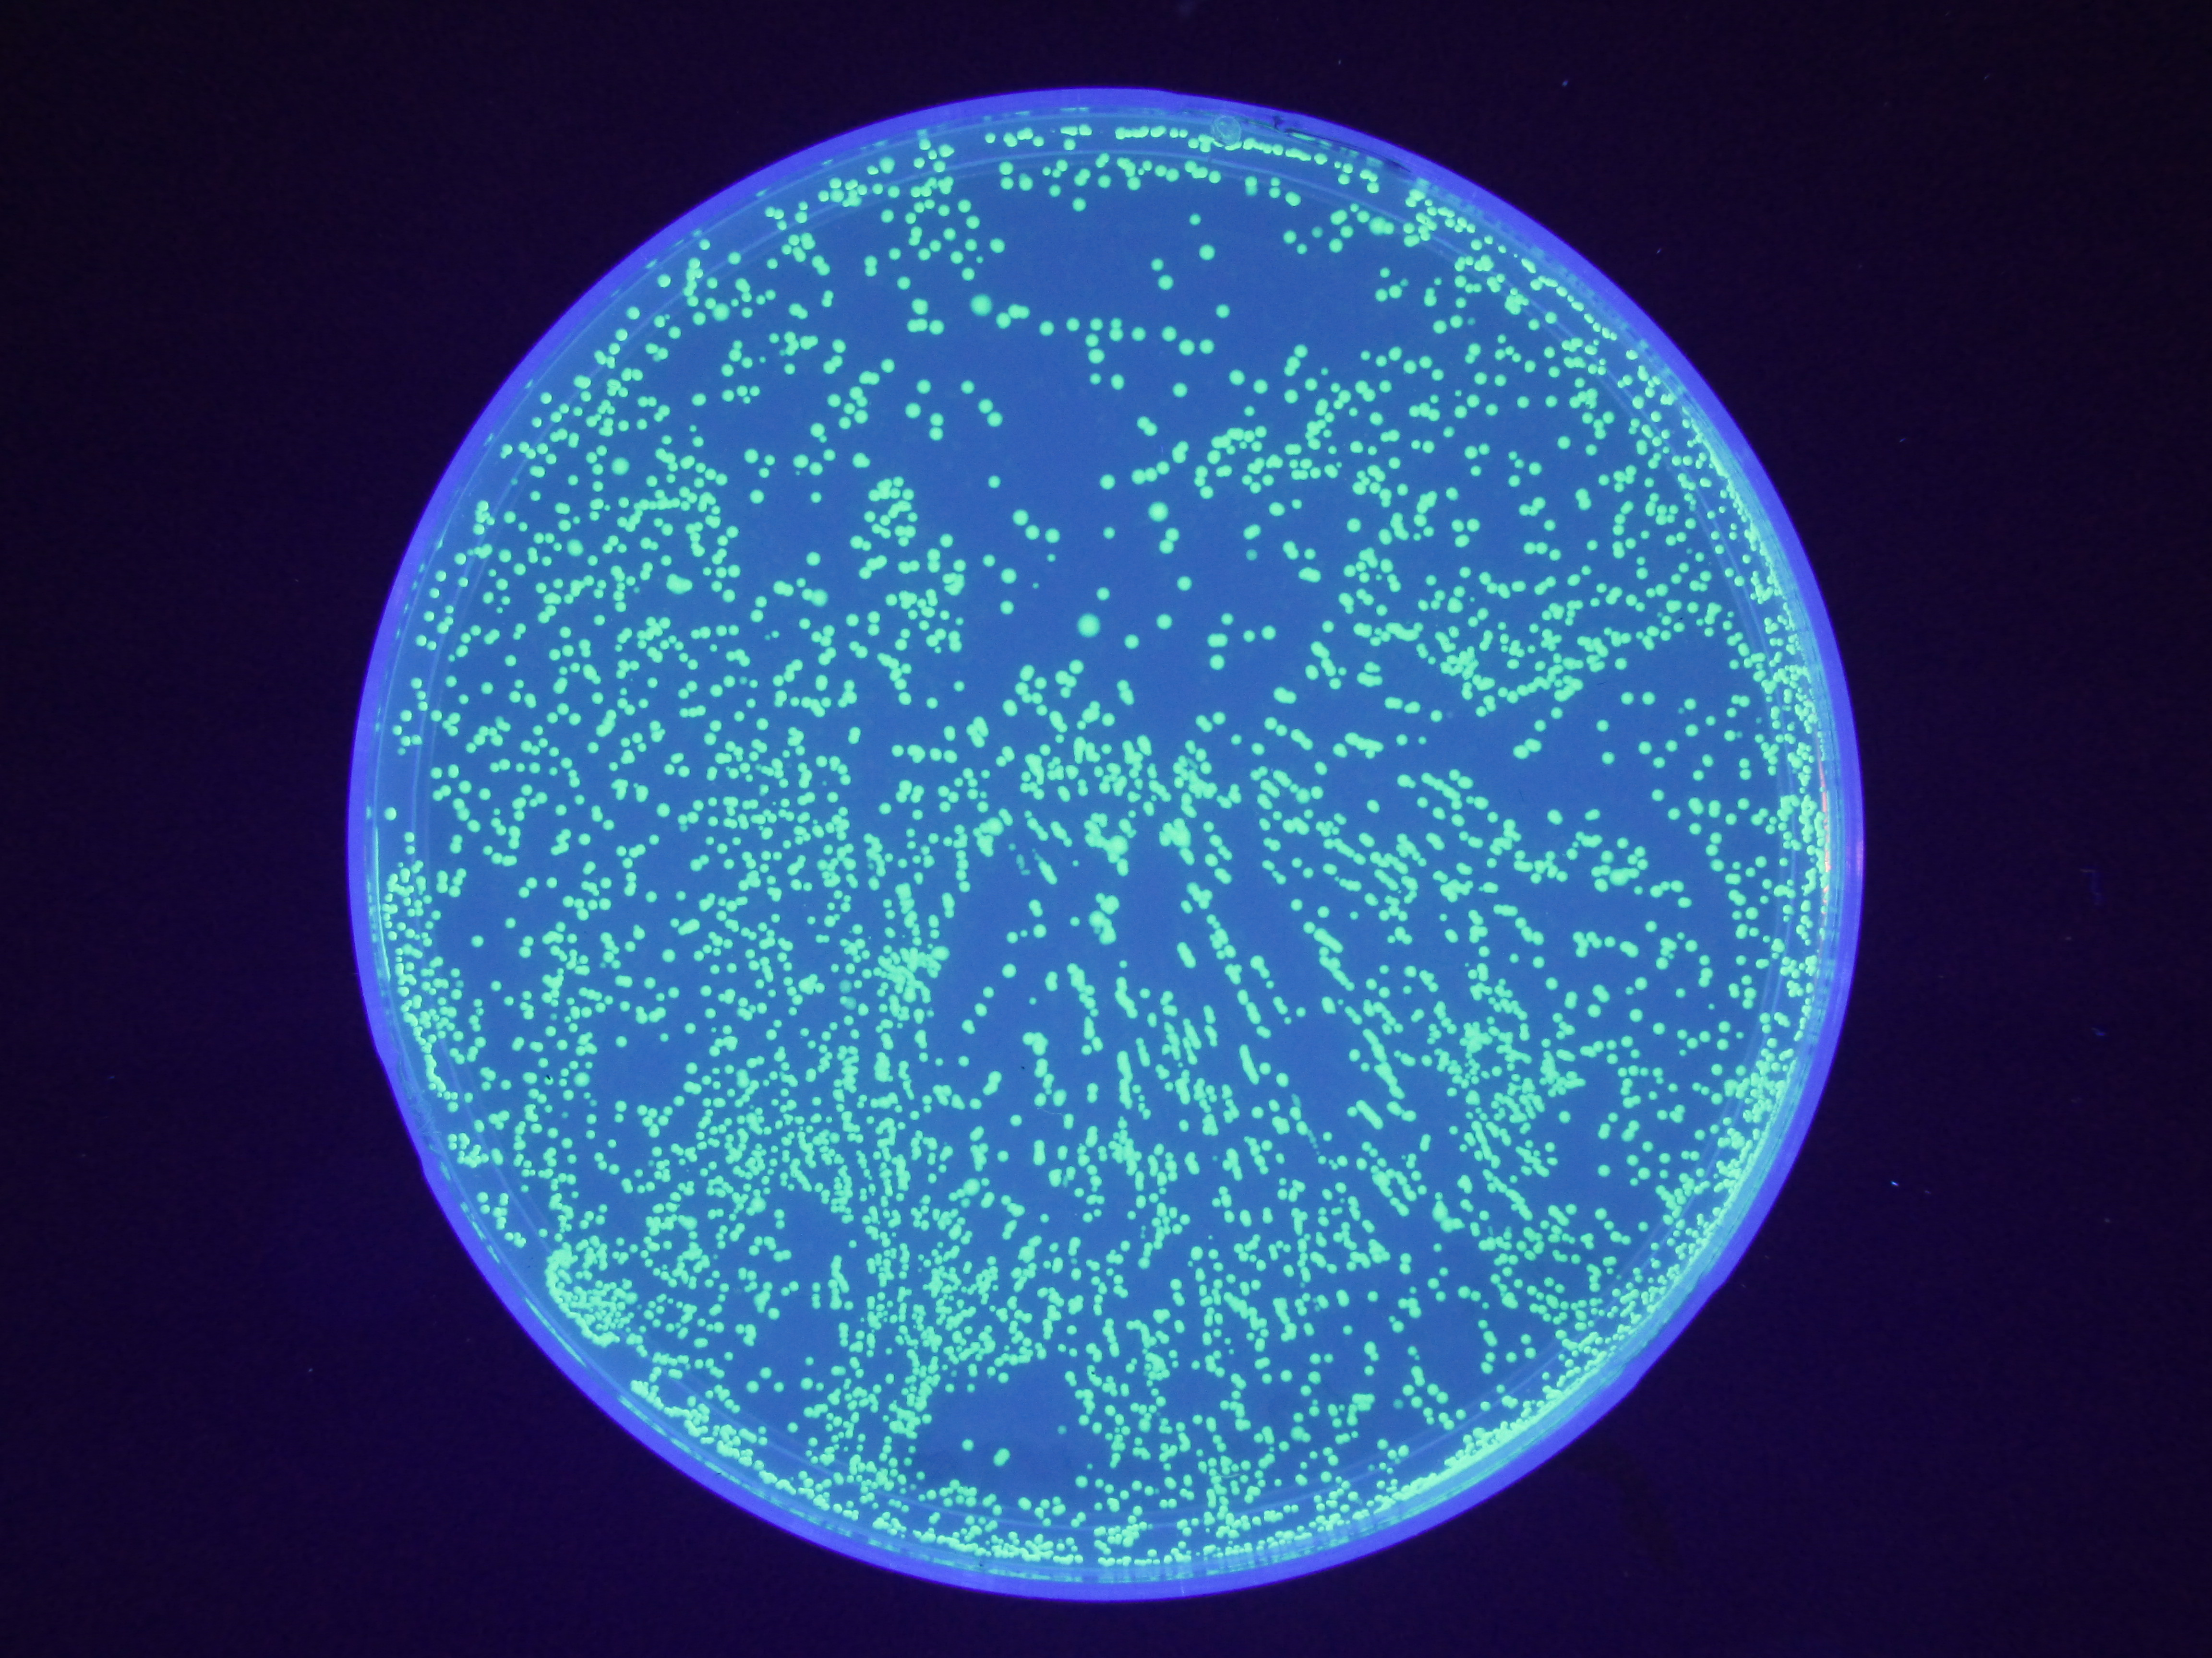
Vector Only

Slide 16
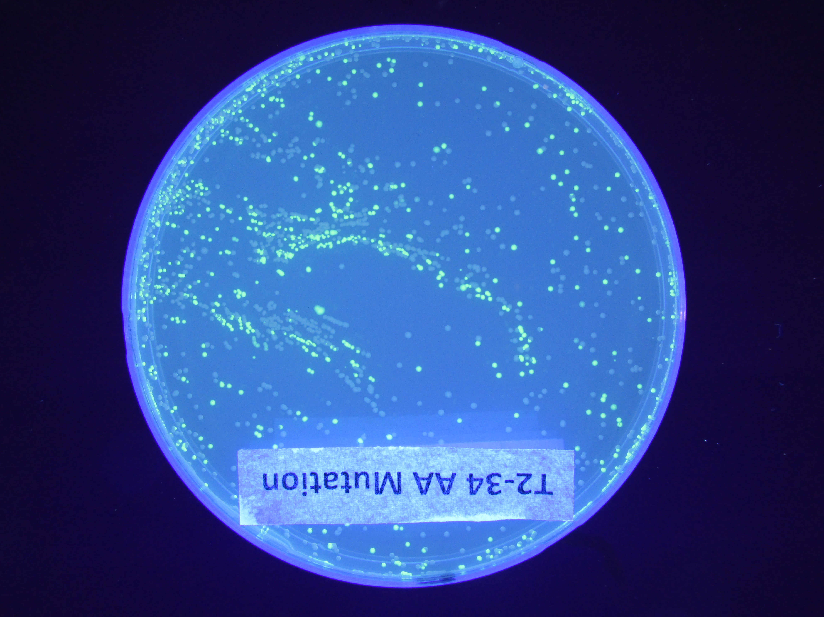
Mutation #3

Slide 17
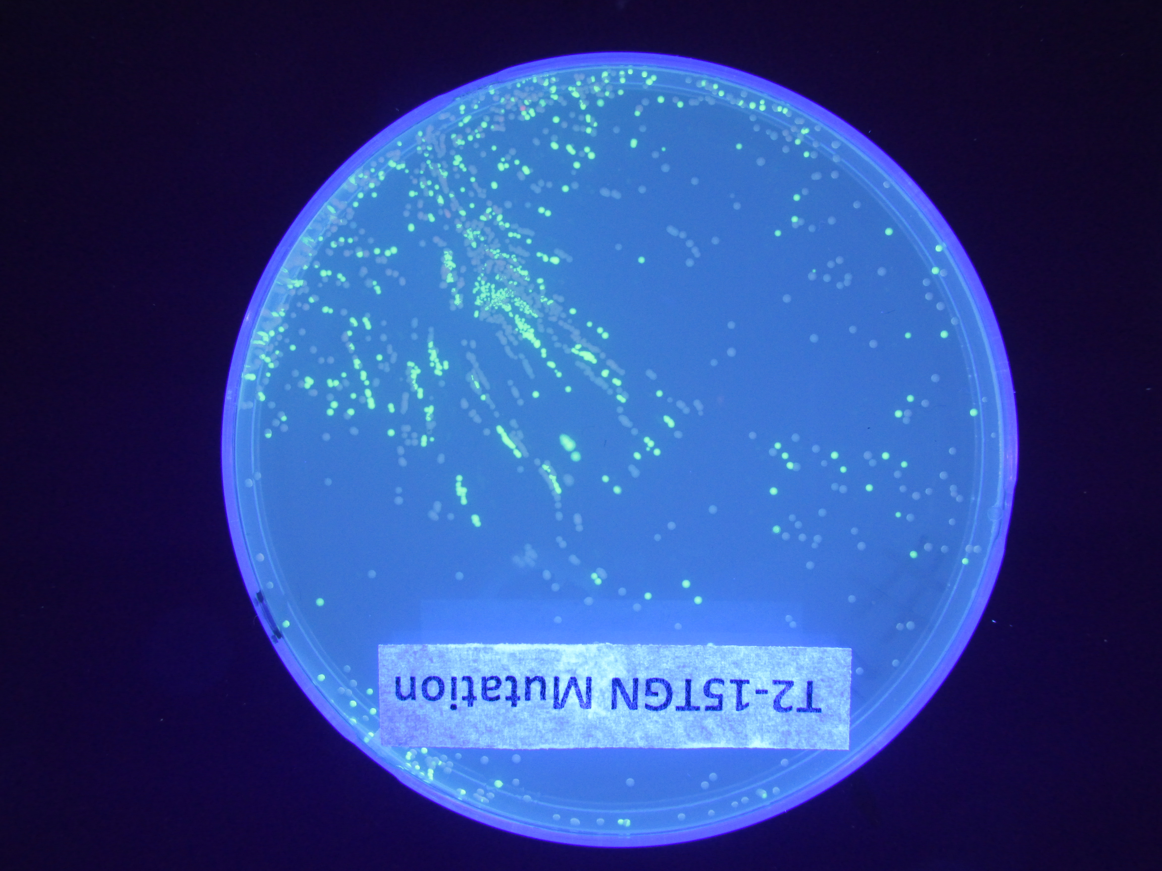
Mutation #4

Slide 18
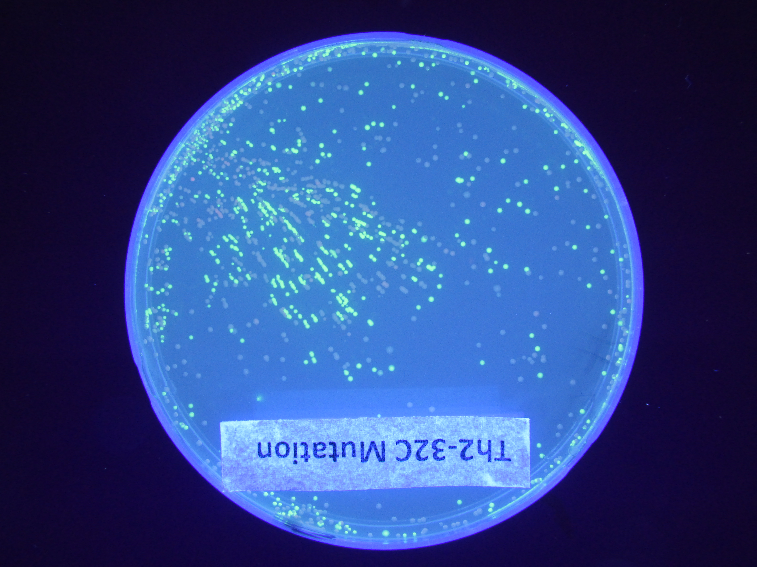
Mutation #5

Slide 19
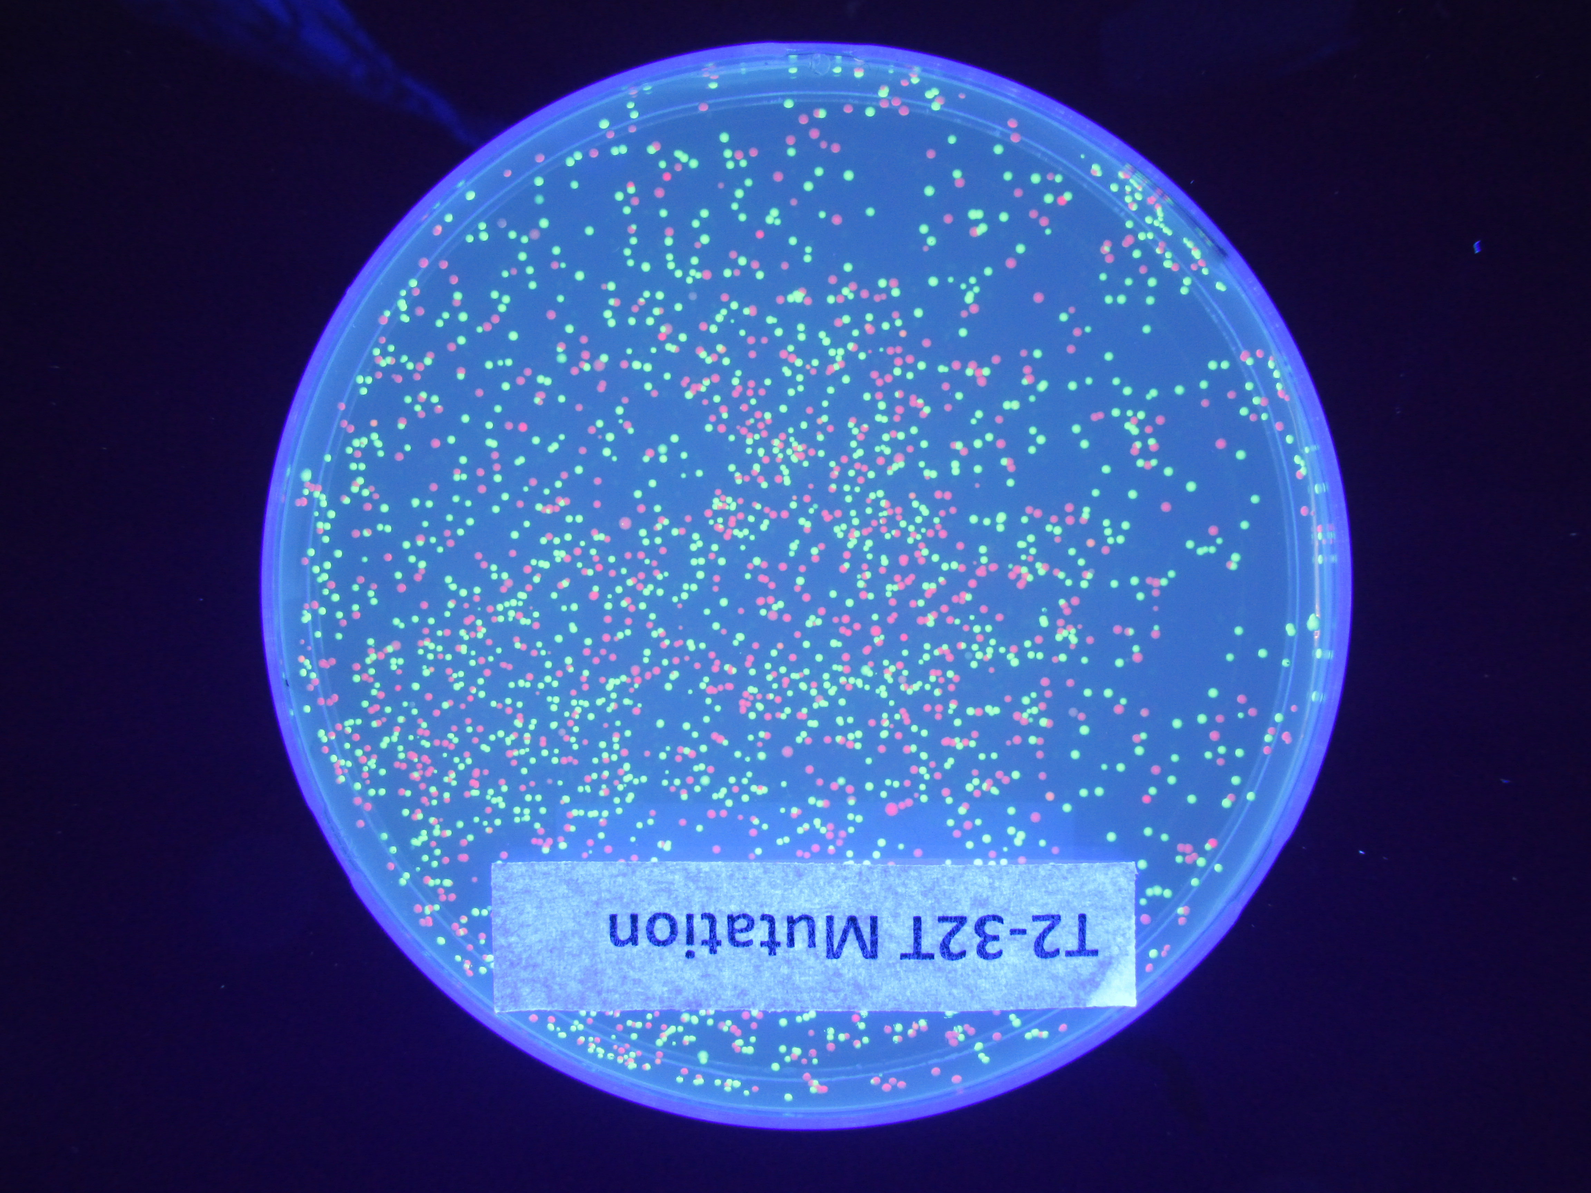
Mutation F

